Slide 1
Basin Delineation With NHDPlusV2 Cindy McKay
NHDPlus Training Series
Notes:
Welcome to the NHDPlus Training Series. This webinar is about basin delineation with NHDPlusV2. I’m Cindy McKay, a member of the NHDPlus Team.
The NHDPlusV2 Training Series is designed for NHDPlus users who have studied the NHDPlusV21 User Guide, downloaded and installed some NHDPlus data, and spent time exploring the content of NHDPlus. Users new to NHDPlus will benefit most from the Training Series after completing these recommended prerequisite tasks:
1. Read the NHDPlusV21 User Guide, through section on “NHDPlusV2 Versioning”
2. Perform Exercises 0 and 1 found on the NHDPlusV2 Documentation webpage.
The Training Series does not cover how the NHDPlus components were built. This information can be found in Appendix A of the NHDPlusV21 User Guide.

Slide 2
Objectives
Understand basin delineation
Learn various ways to delineate basins using NHDPlusV2
Learn how to use the NHDPlusV2 Basin Delineation Tool
Objectives
Notes:
The objectives of this session are to understand basin delineation, to learn various ways to delineate basins using NHDPlusV2 and to learn how to use the NHDPlusV2 Basin Delineation Tool.

Slide 3
Agenda
What is basin delineation?
Using native ArcGIS Tools
Using NHDPlusV2 Basin Delineator
Agenda
Notes:
During this session, we’ll discuss what basin delineation is and how to perform basin delineation using native ArcGIS tools and the NHDPlusV2 Basin Delineator.

Slide 4
What is basin delineation?
Defining of the geographic land area which drains to a point on the landscape
Producing a polygon of that geographic land area
Inclusion or exclusion of non-contributing areas
What is Basin Delineation
Notes:
So what is basin delineation? It’s the definition of the geographic land area which drains to a point on the landscape. This is generally followed by producing a polygon of that geographic land area. Finally, we must make a decision about whether to include or exclude non-contributing areas within the basin polygon.

Slide 5
How is basin delineation done?
Manually using a topographic map (i.e., a map that contains elevation contours)
Using native tools in GIS software such as ArcGIS along with a flow direction raster and a flow accumulation raster
Using automated tools such as NHDPlusV2 tools
What is Basin Delineation
Notes:
How is basin delineation done? Historically, basin delineation was performed manually using a topographic map. Topographic maps contain elevation contours which are used to delineate a basin.
With the advent of GIS, many GIS systems contain native tools for basin delineation. Today we’ll discuss how to do this in ArcGIS. Within a GIS, it is often desirable to script the basin delineation process. We’ll also discuss the use of a script called the NHDPlusV2 Basin Delineation tool.

Slide 6
Basin Delineation with Native ArcGIS
Assemble NHDPlusV2 data in ArcMap: FDR raster, FAC raster, NHDFlowline, Catchments
Create a pourpoint in a dataset
Snap the pourpoint to FAC high accumulation cell
Run Watershed Geoprocessing Tool
Using Native ArcGIS Tools
Notes:
Lets begin with basin delineation using native ArcGIS.
The first step is to assemble the NHDPlusV2 data in ArcMap. For this, we’ll need the flow direction raster, the flow accumulation raster, the NHDFlowline feature class and the NHDPlusV2 Catchment feature class.
Next we define our pourpoint in a shapefile dataset. The pourpoint is the point on the landscape to which the basin drains.
We then snap the pourpoint to a high accumulation cell in the flow accumulation raster.
And finally we run the ArcGIS Watershed geoprocessing tool.

Slide 7
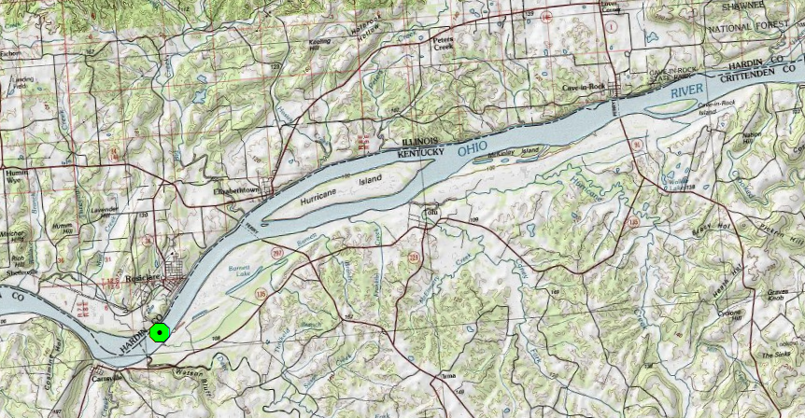
Create a Pourpoint
Using Native ArcGIS Tools
Notes:
After creating a pourpoint shapefile, a pourpoint can be added to the shapefile with the ArcMap editing tools. In this picture, the pourpoint is along the Ohio River at the large green dot.

Slide 8
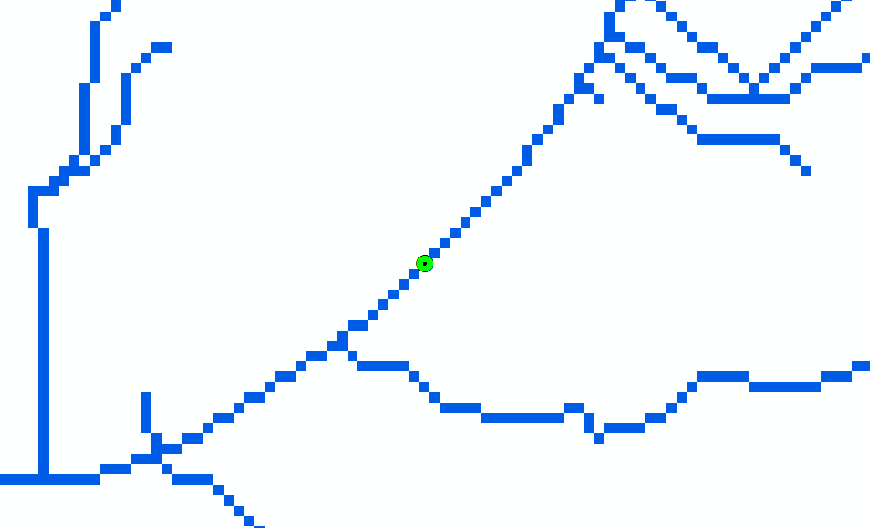
Snap the Pourpoint to a High Accumulation FAC cell
Using Native ArcGIS Tools
Notes:
It’s important that the pourpoint be located on a high accumulation cell in the Flow Accumulation raster. In this picture, the blue lines are the FAC cells which have at least 100 cells flowing to them. We are defining these as FAC high accumulation cells. These blue lines are often referred to as synthetic streams, because they are based solely on hydro-enforced elevation data and not on mapped stream like those found in NHDFlowline. 100 is a common threshold to use for defining these synthetic streams or FAC high accumulation cells.
Here you can see that our pourpoint (in green) is exactly on a high accumulation cell

Slide 9
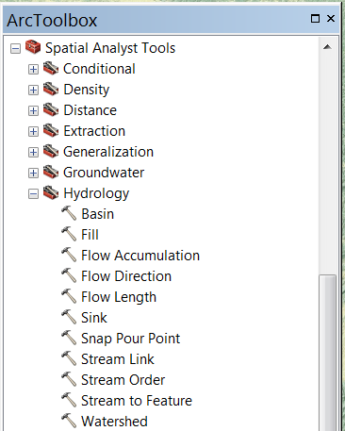
Run the ArcGIS Watershed Tool
Using Native ArcGIS Tools
Notes:
The next step is to run the ArcGIS Watershed tool which is located in the Spatial Analyst Extension under the Hydrology tool group. The Watershed tool uses the pourpoint and the Flow Direction raster to delineate our basin.

Slide 10
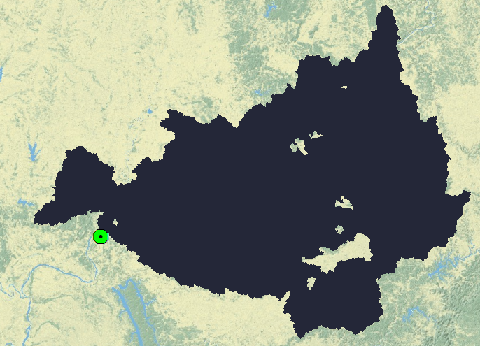
Resulting Basin (Raster)
Using Native ArcGIS Tools
Notes:
The resulting basin is saved as the black raster shown here.

Slide 11
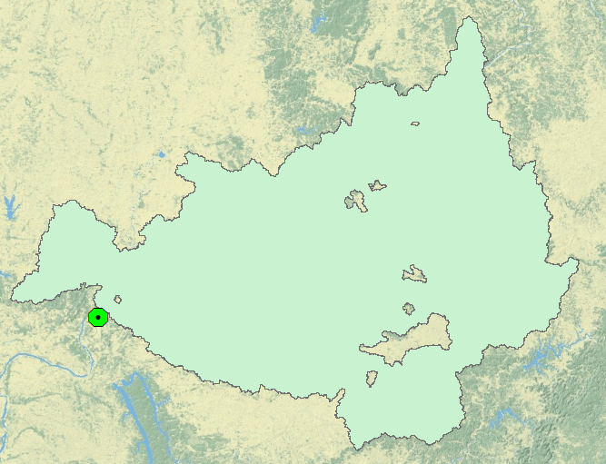
Resulting Basin (Polygon)
Using Native ArcGIS Tools
Notes:
Converting the raster to a polygon results in the green polygon shown here. Notice that the polygon contains holes. These are areas inside the basin that are non-contributing to the basin. In other words, these areas do not drain to our basin pourpoint.

Slide 12
Limitations of this Technique
No option to include non-contributing areas
Non-inclusion of upstream raster production units.
Using Native ArcGIS Tools
Notes:
There are two limitations of basin delineation with native tools:
First, there is no option of including non-contributing areas.
Second, which will be described more fully in a later slide, the Watershed tool only operates on the extent of the NHDPlusV2 Flow Direction raster.
These limitations can be overcome.

Slide 13
Non-contributing Areas Due to Sinks
Using Native ArcGIS Tools
Notes:
First lets look at non-contributing areas. These are caused by NHDPlusV2 sinks. NHDPlusV2 Sinks represent areas of land that drain into the ground or into closed features such as terminal lake/ponds or playas. These areas are disconnected from the main network and are isolated in the NHDPlusV2 Flow Direction raster. They appear as holes in the basin delineated by the Watershed command.

Slide 14
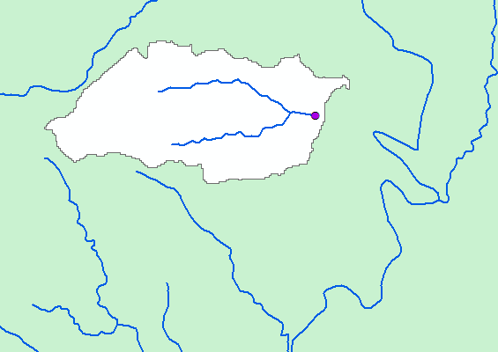
Sinks from Isolated Flowlines
Using Native ArcGIS Tools
Notes:
NHDPlusV2 sinks are created by a number of data conditions. In this picture, there is a small group of flowlines that are isolated from the main network. A sink, represented by the red dot, is placed at the bottom of isolated flowline networks.

Slide 15
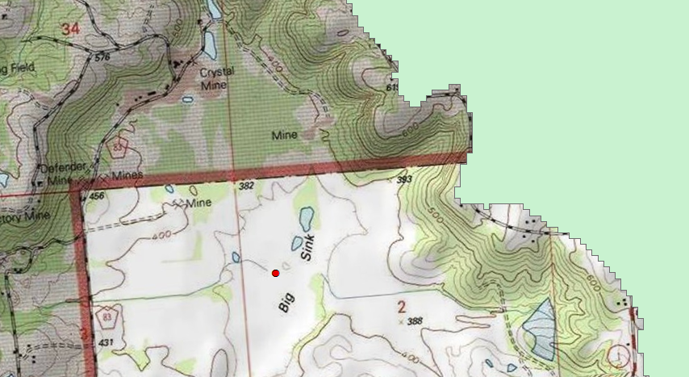
Sinks from Landscape Depressions
Using Native ArcGIS Tools
Notes:
There are natural land depressions which also receive NHDPlusV2 sinks. In this picture, the Topo map tells us that this area is called “Big Sink” and the red dot is the NHDPlusV2 sink feature.

Slide 16
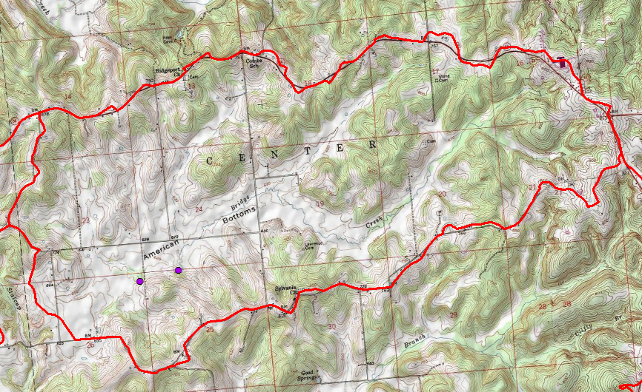
Sinks from Closed WBD HUC12
051202020303
Using Native ArcGIS Tools
Notes:
Occasionally, WBD HUC12s are closed and surface water does not leave the HUC. NHDPlusV2 sinks, represented by the red dots, are placed at various places in these closed HUCs.

Slide 17
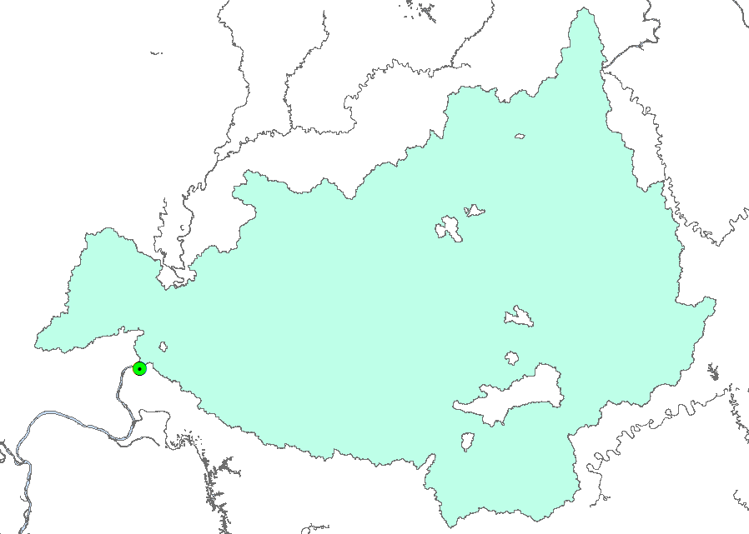
Including Non-contributing Areas
Using Native ArcGIS Tools
Notes:
If we choose to include these non-contributing areas in our basin, we can do so by using several ArcGIS GP tools.

Slide 18
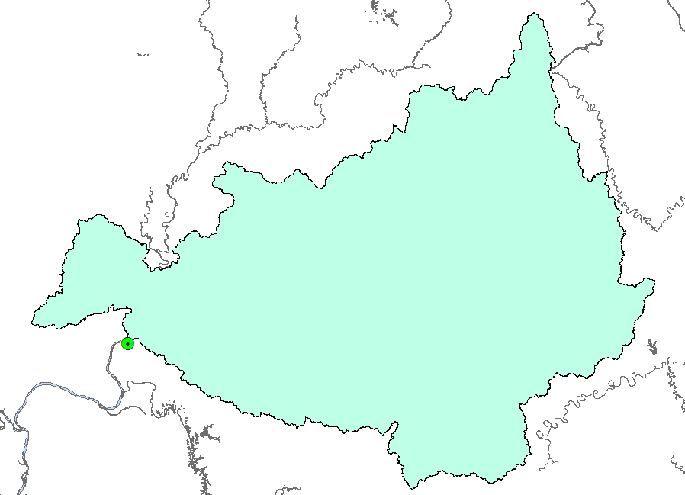
Non-contributing Areas Included
Using Native ArcGIS Tools
Notes:
First, we convert the basin to lines with the “Polygon to Line” tool. We then convert the lines to Polygons with the “Feature to Polygon” tool. This step turns the holes in the basin into polygons. The last step is to dissolve these polygons into one polygon resulting in the polygon shown here without holes.

Slide 19
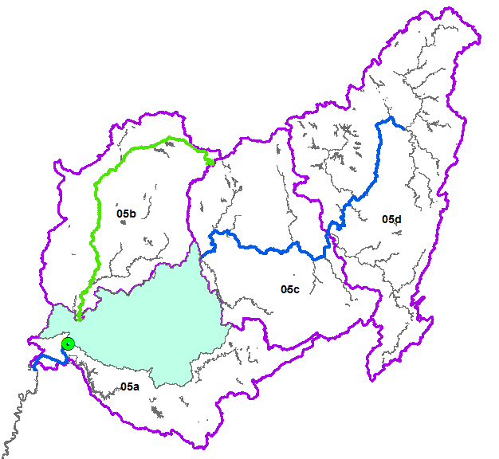
Non-Inclusion of Upstream Raster Production Units
Using Native ArcGIS Tools
Notes:
The second limitation that we noted above is that when NHDPlusV2 has upstream raster processing units, the basin delineated by the Watershed tool stops at the edge of the processing unit that contains the pourpoint.
Here we have zoomed out to the extent of HUC2 05. The blue line is the Ohio River. It extends far upstream of our delineated basin. The green line is the Wabash River which also drains into our delineated basin. The grey lines are other major rivers in 05. The purple lines are the boundaries of the NHDPlusV2 raster processing units. These units represent the extent of the NHDPlusV2 raster components.
Note that if our processing unit had been one of the many headwater processing units in NHDPlusV2, our basin would be complete and we would be finished.
But in order to have a true basin in this case, we need to include raster processing units 05b, 05c and 05d.
There are two ways to accomplish this. We could create pourpoints at the downstream ends of 05b, 05c and 05d and repeat the process that we just described using the Watershed tool. However, there is another way that is a bit easier and faster.

Slide 20
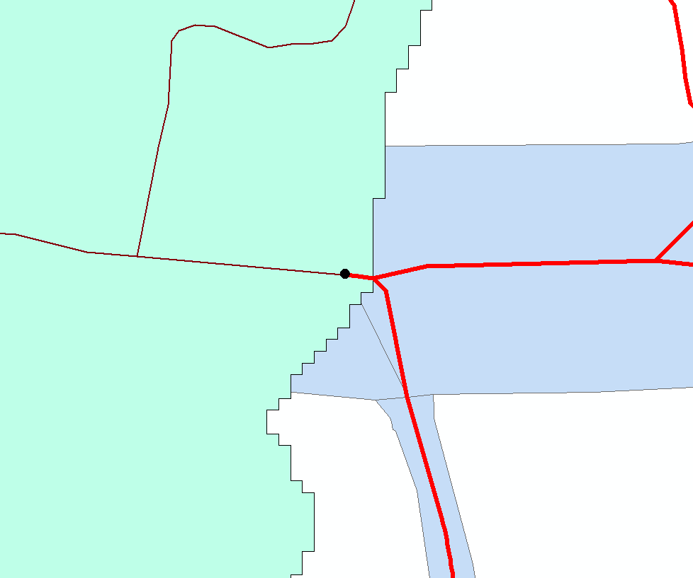
Perform an Upstream Trace
Using Native ArcGIS Tools
Notes:
We zoom in to where the Ohio River enters our partial basin. We’re going to start along the Ohio River at the top of our basin and trace the NHDPlusV2 stream network upstream of this location. There are two ways to accomplish the trace.
Staying within the native tools, we could create a geodatabase, load the NHDPlusV2 flowline network, build a geometric network, and use the ArcGIS network trace tools.
But the easiest way is to leave the ArcGIS native tools and install the NHDPlusV2 VAA Navigator that was discussed in an earlier lesson.

Slide 21
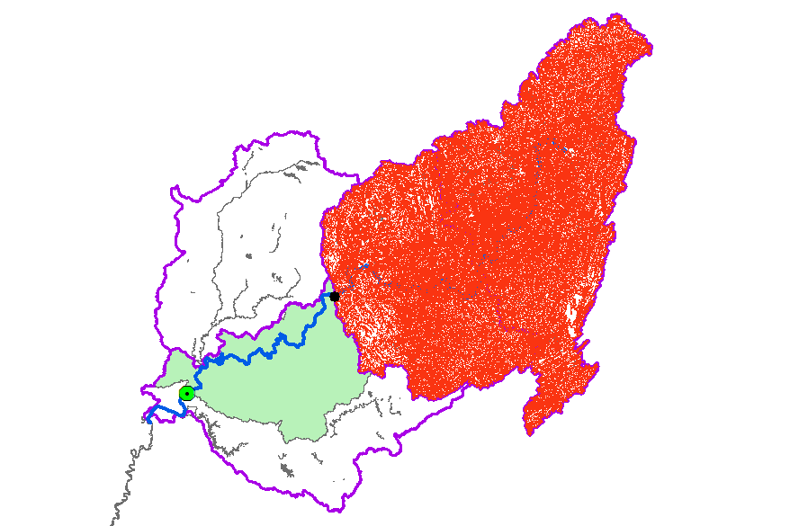
Upstream Trace - Ohio
Using Native ArcGIS Tools
Notes:
Here is an upstream trace created by the VAA navigator of the Ohio. Note that the upstream trace goes to the headwaters of the Ohio and all tributaries along the way. We would get the same results using the ArcGIS geometric network approach.

Slide 22
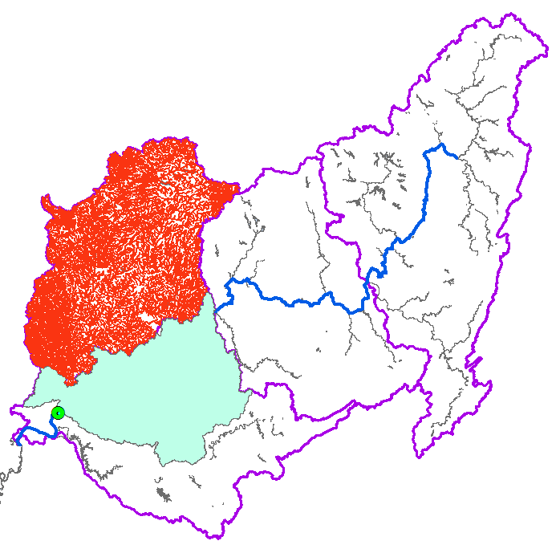
Upstream Trace - Wabash
Using Native ArcGIS Tools
Notes:
Here is an upstream trace created by the VAA navigator of the Wabash. Note that the upstream trace goes to the headwaters of the Wabash and all tributaries along the way. We would get the same results using the ArcGIS geometric network approach.

Slide 23
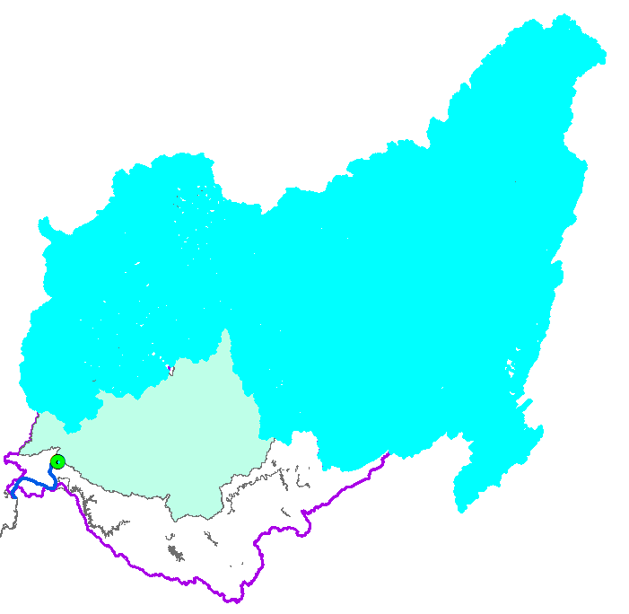
Select NHDPlus Catchments based on UpStream Traces
Using Native ArcGIS Tools
Notes:
The two traces are used to select NHDPlusV2 catchments for the associated flowlines. The flowline ComIDs relate to the Catchment FeatureIDs.

Slide 24
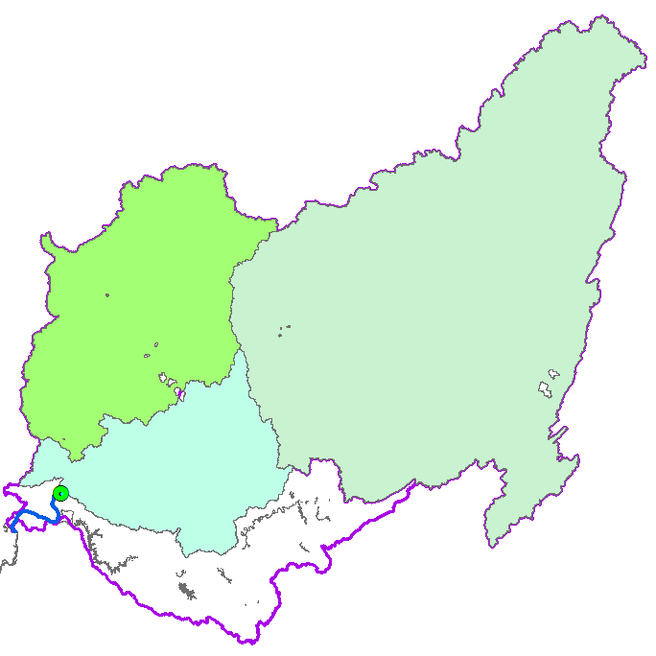
Dissolve the catchments
Using Native ArcGIS Tools
Notes:
We dissolve the selected Catchments associated with each of the traces to get polygons representing these additional parts of the basin.
Note, again, that there are holes due to sinks. The technique for including these non-contributing areas is the same one we used for the lower part of the basin – i.e., polygon to line, feature to polygon, then dissolve.

Slide 25
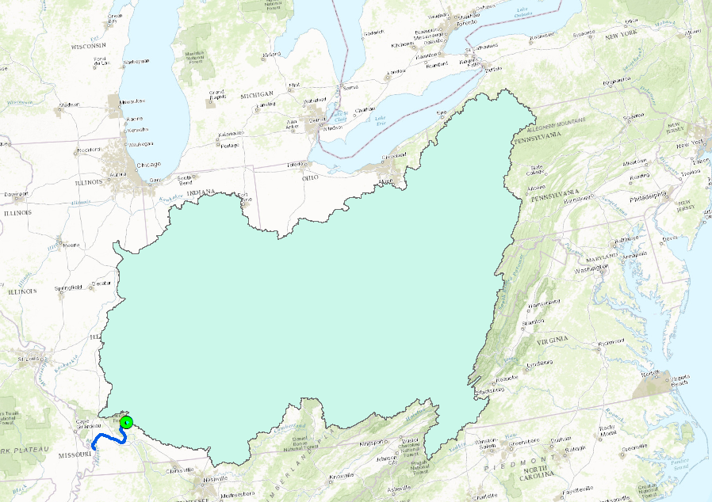
Combine the Three Basin Parts => We’re Finished
Using Native ArcGIS Tools
Notes:
Once we’ve filled the holes and combined all three parts of the basin, we have a complete basin from our pourpoint to the headwaters.
As you can see, the use of native tools can be a long and arduous effort. Certainly doable for a single basin, but if you have many basins to delineate, there is an easier and faster way.

Slide 26
The NHDPlusV2 Basin Delineation Tool
Using NHDPlusV2 Basin Delineator
Notes:
We have scripted the process into the BasinDelineatorV2 Tool.

Slide 27
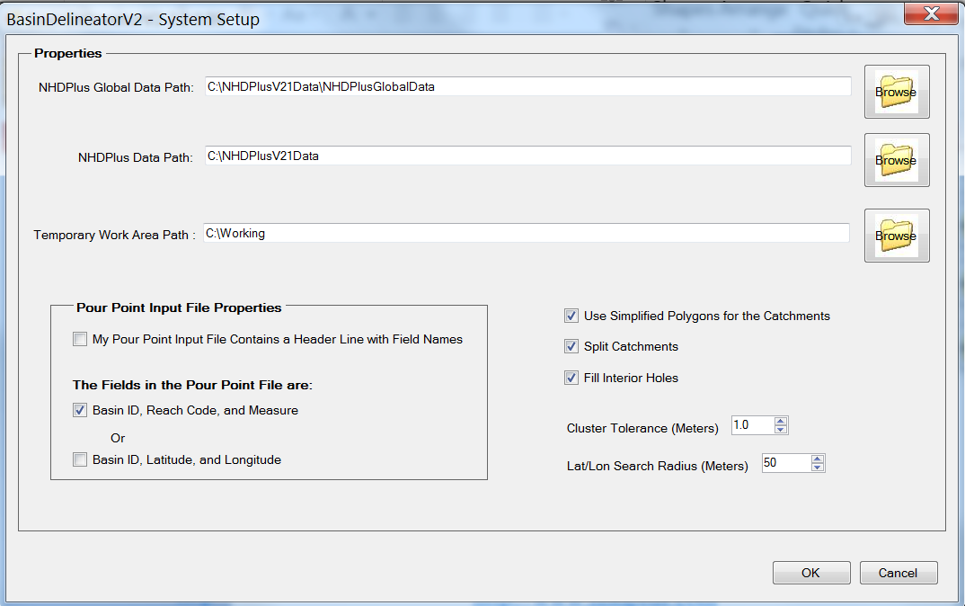
Basin Delineation Tool Options
Using NHDPlusV2 Basin Delineator
Notes:
From the System Setup menu choice, you can set many basin delineation options. Complete explanations and instructions for these options is provided in the BasinDelineator User Guide which is available at the same location as the tool install package download. We’ll cover the highlights of this dialog.
First, you’ll need to tell BasinDelineator where your NHDPlusV2 data are. The data requirements for the tool are the NHDPlusGlobalData and the VPU data for the areas where you are going to be delineating basins. You also need to give BasinDelineator a folder where it can create temporary working files. You must have full read/write access to this working folder.
The NHDPlusV2 has a set of simplified catchment polygons which have many fewer vertices than the normal catchments which were built from a 30-meter raster. When you are delineating very large basins, it’s wise to use simplified polygons to avoid issues with the ArcGIS dissolve command used by the Basin Delineator.
You have the option of splitting the pourpoint catchment exactly at the pourpoint. If you don’t chose this option, the whole catchment that contains the pourpoint will be included in the basin.
And finally, you can chose to include the non-contributing areas in the basin by selecting Fill Interior Holes.

Slide 28
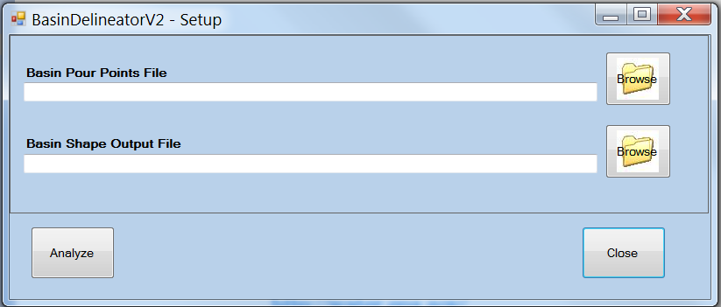
Basin Delineation Tool Setup
Using NHDPlusV2 Basin Delineator
Notes:
Once the options have been set, you can use the Run BasinDelineatorV2 menu choice to specify inputs and outputs and to execute the tool. The tool takes a text file of pourpoints as input and produces a shapefile of basin polygons as output. You will need to build the pourpoint text file.

Slide 29
Basin Delineation Input Pourpoints
Basin1<tab>05140203000064<tab> 8.25060
.
.
.
Basin26<tab>05130206000245<tab>0.0
Basin26<tab>05130206000431<tab>0.0
Using NHDPlusV2 Basin Delineator
Notes:
The text file is a tab delimited file of pourpoints. Each pourpoint has a basin identifier of your choice plus the pourpoint location. Recalling the tool options shown in a previous slide, the location can be specified as a latitude and longitude (lat/long) or as a reachcode and measure. We recommend reachcodes and measures because they define very precise pourpoints along flowlines. If you specify lat/long, the Basin Delineator snaps the pourpoints to the flowlines and the flow accumulation raster high accumulation cells.
The other example in this pourpoint file is Basin26. If you are delineating a basin from a confluence, you can either start the basin just below the confluence or you can take advantage of a Basin Delineator option. This option allows you to define multiple pourpoints for a single basin. By specifying the same Basin ID on multiple lines in the pourpoint file, the resulting basin will be a combination of the basins delineated for each of those pourpoints. In this example, the confluence is defined by the 0 measure of the two reachcodes shown here.
This multiple pourpoint option has other uses. For example, if you wish to define a project area that is made up of the areas that drain to multiple points, this can be done using the multiple pourpoint option with a single Basin ID.

Slide 30
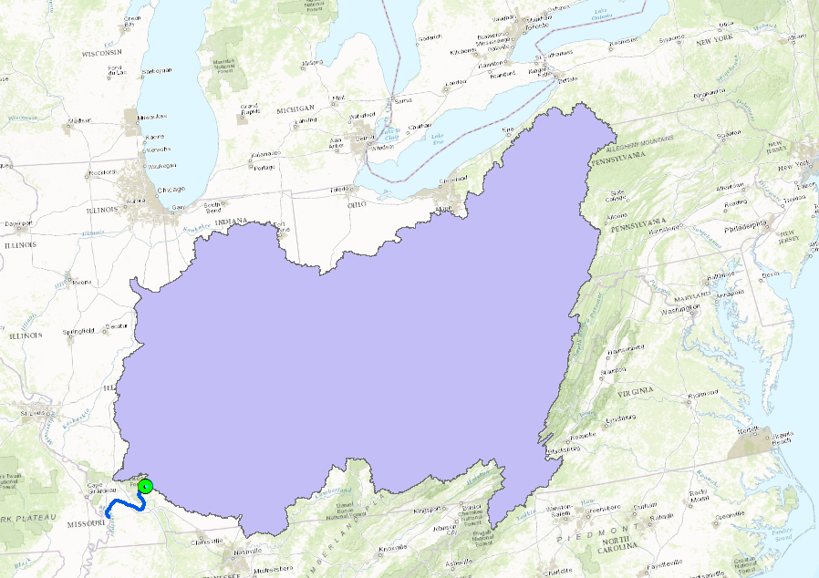
Basin Delineation Output
Using NHDPlusV2 Basin Delineator
Notes:
And here is a picture of the output from Basin Delineator. It is identical to the basin produced with the native ArcGIS tools described earlier.

Slide 31
Resources
Additional information on NHDPlus is available from the NHDPlus website documentation page. You are encouraged to read and reference the NHDPlusV21 User Guide and other NHDPlus documentation.
The NHDPlus team maintains a user email list and periodically sends emails regarding new tools, data, documentation, and events. If you would like to be on the user list, send an email to nhdplus-support@epa.gov
The NHDPlus team also provides technical support to users of the data and tools. If you have a technical support question, please send a detailed email to nhdplus-support@epa.gov
Resources
Notes:
Additional Resource information on NHDPlus is available from the NHDPlus website documentation page. You are encouraged to read and reference the NHDPlusV21 User Guide and other NHDPlus documentation.
The NHDPlus team maintains a user email list and periodically sends emails regarding new tools, data, documentation, and events. If you would like to be on the user list, send an email to NHDPlus-Support@epa.gov
The NHDPlus team also provides technical support to users of the data and tools. If you have a technical support question, please send a detailed email to NHDPlus-Support@epa.gov

Slide 32
Notes:
Thank you…..This concludes the NHDPlusV2 Basin Delineation webinar.

