Slide 1


NHDPlus Extensions
Tim Bondelid
NHDPlus Training Series
Notes:
The NHDPlusV2 Training Series is designed for new and experienced NHDPlus users. To get the most from the Series, students new to NHDPlusV2 are encouraged to read up through the "NHDPlusV2 Versioning System" section of the NHDPlusV21 User Guide, download and install some NHDPlus data (as described in Exercises 0 and 1 on the web site), and spend time exploring the content of NHDPlus.
The Training Series does not cover how the NHDPlusV2 components were built. This information can be found in Appendix A of the NHDPlusV21 User Guide.

Slide 2
Objectives
Help to Understand and Make Use of:
Flow Volume and Velocity Methods and Data
The Supporting Data
Introduction
1
Notes:
The objectives of this Webinar are to explain: the NHDPlusV2 Flow volume and velocity data and how it is computed, and the supporting data developed for computing flows. At the end of this Webinar you will be able how this data can be helpful in your work. This data is referred to as “Extensions” because it is developed after all of the core NHDPlus data is developed. The term “Extensions” is used with NHDPlusV2 for data developed after the core processing is completed.

Slide 3
Agenda
How the Data is Organized
EROMExtension –Flow and QA
VogelExtension – Flow Estimate Method
VPUAttributeExtension – How the data is developed and what is available using CA3T
What is in the data tables; the most-used data fields
How velocity is calculated
Introduction
2
Notes:
I will talk about the processes used for developing these flow and velocity estimates, the most useful data fields in the files, and in the case of EROM, the QA data. The VPUAttributeExtension folder contains data developed by a program called CA3T, and I will explain some aspects of how CA3T operates.

Slide 4
Two Methods For Flow Estimation
The Enhanced Runoff Method (EROM): A five-step process-based method
The Vogel Method: A Regression-based method
There is also the supporting data used by these methods called VPUAttributeExtensions
Introduction
3
Notes:
NHDPlus provides two methods for flow estimation: The Enhanced Runoff method (EROM) and the “Vogel” method. EROM is a multi-step processed-based method and the Vogel method is a regression method. The Vogel method is named after Dr Richard Vogel, who is the lead author on the study that developed the regressions for these flow estimates; the reference to his method is in the User Guide. The VPUAttributeExtensions contains the data used for developing these flow estimates.

Slide 5
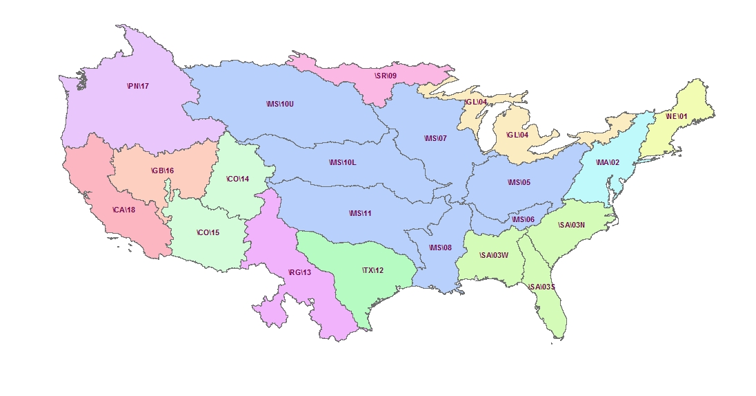
Extensions Are Provided by Vector Processing Unit (VPU)
Tennessee
River Basin:
\MS\06\
Data Organization
4
Notes:
The following slides described how the data are organized. The flow estimates are developed and provided at the Vector Processing Unit level. For example, The Tennessee River Basin would be in the \NHDPlusV21\MS\06 VPU folder. This VPU will be used throughout this training module for most examples.

Slide 6
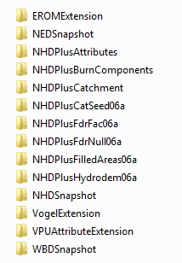
The Folder Structure and the Extensions
In \NHDPlusV21\MS\06:
Data Organization
5
Notes:
Here is the folder structure using VPU 06, the Tennessee River Basin as an example. The EROM flow and velocity estimates, along with supporting QA data, are in the EROMExtension Folder.

Slide 7
The Folder Structure and the Extensions
In \NHDPlusV21\MS\06:
Data Organization
6
Notes:
The Vogel flow and velocity estimates are in the VogelExtension folder.

Slide 8
The Folder Structure and the Extensions
In \NHDPlusV21\MS\06:
Data Organization
7
Notes:
The supporting data used for these flow estimates is provided in the VPUAttributeExtension folder. Note – the flows are all in cubic feet per seconf (cfs) and velocities are in feet per second (fps). Also, please note that the data available for the islands, such as Hawaii and Caribbean, is different because data availability and methods differ in these areas. More information about this data is available in the NHDPlusV2 User Guide!

Slide 9
EROM Flow Estimation
It is a five-step process for estimating flow
A separate QA module is incorporated that produces flow QA statistics and data tables for users to do their own QA
All of the input data is harmonized to the 1971-2000 time period, so the EROM flows consistently reflect this time period
EROM uses USGS gage flow data for adjustments and QA
    The gage data must meet specific criteria
Mean annual (MA) and mean monthly flows are developed
EROM
8
Notes:
Now, I’ll talk about EROM: It uses a five-step sequential process to arrive at the “best” flow estimates that can be developed over the national scope covered by NHDPlus . EROM flow estimates are provided for mean annual and mean monthly flows. Note that the EROM flows and data are harmonized to reflect the 1971-2000 time period. This means that all of the input data (in the VPUAttributeExtension folder) is harmonized to 1971-2000. Also, EROM will only use gage flows where there are at least 10 complete years for mean annual (MA) flows or 10 complete months for mean monthly (MM) flows.

Slide 10
EROM Flow Estimation Steps
Runoff based on water balance model (RO)
“Excess ET” component that takes into account excess evapo-transpiration in the stream channel area (EET)
A regression of Step 2 flows on Gage flows using Reference gages (RGR)
A capability for users to add, remove and transfer flows (PlusFlowAR)
Adjustments to observed gage flows
EROM
9
Notes:
Rather than numbering these steps 1-5, I will “letter” them A-E, because the EROM files uses these letters for the five steps instead of numbers. A second note: Note that EROM estimates flows for all networked flowlines as well as coastal catchments with shoreline flowlines.

Slide 11
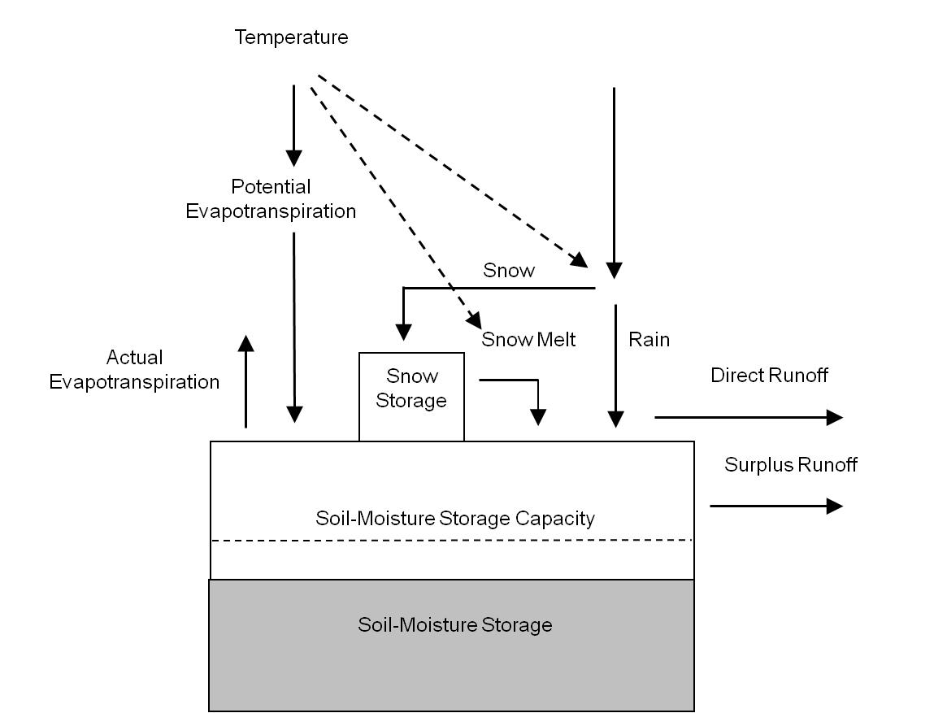
Step A: Runoff
EROM
(Slide courtesy of Dave Wolock, USGS)
10
Notes:
The first EROM step is runoff, MA and MM; this is the foundation for EROM flows. This is a basic diagram of how the runoff model works, courtesy of Dave Wolock of USGS who along with his colleague Greg McCabe developed and run this model. It runs on a monthly time step. It produces mean annual and mean monthly 900m runoff grids, so EROM starts off with a pretty fine resolution for flows. Explain main terms, especially Note the precipitation and Evapotransporation (ET) terms; these are usually the largest 2 terms in a water balance. ET is a combination of evaporation from water surfaces and land plus transpiration, which is water given off by plants. Transpiration can be a large amount of the water “lost”/released to the atmosphere; a large oak tree can give off about as much water as an average person uses. Keep this in mind when we go to Step “B”, EET.

Slide 12
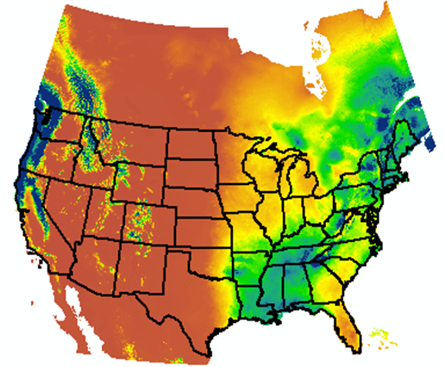
Step A: Runoff Map
EROM
11
Notes:
The result of the Runoff model is a grid of mean annual and mean monthly flows. These grids are overlaid on the NHDPlus catchments to produce mean runoff by catchment. EROM routes and accumulates this runoff to produce the Step “A” runoff flow estimates. The subsequent steps help to further refine these flows.

Slide 13
Step B: Excess Evapotranspiration
Method developed by Dave Wolock of USGS.
(graphic courtesy of Dave Wolock)
EROM
12
Notes:
The second step is called “Excess EvapoTransporation” (EET) (Remember what I said about ET: ET is evaporation plus transpiration given off by plants) which takes into account instream water losses to the atmosphere. This image, again courtesy of Dave Wolock who developed the method, shows a profile plot of cumulative flows (corresponding to Step 1 in EROM), and what can happen by taking the EET into account. Streams can actually lose flow, especially during warmer, drier periods. In this example, the Colorado River will actually lose flow because of excess evapotranspiration as it moves downstream. The dashed line is using cumulative flow, the solid line shows the flow taking EET into account and the diamonds show the observed gage flows. Note how EET matches the observed flow much better than the cumulative does. Also, note the area circled in red – it indicates a large water transfer from the Colorado River.

Slide 14
Step C: Reference Gage Regression (Example from Souris-Red River VPU 09)
Note: Blue is Step A flow, Purple is Step C flow
EROM
13
Notes:
The third step is a Reference Gage regression (RGR) that adjusts flows based on observed stream gage flows. Reference gages are defined as flow gages that are not significantly impacted by human activities. This step can help take some stream flow aspects into account, such as groundwater inflows or outflows, that are not accounted for in the runoff step. This example is from VPU 09, the Souris-Red River, which is VPU 09. The graph shows observed gage flows on the x-axis and EROM flow estimates on the y-axis. The diagonal red line would show “perfect” agreement between gage and EROM flows. The blue diamonds are the flows from the runoff step and the pink squares are after the RGR in Step C. You can see that the RGR improves the EROM flow estimates.

Slide 15
Step D: “PlusFlowAR”
Transfers flow
from one flowline to
another flowline
EROM
14
Notes:
The fourth step is called “PLUSFlowAR”. This step uses a powerful tool that can be used to take interbasin transfers, flow withdrawals and augementation into account at specific locations. This shows an application of PlusFlowAR that transfers flow from one flowline to another. The thicker red line shows the flow transfer. There are currently not many such adjustments in this table, but we are hopeful for more in the future.

Slide 16
Step E: Gage Adjustment
Gage DA = 12
Gage Q = 13
Flowline Flow = 12
QAdj = 13 – 12 = 1
EROM
15
Notes:
The final step is a stream flow gage adjustment that adjusts flows upstream and downstream of observed gage flows. Gages are screened so that they contain at least 10 years of complete record in the 1971-2000 time period and the NHDPlus drainage area is within +/- 20% of the USGS/NWIS DA; this assures that the gages have enough data for the time period and there is an “apples to apples” comparison in the drainage areas between NHDPlus and USGS/NWIS. The example shows a gage on the network and the thicker red lines are the flowlines that get the gage adjustments, both upstream and downstream.

Slide 17
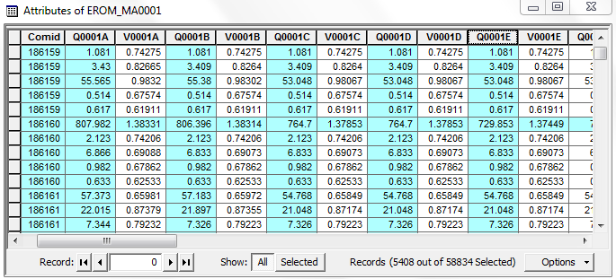
EROM Results Files
EROM Files are named “EROM_nn0001.dbf” where
“nn” = time period – “MA” = mean annual, “01” = January, etc.
“0001” is used as the baseline, “0002” could be a scenario…
EROM
16
Notes:
The EROM results files are all in the EROMExtension. The EROM results files are named “EROM_nn0001.dbf” where “nn” is the time period, that is, “MA” for mean annual, “01” for January, etc. By the way the “0001” portion of the name was constructed to allow for the eventual development of alternative EROM flows, for instance different scenarios or different time frames instead of 1971-2000. The slide shows a screen capture of the most commonly used fields in EROM. The underlined fields show that each flow has an associated velocity.

Slide 18
EROM Results Files
EROM Files are named “EROM_nn0001.dbf” where
“nn” = time period – “MA” = mean annual, “01” = January, etc.
“0001” is used as the baseline, “0002” could be a scenario…
EROM
17
Notes:
I will discuss the fields underlined in red. The fields are the COMID and the five flow estimates – A to E. Associated with each of these is the velocity. The highlighted and underlined row is a flowline that has a gage on it. If we compare across the five flows shown in the columns, starting with A (RO), the flow gradually gets smaller. In step C, the flow drops by ~40 cfs until it gets its final value in Step E, based on the actual gage flow of 730 cfs. As a general guideline, use Q0001C for “natural” flows and Q0001E for the “best” overall flow estimate. Again, the estimates are for the period of 1971-2000.

Slide 19
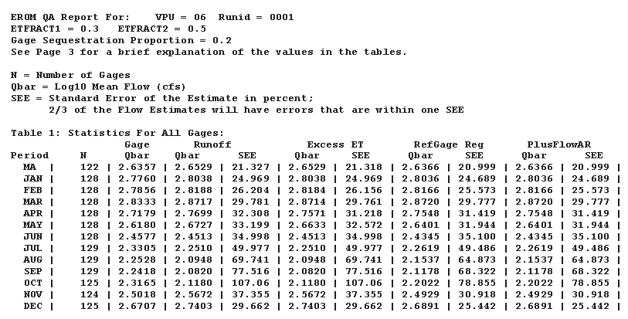
EROM QA Report
EROM QA Report is named “EROMQA_0001.PDF”
It contains statistical measures of expected EROM flow accuracy
EROM
18
Notes:
I mentioned that EROM also contains QA information. The first part of the QA is a report that shows how well the EROM flows compare to the gage flows. This file is named “EROMQA_0001.PDF”. There are two basic methods for comparison: The first measure is gage log10 mean flow as compared to the EROM log10 mean flow; this reflects any general bias between the estimates. The second measure is called the Standard Error of the Estimate (SEE) in percent. Basically, 2/3 of the EROM flow estimates can be expected to be within +/- one SEE %. EROM statistics shown on this slide indicate that it performs quite well in VPU 06 – the Tennessee River Basin, judging by the SEE which indicates that EROM flows are within plus or minus 21 percent.

Slide 20
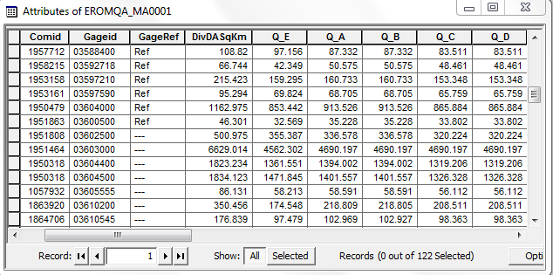
EROM QA Files
EROMQA Files are named “EROMQA_nn0001.dbf” where
“nn” = time period – “MA” = mean annual, “01” = January, etc.
These files are useful, for instance, for making graphs
EROM
19
Notes:
The 2nd part of the EROM QA is a .dbf table with flows at gages. These files are named “EROMQA_0001.dbf, where “nn” is the time period, that is, “MA” for mean annual, “01” for January, etc. This table is provided to allow interested users to perform their own QA of EROM flows. This table can be used, for example, in Excel to plot the gage versus EROM flows; it is a useful diagnostic tool for evaluating EROM performance. There is one record for each gage used in EROM.

Slide 21
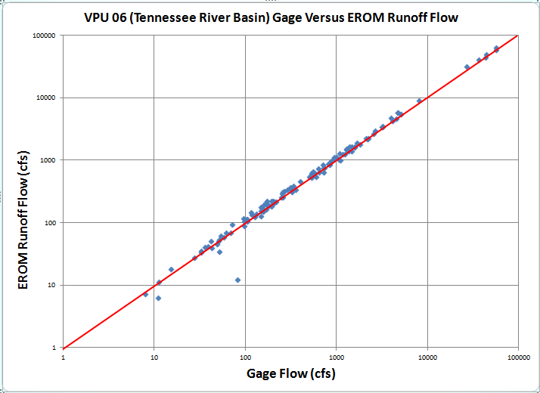
EROM QA Graph
EROM
20
Notes:
Here is an example plot showing, on a log-log scale, how well the EROM Runoff flows compare to the observed gage flows in the Tennessee River Basin (VPU 06). The red diagonal line shows a perfect fit between EROM and gage flows. The closer to the diagonal red line, the better. EROM performs pretty well in 06. There are a few “outliers”; these are often caused by flow splits at divergences or flow withdrawals that are not accounted for.

Slide 22
Vogel Flow Method
Uses a regression method for mean annual flow estimation
Q = 10a * DAb * MAPc * MATd * BCF,
  a, b, c, d are regression coefficients
  BCF is the Bias Correction Factor
  Estimates for many networked flowlines
  Regression coefficients by Hydroregion
  Velocity estimates using Jobson method
Vogel
21
Notes:
Now I will switch to the Vogel flow method. It is a regression method that operates on the 18 Hydrologic Regions (HUC2’s) in the continental U.S. It is a log-log regression of the form shown here. It uses cumulative Drainage Area, mean annual temperature and mean annual precipitation.

Slide 23
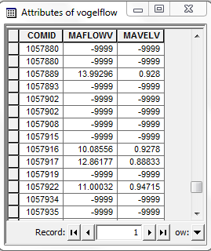
Vogel Results Files
The name of the Vogel Flow table is “VogelFlow.dbf”
Note the large number of missing values (-9999)
Vogel
22
Notes:
Here is the file structure for the results of the Vogel method. Note that there are quite a few missing values (-9999). This is because the Vogel method is only applied within the cumulative drainage area bounds used in the regression development. Vogel flows are not available for all flowlines.

Slide 24
Calculating Velocities and Time-of-Travel
Velocities are calculated using a method developed by Harvey Jobson of USGS.
It is a multiple regression method using:
  Drainage Area
  Slope
  Flow
  There is also a method that does not require slope; used when there is a “missing” slope value.
Velocity
23
Notes:
Velocities, and a derived Time-of-Travel, are based on the method of Jobson. The method that does not require slope is very useful, because not all flowlines have a slope (some have “missing” values). For example, slopes may be missing where there is no catchment for a very short flowline or there is no elevation at a start flowline that has no headwater area. Slopes are in the “ElevSlope” table in the NHDPlusAttributes folder.

Slide 25
Calculating Velocities and Time-of-Travel (2)
NHDPlus V1 and initial V2.1 extensions
  Velocity - Jobson method used for streams, lakes and estuaries
  Time-of-travel – none
NHDPlus V2.1 improved extensions
  Velocity - Jobson method used for streams; back-calculated from modeled residence time for lakes; none for estuaries
  Time-of-travel – length/velocity for streams; modeled residence time for lakes; none for estuaries
Velocity
24
Notes:
Velocities and TOT: Time of travel can be used to determine, for instance, how long it would take for a pollutant to move downstream. For instance, can estimate how long it will take a pollutant to move downstream. It is also very useful for modeling. Note that velocity is in feet per second (fps). There are caveats: calculating Time Of Travel and “routing” it upstream/downstream should be used only along flowing waters and not in waterbodies.

Slide 26
Calculating Velocities and Time-of-Travel (3)
The Jobson method is valid ONLY for flowing waters
  It should not be used in lakes, reservoirs or estuaries
Time-of-Travel (TOT) = length/velocity, can route upstream or downstream
Velocity
25
Notes:
We need to emphasize that the velocities and time of travel are valid only for flowing waters. There is work underway to provide time of travel estimates for lakes and also define which waters in NHDPlus are in estuaries.

Slide 27
VPUAttribute Data Needed for Flow:
EROM:
  Allocations of mean annual and mean monthly runoff, temperature and precipitation
For Vogel: Accumulations of drainage area, mean annual temperature and precipitation
Note: Divergence-routed methods are used to maintain a flow balance
VPUAttributes
26
Notes:
Now I will talk about the VPUAttributeExtension folder. This folder contains data allocated and accumulated by catchment for the flow calculations. EROM does its own accumulations so it only needs the allocations. The data include: mean monthly temperature and precipitation used by the water balance model and the EET in EROM step B; mean annual and mean monthly runoff data for EROM Step A. The water balance model is run separately on a grid basis, but EROM requires data allocated to catchments. Vogel requires accumulated drainage area, temperature and precipitation data for its regressions.

Slide 28
VPUAttributeExtension
Data Built Using the
NHDPlus Catchment Attribute Allocation and Accumulation Tool
(CA3T)
CA3T has been released as a user tool
CA3T
27
Notes:
The VPUAttributeExtensions are built using the CA3T tool. This tool is now available for users on the NHDPlus.com web site. I will now go through a quick explanation of how CA3T operates. “Divergence-routing” is where minor divergences are (usually) treated like “start” reaches. I will explain divergence routing later.

Slide 29
CA3T Starts with a Grid
For Example, Mean Annual Runoff:
CA3T
28
Notes:
CA3T starts with a grid, for instance, the gridded data of mean annual runoff shown on this slide.

Slide 30
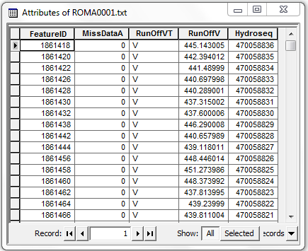
Allocates to Catchments
CA3T
29
Notes:
It then allocates these data to the NHDPlus catchments. This shows the table layout for the allocation of MA RO to catchments. Note that it uses FeatureID as the allocatrion identifier; this is because FeatureID is used for catchments; it can of course be linked to NHDPlus flowlines using the COMID.

Slide 31
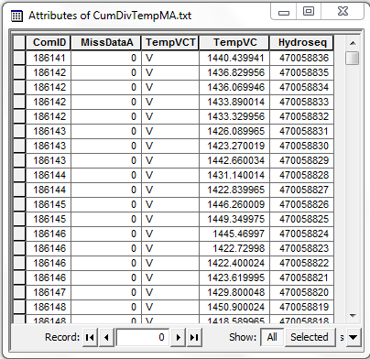
Accumulates Down the Network
Average temperature (Deg.C*100) is computed by accumulating catchment allocations and then dividing by the cumulative drainage area (CumulativeArea.DivDASqKM)
30
Notes:
CA3T can then accumulate the allocations down the NHDPlus network. This is a very powerful capability! The result is that, for each networked flowline, the summary of the total upstream drainage area as represented by the NHDPlus network is provided for EVERY Flowline. Accumulation can have some underlying complexities, but CA3T is built for this; I will explain some complexities about divergences and then show across major Drainage Areas.

Slide 32
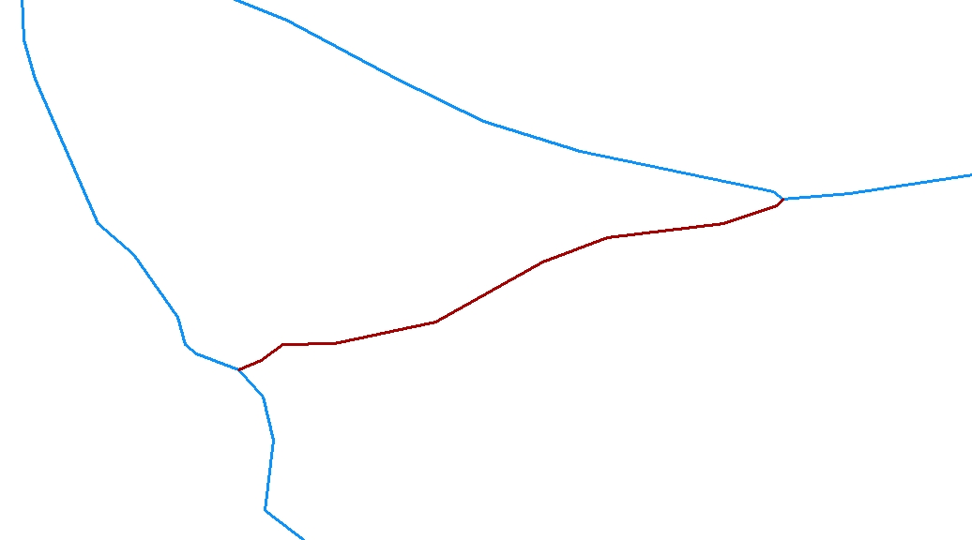
Accumulations and Divergences
PlusFlowLineVAA.Divergence = 1
Major Path
PlusFlowlineVAA.Divergence = 2
Minor path
CA3T
31
Notes:
For divergences, this shows the major path versus the minor path, the flowline to the south is the minor path. In these figures the arrows are used to show the flow direction.

Slide 33
Accumulations and Divergences
Divergence routing routes
flow down major path
Divergence routing treats the
Minor path as a start reach
CA3T
32
Notes:
“Divergence Routing” assumes (with some exceptions) that all of the flow goes down the major path. The minor path is in effect treated like a ‘start” reach.

Slide 34
Accumulations and Divergences
CumulativeArea.DivDASqKM = 2.0682
CumulativeArea.TotDASqKM = 2.0682
CumulativeArea.DivDASqKM = 0.342
CumulativeArea.TotDASqKM = 2.0295
CA3T
33
Notes:
CA3T does Divergence routing and “Total” routing. Total routing takes the entire upstream area into account regardless of major/minor path. This shows that divergence versus total routing produces very different results. An advantage of total routing is that the assumed major/minor path designations are not included;

Slide 35
Accumulations and Divergences
CumulativeArea.DivDASqKM = 495.4995
CumulativeArea.TotDASqKM = 497.187
The effects of total versus divergence accumulations carry downstream
This makes total routing complex
CA3T
34
Notes:
This effect carries downstream until the divergences are “resolved”, i.e., comes back together.

Slide 36
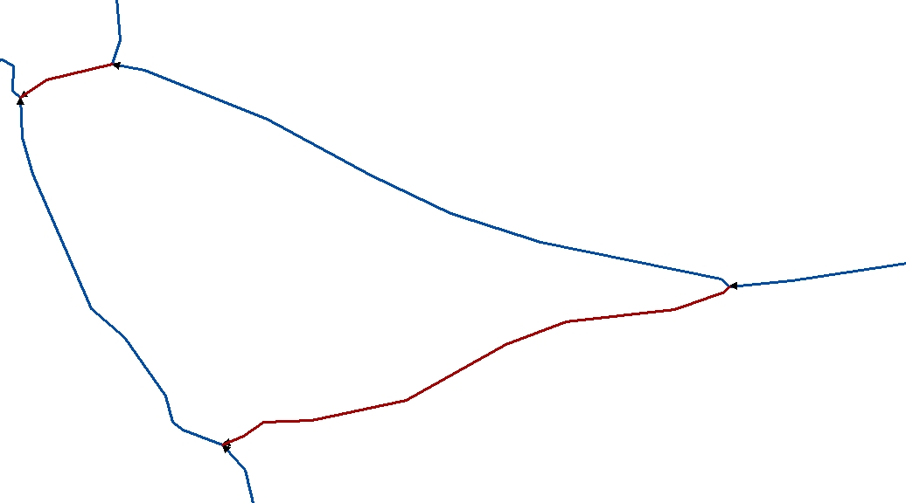
Accumulations and Divergences
Total Accumulations get more
“interesting” with multiple divergences
CA3T
35
Notes:
Total versus divergence routing can get very complex due to multiple divergences. Of course, they may never resolve or become entangled with ever more divergences. It gets quite “interesting”!

Slide 37
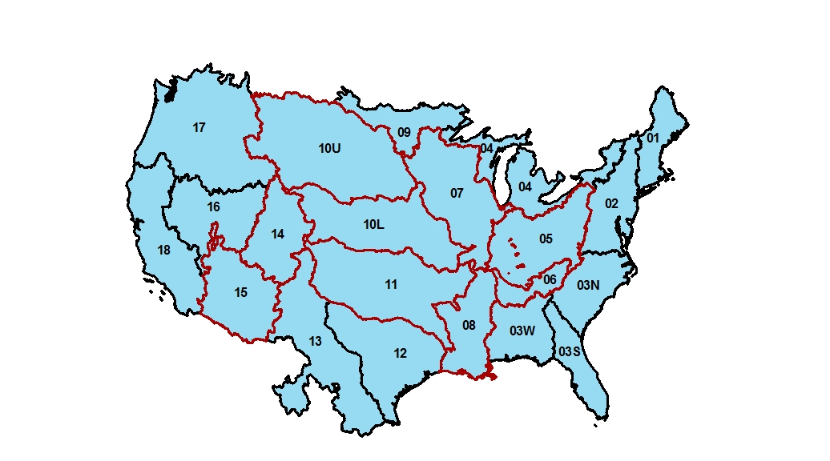
Accumulations Across Drainage Areas
CA3T
36
Notes:
The other thing that CA3T will do is accumulate across the VPU’s, for instance down the entire Mississippi and Colorado Basins. The arrows show how CA3T will accumulate down all 7 VPUs in the Mississippi Basin and the Upper and Lower Colorado Basin..

Slide 38
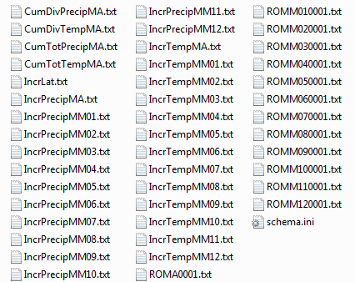
VPUAttributeExtension
VPUAttributes
37
Notes:
Here we see the five groups of files in the VPUAttributeExtension folder. Each group is enclosed in a box.

Slide 39
Review of Extensions:
Folder | Table(s)
EROMExtension | EROM_nn0001.DBF
 | EROMQA_0001.PDF
 | EROMQA_nn0001.DBF
VogelExtension | VogelFlow.DBF
VPUAttributeExtension | Cum…Precip.txt
 | Cum…Temp.txt
 | Incrlat.txt
 | IncrPrecip….txt
 | IncrTemp….txt
 | RO….txt
Folder | Table(s)
EROMExtension | EROM_nn0001.DBF
 | EROMQA_0001.PDF
 | EROMQA_nn0001.DBF
VogelExtension | VogelFlow.DBF
VPUAttributeExtension | Cum…Precip.txt
 | Cum…Temp.txt
 | Incrlat.txt
 | IncrPrecip….txt
 | IncrTemp….txt
 | RO….txt
VPUAttributes
38
Notes:
To summarize what was covered: These are the three NHDPlus Extension folders and the files in them.

Slide 40
Review of Extensions:
Folder | Table(s)
EROMExtension | EROM_nn0001.DBF
 | EROMQA_0001.PDF
 | EROMQA_nn0001.DBF
VogelExtension | VogelFlow.DBF
VPUAttributeExtension | Cum…Precip.txt
 | Cum…Temp.txt
 | Incrlat.txt
 | IncrPrecip….txt
 | IncrTemp….txt
 | RO….txt
Folder | Table(s)
EROMExtension | EROM_nn0001.DBF
 | EROMQA_0001.PDF
 | EROMQA_nn0001.DBF
VogelExtension | VogelFlow.DBF
VPUAttributeExtension | Cum…Precip.txt
 | Cum…Temp.txt
 | Incrlat.txt
 | IncrPrecip….txt
 | IncrTemp….txt
 | RO….txt
NEW! --→ | Cum….RO.txt
VPUAttributes
39
Notes:
Note: Cumulative Runoff files have been added since the initial release of NHDPlusV21!

Slide 41
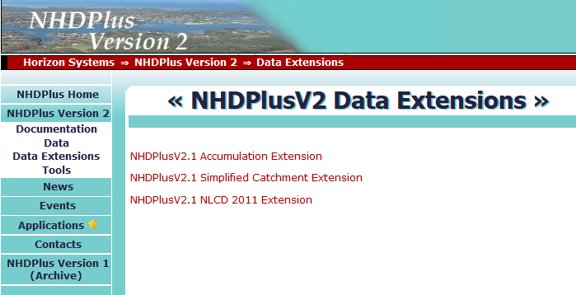
There Are Other “Extensions”
VPUAttributes
40
Notes:
There are other “Extensions”: these serve a variety of purposes. The word “extension” is used in NHDPlus for data that are produced after the core NHDPlus processing is done.

Slide 42
Resources
Additional information on NHDPlus is available from the NHDPlus website documentation page. You are encouraged to read and reference the NHDPlusV21 User Guide and other NHDPlus documentation.
The NHDPlus team maintains a user email list and periodically sends emails regarding new tools, data, documentation, and events. If you would like to be on the user list, send an email to nhdplus-support@epa.gov
The NHDPlus team also provides technical support to users of the data and tools. If you have a technical support question, please send a detailed email to nhdplus-support@epa.gov
Resources
41
Notes:
Additional information on NHDPlus is available from the NHDPlus website documentation page. You are encouraged to read and reference the NHDPlusV21 User Guide and other NHDPlus documentation.
The NHDPlus team maintains a user email list and periodically sends emails regarding new tools, data, documentation, and events. If you would like to be on the user list, send an email to NHDPlus@hscnet.com
The NHDPlus team also provides technical support to users of the data and tools. If you have a technical support question, please send a detailed email to NHDPlus@hscnet.com

Slide 43


