Slide 1
NHDPlusV2 Raster Components: Catchments and Related Raster Components
NHDPlus Training Series
Notes:
Hello, welcome to the NHDPlus Version 2 webinar. In this webinar we will discuss the raster components of NHDPlus. A raster is a matrix of cells or pixels organized into rows and columns were each cell is represented by a value. For example the NHDPlus catchments are created as rasters where the value of the raster identifies the catchment. There are also other secondary rasters that are created in the catchment development process that are useful for other purposes. We include these secondary raster components in the NHDPlusV2 dataset.
The NHDPlusV2 Training Series is designed for new and experienced NHDPlus users. To get the most from the Series, students new to NHDPlusV2 are encouraged to read up through the "NHDPlusV2 Versioning System" section of the NHDPlusV21 User Guide, download and install some NHDPlus data (as described in Exercises 0 and 1 on the web site), and spend time exploring the content of NHDPlus.
The Training Series does not cover how the NHDPlusV2 components were built. This information can be found in Appendix A of the NHDPlusV21 User Guide.

Slide 2
Objectives
Understand:
What data are included in NHDPlus data suite related to catchments
How these components were used to develop catchments
Other possible uses for the data
Objectives
Notes:
In this webinar we will cover the rasters that are included in the NHDPlusV2 data suite. We will also cover how these components are used to develop catchments. Finally, we will discuss some of the other possible uses of these raster components.

Slide 3
Agenda
Raster components
Cat grid
Hydrodem
Flow direction grid (fdr)
Additional rasters/grids
fac grid
fdrnull grid
filledarea grid
Agenda
Notes:
After a brief introduction into the raster components, we will discuss raster components used in developing the catchments: the cat grid; hydrodem; and flow direction grid. For each, we will cover how the component was developed and offer examples of how they can be used.
We then describe three additional raster components and provide examples of their use: fac grid; fdrnull grid; and filledarea grid.

Slide 4
What is included in NHDplus data suite relative to catchments
NHDPlus Value Added Layers
Primary Raster Product
GridCode
FeatureID GridCode
Raster
FeatureID GridCode
FeatureID GridCode
GridCode
Cardinality
(0,1) zero or one (0,n) zero or more
(1) one and only one
(n) Many
GridCode
GridCode
(1)
FeatureID GridCode
FeatureID GridCode
GridCode
FeatureID GridCode
Raster
Components
(Grids) are distributed by RPUs, except for cat grid.
FeatureID FeatureID GridCode
(1)
ComID GridCode
(0,1)
SinkID
ComID
(1)
Raster Components
Notes:
This is a simplified schematic diagram that shows the components of the NHDPlusV2 data suite relative to catchments. In the NHDPlusV2 data suite “cat” is the catchment grid, the product of the raster processing. The feature class “catchment” is the vectorized version of cat. Both the cat and catchment are distributed by the entire vector processing unit (VPU) which is typically a hydrologic region (a 2-digit hydrologic unit). The six items within the oval represent raster components that are distributed as grids. All are distributed by the raster processing unit (RPU) which can be either the same size as the vector processing unit or significantly smaller. There is a software limit on how big an area can be processed together as one unit.

Slide 5
What is included in NHDplus data suite relative to catchments
NHDPlus Value Added Layers
Primary Raster Product
GridCode
FeatureID GridCode
Raster
FeatureID GridCode
FeatureID GridCode
GridCode
Cardinality
(0,1) zero or one (0,n) zero or more
(1) one and only one
(n) Many
GridCode
GridCode
(1)
FeatureID GridCode
FeatureID GridCode
GridCode
FeatureID GridCode
FeatureID FeatureID GridCode
Grids used
to create the final catchment grid “Cat”
(1)
ComID GridCode
(0,1)
SinkID
ComID
(1)
Raster Components
Notes:
The grids hydrodem, fdr, and catseed, shown here, are used in the creation of “cat” – the grid of catchments. The first of the three grids is hydrodem. This is a hydrologically condition digital elevation model that we will discuss further in this webinar as well as the webinar on “burn components”. The hydrodem is used to create a flow direction grid (fdr) which is then used in conjunction with “catseed” to create an RPU wide grid of catchments. These grids of catchments for each RPU are not distributed by RPU but rather are merged together to create a single “cat” grid for the entire vector processing unit. “Cat” is distributed by VPU. All processing is done in a map projection that is appropriate for grids or raster processing. For the 48 contiguous United States this is the US Albers projection.

Slide 6
What is included in NHDplus data suite relative to catchments
NHDPlus Value Added Layers
Primary Raster Product
GridCode
FeatureID GridCode
Raster
FeatureID GridCode
FeatureID GridCode
GridCode
Cardinality
(0,1) zero or one (0,n) zero or more
(1) one and only one
(n) Many
GridCode
GridCode
(1)
FeatureID GridCode
FeatureID GridCode
GridCode
FeatureID GridCode
Catchment shape file is generated from the “cat” grid
FeatureID FeatureID GridCode
(1)
ComID GridCode
(0,1)
SinkID
ComID
(1)
Raster Components
Notes:
The catchment shape file is generated from the “cat” grid which already covers the entire VPU.

Slide 7
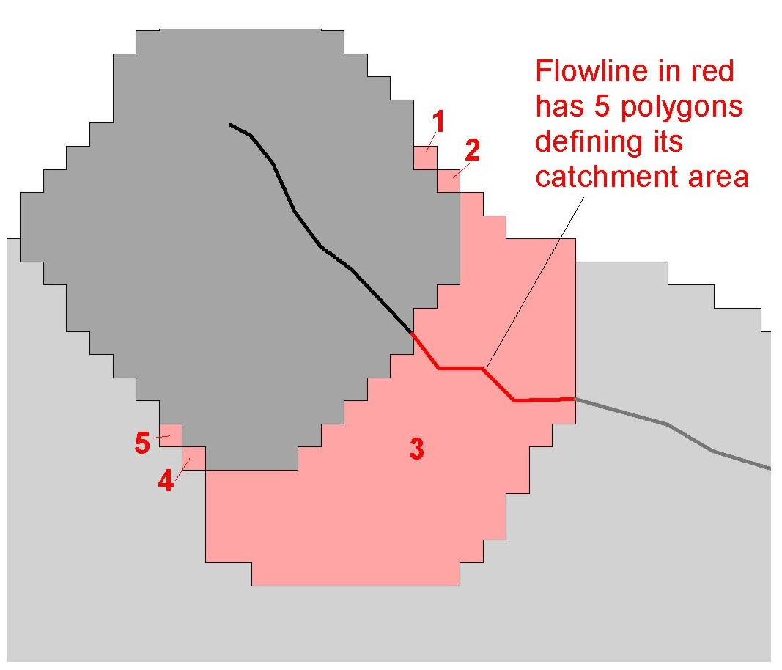
Catchment Shapefile Generated from the “cat” Grid
Cat Grid
Notes:
The catchment shape file is a multipart polygon shapefile. In the example shown, if “catchment” were not created as a multipart polygon, the rasterization of the “cat” grid would have resulted in five separate polygons to represent the catchment for the flowline shown in red. By processing the data as multipart polygons these five polygons are combined into a single multipart polygon feature.

Slide 8
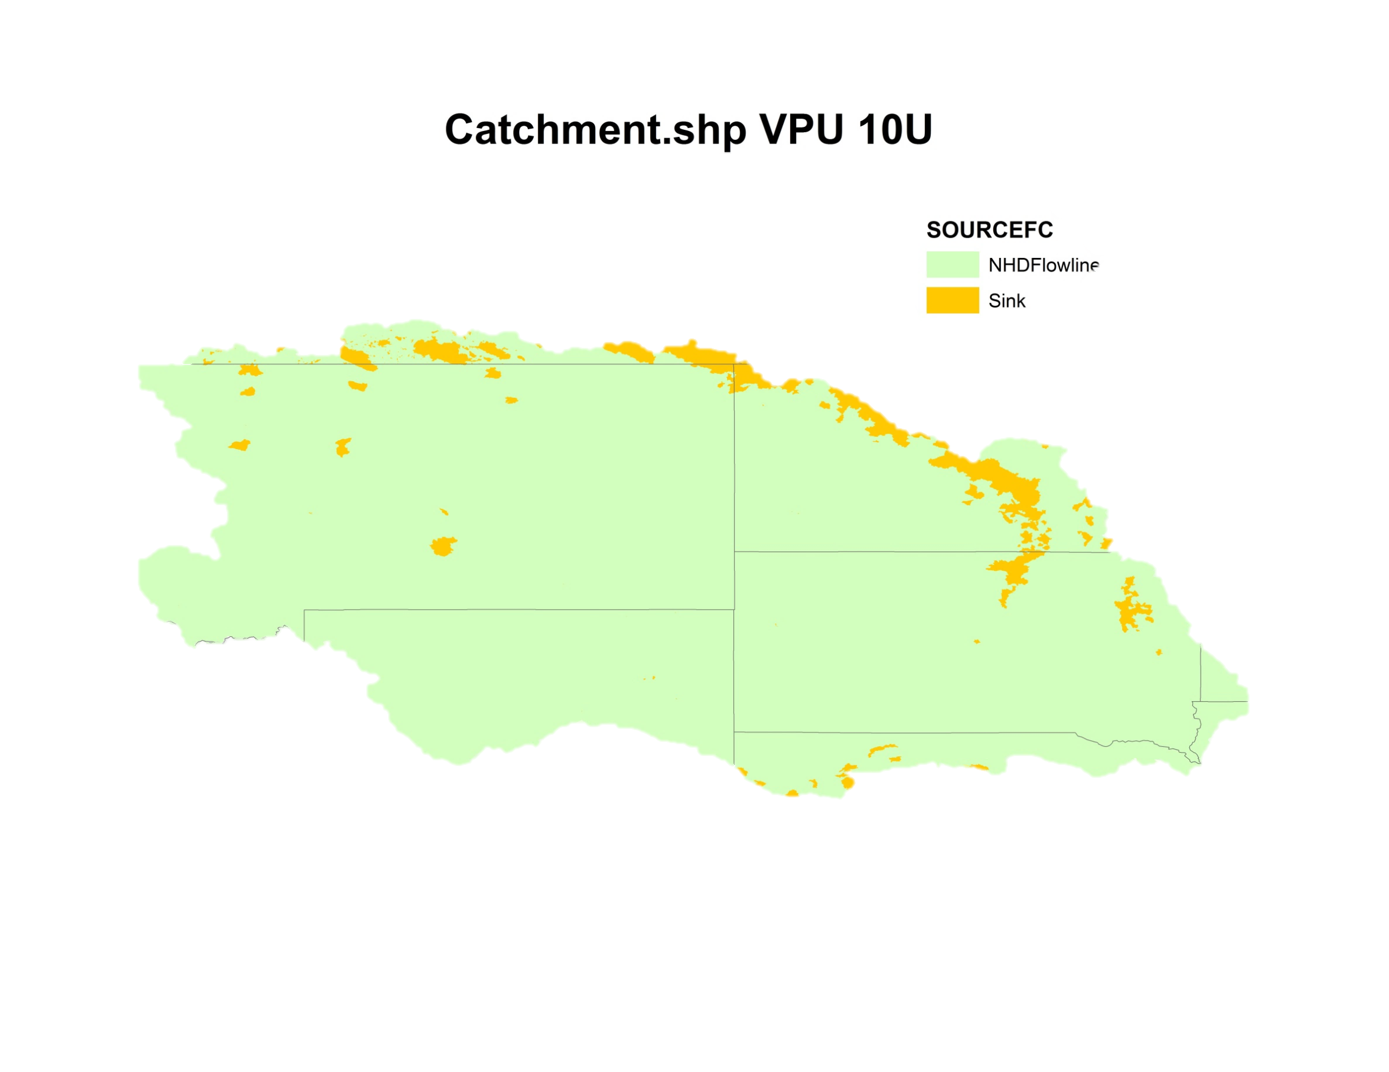
Catchment
Cat Grid
Notes:
A catchment within either the “cat” grid or the catchment shapefile can represent the drainage areas to either a NHD flowline or to a sink that is isolated and not associated with a flowline.

Slide 9
HydroDEM
A hydrologically conditioned digital elevation model
… starts with the National Elevation Model (NED) “NEDsnapshot”
… and modified using the Burn Components
NED
Burn Components
HydroDEM
HydroDEM
Notes:
The hydrodem is a hydrologically conditioned digital elevation model. For this elevation model, prior to “hydrologic conditioning”, we start with the national elevation dataset (1arc-second NED) referred to in the NHDPlusV2 dataset as the “NED snapshot”. The “NED snapshot” is then modified or hydrologically conditioned by using the “burn components”. Burn Components will be covered in detailed in the NHDPlusV2 webinar on Burn Components.

Slide 10
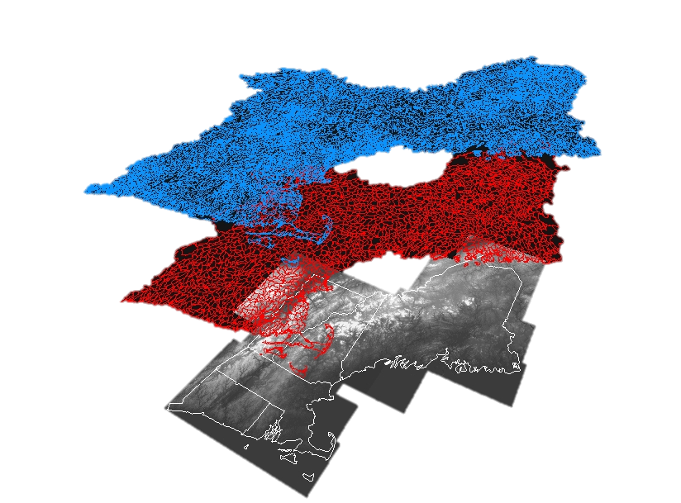
Hydrologically-Conditioned DEM (NED) incorporating example burn components (Burnline Event and Wall)
Burnline event
rendering of the
NHD
Wall (WBD)
National
Elevation
Dataset (NED
snapshot)
HydroDEM
Notes:
Two examples of the burn components that are used to modify the “NED snapshot”, in order to create the hydrodem, are: (1) the “burnline event”, a rendering of the NHD flowlines, and (2) the watershed divides called “walls.” The divides or wall data come from the 12-digit hydrologic unit data within the national Watershed Boundary Dataset (WBD).

Slide 11
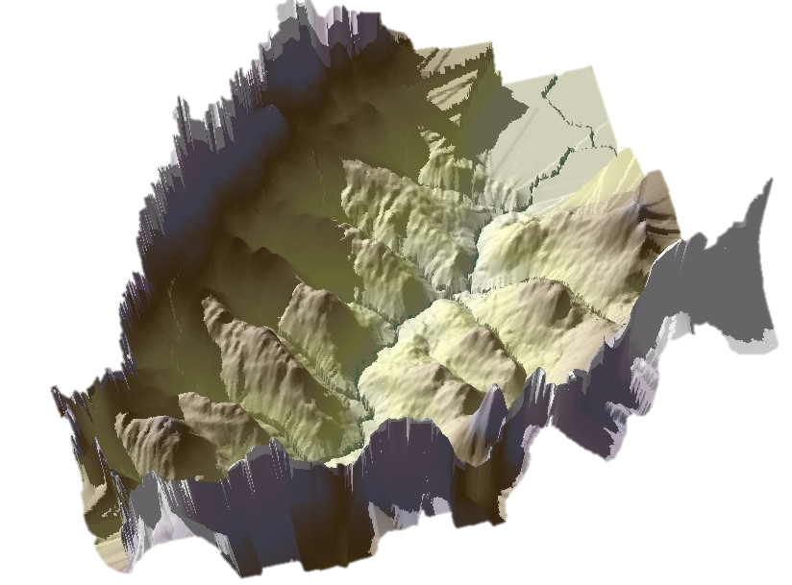
HydoDEM
Examples of
BurnComponents:
Burnline Event (NHD)
Wall (WBD)
Burnline Event
(NHD)
Wall (WBD)
Catseed
HydroDEM
Notes:
This figure (and the one on the next slide) illustrates how the two burn components, burnline event and wall, are used to modify the digital elevation model in order to create the hydrodem. The sole purpose of creating the hydrodem is to have a surface from which a flow direction grid is created which points downward from the ridges or walls down across the land surface and to the streams. For this purpose, the locations of the rivers, represented by the burnline event, are burnt into the hydrodem. The surface can then be used to create the fdr and catchments.

Slide 12
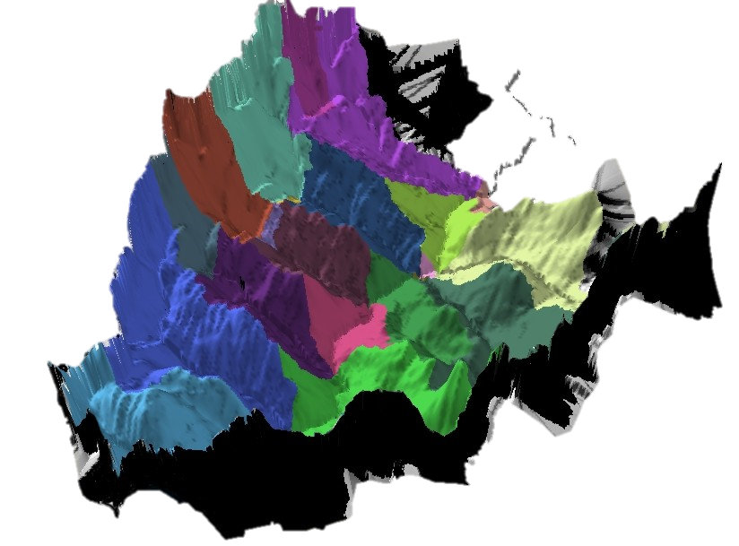
HydoDEM
Examples of
BurnComponents:
Burnline Event (NHD)
Wall (WBD)
Burnline Event
(NHD)
Wall (WBD)
Catseed
HydroDEM
Notes:
Catchments are identified by unique colors. Each area, with a unique color, drains to a specific flowline.

Slide 13
Flow Direction Grid (fdr)
The flow direction grid (fdr) is developed based on the hydrologically conditioned digital elevation model (HydroDEM)
Flow Direction Grid
Notes:
The FDR grid is essentially made up of pointers (integers) that indicate, for any grid cell, the direction downward to the lowest of its neighboring cells.

Slide 14
Flow Direction Grid Conventions
32
64
128
16
1
0 = sink
8
4
2
Flow Direction Grid
Notes:
This figure illustrates how the fdr works. The cell within the FDR grid is populated with a one, if the lowest downward neighboring cell is to the east. If the lowest downward neighboring cell is to the southeast it is populated with a two. If the lowest downward neighboring cell is to the south it is populated with a four. And so on. (note: the numbers follow orders within a base two numbering system). For the purposes of NHDPlus the flow direction grid (fdr) is populated with a zero to indicate that it is the location of a sink. This is where surface water exits the system and enters the ground.

Slide 15
Flow Direction Grid
Flow Direction Grid
Notes:
This figure and that on the next slide illustrate how the cells of a flow direction grid (fdr) point downwards from the ridges towards the river. Cyan colored lines, shown on this slide, represent the streams.

Slide 16
Flow Direction Grid
Flow Direction Grid
Notes:
This figure shows the same cyan colored lines (shown here) representing the streams. The colors represent the direction of the flow. The gray cells, for example, are populated with a value of one which indicates a flow direction from west to east. Green cells are populated with value of two indicating that the flow is from the Northwest towards the southeast, again pointing towards the river or drainage system. Dark navy blue cells in this illustration indicate a flow direction to the northeast again towards the river.

Slide 17
Other Uses of the Flow Direction Grid
Delineations within a catchment, not on network
Splitting catchments along stream network
Flow Direction Grid
Notes:
There are other uses of the flow direction grid besides creating catchments for stream segments or for sinks. Drainage areas can also be delineated for points off the stream network. Or drainage areas can be delineated from midpoints along a stream reach for some point of interest such as a sampling point. The point of interest may not be right at the downstream end of a flowline, but rather some at some point midway up the flowline.

Slide 18
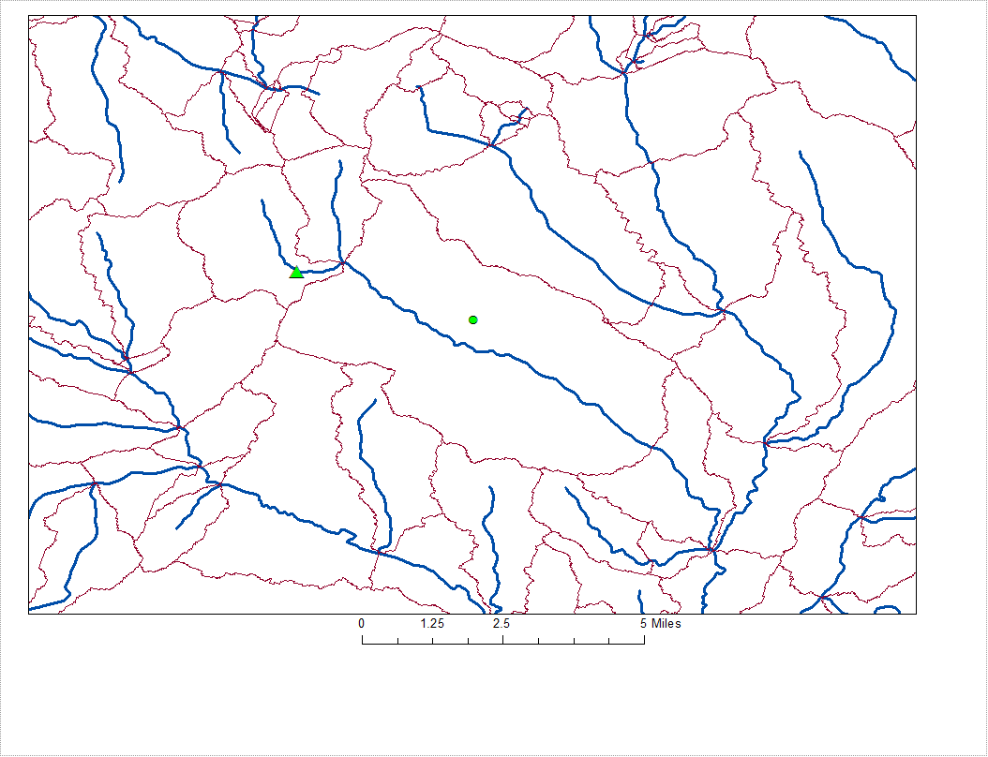
Sample
Site
Well
Flow Direction Grids (fdr) are useful for delineating watersheds within catchments.
Notes:
This figure and that on the next slide illustrate these uses. For example, the surface drainage area above a point on the land surface, such as a well, or a point along a stream, such as a well location, can be determined.

Slide 19
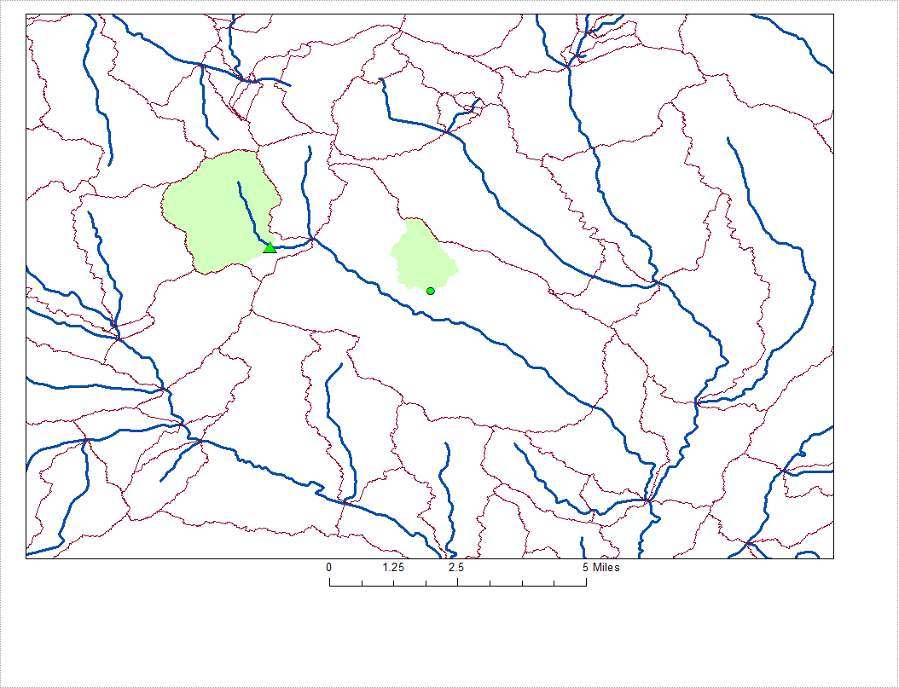
Sample
Site
Well
Flow Direction Grids (fdr) are useful for delineating watersheds within catchments.
Notes:
In these examples, the delineated area comprises only a portion of the catchment of the flowline. The stream segments are in blue, the boundary of the catchments to flowlines in red, and the smaller drainage areas within the flowline catchments are shown in green. The surface drainage area above a well (shown in green) is one such example where the fdr can be used to delineate a drainage area. Similarly the drainage area above a sample site that is not at the downstream end of a NHD flowline line can be delineated by use of the fdr grid. An example of this is the green area shown on the left.

Slide 20
What is included in NHDplus data suite relative to catchments
NHDPlus Value Added Layers
Primary Raster Product
GridCode
FeatureID GridCode
Raster
FeatureID GridCode
FeatureID GridCode
GridCode
Cardinality
(0,1) zero or one (0,n) zero or more
(1) one and only one
(n) Many
GridCode
GridCode
(1)
FeatureID GridCode
FeatureID GridCode
GridCode
FeatureID GridCode
Grids created
as useful byproducts of the catchment process.
FeatureID FeatureID GridCode
(1)
ComID GridCode
(0,1)
SinkID
ComID
(1)
Notes:
There are three other rasters (or grids) that are part of the NHDPlusV2 suite of data. These are the flow accumulation (fac) grid, the filled area grid and the fdrnull grid, which are explained in the following slides.

Slide 21
fac Grid
The flow accumulation grid (fac) is based on the flow direction grid (fdr).
Integer grid that is a count of the number of cells draining to each cell in the grid.
Values only represent the number of upstream cells within the RPU. (Cells in upstream production are not included.)
Flow Accumulation Grid
Notes:
The flow accumulation grid (fac) is based on the flow direction grid (fdr). The fac is an integer grid that represents the count of the number of cells draining to each cell within the RPU. The flow accumulation grid values only represent the number of upstream sells the drain to a given cell from within that particular RPU. Cells in upstream or adjacent RPU production units are not included.

Slide 22
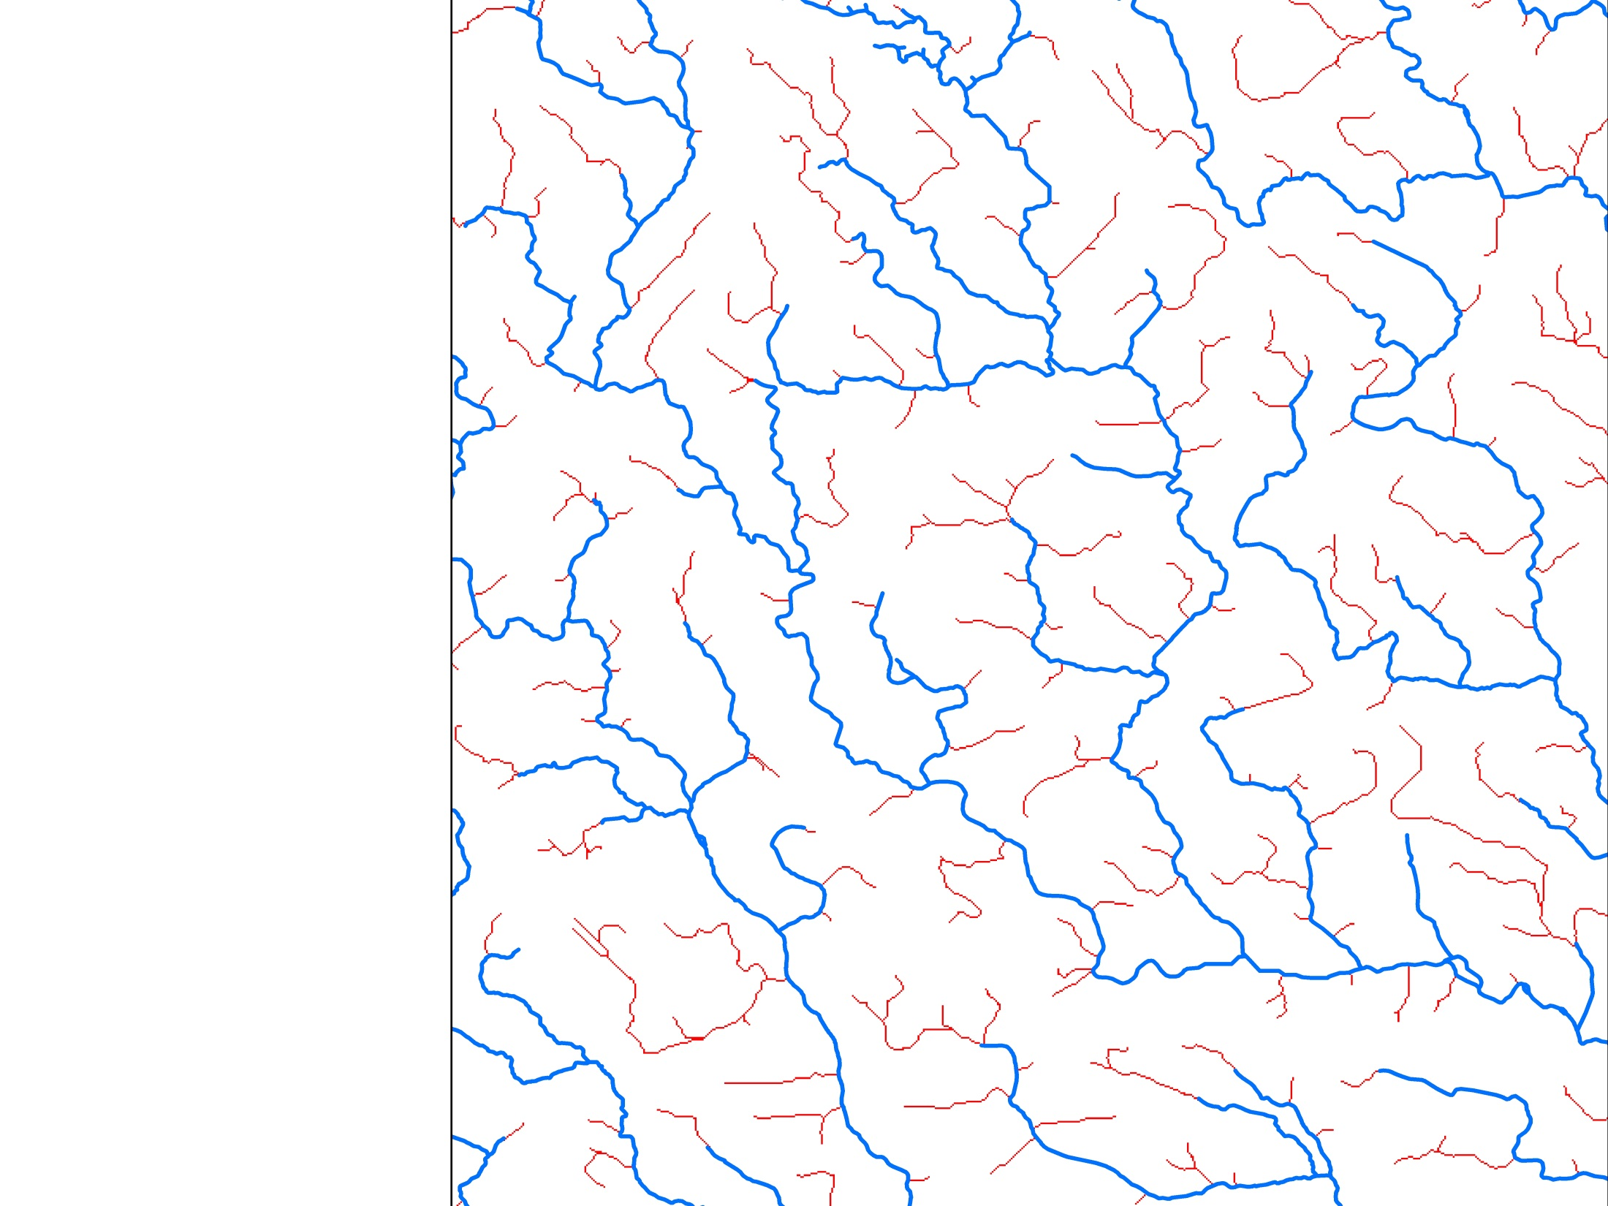
fac grid In this example the flow accumulation grid is used to show potential paths of smaller streams that may enter the stream network.
1:100,000 scale NHD flowline network
Fac grid cells with >500 uphill cells
Notes:
In this example the flow accumulation (fac) grid shows potential paths of smaller streams that may be tributary to the NHD stream network but are not included in that network. The 1:100,000 scale NHD flowlines in the network are shown here in blue. The FAC grid cells with more than 500 uphill cells are identified in red. These red lines (raster cells) indicate potential paths of smaller streams that may drain into the streams represented by the NHD flowlines.

Slide 23
fdrnull Grid
Is just like the flow direction grid (fdr) except the stream cells, at flowlines, are replaced with “NoData”.
Flow Direction Grid Null
Notes:
The fdrnull grid is just like the fdr grid, except the stream cells, at flowlines, are replaced with “NoData”. It too is based on the hydrologically conditioned digital elevation model. This modified flowdirection grid is useful in determining how far downhill it is from any point within a catchment to the flowline.

Slide 24
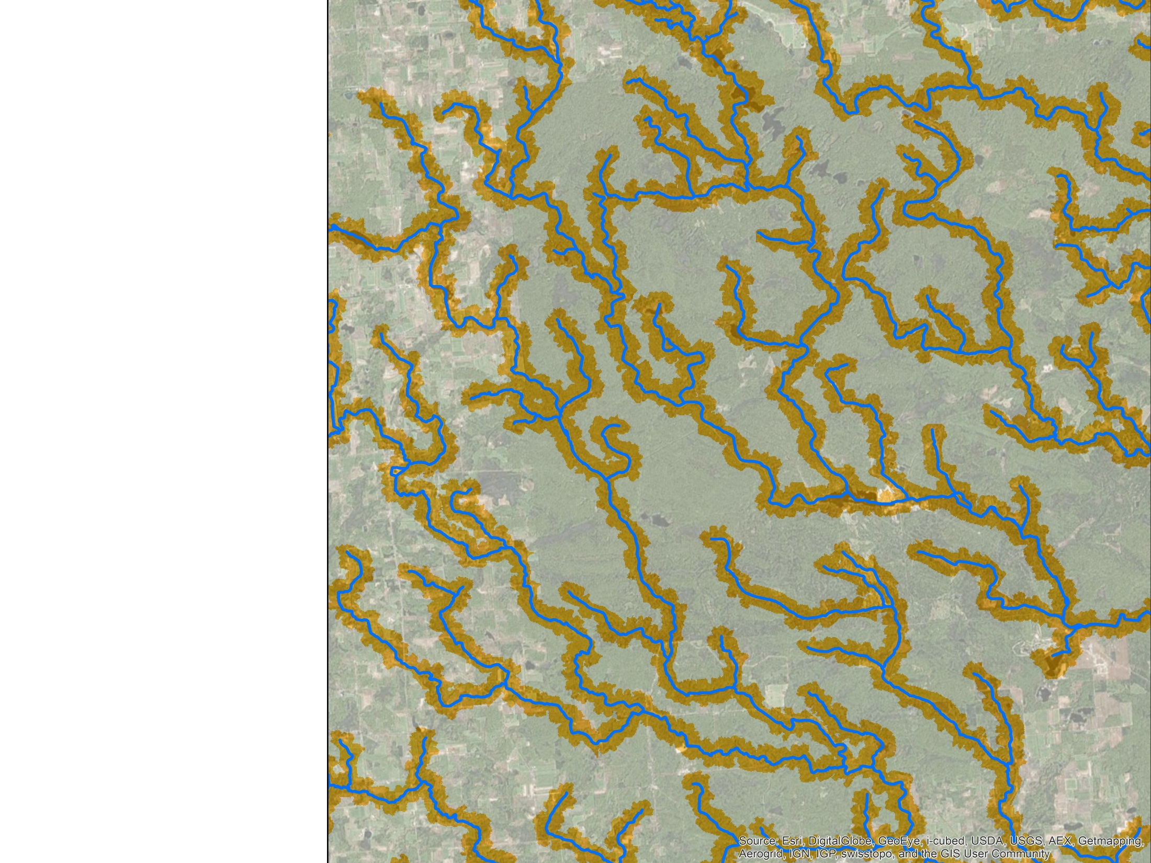
fdrnull grid An example using the grid command “flowlength” to generate distance to flowlines.
Computed >500-meter buffer zone
Notes:
This figure illustrates how the fdrnull grid can be used in conjunction with the “flowlength” command to measure distances from each cell location within a catchment to its flowline. The orange shaded areas use the results of such an operation to identify a 500-meter buffer around the flowlines. Further variations of this would be to replace any networked waterbody areas as “no data” as well. In this case similar buffer zones could be created around waterbodies.

Slide 25
filledarea Grid
Integer grid which identifies cells which were raised by the fill process.
Produced during quality control of the catchment delineation process.
Large areas that have been filled in during the creation of the HydroDEM may result in inaccurate watershed delineations especially within catchments.
Filled Area Grid
Notes:
The last NHDPlus raster component is the filled area grid. The “filledarea” grid identifies all cells for which conditioned elevations were raised by the “fill” process used while creating the hydrodem. After burning in the streams, the last step in creating the hydrodem is running a “fill” command. The purpose of this is to fill any small pockets within the hydrodem so that the subsequent flowdirection grid always points downward towards the flowlines (or to identified off-network sink locations). If, however, there are conflicts in the information contained in the input datasets that define the location of the ridges, the topographic configuration of the land surface, and location of the streams, then large areas can be filled in or raised by running the fill command. The filledarea grid is thus a useful part of the quality control process of creating catchments. Large areas may help identify inconsistencies in the ingredient (input) datasets.

Slide 26
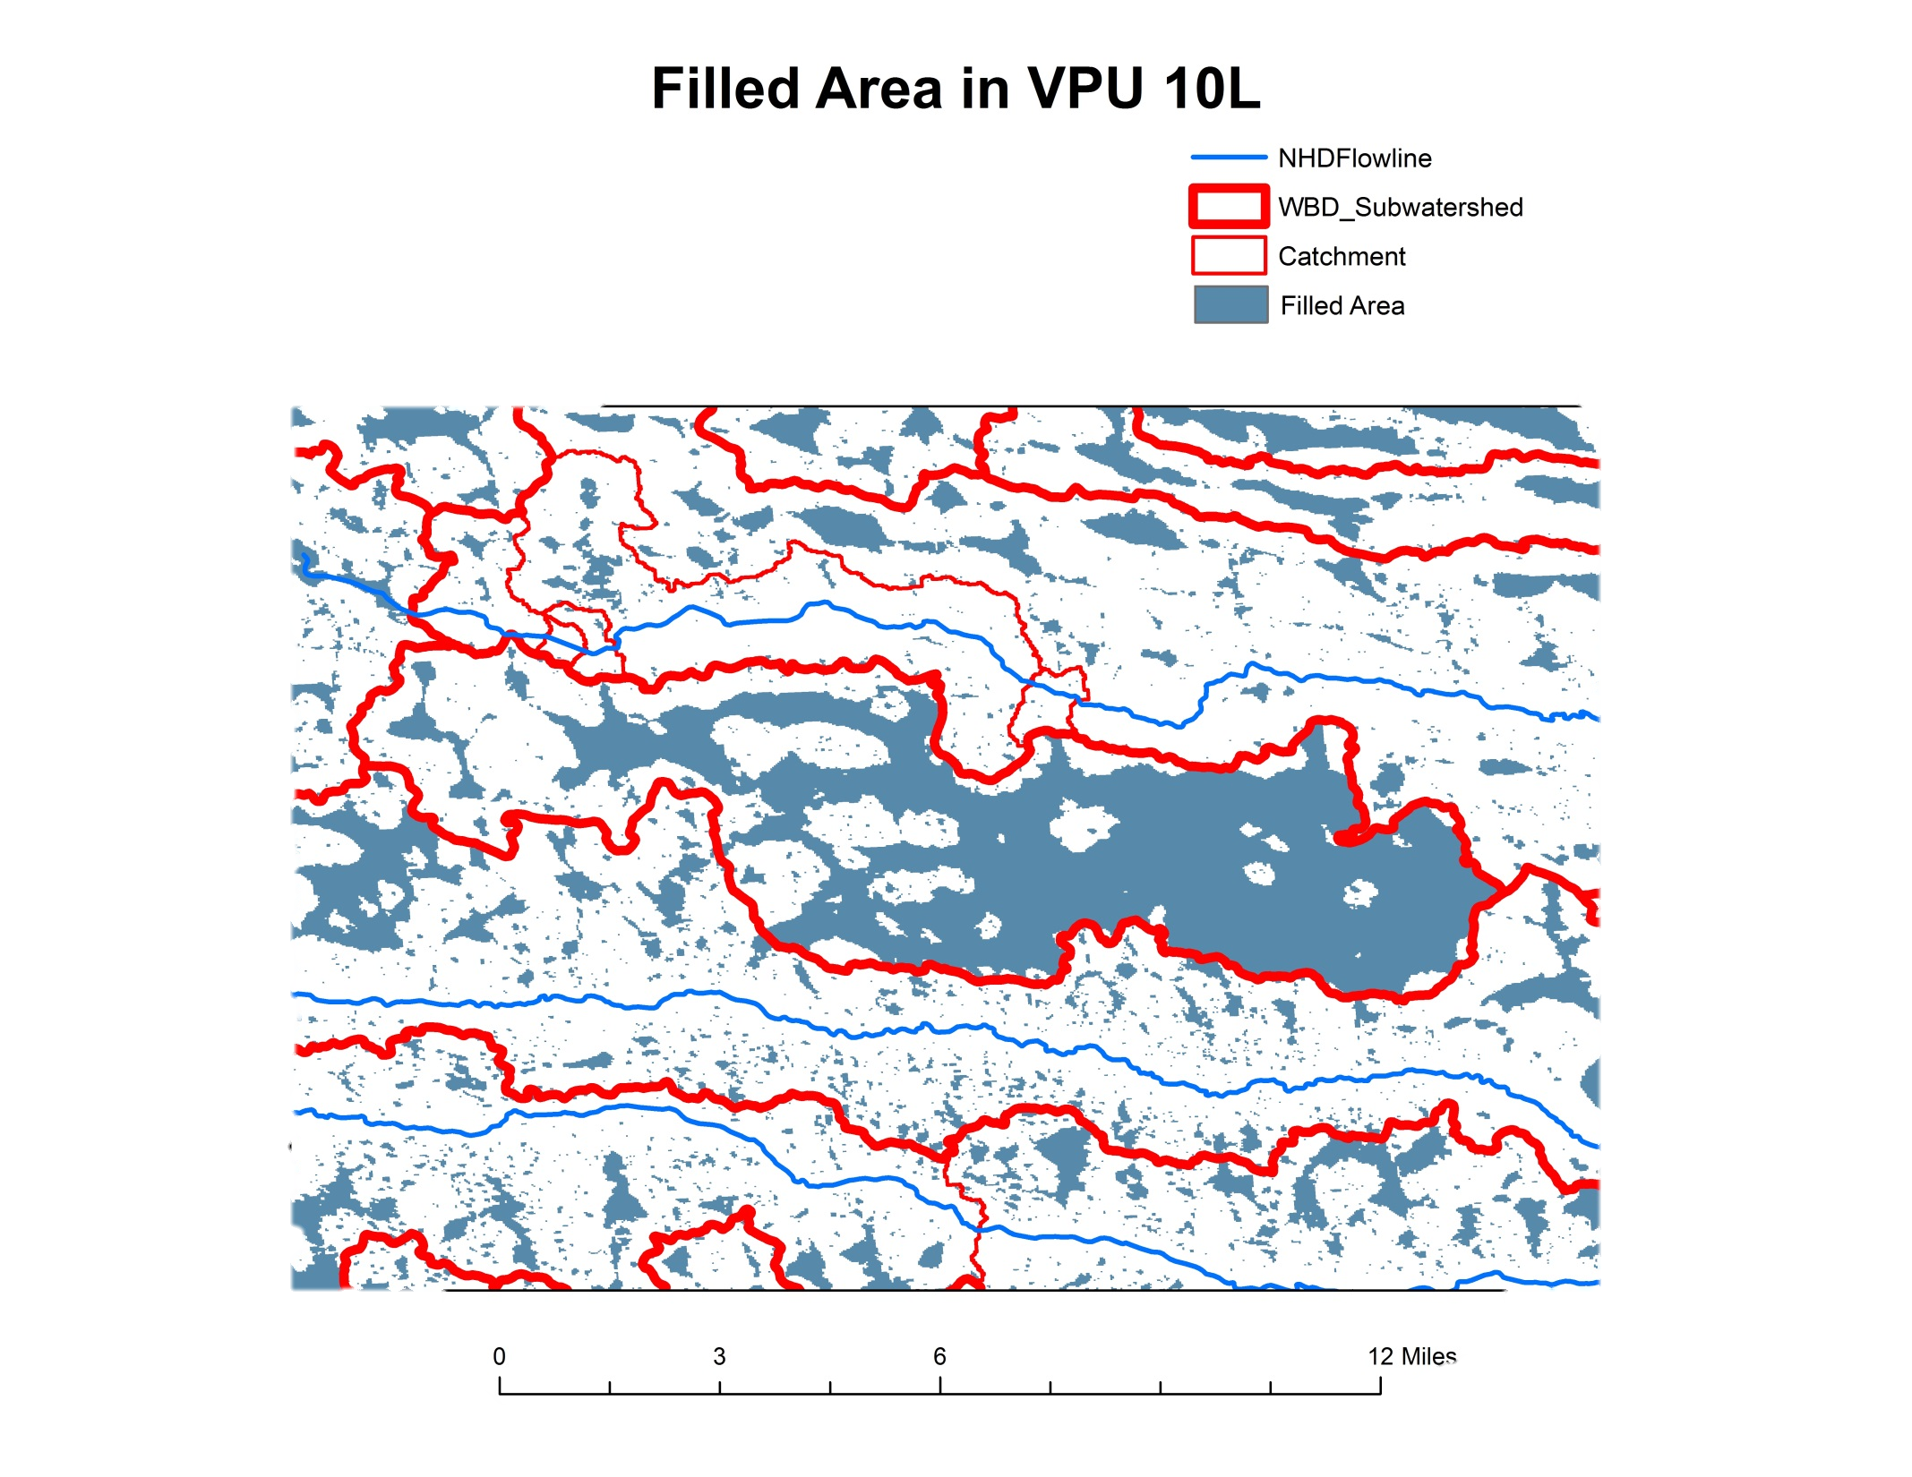
Flowline crossing the WBD wall at the wrong location
Filled Area Grid
Notes:
This slide shows an example use of the filledarea grid. The figure shows a large area that was filled during the creation of the hydrodem for this area. It is indicative of an inconsistency between (1) the NHD which is shown as blue lines, (2) the WBD divides which are shown as thick red lines, and (3) the underlying topography of the NED snapshot. The resultant catchments boundaries are shown as thin red lines. In this case the inconsistency resulted is an incorrect exit point from the WBD Subwatershed. A flowline crosses the WBD wall (in the northwestern part of the WBD Subwatershed) at a point which is not the outlet for that WBD Subwatershed. In the model, the crossing creates a breach in the wall. Also this Subwatershed has no flowlines within it nor NHDPlus sinks. Yet, it is not identified as a closed Subwatershed. This situation creates an inconsistency where the fill command fills a large area until the cells within the Subwatershed fill up to the elevation of the breach in the wall (where the flowline crosses the WBD divide). The lowest point within the Subwatershed must be elsewhere and should be represented by either a flowline or a sink.

Slide 27
Resources
Additional information on NHDPlus is available from the NHDPlus website documentation page. You are encouraged to read and reference the NHDPlusV21 User Guide and other NHDPlus documentation.
The NHDPlus team maintains a user email list and periodically sends emails regarding new tools, data, documentation, and events. If you would like to be on the user list, send an email to nhdplus-support@epa.gov
The NHDPlus team also provides technical support to users of the data and tools. If you have a technical support question, please send a detailed email to nhdplus-support@epa.gov
Resources
Notes:
Additional Resource information on NHDPlus is available from the NHDPlus website documentation page. You are encouraged to read and reference the NHDPlusV21 User Guide and other NHDPlus documentation.
The NHDPlus team maintains a user email list and periodically sends emails regarding new tools, data, documentation, and events. If you would like to be on the user list, send an email to NHDPlus@hscnet.com
The NHDPlus team also provides technical support to users of the data and tools. If you have a technical support question, please send a detailed email to NHDPlus@hscnet.com

Slide 28
Notes:
This concludes our webinar on NHDPlusV2 raster components. A follow-up webinar is on the NHDPlusV2 “Burn Components” which further describes the components that modify the hydrodems. These components include sinks, burnlines, WBD divides, NHD water bodies, etc. Thank you!

