Slide 1


NHDPlusV2
Network Value Added Attributes
Part 4
Cindy McKay
NHDPlus Training Series
Notes:
Welcome to the NHDPlus Training Series. This session is the final part of a 4 part set about NHDPlusV2 Network Value Added Attributes. My name is Cindy McKay and I’m a member of the NHDPlus team. My name is Cindy McKay and I’m part of the NHDPlus Team.
The NHDPlusV2 Training Series is designed for new and experienced NHDPlus users. To get the most from the Series, students new to NHDPlusV2 are encouraged to read up through the "NHDPlusV2 Versioning System" section of the NHDPlusV21 User Guide, download and install some NHDPlus data (as described in Exercises 0 and 1 on the web site), and spend time exploring the content of NHDPlus.
The Training Series does not cover how the NHDPlusV2 components were built. This information can be found in Appendix A of the NHDPlusV21 User Guide.

Slide 2
Objectives
Understand the format and content of the PlusFlowTable
Learn the mechanics of using the table to traverse the NHDPlus network.
Learn how to obtain, install and use the NHDPlusV2 Flow Table Navigator Tool
Objectives
Notes:
At the completion of this training session, you will understand the format and content of the PlusFlow table and understand the mechanics of using the table to traverse the NHDPlus network. Finally, you’ll be able to obtain, install and use the Flow Table Navigator Tool.

Slide 3
Agenda
PlusFlow Table
NHDPlusV2 Flow Table Navigator Tool
Agenda
Notes:
Our agenda begins with a discussion of the PlusFlow Table. This is then followed by information about the Flow Table Navigator Tool

Slide 4
NHDPlusV2 PlusFlow Table
Purpose:
  Enables traversal of the network (and coastline), both upstream and downstream one flowline at a time.
Contains a record for every:
  Place where two flowlines exchange water
  Headwater flowline
  Network terminal flowline
  Place where a surface water flowline touches a coastline flowline
  Place where two coastline flowlines touch
PlusFlow Table
Notes:
The purpose of the PlusFlow table is to provide the information necessary to traverse the NHDPlus network and coastline, both upstream and downstream. The traversal technique supported by the PlusFlow table is “walking” from one flowline to the next. The table contains a record for every place where two flowlines exchange water a record that identifies each headwater flowline; a record that identified each terminal flowline; a record for each place where a surface water flowline touches a coastline flowline; and ,finally, a record for each place where two coastline flowlines touch.

Slide 5
PlusFlow Table Attributes
FromComID | ToComID | Direction | HasGeo | GapDist
Upstream Flowline
Downstream Flowline
Record Type
Is the Connection Geometric?
Distance Between From and To Flowlines
Direction Domain
712 - Start Flow
709 - Flowing
713 - End Flow
714 - Non-Flowing
PlusFlow Table
Notes:
The 5 essential attributes in the table are shown in this slide. FromComID and ToComID contain the ComID identifiers of flowlines. The FromComID flowline is upstream of the ToComID flowline.
Direction describes the type of flow record. “712” indicates that the record is identifying a headwater and, by convention, FromComID is 0 and ToComID is the headwater flowline. “713” indicates that the record is identifying a network terminus and, by convention, FromComID is the terminal flowline and ToComID is 0. A “709” record tells us that the upstream flowline is flowing to the downstream flowline. A direction of “714” is used when FromComID is a surface water flowline and ToComID is a Coastline flowline or when both FromComID and ToComID are Coastline flowlines.
HasGeo indicates whether or not the flow relationship is also represented in the NHDFlowline geometry. HasGeo = “Y”, for “yes”, means that the geometry for the FromComID actually touches the geometry for the ToComid. When HasGeo = “N”, for “No”, the two flowlines do not actually touch, however it is known that flow does occur from one to the other. HasGeo = “N” is used in karst terrain and in urban areas to logically connect flowlines when the actual connecting geometry is not known.
Finally, when HasGeo = “N”, GapDist tells us the straight line distance between the flowlines.

Slide 6
Direction Attribute
1
Type of Connection
FromComID | ToComID | Direction
0 | 1 | 712
0 | 2 | 712
0 | 4 | 712
1 | 3 | 709
1 | 6 | 709
2 | 3 | 709
2 | 6 | 709
6 | 7 | 709
3 | 5 | 709
4 | 12 | 709
4 | 11 | 709
12 | 0 | 713
11 | 5 | 709
5 | 8 | 709
7 | 8 | 709
8 | 9 | 714
10 | 9 | 714
2
Domain
712 - Start Flow
709 - Flowing
713 - End Flow
714 - Non-Flowing
6
3
4
11
12
5
7
8
10
9
PlusFlow Table
Notes:
This slide shows an example of some records in a typical PlusFlow table. The diagram on the right is a schematic of a small network. The blue lines are surface water flowlines and the red lines are Coastline flowlines. In the table, there are “712” records for each of the headwater flowlines in the network – 1, 2, and 4. There are “709” records for each pair of flowlines that exchange water. There is a “713” record where flowline 12 terminates the network and flows into the ground. Finally, there are “714” records for where flowline 8 touches the Coastline and where the two Coastline features, 10 and 9, touch. By convention, the downstream Coastline connections are represented in a counter clockwise direction around the U.S. Tracing “downstream” using the PlusFlow Coastline records takes us from Puget Sound to the southern end of the California coast, from the Rio Grande eastward along the Gulf of Mexico, around the Florida panhandle and up the Atlantic coast to Maine. Likewise, the PlusFlow records for the Coastline features along the Great Lakes proceed from east to west.

Slide 7
HasGeo/GapDist Attributes
HasGeo | GapDist
1
Is the Connection
Geometric?
Distance between
From and To
Flowlines
2
Domain
Y = Yes
N = No
Domain
>= 0
3
4
FromComID | ToComID | HasGeo | Gap Dist
1 | 3 | Y | 0
2 | 3 | Y | 0
3 | 5 | N | 0.5
4 | 5 | N | 0.5
5
PlusFlow Table
Notes:
This slide illustrates the HasGeo and GapDist attributes. In a geometrically connected network for flowlines, HasGeo is set to “Y” and GapDist is 0. When there are geometric gaps in the network due to karst terrain or urban development, the PlusFlow records that bridge the gaps have HasGeo set to “N” and GapDist provides the straight line distance, in kilometers, of the gap. The gap in the drawing on the right is represented by two records in the PlusFlow table. One record says that flowline 3 flows to flowline 5 and the other record says that flowline 4 flows to flowline 5. Both 3 and 4 are 0.5 kilometers from 5.

Slide 8
Additional Attributes
PlusFlowlineVAA Attributes Conveniently Joined to PlusFlow
FromHydSeq PlusFlowlineVAA.HydroSeq
ToHydSeq PlusFlowlineVAA.HydroSeq
FromLvlPat PlusFlowlineVAA.LevelPathID
ToLvlPat PlusFlowlineVAA.LevelPathID
NodeNumber PlusFlowlineVAA.NodeNumber
TotDASqKM PlusFlowlineVAA.TotDASqKM
DivDASqKM PlusFlowlineVAA.DivDASqKM
PlusFlow Table
Notes:
For convenience, there are 7 network value-added attributes from the PlusFlowlineVAA table included in the PlusFlow table. These 7 attributes are listed here and described in Parts 1 and 2 of this 4-part set of sessions on the NHDPlusV2 Network Value Added Attributes.
These attributes assist the operation of the NHDPlusV2 Flow Table Navigator Tool which is our next topic.

Slide 9
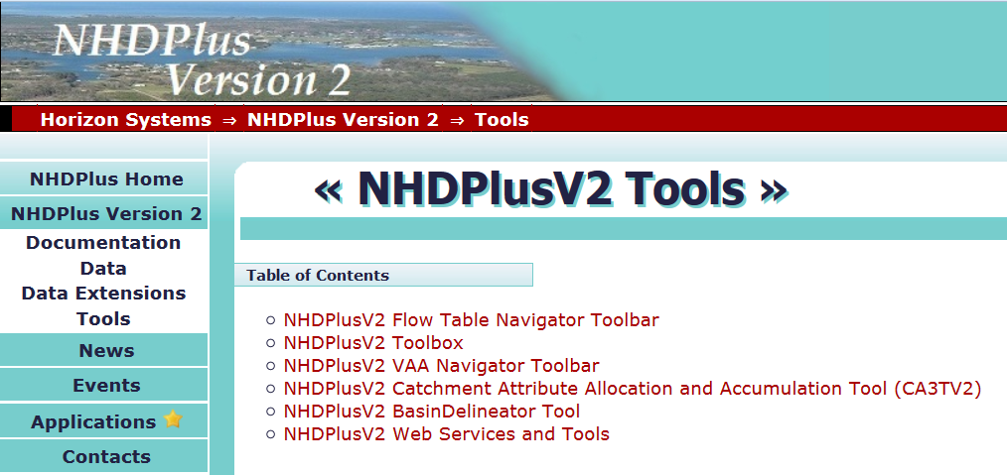
NHDPlusV2 Flow Table Navigator
Flow Table Navigator
Notes:
The NHDPlusV2 Flow Table Navigator uses the PlusFlow table to move either upstream or downstream in the network. The tool is implemented as an ArcMap toolbar and is available from the NHDPlus website on the NHDPlusV2 Tools page.

Slide 10
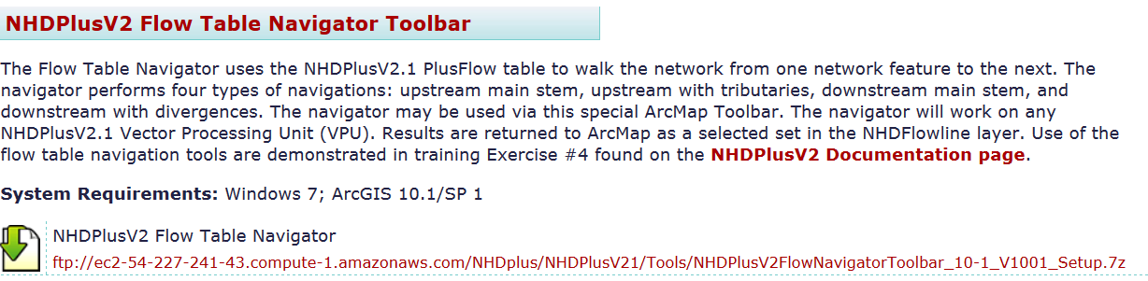
Download the Navigator Install Package
http://www.horizon-systems.com/NHDPlus/NHDPlusV2_tools.php
Flow Table Navigator
Notes:
The tools page describes the system requirements for using the tool. Be certain to install the versions specified on the webpage that are required for the Flow Table Navigator.
To obtain the navigator tool software, click on the download link.

Slide 11

Navigator Installation
Uncompress the .7z file. Run the .exe.
Install:
.Net
ArcGIS
Flow Table Navigator ToolBar
Flow Table Navigator
Notes:
Once the install package has been downloaded, it needs to be uncompressed to expose the .msi and .exe files. Before installing the navigator tool, insure that the system prerequisites, as listed on the Tools webpage, for the .NET framework, ArcGIS, and SQL Server Express Localdb are installed. Then, to install the Navigator, run the .exe file and follow the instructions for installing the Navigator tool in the Windows operating system.

Slide 12
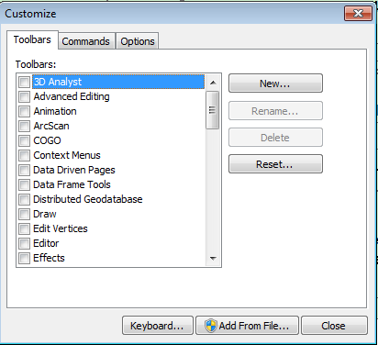
Install the Custom ArcMap Navigator Toolbar
Flow Table Navigator
Notes:
Once the Navigator is installed in Windows, start ArcMap and add the Navigator toolbar to ArcMap. To accomplish this, right click on an empty place on the ArcMap toolbar ribbon. Go to the bottom of the toolbar list and select “Customize.” From the Customize dialog, select “Add From File.”

Slide 13
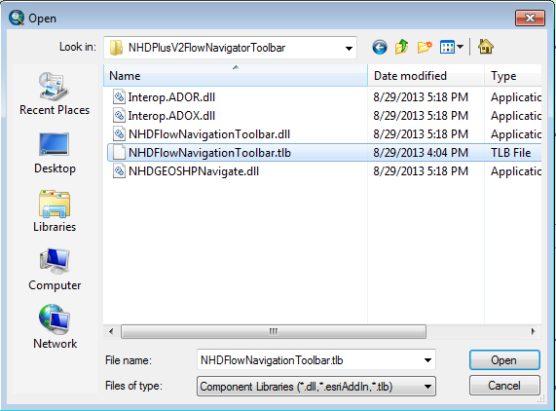
Install the Custom ArcMap Navigator Toolbar
Flow Table Navigator
Notes:
From the Open dialog, navigate to the folder where the Navigator was installed and select the NHDFlowNavigationToolbar.tlb and click “Open.”

Slide 14
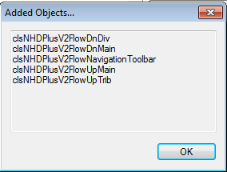
Add the Custom Navigator Toolbar to ArcMap
Flow Table Navigator
Notes:
The Added Objects window should appear with a list of the 5 objects that comprise the navigator. If this window says “No Objects Added”, there is a Windows permission issue on your system that you will need to discuss with your System Administrator.
After successful installation, right click on an empty place on the ArcMap toolbar ribbon. You will see the NHDPlusV2 Flow Navigation Toolbar in the toolbar list. Checkmark it to add it to ArcMap.

Slide 15

The Navigator ArcMap Toolbar
Upstream Mainstem
Downstream Mainstem
Upstream with Tributaries
Downstream with Divergences
Flow Table Navigator
Notes:
The toolbar contains 4 tools.
The single up arrow tool is for Upstream Mainstem navigation. This tool will traverse a single path upstream following the mainstem flowlines until the headwater flowline is reached.
The multi up arrow tool is for Upstream with Tributaries navigation. This tool will traverse all flowlines upstream until headwater flowlines are reached.
The single down arrow tool is for Downstream Mainstem navigation. This tool will traverse a single path downstream following the mainstem flowlines until the network terminus is reached.
The multi down arrow tool is for Downstream with Divergences navigation. This tool will traverse all flowlines downstream until network termini are reached.

Slide 16
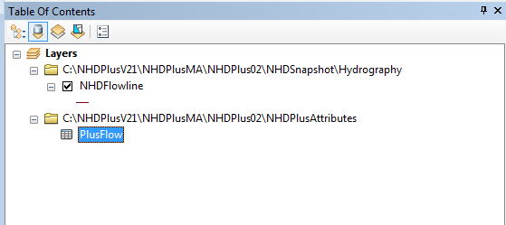
Data Used by the Flow Table Navigator
Flow Table Navigator
Notes:
To use the Flow Table Navigator, you must add an NHDFlowline feature class and its corresponding PlusFlow table to the map.

Slide 17
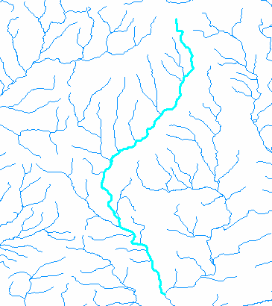
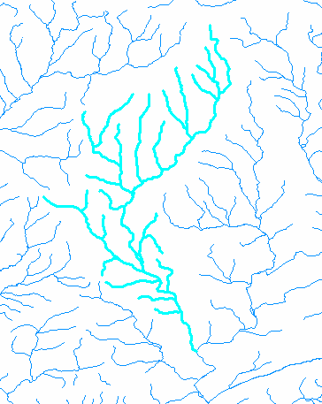
Flow Table Navigator Upstream Output
Upstream Mainstem
Upstream with Tributaries
Point and Click on Flowline
Flow Table Navigator
Notes:
To start a navigation, zoom in close enough to see the individual flowlines near your desired navigation start point. Select one of the flow tools from the toolbar and click on a flowline where the navigation is to begin. The image on the left side of this slide shows the results of an Upstream Mainstem navigation. The image on the right shows the results of an Upstream with Tributaries navigation.
Upstream navigations may begin on a Coastline Flowline. Upstream Mainstem traversals will include only Coastline flowlines, while Upstream with Tributaries traversals will navigate up every surface water network that touches the coastline.

Slide 18
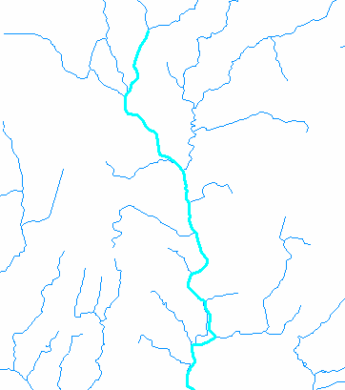
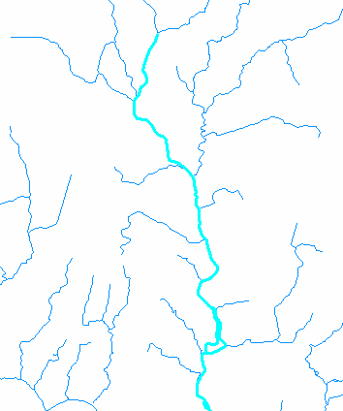
Flow Table Navigator Downstream Output
Downstream Mainstem
Downstream with Divergences
Point and Click on Flowline
Flow Table Navigator
Notes:
The image on the left side of this slide shows the results of an Downstream Mainstem navigation. The image on the right shows the results of a Downstream with Divergences navigation.. Note that inside the circle in the image on the right-hand side is a flow divergence/split and both sides of the split were navigated.
If the network being navigated touches the Coastline, then downstream navigations will include the Coastline flowlines that are counter clockwise beginning with the place where the coastline is touched.
Downstream navigations may begin on a Coastline Flowline.

Slide 19
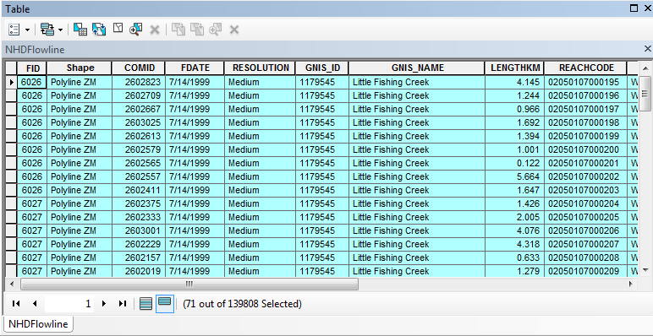
Flow Table Navigator Tabular Output
Returns a Selected Set of Flowlines
Flow Table Navigator
Notes:
The Flow Table Navigator returns a selected set in the NHDFlowline feature class. If you wish to save the navigation results you can export the selected flowlines.
This completes the discussion of the navigator. The NHDPlusV2 Documentation page contains a set of interactive exercises. “Exercise 4 – Navigating with the Flow Table” provides additional hands-on explanations on use of the NHDPlusV2 Flow Table Navigator.

Slide 20
Resources
Additional information on NHDPlus is available from the NHDPlus website documentation page. You are encouraged to read and reference the NHDPlusV21 User Guide and other NHDPlus documentation.
The NHDPlus team maintains a user email list and periodically sends emails regarding new tools, data, documentation, and events. If you would like to be on the user list, send an email to nhdplus-support@epa.gov
The NHDPlus team also provides technical support to users of the data and tools. If you have a technical support question, please send a detailed email to nhdplus-support@epa.gov
Resources

Slide 21


