Slide 1


NHDPlusV2 Network Value Added Attributes - Part 3
By Tim Bondelid
NHDPlus Training Series
Notes:
The NHDPlusV2 Training Series is designed for new and experienced NHDPlus users. To get the most from the Series, students new to NHDPlusV2 are encouraged to read up through the "NHDPlusV2 Versioning System" section of the NHDPlusV21 User Guide, download and install some NHDPlus data (as described in Exercises 0 and 1 on the web site), and spend time exploring the content of NHDPlus.
The Training Series does not cover how the NHDPlusV2 components were built. This information can be found in Appendix A of the NHDPlusV21 User Guide.

Slide 2
Agenda – Network Value Added Attributes Part 3
Introduction
Tables For:
  Divergences
  Drainage Area
  Flow
  Elevations and Slope
Introduction
Notes:
The agenda has of course an introduction, which we are doing now. I will then discuss tables for the following 4 aspects of the Plus part. Please note that the topic being covered is shown in the lower left corner, which can help you keep track of where we are in this Webinar.

Slide 3
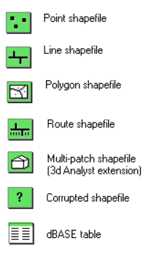



NHDPlusV2 Value Added Attributes
Cumulative
Area
PlusFlowline
VAA
DivFracMP
Raster
NodeNumber
ComID
ComID
ComID
NodeNumber
(1)
(1)
NHDFlowline
(0,n)
(1)
ComID
(n)
ComID
Cardinality
(0,1) zero or one
(0,n) zero or more
(1) one and only one
(n) Many
(0,1)
(n)
(0,1)
PlusFlow
FromComID
ToComID
ComID
ElevSlope
(0,n)
(0,1)
ComID
ComID
MegaDiv
HeadWater
NodeArea
(0,n)
(0,n)
PlusARPoint
Event
ComID
FromComID
ToComID
PlusFlowAR
FromComID
ToComID
Introduction
Notes:
This is the schema of the VAAs. The circled elements are the tables I’m covering in this presentation. All of these tables relate to themselves and to other components via the ComID. As I go through the topics in this presentation, I will show this schema and circle the particular tables for each topic being discussed.

Slide 4
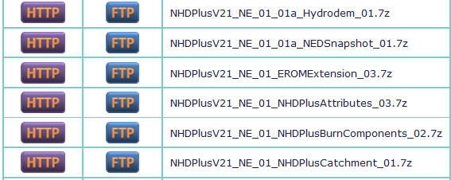
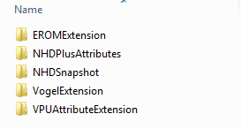
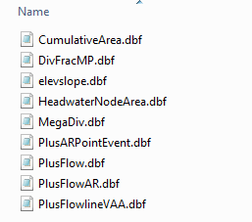
Where to find the data
Introduction
Notes:
This is where to find the data in the NHDPlus data structure. The tables are stored in the directory named “NHDPlusAttributes”.

Slide 5
Tables Using Divergences
NHDPlusV2 Value Added Attributes
Cumulative
Area
PlusFlowline
VAA
DivFracMP
NodeNumber
ComID
ComID
ComID
NodeNumber
(1)
(1)
NHDFlowline
(0,n)
(1)
ComID
(n)
ComID
(0,1)
(n)
(0,1)
PlusFlow
FromComID
ToComID
ComID
ElevSlope
(0,n)
(0,1)
ComID
ComID
MegaDiv
HeadWater
NodeArea
(0,n)
(0,n)
PlusARPoint
Event
ComID
FromComID
ToComID
PlusFlowAR
FromComID
ToComID
Divergences
Notes:
The first topic is tables that use divergences. Many of us were taught about hydrology and hydrography based on dendritic stream networks. Dendrite networks are where the flow always goes from start reaches into convergences and then downstream to a larger stream. However, the real world doesn’t work that way! Streams join and then diverge down multiple paths. NHDPlus goes to a great deal of effort to help us work with divergences. Two of the tables I will talk about that deal with divergences are MegaDiv and DivFrac. First, I will explain the types of junctions and divergences in NHDPlus.

Slide 6
Divergences
Convergent
Junction
Divergent
Junction
Complex
Junction
Divergences
Notes:
Here are the basic types of junctions in the real world and therefore in NHDPlus. We have the nice, well-behaved convergent junctions. Then a basic divergent junction where the flow splits down 2 paths. Finally, we get much more complex situations.

Slide 7
Major and Minor Paths
Minor Path
Divergence = 2
Major Path
Divergence = 1
Divergences
Notes:
The first thing NHDPlus does is to define the divergent outlets as Major or Minor. In general, 100% of the flow (and other attributes at times) is routed down the Major path and the minor path is treated as a start reach. Doing this prevents double-counting of flows, etc., as we navigate downstream. There are various “rules” for defining major and minor paths. The primary rule is for the major paths to follow the name, i.e., the Mississippi River named flowlines are all on the major path.

Slide 8
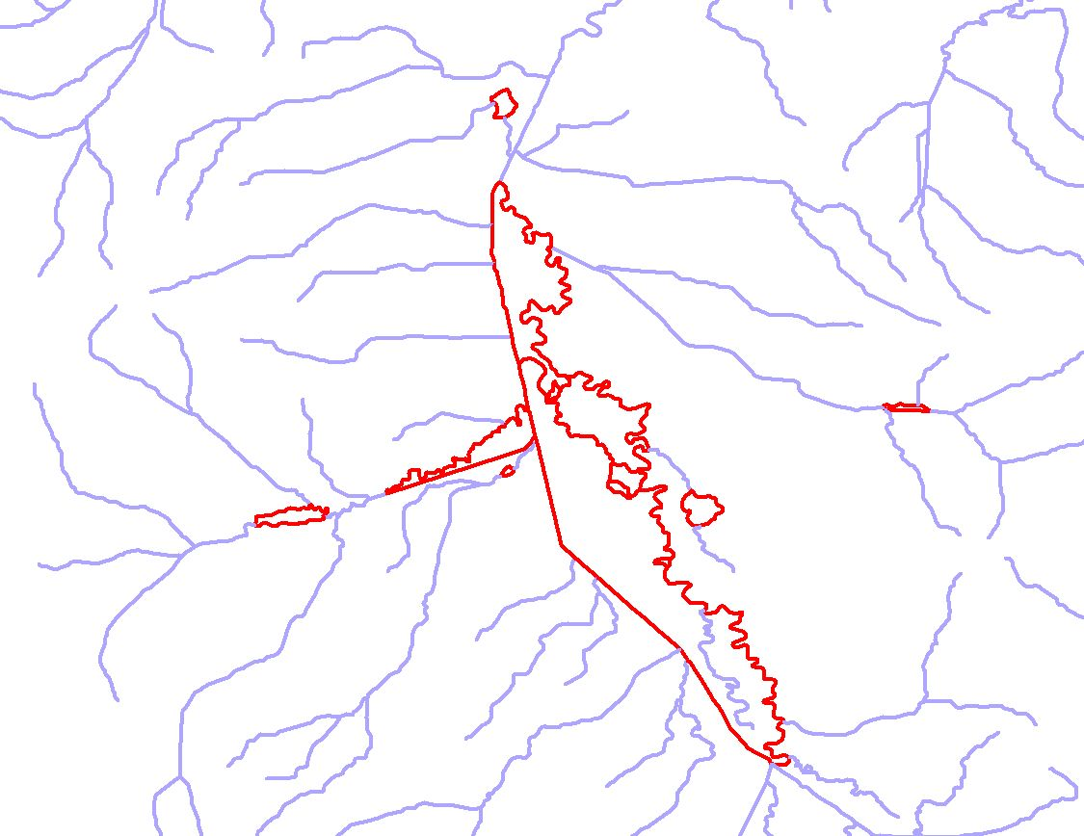
Flowlines Affected by Divergences
Divergences
7
Notes:
Divergences often get quite complicated. This map shows all of the flowlines in an area that are affected by divergent flow (they are highlighted in red). By the way, this is not a particularly unique area; this occurs pretty much everywhere. So much for our dendritic network “training!”

Slide 9
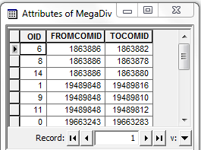
MegaDiv Table
More than two outflow
paths at a divergence
FromComid
ToComid’s
Divergences
Notes:
The Megadiv table defines junctions where there are more than 2 outflows at a junction. This table is needed in conjunction with the PlusFlowlineVAA table. The primary reason this table is needed is that the VAA table contains the information only for convergent junctions and divergent junctions that have 2 outlets. The VAA table would get unnecessarily large to contain all of the information for these megadiv junctions.

Slide 10
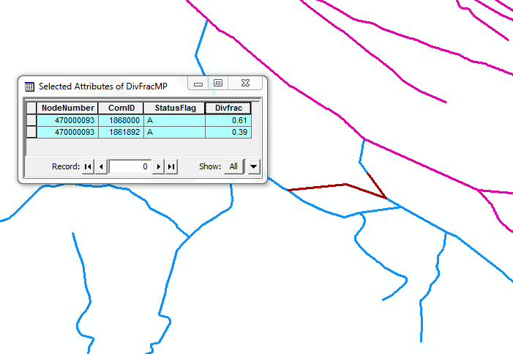
DIVFracMP Table
Ohio River
Tennessee River
61% of the flow down major path
39% of the flow down minor path
Divergences
Notes:
The DivFrac table is used to override the general “rule” that all flow goes down the major path. DivFrac provides a defined flow split that routes a fraction of the flow down each path. This is very important, especially at major flow splits. In this example, 61% of the Tennessee mainstem flow is routed down one path and 39% is routed down the other path. This is an important junction that divides the flow just before it enters the Ohio River. As of this Webinar, there are not a lot of DivFrac junctions defined, but we hope for more in the future.

Slide 11
Drainage Area Tables
NHDPlusV2 Value Added Attributes
Cumulative
Area
PlusFlowline
VAA
DivFracMP
NodeNumber
ComID
ComID
ComID
NodeNumber
(1)
(1)
NHDFlowline
(0,n)
(1)
ComID
(n)
ComID
(0,1)
(n)
(0,1)
PlusFlow
FromComID
ToComID
ComID
ElevSlope
(0,n)
(0,1)
ComID
ComID
MegaDiv
HeadWater
NodeArea
(0,n)
(0,n)
PlusARPoint
Event
ComID
FromComID
ToComID
PlusFlowAR
FromComID
ToComID
Drainage Area
Notes:
Now, I will talk about 2 tables that provide extra information about drainage areas. These are the CumulativeArea and the HeadwaterNodeArea tables, circled in the schema.

Slide 12
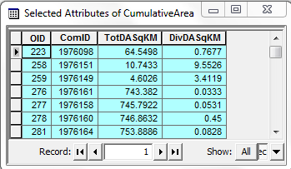
CumulativeArea Table
DivDASqKM is accumulated
down the major path
TotDASqKM is accumulated
Down all paths
Divergence routing treats the
Minor path as a start reach
Minor Path
Divergence = 2
Major Path
Divergence = 1
Note: The CumulativeArea Table is computed using the CA³T tool
Drainage Area
Notes:
The CumulativeArea table is very helpful in that it provides the total drainage area upstream of the downstream node of each networked flowline. Note that this table provides two drainage areas. The TotDASqKm value is the total drainage regardless of the effects of the divergences. The DivDASqKM value is the “divergence routed” drainage area; this value assigns the total drainage area to the major path and the minor path is treated as a start flowline. Note that there can be a significant difference between these two drainage area values. Remember the map before that showed flowlines affected by divergences; all of these flowlines will have different values for total and divergent-routed drainage areas. These two drainage areas could both be useful, depending on your application.

Slide 13
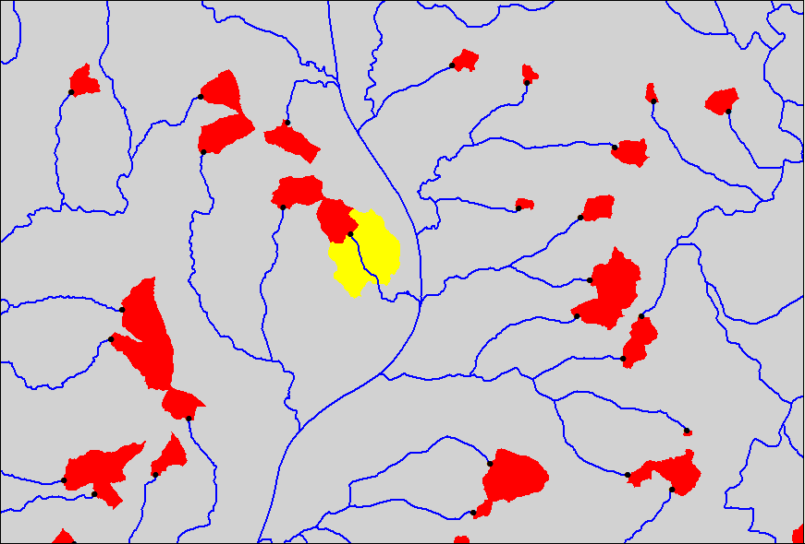
HeadWaterNodeArea
HWNodeSqKM is the drainage
area of the catchment
upstream of the top of a start reach
Note: Headwater drainage areas are
also used in the ElevSlope table, which is
discussed later
Drainage Area
12
Notes:
The HeadwaterNodeArea relates to the catchment that drains into the top of a start flowline. We will re-visit these HeadwaterNodeAreas when we get to elevations and slopes later in this presentation; these areas are very important for this.

Slide 14
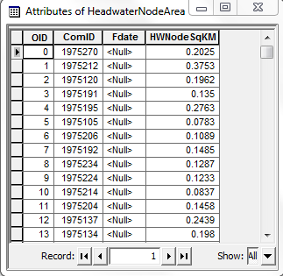
HeadWaterNodeArea Table
Drainage Area
13
Notes:
The HeadwaterNodeArea table provides the drainage areas of these catchments. This is very useful for setting modeling values for the most upstream nodes in a network.

Slide 15
Tables Affecting Flow
NHDPlusV2 Value Added Attributes
Cumulative
Area
PlusFlowline
VAA
DivFracMP
NodeNumber
ComID
ComID
ComID
NodeNumber
(1)
(1)
NHDFlowline
(0,n)
(1)
ComID
(n)
ComID
(0,1)
(n)
(0,1)
PlusFlow
FromComID
ToComID
ComID
ElevSlope
(0,n)
(0,1)
ComID
ComID
MegaDiv
HeadWater
NodeArea
(0,n)
(0,n)
PlusARPoint
Event
ComID
FromComID
ToComID
PlusFlowAR
FromComID
ToComID
Flow
Notes:
Here are the tables that affect flow. I have already covered the DivFracMP table when discussing divergences earlier in this presentation. This table, of course, will have a major effect on flow calculations.

Slide 16
PlusFlowAR and PlusARPointEvent
These files provide a way to define flow withdrawals, transfers and augmentation
PlusFlowARPointEvent is an event file that identifies points for flow withdrawals or inputs
PlusFlowAR contains the quantity of flow to be withdrawn or added
Flow
Notes:
The other tables are the PlusARPointEvent and the PlusFlowAR tables . These tables provide an extended capability in NHDPlus and are used for defining flow transfers, withdrawals, and additions. An example is the transfer of flows from one river basin to another to augment the stream flow; this is a major water management issue in the West.

Slide 17
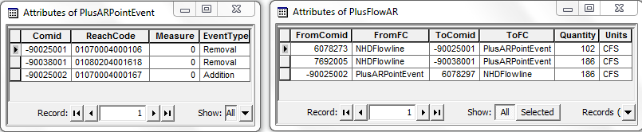
PlusFlowAR and PlusARPointEvent Tables
Flow
16
Notes:
Here is the layout of these 2 tables. The PlusARPointEvent table defines points on the network that are either removals or additions of flow. These records are in turn associated with PlusFlowAR records that define how much flow is either removed or added at points on the network. Note that the 2nd and 3rd records in these 2 tables effectively define a flow transfer of 186 cfs from Comid 7692005 to Comid 6078297. The first record defines a flow removal of 102 cfs from Comid 6078203.

Slide 18
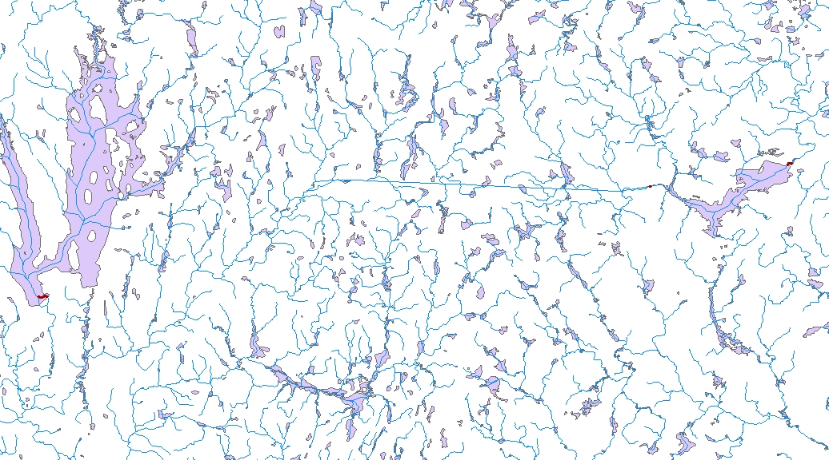
PlusFlowAR and PlusARPointEvent
102 cfs
186 cfs
186 cfs
Flow
17
Notes:
This map shows the PlusFlowAR effects. The flow transfer is shown as well as the flow removal.

Slide 19
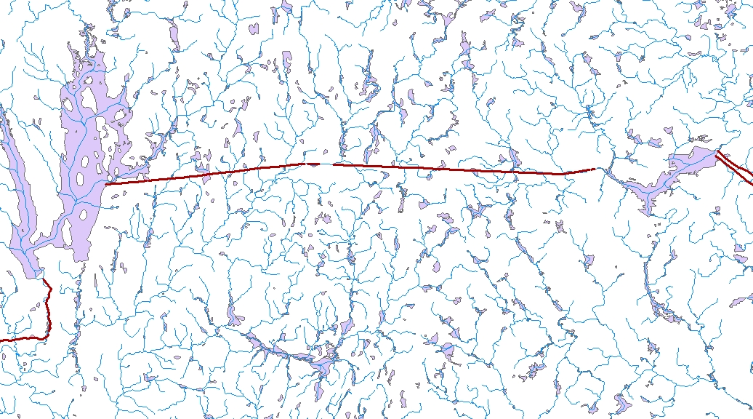
PlusFlowAR and PlusARPointEvent
Pipelines highlighted in red
Flow
18
Notes:
This map helps explain what is happening with the flow transfer. Pipelines in NHDPlus are highlighted on the map. Note that these pipelines correspond to the flow transfer defined in the PlusFlowAR records.

Slide 20
Elevation and Slope
NHDPlusV2 Value Added Attributes
Cumulative
Area
PlusFlowline
VAA
DivFracMP
NodeNumber
ComID
ComID
ComID
NodeNumber
(1)
(1)
NHDFlowline
(0,n)
(1)
ComID
(n)
ComID
(0,1)
(n)
(0,1)
PlusFlow
FromComID
ToComID
ComID
ElevSlope
(0,n)
(0,1)
ComID
ComID
MegaDiv
HeadWater
NodeArea
(0,n)
(0,n)
PlusARPoint
Event
ComID
FromComID
ToComID
PlusFlowAR
FromComID
ToComID
Elevation
and Slope
Notes:
Now I will talk about elevation and slope. The data are stored in the ElevSlope table. I have put a dashed line around the HeadWaterNodeArea table because the headwater node catchments are an important part of the NHDPlus elevations.

Slide 21
ElevSlopeTable
The ElevSlope table provides maximum and minimum elevations and slopes for flowlines. This is used for velocity calculations and can be helpful for other user applications.
The elevation/slope computation process:
  Step 1: Assign “Raw” elevations to flowlines
  Step 2: Compute consistent elevations at nodes
  Step 3: “Smooth” the elevations along LevelPaths
Elevation smoothing is needed to ensure that flowline slopes are not negative (water flowing downhill)Note: Minimum slope = 0.00001 (cm/cm)
Elevation
and Slope
20
Notes:
The ElevSlope table provides max and min elevations and a slope for most networked flowlines. The elevations are very useful, for instance in modeling. As an example, saturation dissolved oxygen concentrations, which are important in modeling wasteload allocation, depend in part on elevation. Additionally, channel slopes help to estimate stream velocities. There are 3 steps used in estimating elevations and slopes: first, the “raw” elevations, derived from minimum catchment elevations, are assigned to flowlines including headwater catchments for the top of headwater flowlines. Then, a process refines the elevations so that they are consistent at nodes. Finally, a “smoothing” process ensures that the slope is a least flat or slopes in the downstream direction; it wouldn’t do to have the water flowing uphill. I go through the three steps in the following slides.

Slide 22
Assign “Raw” Elevations
Minimum elevation of headwater node
area is the MaxElevRaw value
Minimum elevation of catchment is the
MinElevRaw value
For “interior” flowlines the MinElevRaw
is set to the minimum catchment elevation,
the MaxElevRaw is set to -9998
Elevation
and Slope
21
Notes:
Here is how the raw elevations are determined. They are based on the minimum elevation in each catchment, including headwater catchments. Note that in “interior” catchments, there is no upstream elevation; these get assigned based on the minimum elevations for the immediate upstream catchments.

Slide 23
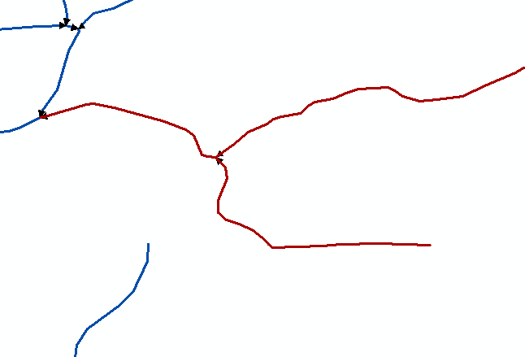
Consistent Elevations at Nodes
Note: Elevations are in cm
ComID = 14639831
MaxElevRaw = -9998
MinElevRaw = 38864
MaxElevSmo = 39425
MinElevSmo = 38919
ComID = 14639833
MaxElevRaw = -9998
MinElevRaw = 38360
MaxElevSmo = 38919
MinElevSmo = 38384
ComID = 14639831
MaxElevRaw = 46664
MinElevRaw = 38919
MaxElevSmo = 46664
MinElevSmo = 38919
Elevation
and Slope
22
Notes:
This map shows how consistent elevations at nodes are set. Also, elevations at the upstream ends of “interior” flowlines are set. The node elevation is the maximum of the downstream elevations at the node. For instance, at the junction shown, the two incoming flowlines in red have MinElevRaw values of 38864 and 38919; the maximum of these is 38919. Therefore the minimum “smoothed elevation at the downstream ends is 38919, and the maximum elevation for the downstream flowline is 38919. This process is done at all networked nodes.

Slide 24
Elevation Smoothing
Elevation
and Slope
23
Notes:
The final step is called “elevation smoothing”. This smoothing process is done along each levelpath . This graph shows the raw and smoothed elevations along a stream, going right-to-left from upstream to downstream. The smoothing process has to go down, or at least not go up; this otherwise would have the water flowing uphill – not good. The lower, blue line shows the raw elevations and the red line that “rides” along the tops of these raw elevations is the smoothed elevation.

Slide 25
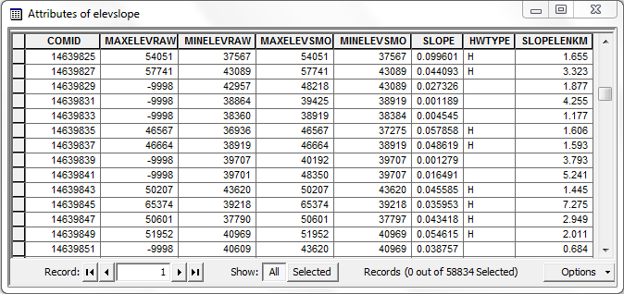
The ElevSlope Table
Elevation
and Slope
24
Notes:
This is the file layout for the ElevSlope table. Of course it has the Comid. Then, the max and min “raw” elevations, then the smoothed elevations. Note the several occurrences of MaxElevRaw = -9998. These are interior flowlines where there is no MaxElevRaw; these get filled first in step 2, which is getting consistent elevations at nodes, and refined in step 3 as needed in the smoothing process. The slope is dimensionless – it is the difference between the max-min elevations divided the SlopeLenKM. The SlopeLenKM is usually the BurnLenKM, because the elevations are based on catchments and there is flowline trimming at headwaters. The HWTYPE field uses an “H” to denote headwater flowlines. Note that in this screen capture all of the “H” flowlines have a raw elevation and all of the others have a raw elevation = -9998. There are cases where the headwater elevation is -9998, which is when a flowline is basically trimmed to zero and has no HeadwaterNode catchment. As with all of these topics, there is more detailed information in the User Guide.

Slide 26
NHDPlusV2 Value Added Attributes
Cumulative
Area
PlusFlowline
VAA
DivFracMP
Raster
NodeNumber
ComID
ComID
ComID
NodeNumber
(1)
(1)
NHDFlowline
(0,n)
(1)
ComID
(n)
ComID
Cardinality
(0,1) zero or one
(0,n) zero or more
(1) one and only one
(n) Many
(0,1)
(n)
(0,1)
PlusFlow
FromComID
ToComID
ComID
ElevSlope
(0,n)
(0,1)
ComID
ComID
MegaDiv
HeadWater
NodeArea
(0,n)
(0,n)
PlusARPoint
Event
ComID
FromComID
ToComID
PlusFlowAR
FromComID
ToComID
Recap

Slide 27
Recap – Network Value Added Attributes - Part 3
Introduction
Tables For:
Divergences
Drainage Area
Flow
Elevations and Slope
Recap
Notes:
To recap, these are the VAA tables covered in this Webinar.

Slide 28
NHDPlus Resources
Additional information on NHDPlus is available from the NHDPlus website documentation page. You are encouraged to read and reference the NHDPlusV21 User Guide and other NHDPlus documentation.
The NHDPlus team maintains a user email list and periodically sends emails regarding new tools, data, documentation, and events. If you would like to be on the user list, send an email to nhdplus-support@epa.gov
The NHDPlus team also provides technical support to users of the data and tools. If you have a technical support question, please send a detailed email to nhdplus-support@epa.gov
Resources

Slide 29


