Slide 1


NHDPlusV2
Network Value Added Attributes
Part 1
Cindy McKay
NHDPlus Training Series
Notes:
Welcome to the NHDPlus Training Series. This webinar is part 1 of a 4 part webinar set about NHDPlusV2 Network Value Added Attributes. I’m Cindy McKay and I’m a member of the NHDPlus Team.
The NHDPlusV2 Training Series is designed for new and experienced NHDPlus users. To get the most from the Series, students new to NHDPlusV2 are encouraged to read up through the "NHDPlusV2 Versioning System" section of the NHDPlusV21 User Guide, download and install some NHDPlus data (as described in Exercises 0 and 1 on the web site), and spend time exploring the content of NHDPlus.
The Training Series does not cover how the NHDPlusV2 components were built. This information can be found in Appendix A of the NHDPlusV21 User Guide.

Slide 2
Objectives
Understand how VAAs are created and their dependency on the NHD surface water network
Learn about the Navigation Attributes
Learn how to obtain, install and use the Value Added Attribute (VAA) Navigator
Objectives

Slide 3
Agenda
Fundamentals
NHDFlowline Attributes
Navigation Attributes
Value Added Attribute (VAA) Navigator
Agenda
Notes:
Our agenda begins with the fundamentals of the attributes. This is followed by detailed discussions of the NHDFlowline attributes and the navigation attributes. Finally, you’ll learn about NHDPlusV2 VAA Navigator tool.

Slide 4
NHDPlusV2 Network VAAs
The Fundamentals:
Computed from PlusFlow table and NHDFlowline attributes FlowDir, Ftype, GNIS_ID, and LengthKM
Can not be computed unless NHDFlowline and PlusFlow table pass the NHDPlus NHD QAQC checks.
VAA computations build on each other with QAQC checks to maintain consistency across attributes.
Computed for a complete drainage area.
All identifier VAAs are nationally unique.
Stored in the PlusFlowlineVAA table.
VAAs: Fundamentals
Notes:
The NHDPlus network value added attributes (VAAs) are totally derived with software using the NHD network. The network connections are expressed in the PlusFlow table which is used along with the FlowDir (Flow Direction), Ftype (feature type), GNIS_ID (Geographic Names Information System identifier), and LengthKM (feature length).
The Network VAAs cannot be computed unless NHDFlowline and the PlusFlow table pass extensive QAQC checks created especially for NHDPlus.
The VAA computations build on each other. Each one depends on the values computed for one or more of the other VAAs. The computation software performs QAQC on the attributes as they are built to ensure consistency.
The VAAs are computed for a complete drainage area.
All VAAs designated as identifiers are nationally unique.
And finally, the Network VAAs are stored in the PlusFlowlineVAA table.

Slide 5
NHDPlusV2 Network VAAs
Three Groups:
  NHDFlowline Attributes
  Navigation Attributes
  Analysis Attributes
VAAs: Fundamentals
Notes:
The network VAAs can be thought of as being in three groups: the NHDFlowline attributes, the navigation attributes, and the analysis attributes. In this training session, we’ll discuss the first two groups. Analysis attributes are discussed in the fourth part of this 4-part set.

Slide 6
NHDPlusV2 Network VAAs
NHDFlowline Attributes
    Reachcode
    LengthKM
    FCode
    FromMeas (m-value at bottom of flowline)
    ToMeas (m-value at top of flowline)
  Replicated to avoid joins during time-critical applications – e.g. interactive navigation.
VAAs: Flowline
Notes:
For convenience and performance, several NHDFlowline attributes are stored in the PlusFlowlineVAA table: Reachcode, LengthKM, Fcode, “From” Measure and “To” Measure. The from and to measures come from the M-values stored with the NHDFlowline vertice coordinates. The “From” and “To” measures are exposed as attributes only in the PlusFlowlineVAA table.

Slide 7
NHDPlusV2 Network VAAs
Navigation Attributes
    FromNode/ToNode
    StartFlag/TerminalFlag
    VPUIn/VPUOut
    StreamLeve
    Divergence
    Hydroseq
    UpHydroSeq/DnHydroSeq/DNMinorHyd
    DnDrainCou
    DnLevel
VAAs: Navigation
Notes:
The Navigation group of VAAs are attributes designed to enable various forms of network navigation. The navigation VAAs are listed here and discussed in detail in subsequent slides.

Slide 8
NHDPlusV2 Navigation VAAs
10
9
    FromNode/ToNode
8
Set of unique identifiers for the node endpoints of the flowlines.
Nodes are conceptual.
There is no node feature class.
Compact Numbers
7
5
6
3
4
2
1
VAAs: Navigation
Notes:
The FromNode and ToNode attributes hold the set of unique identifiers for the node endpoints of the NHDFlowlines. The nodes are conceptual. There is no node feature class in NHDPlus. The PlusFlowlineVAA table includes the node numbers for each flowline. The FromNode is the upstream endpoint of the flowline and the ToNode is the downstream endpoint of the flowline. Within an NHDPlus Vector Processing Unit dataset, the node numbers are a compact (i.e. sequential) set of numbers.

Slide 9
NHDPlusV2 Navigation VAAs
    StartFlag: Flowline is a headwater.
    TerminalFlag: Flowline is the terminous of a network
    VPUIn: There is another NHDPlus VPU upstream of flowline.
    VPUOut: There is another NHDPlus VPU downstream of flowline
VAAs: Navigation
Notes:
StartFlag is set to 1 if the flowline is a headwater and to 0 otherwise.
Similarly, TerminalFlag is set to 1 if the flowline is a terminus of a network and to 0 otherwise.
Most NHDPlus drainage areas consist of a single vector processing unit (VPU). However, the Mississippi and Colorado drainages consist of 7 and 2 VPUs respectively. In these VPUs, VPUin is set to 1 when there is another VPU upstream of a flowline and VPUOut is set to 1 when there is another VPU downstream of a flowline. Otherwise VPUIn and VPUOut are set to 0.

Slide 10
NHDPlusV2 Navigation VAAs
    StreamLeve – Stream Level
Provides the information necessary to determine the main path upstream at each confluence.
Follows Stream Name.
Follows maximum upstream miles (ArbolateSum) when stream name changes.
2
1
1
2
2
1
3
2
1
VAAs: Navigation
Notes:
Stream Level is an integer attribute that provides the information, at each confluence, necessary to determine which of the inflowing flowlines is the main path upstream.
Stream level follows the stream named path.
When there is no name or if the name changes, then another VAA attribute called ArbolateSum is followed. ArbolateSum is the total miles of stream upstream of the downstream end of a flowline.
StreamLevel is assigned starting at each network terminus. By convention, if the network terminus discharges into the ocean, then StreamLevel assignment starts with 1 and, if the network terminus discharges into the ground, then StreamLevel assignment starts with 4.
The initial value (1 in this diagram) is assigned along the main path moving upstream until a headwater is reached.
This process is repeated with all of the tributaries to the level 1 path and they are assigned a Stream Level of 2. The tributaries to the level 2 paths are assigned a Stream Level of 3. And so on…

Slide 11
NHDPlusV2 Navigation VAAs
    Divergence
0
0
A flag which defines the major and minor paths of a flow split (divergence).
1 = mainpath
2 = minorpath
1
0
2
1
2
0
VAAs: Navigation
Notes:
Divergence is an attribute that looks downstream in the same way that StreamLevel looks upstream. Any flowline that has a divergence (i.e. flow split) at its upstream end is assigned a Divergence value of 1 or 2. 1 indicates that the flowline is the main path in the flow split and 2 indicates that the flowline is a minor path in the flow split. A value of 0 means that there is no divergence at the upstream end of the flowline.

Slide 12
NHDPlusV2 Navigation VAAs
MainPath Divergence Rules (1.0036)
From outflowing comids with a level that equals the minimum level value of all inflowing comids, select the minimum comid of the outflows that is:
name-matched flowline.
DivFracMP overrides, regardless of minimum level
named flowline that flows to coast.
unnamed flowline that flow to coast.
named flowline.
unnamed flowline.
VAAs: Navigation
Notes:
The rules for assigning Divergence values are complex. However, the primary rule is that the downstream path defined by the Divergence value must be consistent with the upstream path defined by StreamLevel.
In simple terms, at each node where a flow split occurs, all the flowlines that are inflows to that node are examined to retrieve the flowline with the minimum StreamLevel and the GNIS_ID of that flowline. The outflowing flowlines from that node are examined:
if one has the same GNIS_ID of the chosen inflow, it becomes the main path of the flow split (i.e. Divergence=1). Otherwise
If there is an entry in the DivFracMP table that choses the main path of the flow split, then that flowline is assigned Divergence = 1. Otherwise
If there is a named flowline that flows to a coastal network terminus, then that flowline is assigned Divergence = 1. Otherwise
If there is an unnamed flowline that flows to a coastal network terminus, then that flowline is assigned Divergence = 1. Otherwise
If there is any named flowline, then that flowline is assigned Divergence = 1. Otherwise
An unnamed flowline is assigned Divergence = 1.
If, at any point in these 6 rules, there is more than one flowline that satisfies the condition, the flowline with the minimum ComID is selected.
Only one outflowing flowline can be assigned Divergence = 1. All the other outflowing flowlines are assigned Divergence = 2.

Slide 13
NHDPlusV2 Navigation VAAs
    Hydroseq – Hydrologic Sequence Number
Unique sequence number that places each stream flowline in hydrologic sequence
Compact numbering system
At any flowline, all upstream flowlines have higher hydrologic sequence numbers and all downstream flowlines have lower hydrologic sequence numbers
Ascending = downstream to up
Descending = upstream to down
8
9
7
6
3
5
4
2
1
VAAs: Navigation
Notes:
The Hydrologic Sequence Number is a concept that was first included in the EPA Reach File Version 1 (RF1) that was built back in the 1970s. Due to the large number of flow splits and the number of flowlines in NHDPlus, Hydroseq is not assigned in the same way that it was back in RF1 days. However, the NHDPlus Hydroseq maintains the primary capability that it had in RF1.
HydroSeq is a nationally unique sequence number that, when sorted in descending order, the flowlines will be in upstream to downstream order. This means that if the flowlines are process sequentially in descending order, at any point in the processing, you are guaranteed to have processed all the flowlines upstream. It’s important to know that because of the way the numbers are assigned, at any point in the processing, you will also have processed some flowlines that are neither upstream nor downstream.
When sorted in ascending order, the flowlines will be in downstream to upstream order.
Hydroseq is a sequential (i.e. compact) numbering system within an NHDPlus vector processing unit.

Slide 14
NHDPlusV2 Navigation VAAs
    UpHydroSeq – upstream main path Hydroseq
    DnHydroSeq – downstream main path Hydroseq
    DNDrainCou – Count of Flowlines immediately downstream
      0 - network terminus
      1 - no divergence at downstream end of flowline
      >1 – number of paths in the divergence at downstream end of flowline
    DNMinorHyd – downstream minor path Hydroseq
    DnLevel – value of the downstream main path StreamLeve
VAAs: Navigation
Notes:
The Network VAAs in this list are ones designed to tell you about the VAA values on the immediate upstream and immediate downstream flowlines. This eliminates the need to actually process these flowlines in order to discover certain information.
UpHydroSeq and DnHydroSeq provide the Hydroseq values of the main path flowline upstream and downstream, respectively.
DnDrainCou provides the number of flowlines immediately downstream
DnMinorHyd provides the hydroseq of a minor path in the downstream flow split. Note: If DnDrainCou is > 2, there is more than one minor path and it’s necessary to access the VAAs for those additional minor path flowlines.
DnLevel provides the StreamLeve value for the downstream main path flowline.

Slide 15
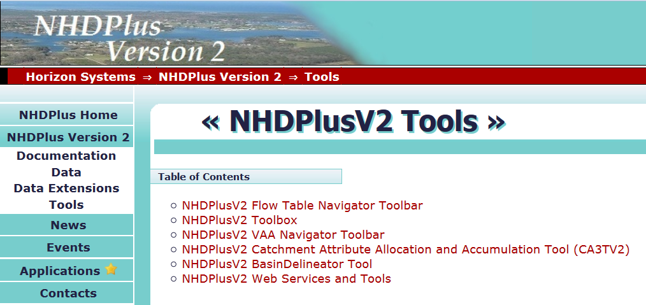
NHDPlusV2 VAA Navigator
VAAs: Navigator
Notes:
As was noted earlier, the Network VAAs enable many forms of navigation. For example, hydroseq can be used to process the flowlines sequentially. The From/To nodes can be used to walk up or down the network. The other network VAAs combine to enable a SQL approach to navigation that is very rapid. This form of navigation is implemented in an NHDPlusV2 tool known as the NHDPlusV2 VAA Navigator.
Let’s learn how to download and install the VAA navigator.
The NHDPlus website tools page is shown in this picture. The VAA navigator is circled in yellow. Click on that link to get to the VAA navigator

Slide 16
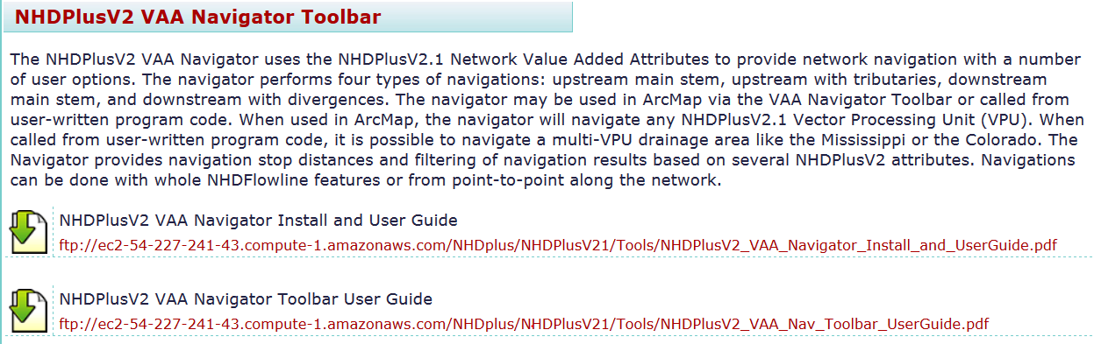
NHDPlusV2 VAA Navigator
Read the Navigator Documentation
http://www.horizon-systems.com/NHDPlus/NHDPlusV2_tools.php
VAAs: Navigator
Notes:
Note that there are two pieces of documentation.
The “NHDPlusV2 VAA Navigator Install and User Guide” covers the navigator installation and introduction to the navigator. The VAA navigator can be used from ArcMap or called from a user-written program. This document includes code snippets for calling the navigator from user code written in Python or VB .NET.
The “NHDPlusV2 VAA Navigator Toolbar User Guide” describes accessing the navigator from the navigator’s ArcMap toolbar. The user interface, including the navigation options, is described in this document.

Slide 17

NHDPlusV2 VAA Navigator
Download the Navigator Install Packages
http://www.horizon-systems.com/NHDPlus/NHDPlusV2_tools.php
VAAs: Navigator
Notes:
Below the document links are links to the software. Note that all the NHDPlusV2 desktop tools use the Microsoft .Net Framework and the Microsoft SQL Server. Both Microsoft products are free and must be installed before the first NHDPlusV2 desktop tool is used.
There are two links to the Microsoft .Net installer. The first link is to the offline installer. The offline package can be used in situations where the Web Installer cannot be used due to lack of internet connectivity. The second link is to the Microsoft .Net Web Installer. The web installer is a small package that automatically determines and downloads only the components applicable for a particular platform.
A guide for installing Microsoft SQL Server for NHDPlusV2 Tools is provided.
And, the last link is for downloading the VAA Navigator software.

Slide 18

NHDPlusV2 VAA Navigator
Install:
.Net
ArcGIS
SQL Server Express Localdb
VAA Navigator ToolBar
Uncompress the .7z file. Run the .exe.
VAAs: Navigator
Notes:
You should verify that the versions of .Net, ArcGIS, and SQL Server, as specified on the webpage, have been installed. Then install the VAA Navigator.
Uncompress the NHDPlusV2VAANavigatorToolbar .7z file. Execute the NHDPlusV2VAANavigatorToolbarSetup.exe. This will install the navigator and the ArcMap Toolbar interface to the navigator.

Slide 19
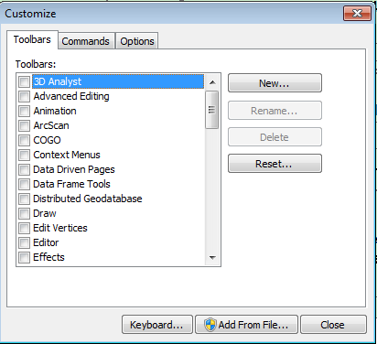
NHDPlusV2 VAA Navigator
Install the Custom ArcMap Toolbar
VAAs: Navigator
Notes:
To add the toolbar to ArcMap, right click on an empty place on the ArcMap toolbar ribbon. Go to the bottom of the toolbar list and select “Customize”. From the Customize dialog, select “Add From File”.

Slide 20
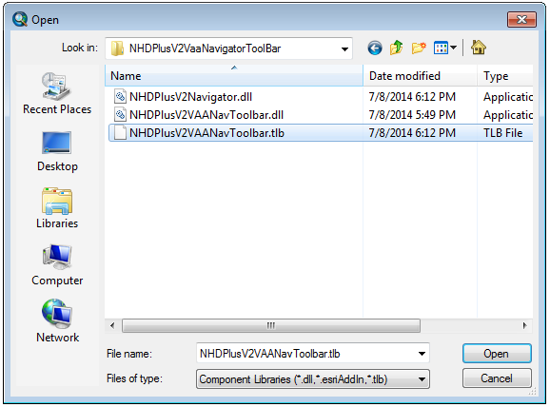
NHDPlusV2 VAA Navigator
Install the Custom ArcMap Toolbar
VAAs: Navigator
Notes:
From the Open dialog, navigate to the folder where the toolbar was installed and select the VAANavigatorToolbar.tlb and click “Open”.

Slide 21
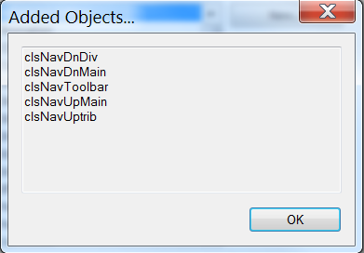
NHDPlusV2 VAA Navigator
Install the Custom ArcMap Toolbar
VAAs: Navigator
Notes:
The Added Objects window should appear with a list of the 5 objects that comprise the navigator. If this window says “No Objects Added”, there is a windows permission issue on your system that you will need to discuss with your System Administrator.
After successful installation, right click on an empty place on the ArcMap toolbar ribbon. You will see the NHDPlusV2 VAA Nav Toolbar in the toolbar list. Checkmark it to add it to the toolbar ribbon.

Slide 22
NHDPlusV2 VAA Navigator
An ArcMap Toolbar
Upstream Mainstem
Downstream Mainstem
Upstream with Tributaries
Downstream with Divergences
VAAs: Navigator
Notes:
The toolbar contains 4 tools. To use these tools, you must have an NHDFlowline feature class loaded into your map. Select a tool and click on an NHDFlowline feature.
The single up arrow tool is for Upstream Mainstem navigation. This tool will traverse a single path upstream following the mainstem of the flowline on which you clicked until the headwaters is reached.
The multi up arrow tool is for Upstream with Tributaries navigation. This tool will traverse all flowlines upstream of the flowline on which you clicked.
The single down arrow tool is for Downstream Mainstem navigation. This tool will traverse a single path downstream following the mainstem of the flowline on which you clicked until the network terminus is reached.
The multi down arrow tool is for Downstream with Divergences navigation. This tool will traverse all flowlines downstream of the flowline on which you clicked.

Slide 23
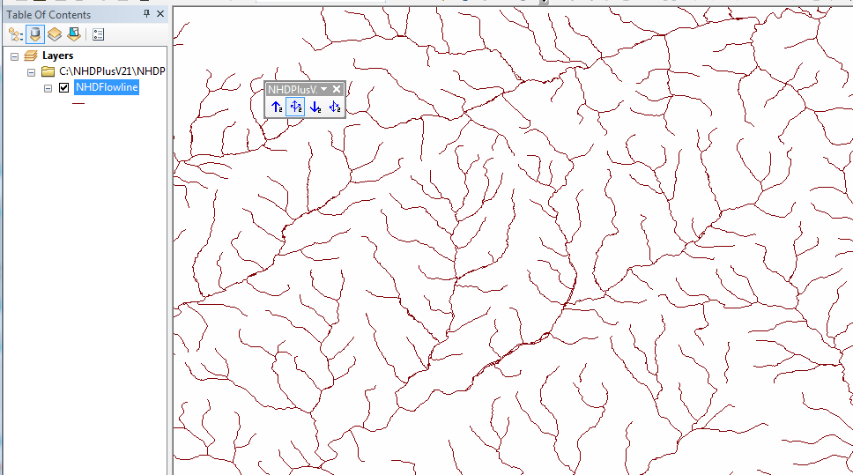
NHDPlusV2 VAA Navigator
VAAs: Navigator
Notes:
This slide shows a map with an NHDPlusV2 NHDFlowline feature class loaded and the NHDPlusV2 VAA Navigator Toolbar installed. For accurate selection of the flowline where you want to start a navigation, it is generally best to zoom in.

Slide 24
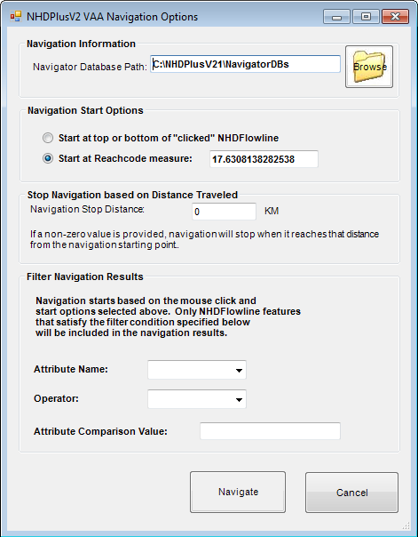
NHDPlusV2 VAA Navigator
VAAs: Navigator
Notes:
After selecting a navigation tool and clicking on the starting flowline, the NHDPlusV2 VAA Navigation Options dialog will appear.

Slide 25
NHDPlusV2 VAA Navigator
VAAs: Navigator
Notes:
At the top of this dialog is the Navigator Database Path option. The first time that the VAA navigator is used on an NHDPlusV2 vector processing unit (VPU), it builds a navigation database that is then used for all subsequent navigations in that VPU. This is a SQL Server database that you will want to store in a permanent folder, preferably near your NHDPlusV2 data. It is recommended that you create a folder and place the navigator databases for all VPUs in this folder. In this way, every time you use the VAA Navigator, this folder will be the default shown in the Navigator Database Path option.
It’s very important to understand that once a SQL Server database is created, it will be registered with SQL Server and may not be deleted, renamed, or moved using any software except SQL Server.

Slide 26
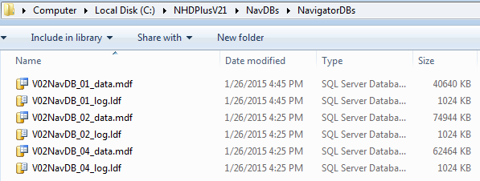
NHDPlusV2 VAA Navigator
Navigation Databases
Created Once, Used Many Times
VAAs: Navigator
Notes:
The navigator databases are named V02NavDB_<vpu id>. Each database is composed of two parts: 1) the database which is .mdf and 2) the log which is .ldf.
It is recommended that you create a folder and place the navigator databases for all VPUs in this folder. In this way, every time you use the VAA Navigator, this folder will be the default shown in the Navigator Database Path option.
It’s very important to understand that once a SQL Server database is created, it will be registered with SQL Server and may not be deleted, renamed, or moved using any software except SQL Server.

Slide 27
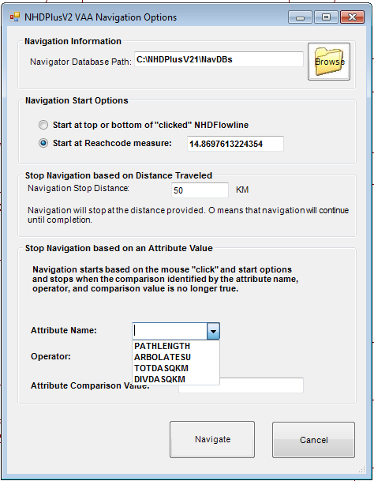
NHDPlusV2 VAA Navigator
VAAs: Navigator
Notes:
The next section of the NHDPlusV2 VAA Navigation Options dialog is Navigation Start Options. The first choice will start upstream navigations at the bottom of the “clicked” flowline and downstream navigations at the top of the “clicked” flowline. In other words, this choice will include the whole flowline in the navigation results.
The second choice will start the navigation at a point along the flowline. The initial measure shown in the box is the exact “click” point on the flowline. You may change the measure value to any value from 0 to 100.

Slide 28
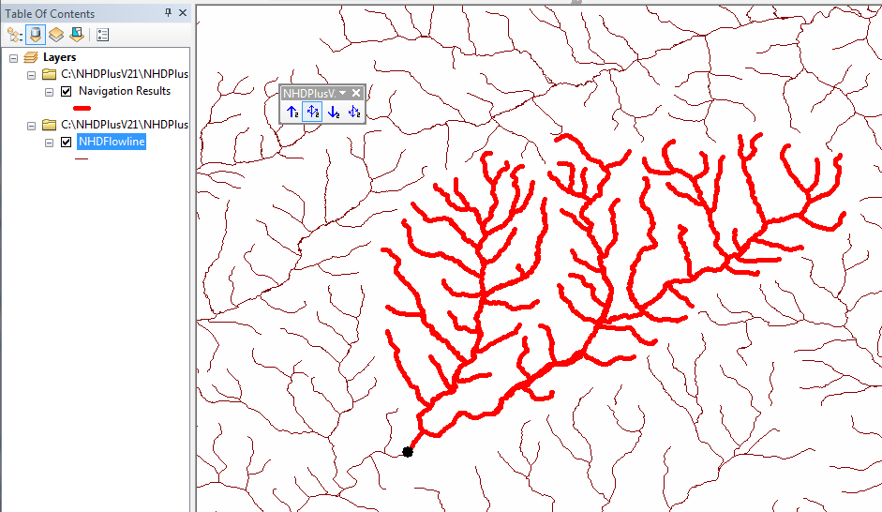
NHDPlusV2 VAA Navigator
VAAs: Navigator
Notes:
This is a picture of selecting the second choice and navigating Upstream with Tributaries from the “click” point. Note that only the portion of the starting flowline that is upstream of the “click” point is included in the navigation results.
Note that the navigation results always appear as a red layer in the map. If you wish to save the navigation results, you must export the layer to a permanent feature class.

Slide 29
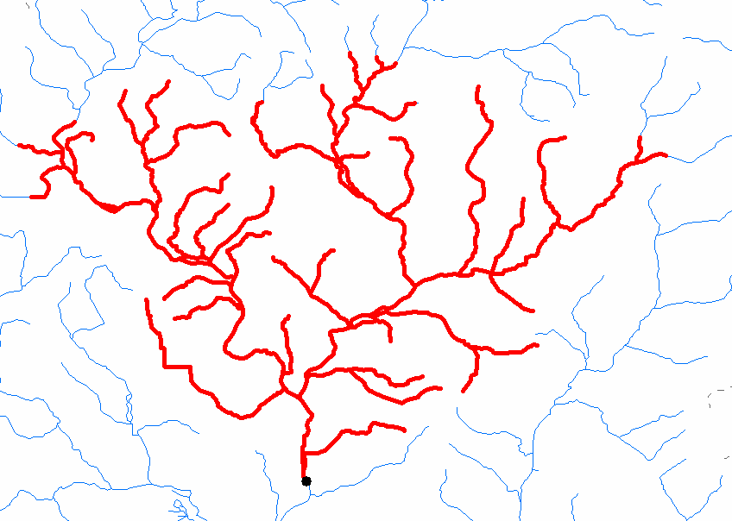
NHDPlusV2 VAA Navigator
VAAs: Navigator
Notes:
The next section of the NHDPlusV2 VAA Navigation Options dialog is used to stop the navigation based on a distance traveled from the navigation start point. The distance defaults to 0 which tells the navigator that there is no stopping distance. When you specify a number greater than 0, the navigator will stop when it reaches that number of kilometers from the starting point. The picture on the right is an Upstream with Tributaries navigation with a stopping distance of 50 kilometers. Note that the navigator computes the distance on every path and stops on each path at the very point where it reaches 50 kilometers from the navigation start.

Slide 30
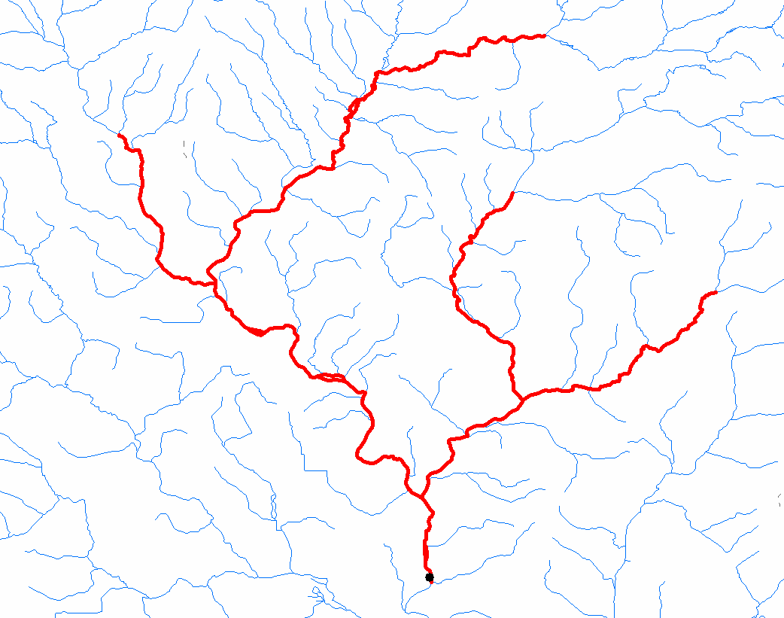
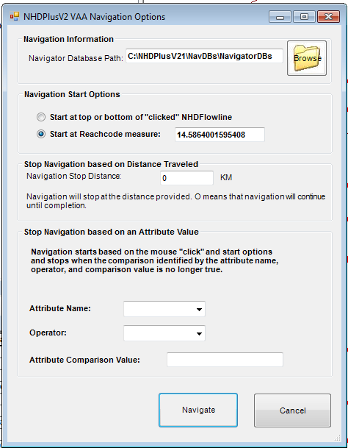
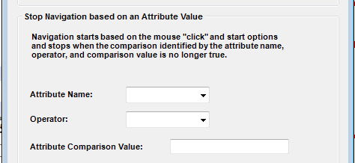
NHDPlusV2 VAA Navigator
Upstream until
drainage area < 50 sqkm
TotDASQKM
>=
50
VAAs: Navigator
Notes:
The next section of the NHDPlusV2 VAA Navigation Options dialog contains options for filtering the navigation results. The form of the filter condition is attribute-operator-value.
You may choose from four NHDPlusV2 attributes: Total Drainage Area (TotDASQKM), Divergence Routed Drainage Area (DivDASQKM), Path length to network terminus (PathLength) or Total Miles of Network Upstream (ArbolateSU).
You may choose from four operators: less than (<), less than or equal to (<=), greater than (>), or greater than or equal to (>=).
You must specify a positive number as a comparison value. Note that the units for the comparison value are assumed to be equal to the units of the NHDPlusV2 attribute.
The picture on the right illustrates the output of an Upstream with Tributaries navigation with a filter condition of total drainage area greater than or equal to 50. Note that the navigator performs an Upstream with Tributaries navigation then removes from the navigation any flowline that does not meet the filter condition of TotDASQKM >= 50.

Slide 31
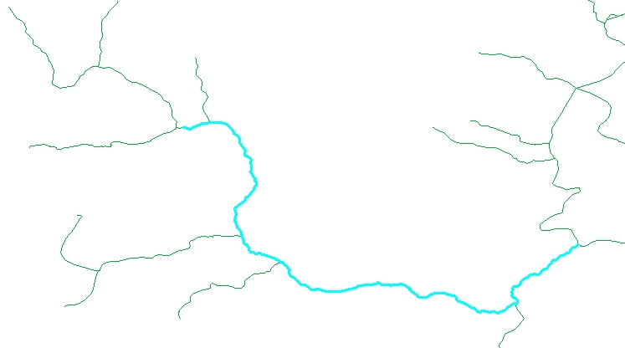
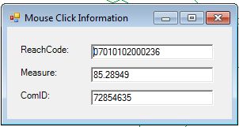
NHD Route System
100
Measure 85.28949
Reach 07010102000236
0
VAAs: Navigator
Notes:
The NHD route system plays an important role in the VAA navigator. This NHD route system is based on the route identifier, which is the NHDFlowline Reachcode, and the measures along the reach. Each NHDFlowline is assigned a Reachcode. In some cases, several flowlines that form a linear path are assigned a single Reachcode. Each reach, as defined by a unique Reachcode, is assigned measures along the reach beginning at 0 at the downstream reach endpoint and 100 at the upstream reach endpoint.

Slide 32
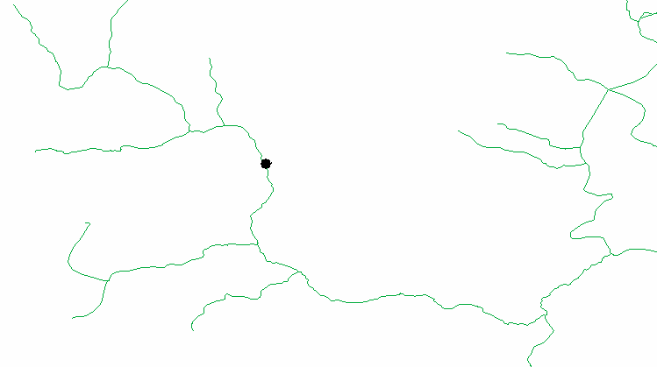
NHD Route System
VAAs: Navigator
Notes:
Every point along the NHD linear network is defined by a unique Reachcode and measure combination. For example, the point in this picture is defined by Reachcode 07010102000236 and measure 85.28949.

Slide 33
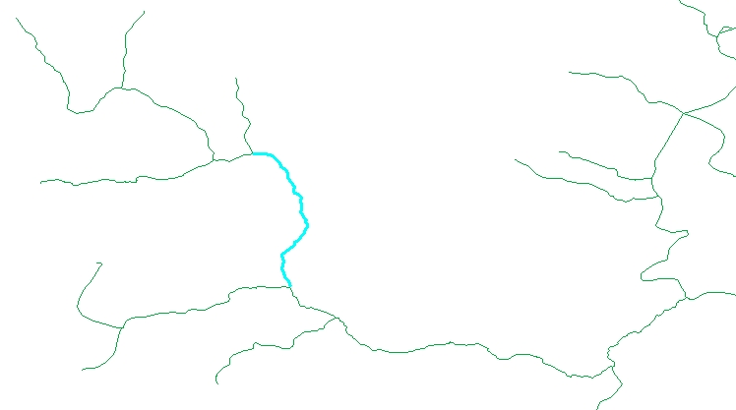
NHD Route System
100
Measure 85.28949
ComID 72854635
Reach 07010102000236
0
VAAs: Navigator
Notes:
Each NHDFlowline is assigned a unique identifier called a ComID. The ComID 72854635 and measure 85.28949 also define this unique point on the linear network. By design, NHD Reachcodes are stable and rarely change. ComIDs on the other hand are very unstable and, as editing occurs, ComIDs can change rapidly. Because of this, the best route identifier for NHD is the Reachcode.

Slide 34
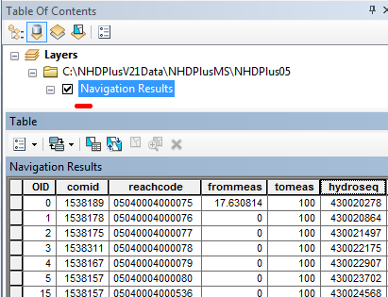
NHDPlusV2 VAA Navigator
Returns a linear event table of flowlines and parts of flowlines.
VAAs: Navigator
Notes:
The importance of the route system to the VAA navigator is readily apparent if you open the attribute table of the navigation results. You will see that this is a linear event table where each feature is defined by a Reachcode and a From measure and a To measure. This is how the navigator can return navigation results that include both whole flowlines and parts of flowlines. The first entry in the navigation results in this picture begins at a From measure of 17.630814 and ends at a To measure of 100. That’s because this upstream navigation started at a “click” point along the flowline rather than at the bottom of the flowline.
Additional information about route systems and linear event tables is available in the ArcGIS documentation.

Slide 35
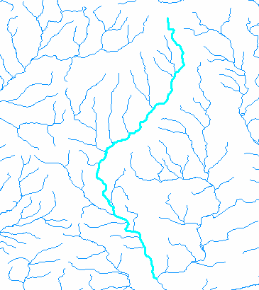
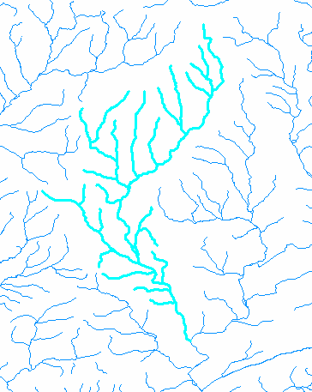
NHDPlusV2 VAA Navigator
Upstream Mainstem
Upstream with Tributaries
Point and Click on Flowline
VAAs: Navigator
Notes:
This slide shows an example of Upstream Mainstem navigation on the left and Upstream with Tributaries on the right.

Slide 36
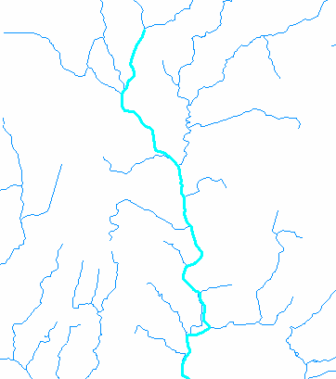
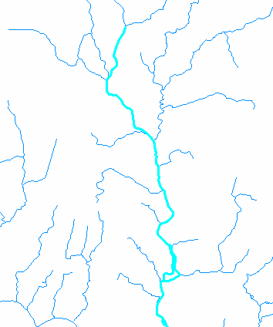
NHDPlusV2 VAA Navigator
Downstream Mainstem
Downstream with Divergences
Point and Click on Flowline
VAAs: Navigator
Notes:
This slide shows an example of Downstream Mainstem navigation on the left and Downstream with Divergences on the right.

Slide 37
Resources
Additional information on NHDPlus is available from the NHDPlus website documentation page. You are encouraged to read and reference the NHDPlusV21 User Guide and other NHDPlus documentation.
The NHDPlus team maintains a user email list and periodically sends emails regarding new tools, data, documentation, and events. If you would like to be on the user list, send an email to nhdplus-support@epa.gov
The NHDPlus team also provides technical support to users of the data and tools. If you have a technical support question, please send a detailed email to nhdplus-support@epa.gov
Resources

Slide 38


