Slide 1
NHDPlusV2 Processing and Distribution Units Craig Johnston
NHDPlus Training Series
Notes:
Hello, this NHDPlus webinar discusses the Processing and Distribution Units of NHDPlus Version 2. This presentation will show how NHDPlus is organized and distributed by major Drainage Areas that consists of Vector Processing Units (VPU) and Raster Processing Units (RPU). I’m Craig Johnston and I am a member of the NHDPlus Team.
The NHDPlusV2 Training Series is designed for new and experienced NHDPlus users. To get the most from the Series, students new to NHDPlusV2 are encouraged to read up through the "NHDPlusV2 Versioning System" section of the NHDPlusV21 User Guide, download and install some NHDPlus data (as described in Exercises 0 and 1 on the web site), and spend time exploring the content of NHDPlus.
The Training Series does not cover how the NHDPlusV2 components were built. This information can be found in Appendix A of the NHDPlusV21 User Guide.

Slide 2
Objectives
Understand how NHDPlusV2 data is organized and distributed
Using the context of NHDPlusV2 processing and distribution units:
Review where to obtain NHDPlusV2 data
Review the NHDPlus directory structure
Learn about the BoundaryUnit shapefile
Objectives
Notes:
The objective of this webinar is to help users understand how NHDPlusV2 data is organized and distributed. We will review some basic concepts that are covered in other NHDPlus webinars about where to obtain NHDPlus data and directory naming structures; but doing so in the context to how these relate to the NHDPlus processing and distribution units. Last, we will explore the contents of the NHDPlus BoundaryUnit shapefile and how it can be used to explore the spatial distribution of these units.

Slide 3
Agenda
Drainage areas
Vector Processing Unit (VPU)
Raster Processing Unit (RPU)
Directory Structure
Global Data BoundaryUnit
Agenda
Notes:
Today’s webinar agenda will explain the various NHDPlus processing and distribution units. These units are hierarchal and spatially nested within each other, with Drainage Areas being the highest level of the distribution units. The three various types of processing and distribution units are:
Drainage Areas
Vector Processing Units, better known by its acronym as a VPU
Raster Processing Units, or RPU
In addition, the NHDPlus directory structure will be discussed. The NHDPlus directories are organized by these various unit types. File naming conventions of data download packages and directory structures will also be discussed.
The NHDPlus BoundaryUnit shapefile will be introduced as a way to explore the geographic distribution of these units.

Slide 4
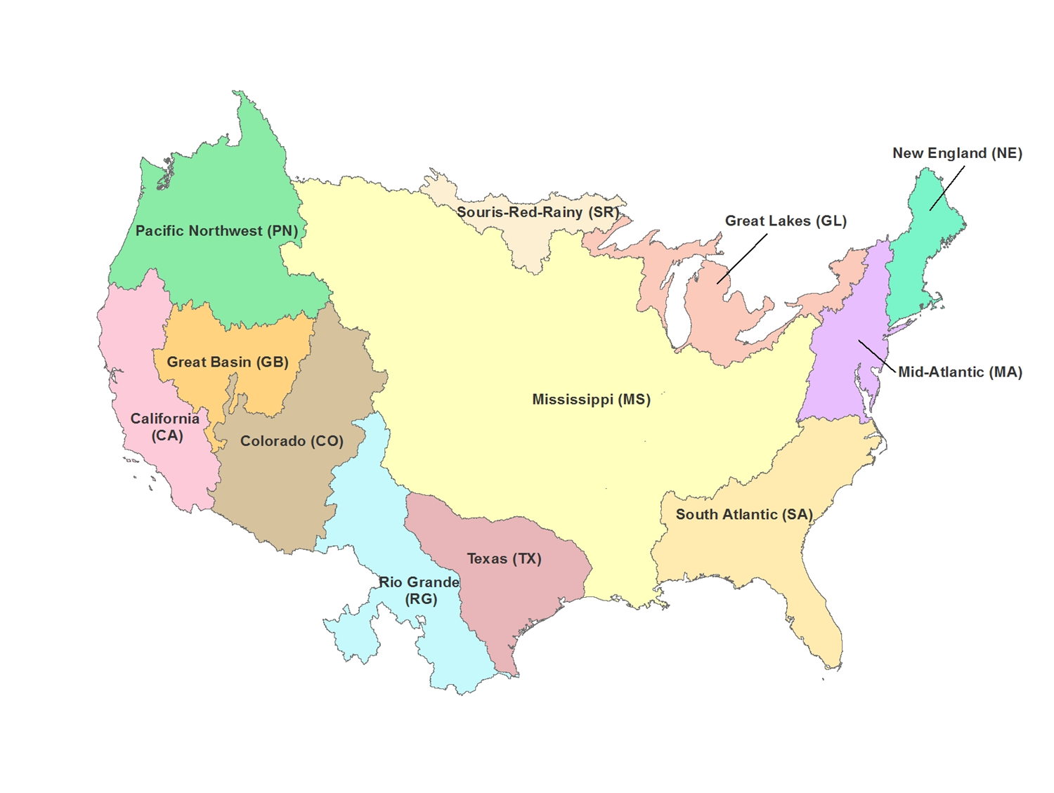
NHDPlusV2 is Distributed by Major Drainage Areas of the United States
Drainage areas
Notes:
NHDPlus is organized by Major Drainage Areas of the United States. This map shows the major drainage areas of NHDPlus. Notice the drainage area codes in parenthesis. These codes are used in the NHDPlus data directory naming structure.

Slide 5
Within each Drainage Area NHDPlusV2 data components are packaged by:
Vector Processing Unit (VPU)
Raster Processing Unit (RPU)
Drainage areas
Notes:
Within each Drainage Area, NHDPlusV2 data components are packaged by Vector Processing Unit (VPU) or Raster Processing Unit (RPU), described in the following slides.

Slide 6
Vector Processing Units (VPU) of NHDPlusV2
A Drainage Area is composed of one or more VPUs
Mississippi, Colorado, and South Atlantic Drainage Areas have multiple VPUs
Vector data and attribute tables are distributed at the VPU level.
NHDPlus Catchment grid also distributed as one file for each VPU
Vector Processing Units (VPU)
Notes:
Now we will talk about the Vector Processing Units commonly referred to as a VPU. A Drainage Area is composed of one or more VPUs. Drainage Areas that are comprised of multiple VPUs include the Mississippi, Colorado, and South Atlantic regions.
Vector data and attribute tables are distributed at the VPU level. The NHDPlus Catchment grid is also distributed as one file for each VPU. It is the only raster dataset distributed at the VPU level.

Slide 7
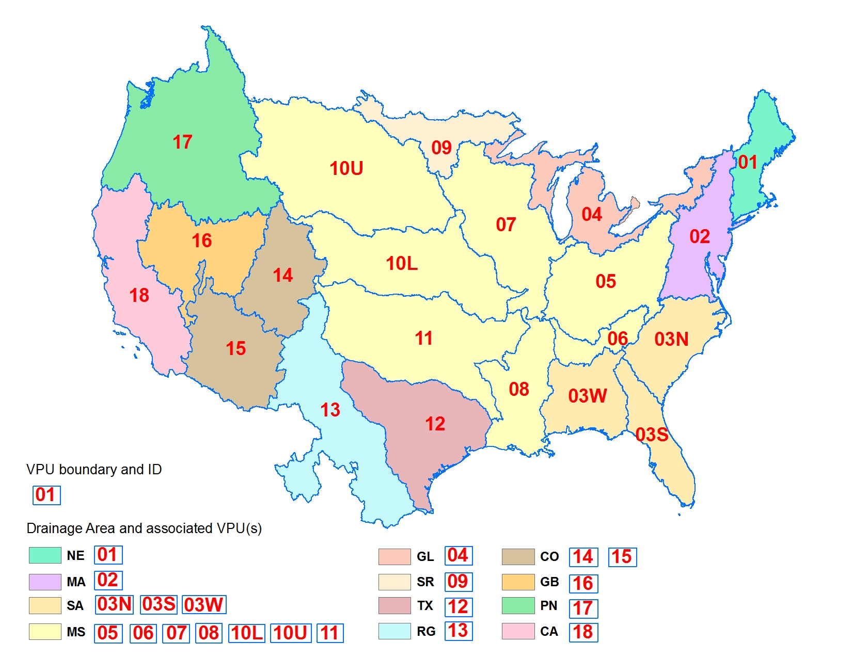
NHDPlus Vector Processing Units (VPU)
of the Major Drainage Areas
Notes:
This map shows the VPU boundaries outlined in blue and the VPU IDs in red. The colored areas on the map are the Major Drainage Area distribution units we saw previously. Notice that some Drainage Areas consist of more than one VPU.

Slide 8
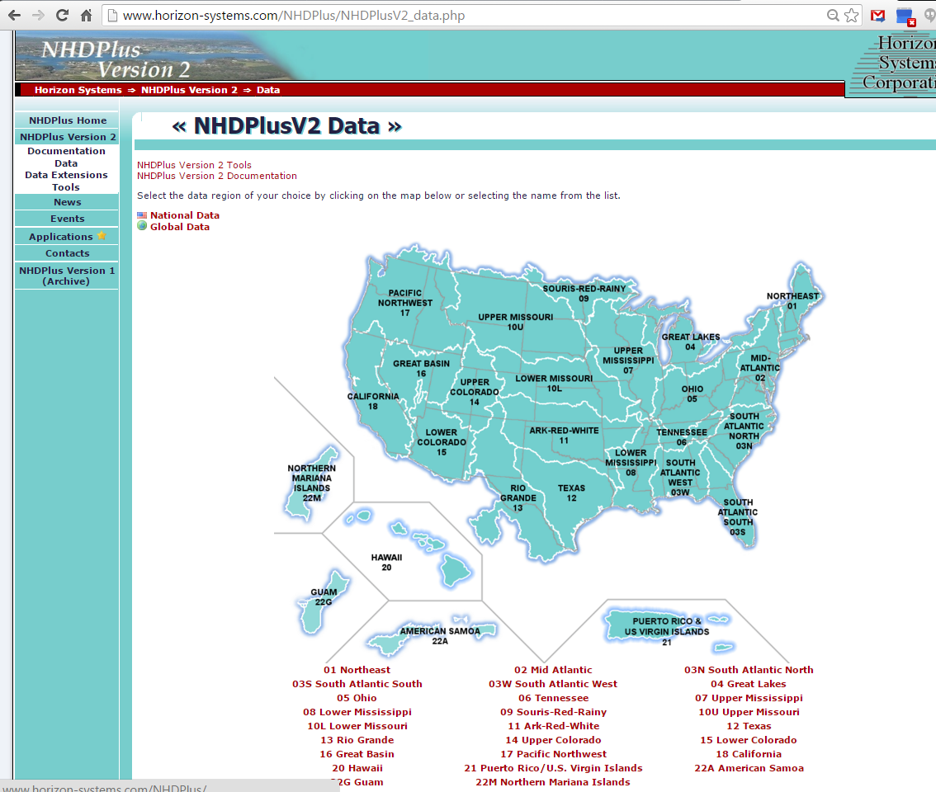
VPUs are shown on the NHDPlusV2
Data access website
7
Notes:
NHDPlus V2 data are accessible from the NHDPlusV2 Data download website. From the home page of the NHDPlusV2 website, the Data download page is found by clicking Data in the left frame of the website.
The main data download page shows a map of all the VPUs available across the nation. To access data for any of these VPU regions, select the VPU by clicking on the map or selecting the VPU name from the list below the map.

Slide 9
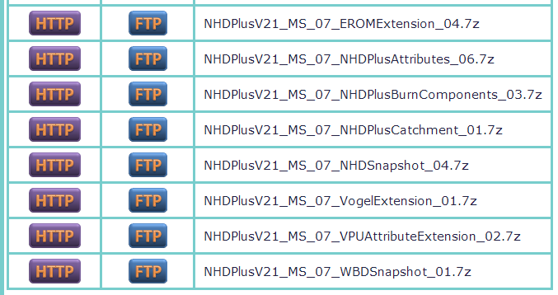
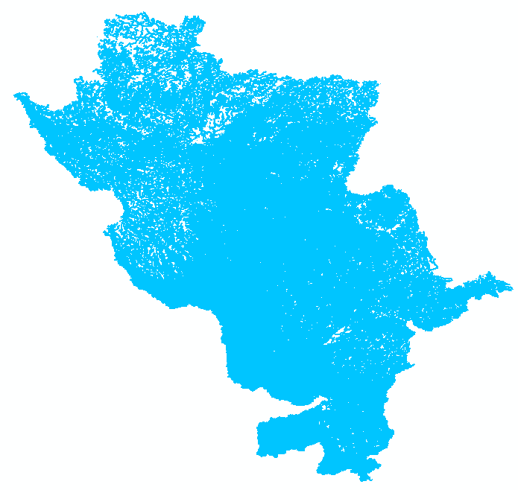
NHDPlusV2 data components by VPU packaged as compressed files
NHDPlusV2 Distribution Filename Key
VPU ID
Drainage area ID
Component Name_vv
NHDPlus Version 2.1
vv = data content version
for component
VPU 07
Upper Mississippi
8
Vector Processing Units (VPU)
Notes:
The data download page for a given VPU lists multiple compressed .7z files. Data packages distributed by VPU (and by RPU) are listed here on the VPU data download page. In this example: VPU data components for VPU 07, the Upper Mississippi are shown.
You can use the NHDPlusV2 Distribution Filename Key to determine which files are organized and distributed at the VPU level. You can determine this by going through the file names and parsing the meaning of the 4 major components in the filename key:
(mouse click) The first element in the filename key is the NHDPlus Version, in this example version v2.1
(mouse click) The second element of a VPU filename list the Drainage Area ID that the VPU is part of, in this example “MS” for Mississippi.
(mouse click) The third element of a VPU filename list the VPU ID, in this example VPU “07”
(mouse click) The fourth element of a VPU filename provides the component name which describes the theme of data that the data package represents. A version number of the component is also embedded in this fourth element of the data package. If updates are made to that specific data element the version number increases. Notice that the individual data packages do not always share the same version number.

Slide 10
Raster Processing Units (RPU) of NHDPlusV2
A VPU is composed of one or more RPUs
Raster data for a VPU is divided by RPU areas and distributed at the RPU level
HydroDEM
Fdr and Fac grids
FdrNull
FilledAreas
NED Snapshot
Catseed
Note: The catchment grid is distributed
at the VPU level
Raster Processing Units (RPU)
Notes:
Next up are the Raster Processing Units or RPU. These units are intended to hold the various NHDPlusV2 raster datasets available for a given VPU. A VPU is composed of one or more RPUs.
Raster data for a VPU is divided by RPU areas and distributed at the RPU level. The list identifies the various NHDPlus V2 Raster data products distributed at the RPU level. These products include:
HydroDem
Fdr and Fac grids
FdrNull
FilledAreas
NED Snapshot
Catseed
Note: The NHDPlus Catchment grid is the only raster dataset not distributed at the RPU level; rather, it is one whole grid file for the VPU and distributed at the VPU level.

Slide 11
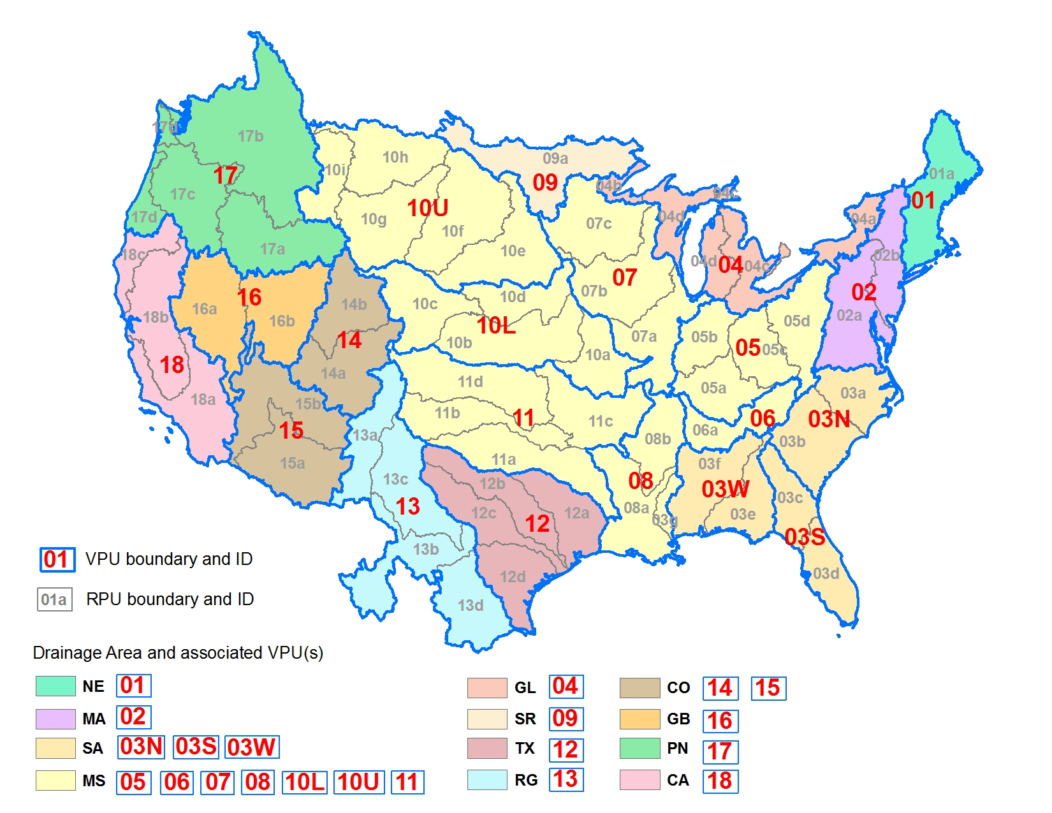
NHDPlus V2 Raster Processing Units (RPU)
nested in VPUs of the Major Drainage Areas
10
Notes:
This map builds upon the previous maps of the Major Drainage Areas and VPU distribution units. In this map, the VPUs of the Major Drainage Areas are further subdivided by the RPU boundaries. The RPU boundaries and associated RPU ids are shown with the grey lines and text.

Slide 12
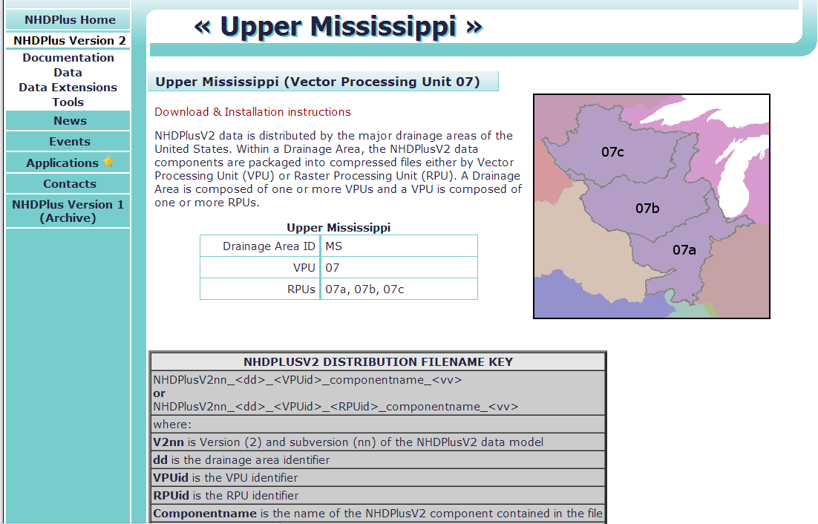
Data Components for RPUs are accessible from the NHDPlusV2 Data download
website for the associated VPU
11
Notes:
RPU data for a given VPU can be accessed from the VPU’s data download page. The RPUs for the VPU are shown and labeled on a map on the VPU data download page. In this example, the VPU map for the Upper Mississippi (VPU 07) is comprised of three separate RPUs (07a, 07b, and 07c).

Slide 13
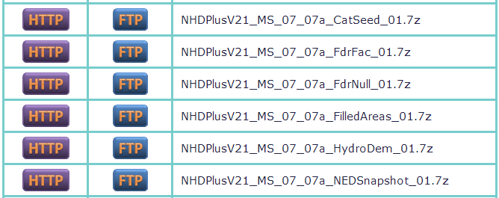
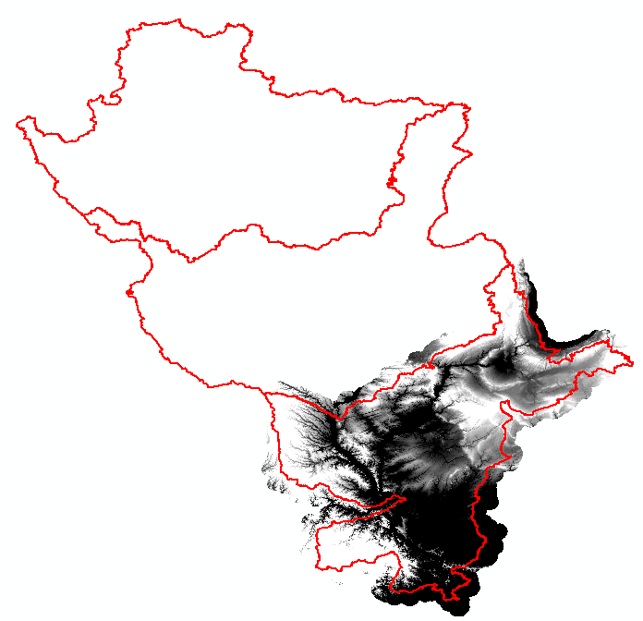
NHDPlusV2 data components by RPU packaged as compressed files
NHDPlusV2 Distribution Filename Key
RPU ID
VPU ID
Component Name_vv
Drainage area ID
NHDPlus Version 2.1
vv = data content version
for component
07c
07b
07a
Elev_cm grid
from the
NED Snapshot data component
12
Raster Processing Units (RPU)
Notes:
RPU data packages are listed on the VPU data download page for a given VPU.
As for VPUs, you can use the NHDPlusV2 Distribution Filename Key to determine which files are organized and distributed at the RPU level. The 5 major elements in the filename key indicate the content of the RPU data file (as noted earlier, VPU data packages have 4 elements in the naming convention).
(mouse click) The first three elements in the filename for RPU data packages are the same as those for VPU data files. These include:
The NHDPlus Version ID
The Drainage Area ID
The VPU ID
The last element listed in an RPU distribution filename is also similar to a VPU distribution name, which contains the component name and version number.
(mouse click)
RPU IDs in distribution filename is unique only for an RPU data package. If a VPU has multiple RPUs the component name (the last element listed) will be repeated for each RPU in the VPU. This example shows all the RPU data distribution files for RPU 07a, which is one of three RPUs in VPU 07.
This example shows all the RPU data distribution files for RPU 07a, which is one of three RPUs in VPU 07.

Slide 14
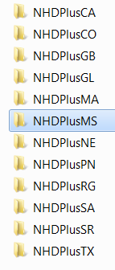
Directory Structure at the highest level
Drainage Area Workspaces
NHDPlusV21/
Drainage Area Workspaces
Directory structure
Notes:
When data are first downloaded and uncompressed for any given VPU, a Drainage Area Workspace folder is created for which the VPU is part of. The example on this slide lists multiple Drainage Area Workspaces. Notice the Mississippi (MS) Drainage Area workspace is highlighted. We will explore the directory structure within this Drainage Area workspace, navigating to the contents of a VPU.

Slide 15
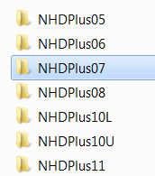
Directory structure within a Drainage Area
Workspace
NHDPlusV21/NHDPlusMS/
Within each Drainage Area workspace
are the VPU workspaces
VPU Workspaces for the
Mississippi (MS) Drainage Area
Directory structure
Notes:
Within the example Mississippi Drainage Area workspace, all the VPUs found within this drainage area are listed as separate workspaces. VPU workspaces will be listed once a VPU or RPU data package for a given VPU is uncompressed. Next we will look at the contents of the Upper Mississippi (VPU 07) workspace.

Slide 16
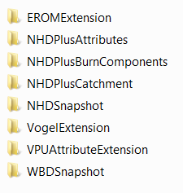
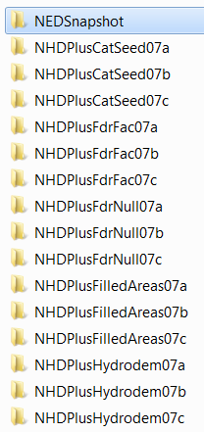
Directory Structure within a VPU workspace
VPU and RPU folders
NHDPlusV21/NHDPlusMS/NHDPlus07
VPU and RPU Data Component folders for the Upper Mississippi VPU 07
VPU workspaces
RPU workspaces
15
15
Directory structure
Notes:
These are the individual workspace folders for VPU 07 after all data packages are downloaded and uncompressed for the VPU. Aside from the NEDSnapshot folder, all workspace names without an RPUID contain data organized at the VPU level. RPU workspaces will have the RPUID in the folder name. Notice that within VPU 07 there are 3 RPUs: 07a, 07b, and 07c. The RPU data theme folders are repeated for each unique RPUID. For example, there is an NHDlusCatSeed folder for each of the three RPUs. The NEDSnapshot folder has RPU subfolders that contain the NEDSnapshot for each RPU.

Slide 17
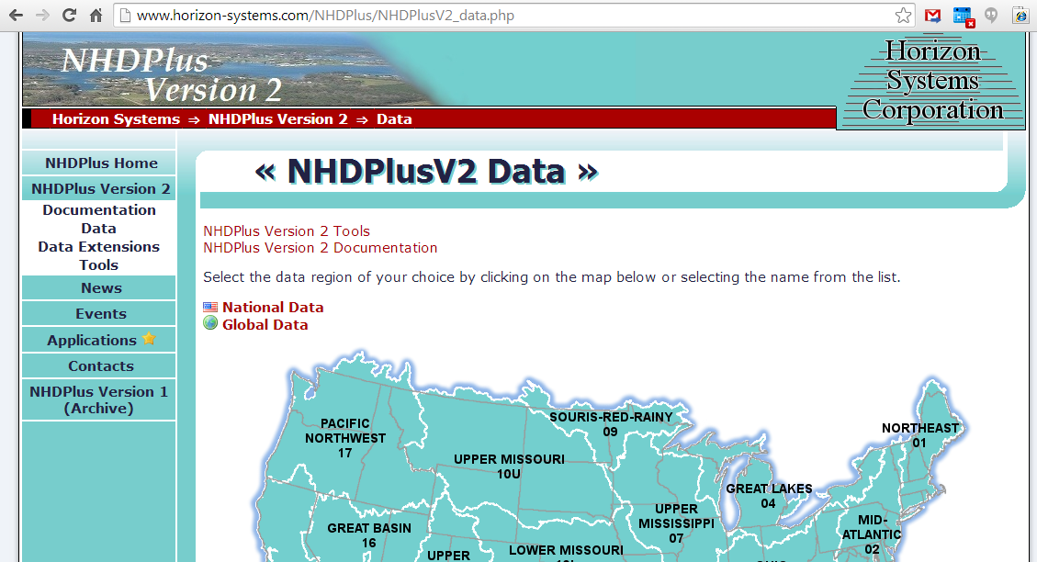
Drainage Areas, VPU, and RPU boundaries are available from the
NHDPlus “Global” Link
Click here to download NHDPlusV21_NHDPlusGlobalData
NHDPlus: Global Data
Notes:
To help explore the spatial distribution of the processing units, NHDPlus V2 distributes a shapefile, named BoundaryUnit, which contains polygon boundaries of the VPUs and RPUs. To access and download these data, click the Global Data link from the NHDPlus V2 Data download page.

Slide 18
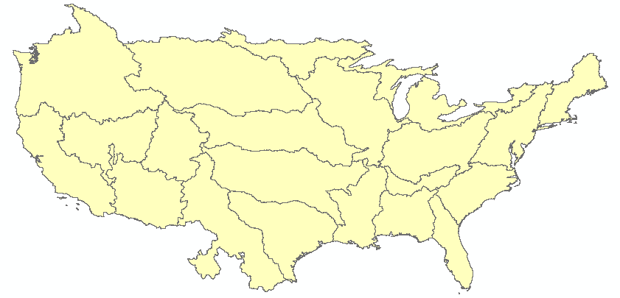
BoundaryUnit.shp
NHDPlusV21/NHDPlusGlobalData
Contains overlapping geometry for VPU and RPU boundaries
When adding BoundaryUnit.shp
to ArcMap, the boundaries show the VPUs, however RPU boundaries are also included in this shapefile
Global Data Boundary Unit
Notes:
Here are some example query expressions using attributes in BoundaryUnit. The top left example shows how to display all the VPU boundaries for the Mississippi Drainage Area. The top right example can be used to display all the RPU units across the country; while the bottom example shows how to display just the RPUs belonging to a given VPU (in this example all RPUs for VPU 17 are being queried and displayed).

Slide 19
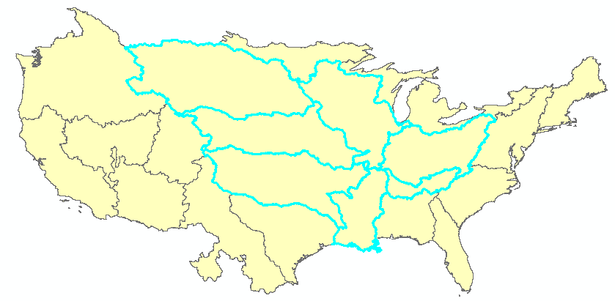
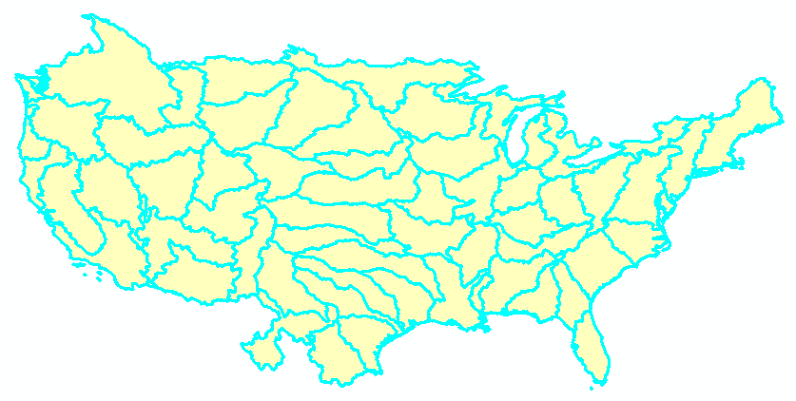
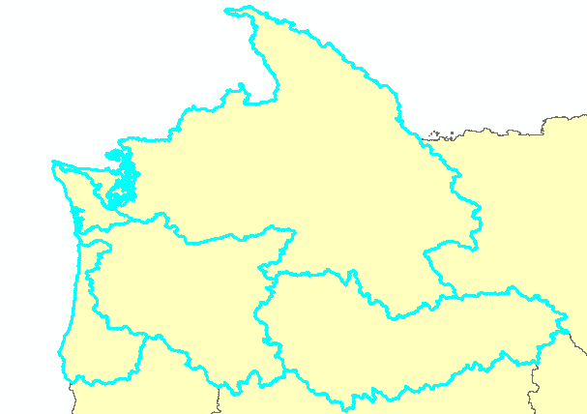
Example Query Expressions for BoundaryUnit.shp
Select all VPUs in the Mississippi Drainage Area
Select all RPUs
"DrainageID" = 'MS' AND "UnitType" = 'VPU'
"UnitType" = ‘RPU'
Find all RPUs
in VPU17
"UnitID" LIKE '17%' AND "UnitType" = 'RPU''
Global Data Boundary Unit

Slide 20
Resources
Additional information on NHDPlus is available from the NHDPlus website documentation page. You are encouraged to read and reference the NHDPlusV21 User Guide and other NHDPlus documentation.
The NHDPlus team maintains a user email list and periodically sends emails regarding new tools, data, documentation, and events. If you would like to be on the user list, send an email to nhdplus-support@epa.gov
The NHDPlus team also provides technical support to users of the data and tools. If you have a technical support question, please send a detailed email to nhdplus-support@epa.gov
Notes:
Additional Resource information on NHDPlus is available from the NHDPlus website documentation page. You are encouraged to read and reference the NHDPlusV21 User Guide and other NHDPlus documentation.
The NHDPlus team maintains a user email list and periodically sends emails regarding new tools, data, documentation, and events. If you would like to be on the user list, send an email to NHDPlus@hscnet.com
The NHDPlus team also provides technical support to users of the data and tools. If you have a technical support question, please send a detailed email to NHDPlus@hscnet.com

Slide 21
Notes:
Thank you…..This concludes the NHDPlusV2 Processing and Distribution Units webinar.

