Slide 1
NHDPlus High-Resolution
Al Rea
National Geospatial Program
ESRI User Conference
7/22/2015

Slide 2
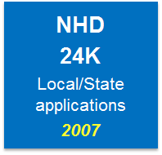
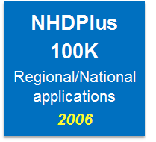
NHD History
Choose one

Slide 3
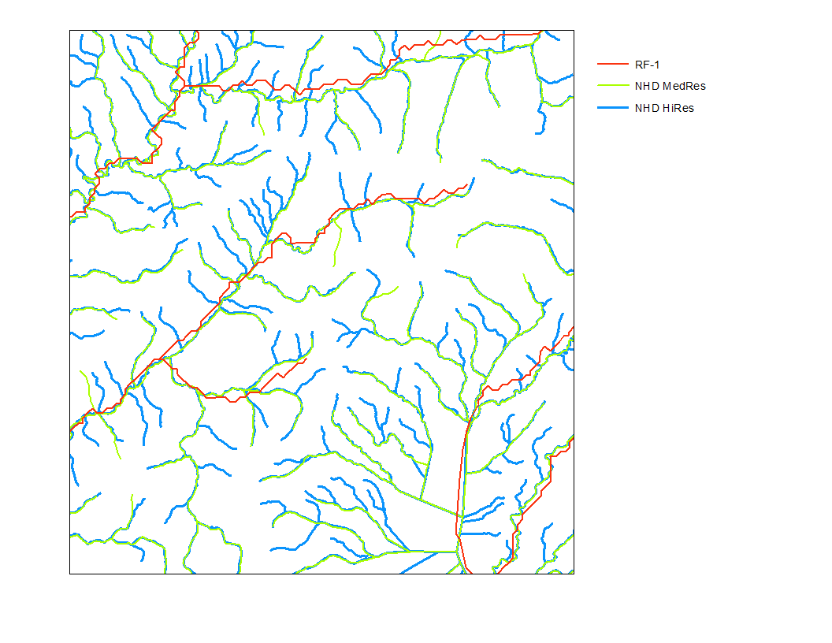
Notes:
Note it is difficult to reference sites of interest that are on tributaries not represented in the stream network being used. Therefore a site on one of the green or blue streams would be difficult to reference to the red RF-1 streams. This is why it is better to reference things to the most detailed network available, then use generalization rules to determine how to represent the things being referenced if a more general network is desired.

Slide 4
NHD History

Slide 5
Notes:
80 % of DOI respondents to the TNM Baseline survey said that High-res NHDPlus would be useful or very useful.

Slide 6
NHD+HR Development Process
Development Team
Horizon Systems—Vector tools and integration, initial production work
USGS New England and SD WSCs: Rich Moore, Craig Johnston, Curtis Price—Raster tools
USGS NGTOC—Data Prep, eventual data production and refresh
Build/Refresh Tools
Update to current ArcGIS versions, ArcPy
Adapt to HR data, current NHD schema
New data formats (FGDB, TIFF)
Initial production
QC Review and Refresh
Generalization capability
Stream network
Matching catchments

Slide 7
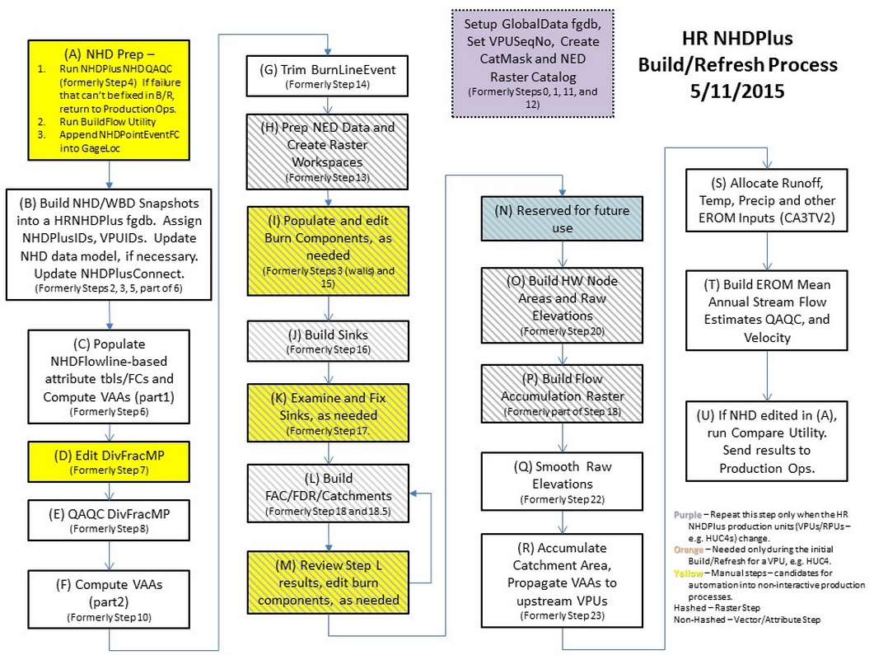

Slide 8
NHDPlus-MR & NHD+HR
 | NHDPlus - Med Res | NHDPlus - High Res
Elevation | National 1 Arc-Second Seamless DEM (30 meters) | National 1/3 Arc-Second Seamless DEM (10 meters)
NHD | Medium Resolution NHD 100K | High Resolution NHD Local, 24K, & 63K (AK)
File format | Shape file & Grids | File GeoDatabase & TIFF
Tools (Build/Refresh) | Version 2 | New High Res Process & Tools

Slide 9
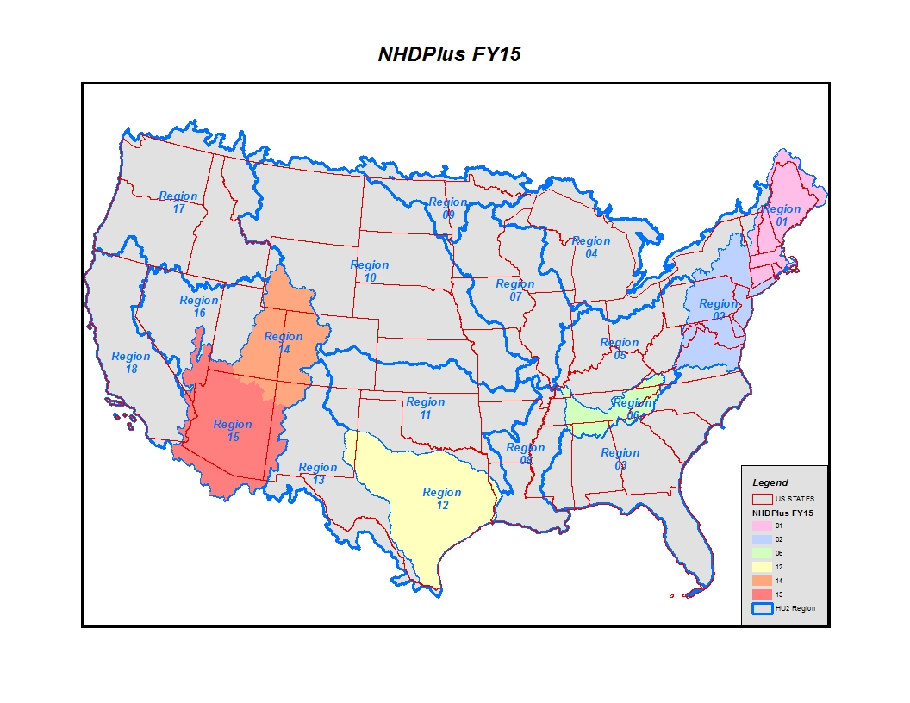

Slide 10
HR NHDPlus Refresh Workflow
National Hydrography Dataset &
Watershed Boundary Dataset
NHDHR
Production Database
Initial QC Review HR NHDPlus
Drivers for Refresh
NHDPlus quality
Change in Source Content NHD, WBD, or DEM
Change Detection routines
HUC4
HUC4
NHD & WBD
HUC4
DEM
National ⅓ Arc-Second Seamless DEM
Results from QC prompt
HR NHDPlus Refresh
HR NHDPlus Tools
HUC4
HUC4
HR NHDPlus
Hydrologic Regions by SubRegions (HU4s)

Slide 11
NHDPlus Initial QC Review
Review Team:
National oversight team
NHDPlus development team
Hydrology experts
Biology expert
Local hydrology experts (by region/state)
Stewards
StreamStats project staff
Water Science Centers staff
NHD and WBD editors
Vector Web Edit Development Team
Participate in / observe review process
Determine markup/edit tool requirements
Iterate toward optimal QC tools and workflow

Slide 12
NHD+HR
Questions….
Alan Rea, P.E., Hydrologist
National Hydrography Dataset
U.S. Geological Survey
230 Collins Road, Boise ID 83702
(208)387-1323 ahrea@usgs.gov
Ellen Finelli, Cartographer
Senior Hydrography Project Lead
National Geospatial Technical Operations Center
U.S. Geological Survey
303-202-4288 elfinelli@usgs.gov

