Slide 1
NHDPlus – the Evolution of a
Surface Water Geofabric
July 22, 2015
ESRI User Conference
San Diego, CA
National Hydrography Dataset Plus News

Slide 2
Overview
Concepts
Data
Tools
Applications
Resources

Slide 3
But first, some fun with water …
Question: Explain one of the processes by which water can be made safe to drink.
  Answer: “Flirtation make water safe to drink because it removes larger pollutants like grit, sand, dead sheep and canoeists.”
Question: How is dew formed?
  Answer: “The sun shines down on the leaves and make them perspire.”
Question: What causes the tides in the oceans?
  Answer: “The tides are a fight between the earth and the moon. All water tends to flow towards the moon, because there is no water on the moon, and nature hates a vacuum. I forget where the sun joins in this fight.”
Question: Where is the water at any point in time?
  Answer: “We’re still working on that … here’s what we have so far.”

Slide 4
Acknowledgements
NHDPlus Team
  Tommy Dewald / EPA Office of Water
  Cindy McKay / Horizon Systems Corporation
  Tim Bondelid / Consultant
  Al Rea / USGS National Geospatial Program
  Craig Johnston, Rich Moore / USGS Water
  (Greg Schwarz, Kernell Ries, Dave Wolock / USGS Water)

Slide 5
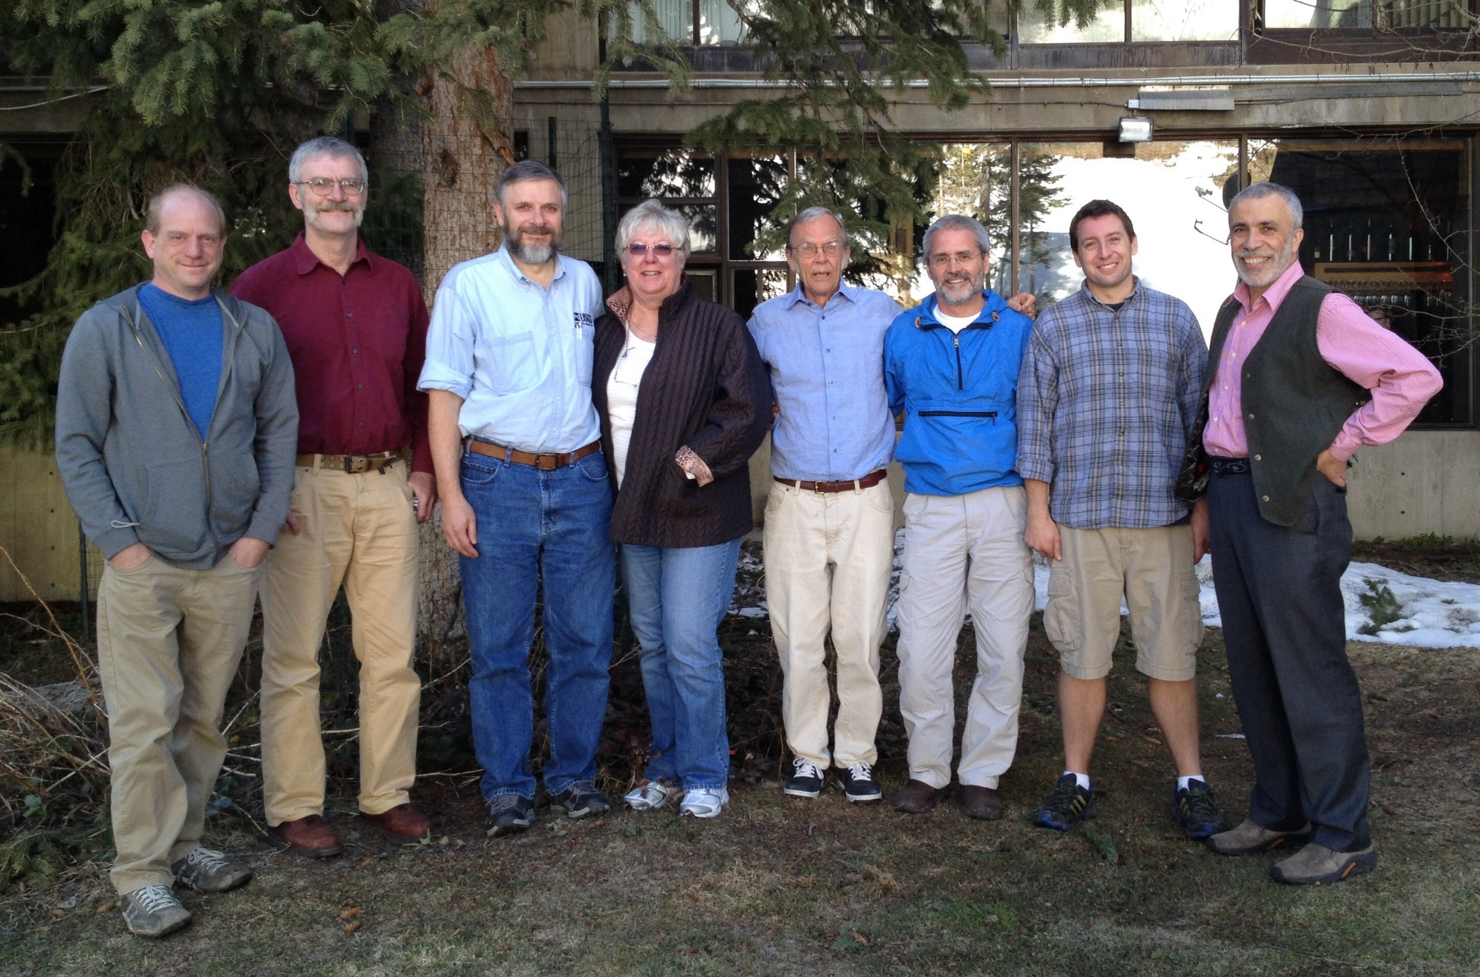
The NHDPlus Team (with friends)
  Tim
  Tommy
  Al
  Cindy
  (Dwane)
  Rich
  Craig
  (Ricardo)

Slide 6
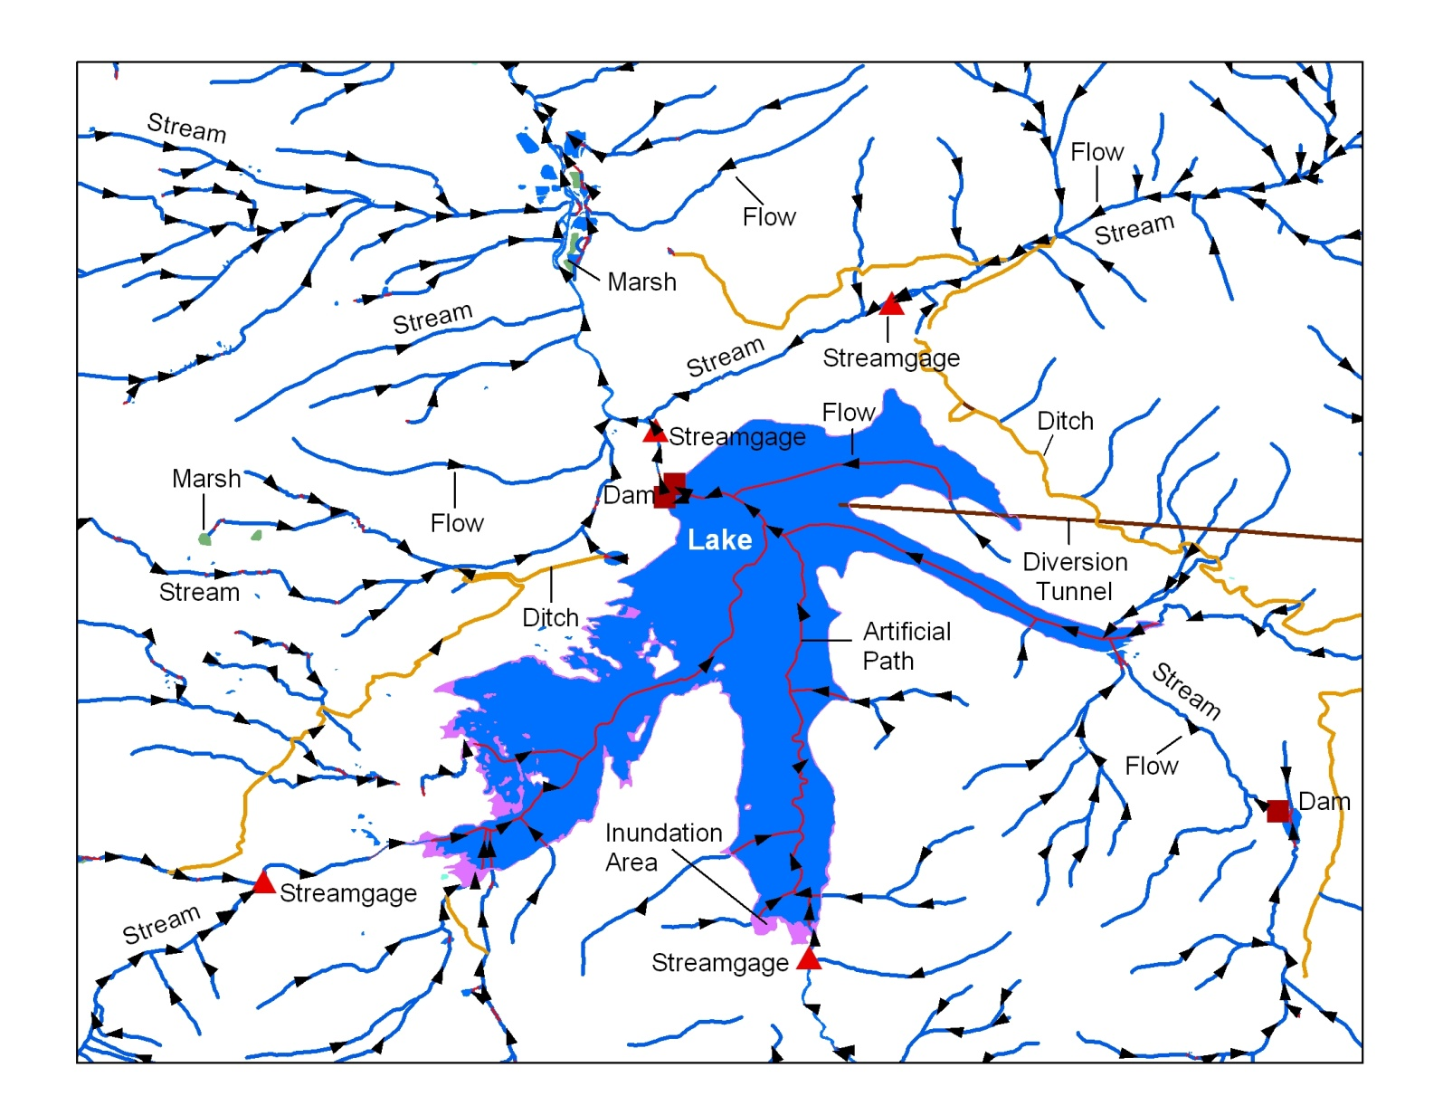

The National Hydrography Dataset is the Foundation
The NHD is comprised of the surface water features found on topographic maps combined to form a stream network with addresses.

Slide 7
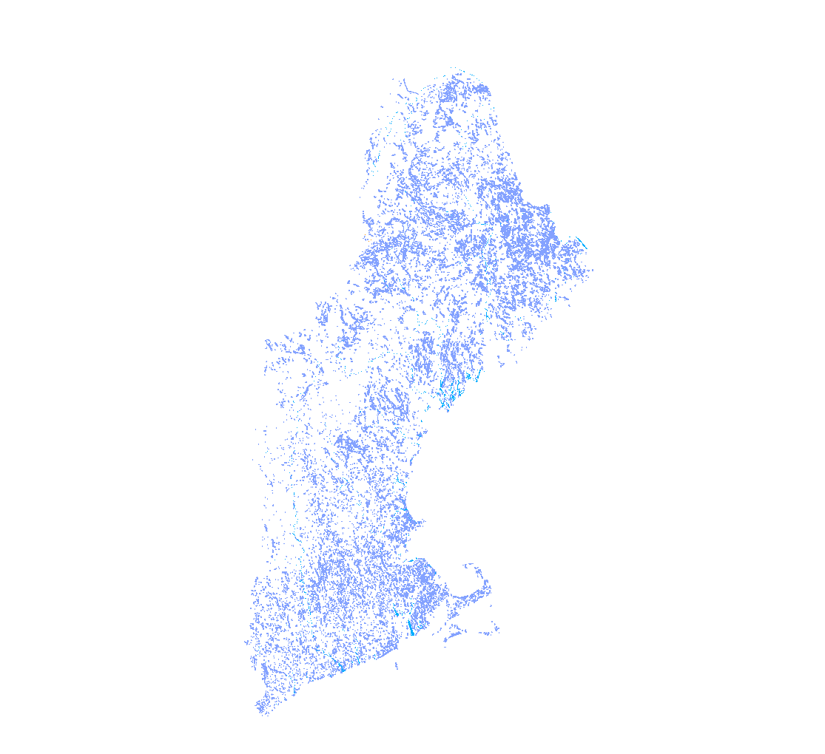
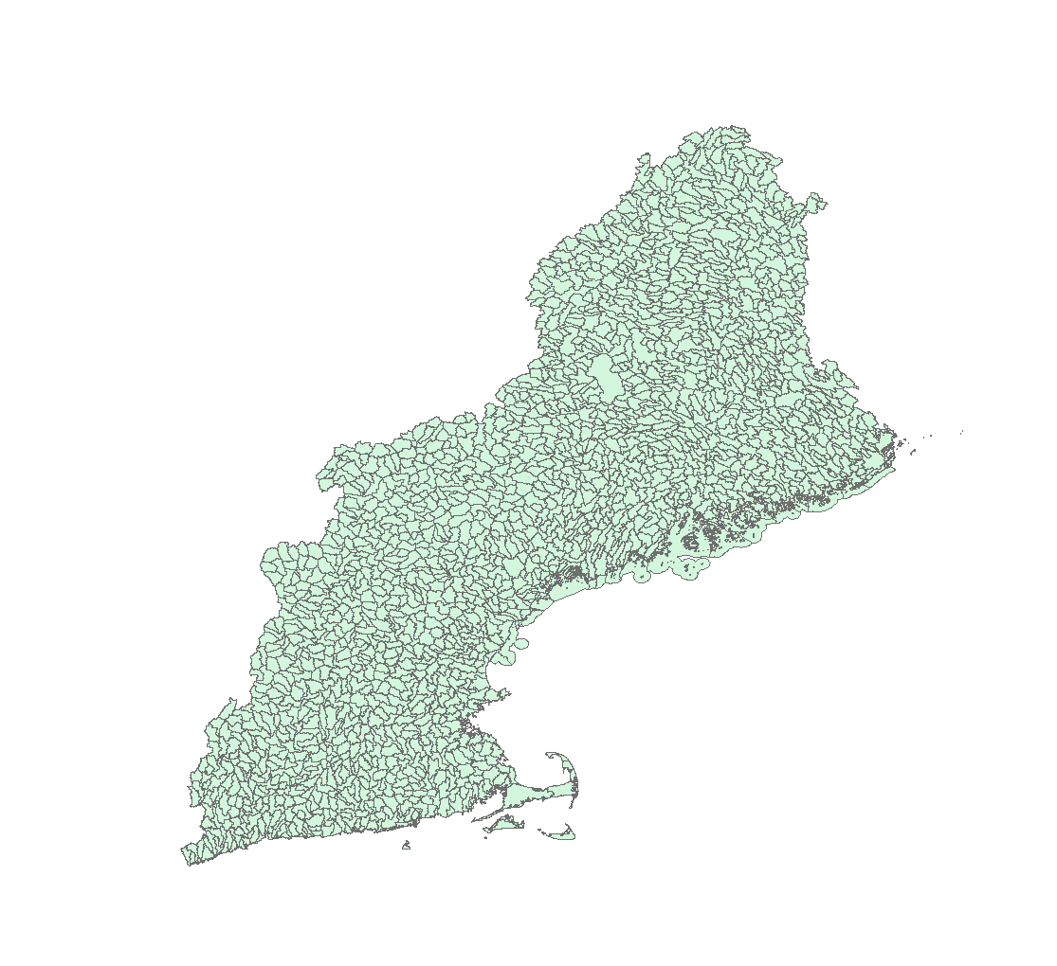
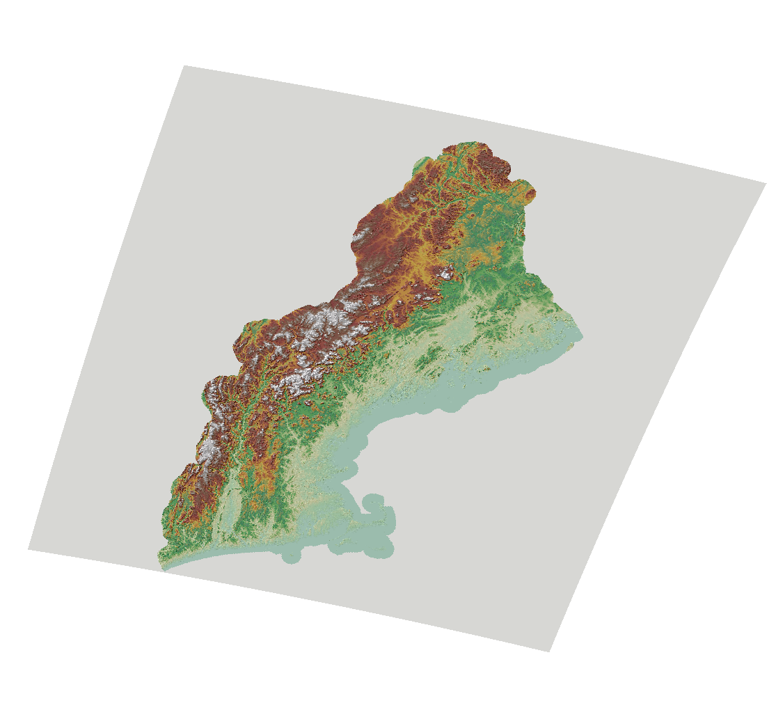
NHDPlus – integrates the …
National
Hydrography
Dataset (NHD)
Watershed
Boundary
Dataset (WBD)
National
Elevation
Dataset (NED)

Slide 8
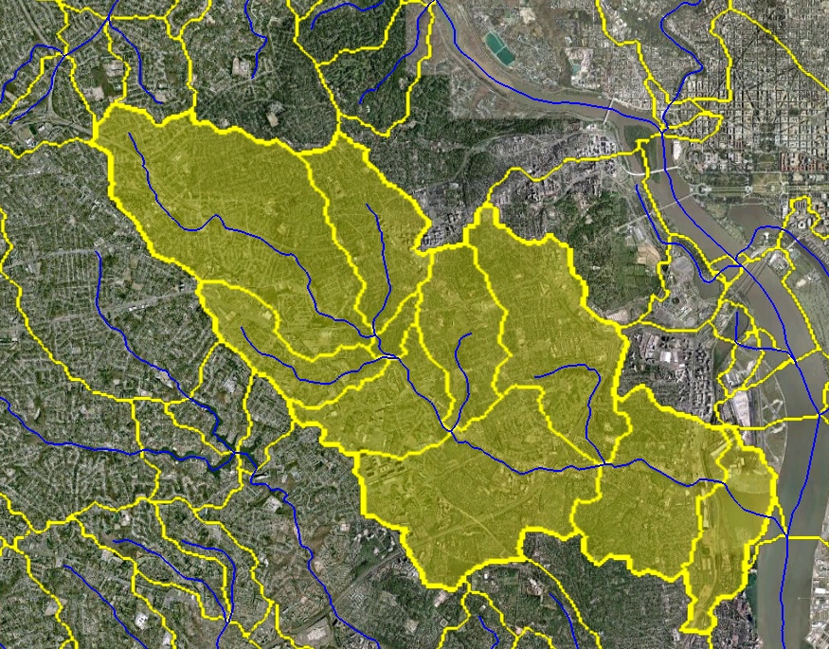
NHDPlus (National Hydrography Dataset Plus)
Developed by USEPA and USGS-Water to provide flow volume
and velocity estimates for pollution dilution modeling
on the NHD network
    Primary ingredient datasets
      National Hydrography Dataset
      National Elevation Dataset
      Watershed Boundary Dataset
    Additional stream attributes include
      stream order
      flow volume and velocity
    Catchments and attributes
      precipitation
      temperature
      land cover
      large user-developed collection
    Flow direction and accumulation grids
Catchments tie the landscape to the stream network forming a ‘surface water geofabric’

Slide 9
An Evolving Surface Water Geofabric
    EPA/USGS-W EPA/USGS-W USGS-M USGS-M
Integrated 1982 2012 5-10 yrs? 10-15 yrs?
Geofabric RF1 Med Res High Res LiDAR
NHDPlusV2 NHDPlus NHDPlus
Base Layers
  Network (NHD)
    500k
    100k
    24k or better*
  Elevation
    100m
    30m
    10m
    3m
  Hydrologic Units (WBD)
    24k or better*
    (*24k or better = patchwork quilt that includes LiDAR-based data)

Slide 10
NHDPlus – Data News
Completed – HI, USVI, Puerto Rico
Under development
  Pacific Trust Territories (Guam, American Samoa, Northern Mariannas)
  Time of travel estimates
  Denormalized Vector National Seamless FGDB pilot
Assessing feasibility – Alaska for Matsu, Kenai and other areas with water quality impairments

Slide 11
… Streamflow Estimates
  Completed
    30Yr mean annual flow and velocity
    30Yr mean monthly flow and velocity
  Under development
    7Q10 flows (evaluating different regionalized estimation techniques in FY15-16)
    Mean daily flows (planned by USGS Water Census)
    Forecasting future flows (substituting forecasted streamflow estimation model inputs)
    Open Water Data Initiative – National Flood Interoperability Experiment pilot
  Open for discussion
    How can we improve our stream characteristics?

Slide 12
NHDPlus – Tool News
Script that confirms available updates to your local NHDPlus holdings
Desktop tools – data prep script, navigation, watershed delineation, and catchment attribute allocation and accumulation (CA3T)
Web Services
  EPA – ESRI mapping and analytical services including navigation, watershed delineation and report
  Open Water Data Initiative pilot
    ESRI and open source mapping services with flow direction and network/non-network flowline breakout for denormalized vector seamless FGDB
    Analytical services are up next

Slide 13
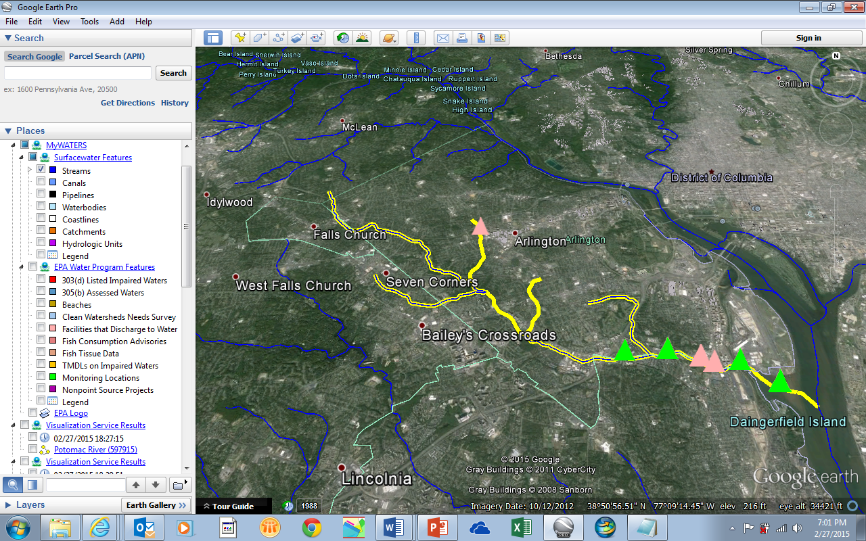

MyWATERS Google KMZ

Slide 14
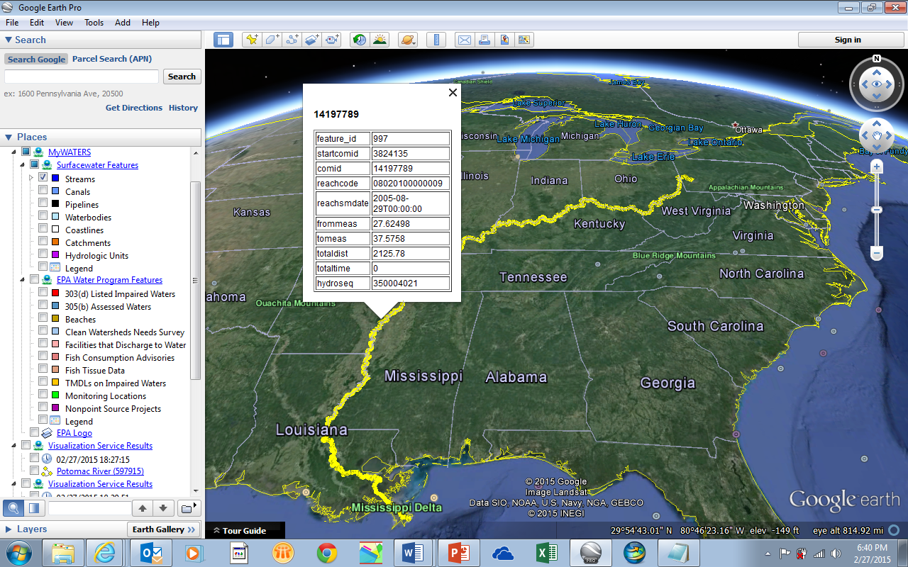
Planned Cloud-based Scalable Performance

Slide 15
Who’s Using NHDPlus?
Email poll (4/17/2013)
Please send us a simple one line description for each of your NHDPlus applications. Within a week, we received 50 responses from the following organizations describing over 100 applications.
Technical support requests
(5/2013 - 9/2014)
domain | # organizations
gov | 6
com | 23
edu | 27
us (state) | 10
org | 11
mil | 2
net | 2
total | 81
  EPA – HQ (6), regions (6), labs (4)
  USGS – HQ & Water Science Centers (6)
  Other feds – COE, NOAA, USFS, NPS,
  States (6)
  NGO - Nature Conservancy (4 offices),
  Conservation Fund Institute
  ESRI

Slide 16
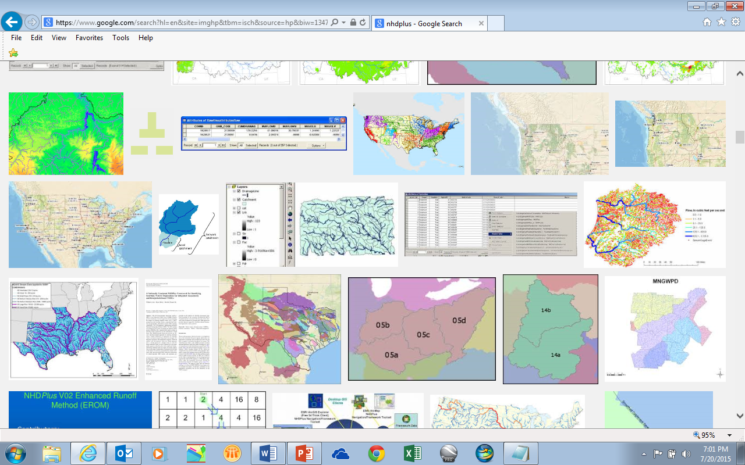
Google It!
Text search for 'nhdplus' found 'About 15,400 results’
Images search for ’nhdplus’ found a rich collection …

Slide 17
How is NHDPlus Being Used?
  Classic applications
    EPA National Aquatic Resource Surveys
    EPA Reporting on water quality
    EPA Pesticide risk assessments
    USGS SPARROW water quality modeling
    DTRA ICWater spill response
  Others
    Open Water Data Initiative
    South Carolina Stream Assessment
    Idaho Lake Monitoring Plan

Slide 18
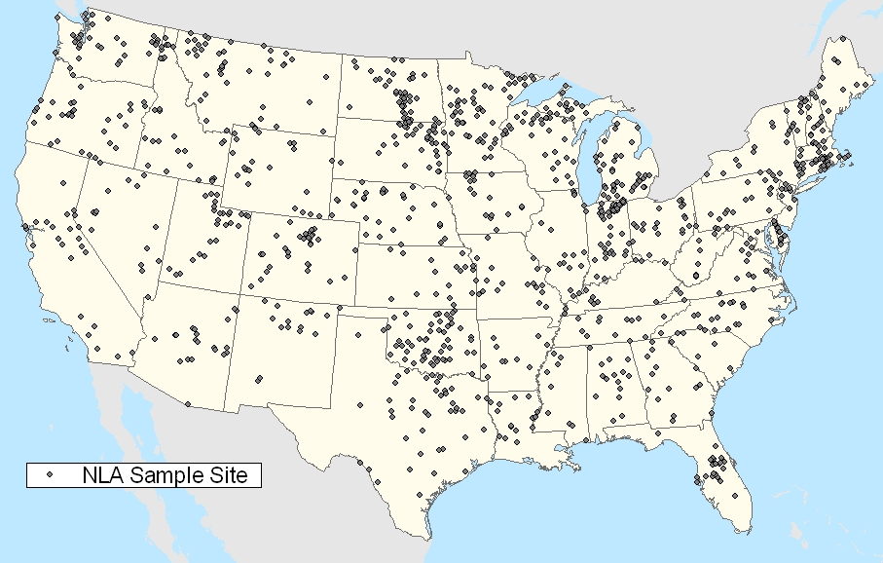
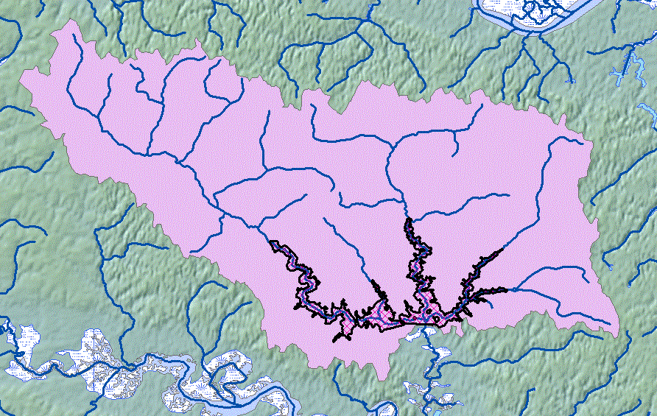
EPA National Aquatic Resource Surveys
NHDPlus serves as the basis for
establishing the NRSA and NLA survey sample frames – from which a representative set of sample sites are randomly selected. >>
<< NHDPlus is also used to support data analysis, such as delineating drainage areas and associated attributes for sampled sites.
Drainage Area = 114.24 km²
NLCD 2001 Land Cover :
- Residential = 7.86 km²
- Forest = 86.42 km²
- Agriculture = 12.64 km²
- Wetlands = 7.32 km²
(epa.gov/type/watersheds/monitoring/aquaticsurvey_index.cfm)

Slide 19
Comprehensive, consistent, and statistically-valid assessments
EPA National Aquatic Resource Surveys
How much surface water have we assessed in the continental United States?
Coastal: >35,000 square miles
Lakes: >110,000 lakes
Rivers/streams: >1.9 million miles
Wetlands: >62,000,000 acres
2015

Slide 20
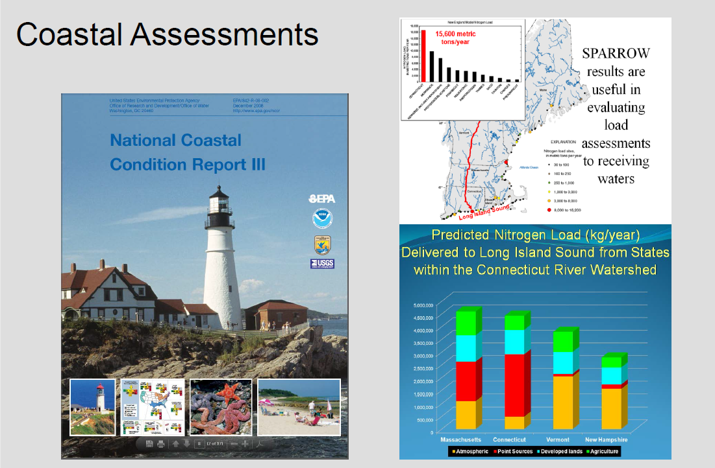
(rmoore@usgs.gov)

Slide 21
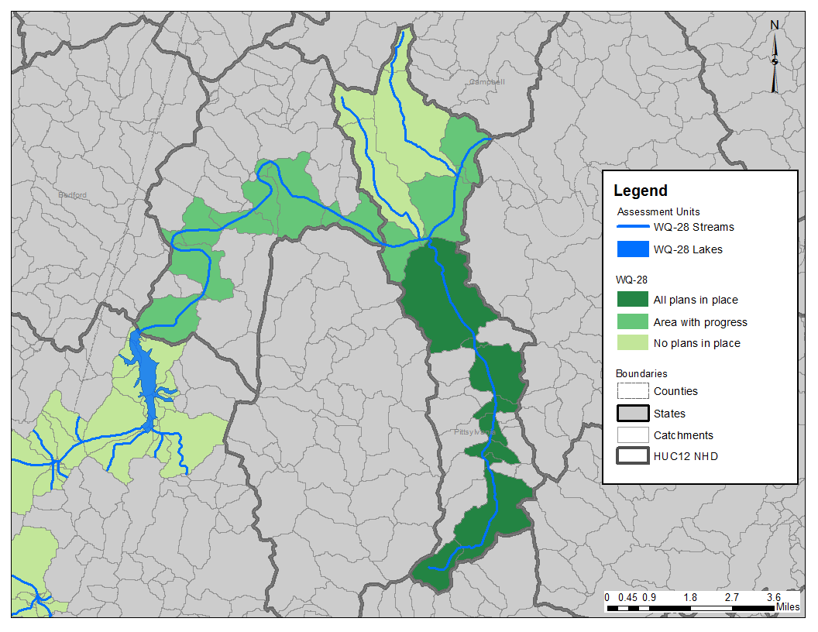
Clean Water Act Section 303(d)
Performance Measures

Slide 22
Modeling Possible Effects on Endangered Species from Pesticide Use
Chemical X Input (any stream with use)
Chemical X Downstream (exceeds threshold)
Chemical X
(thawley.michelle@epa.gov)

Slide 23
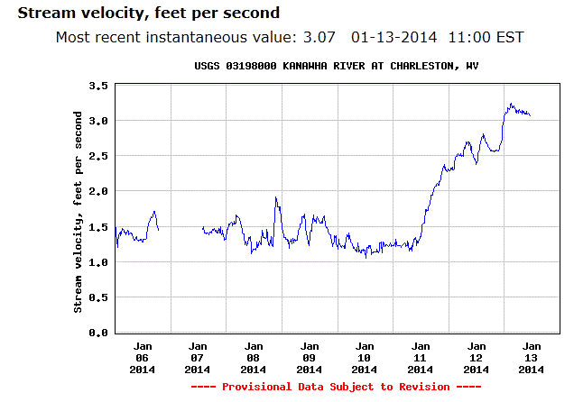
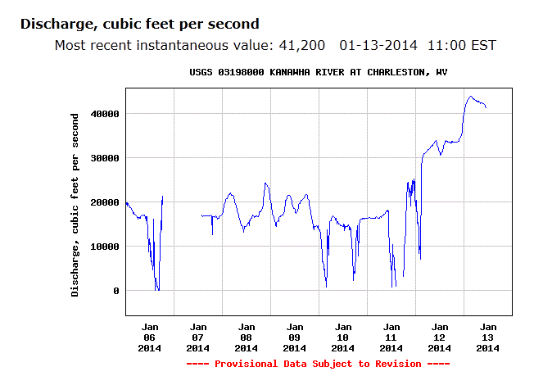
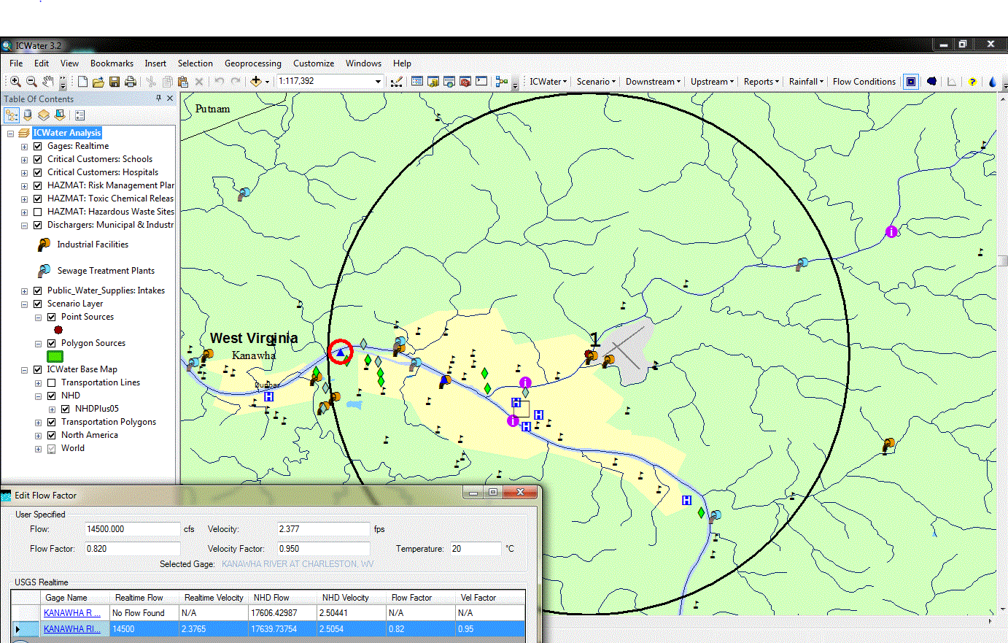
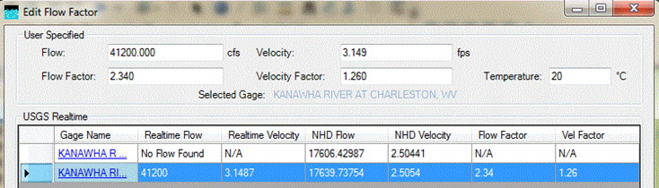
Measured
velocity
Intake
Spill site
West Virginia Chemical
Spill Response
Model velocity
(william.b.samuels@leidos.com)

Slide 24
Open Water Data Initiative
- Use Cases -
Water Supply
Water Quality
Use Case 1:
National Flood Interoperability Experiment
Use Case 2:
Drought
Water Supply Decision Support
Use Case 3:
Spill Response
Flood - Jefferson City, MO
Drought - Texas
Chemical Spill – Charleston, WV
24

Slide 25
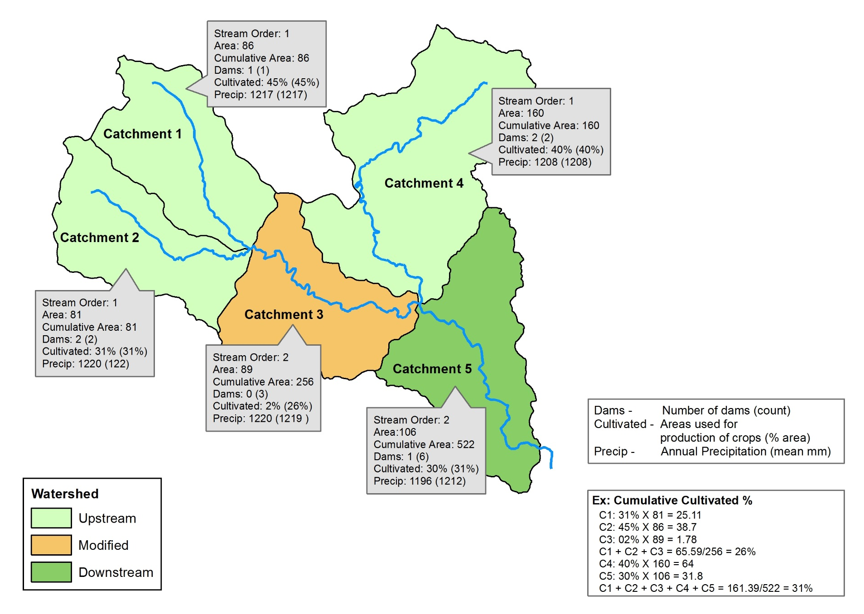
South Carolina Stream Assessment
Conservation Planning Tool
Downstream Cumulative Effects
(Spatial View)
(scottm@sc.dnr.gov)

Slide 26
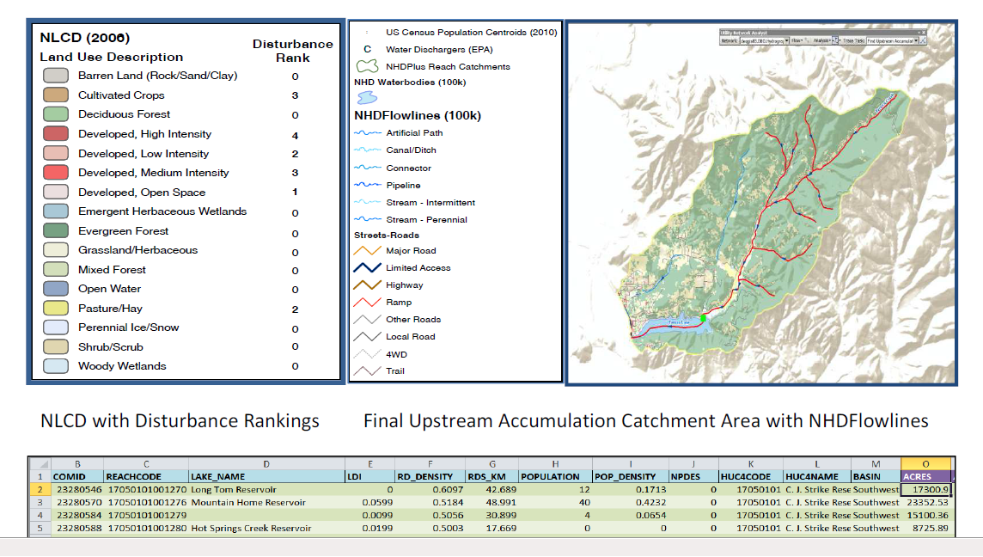
Developing a Strategic Lake Monitoring Plan
Idaho Department of Environmental Quality
(jim.szpara@deq.idaho.gov)

Slide 27
NHDPlus Resources
Web site (on the move to EPA Drupal environment)
User Guide
Exercises
Web-based training (under development)
Data and metadata
Core tools and web services
Applications directory with contacts (share your work!)
Presentations
Technical support and application consultation
On the Web – Google …
‘nhdplus’ for data, tools, documentation
‘epa waters’ for EPA applications, web services

Slide 28
NHDPlus – Other News
  New USGS-EPA Memorandum of Understanding formalizes shared maintenance of NHD, NHDPlus & WBD
  Leveraging partner contributions
    EPA Office of R&D catchment attributes
    USGS-Water network updates
    USGS-NGP production tool improvements
  Medium and High Resolution NHDPlus
    Same core production team
    Improvements to existing production tools (including data model) for high res NHDPlus will benefit any future medium res production
    Planning for same data model

Slide 29
Upcoming Events
JAWRA Issue on Open Water Data Initiative
    Fall 2015
National Water Quality Monitoring Conference
    May 2016 – Tampa, FL
EPA Total Maximum Daily Load Workshop
    Jun 2016 – Shephardstown, WV
ESRI User Conference
    Jun-Jul 2016 – San Diego, CA
AWRA Specialty Conference on GIS and Water Resources
    Jul 2016 – Sacramento, CA

Slide 30
Ruth Patrick (1908-2013) was a pioneer in studying the health of freshwater streams and rivers who laid the scientific groundwork for modern pollution control efforts. She thought that, ultimately, the reason for studying all this was to help to improve human life and the life of the natural world.
Questions?
(We welcome your ideas and feedback)
Tommy Dewald
EPA Office of Water
dewald.tommy@epa.gov
(On the Web - Google ‘nhdplus’)

