Slide 1
NHDPlus Version 2 Web Services
Alan Rea, Tommy Dewald, and Cindy McKay

Slide 2
Transition Time
Transition from NHDPlus Version 1 to Version 2 is incomplete
Several map services currently have V1, but will change to V2 soon
Many base maps include NHDPlus at medium scales, e.g. ESRI Topographic, USGSTopo, ESRI World Hydro Basemap
This presentation will focus on ArcGIS Online, services also work in ArcMap

Slide 3
ArcGIS Online (AGOL)
Pros
Cons
Very fast compared to ArcMap
No license required for viewing—Sharable
Save a map and share a link—quick and easy
Different interface for experienced GIS users
Can be difficult to find the data you want
Harder to bring in data you have locally
Analysis limited, but improving
No relates or joins
Sometimes unstable

Slide 4
Basemaps use NHDPlus, too…
ESRI World Topographic
ESRI World Hydro Basemap
ESRI World Hydro Reference Overlay
ESRI USA Topo Maps (actually 1:100K USGS topo maps)
The National Map (USGSTopo)
  At medium scales (actually MedRes NHD)
  See service listing at
  http://viewer.nationalmap.gov/example/services.html

Slide 5
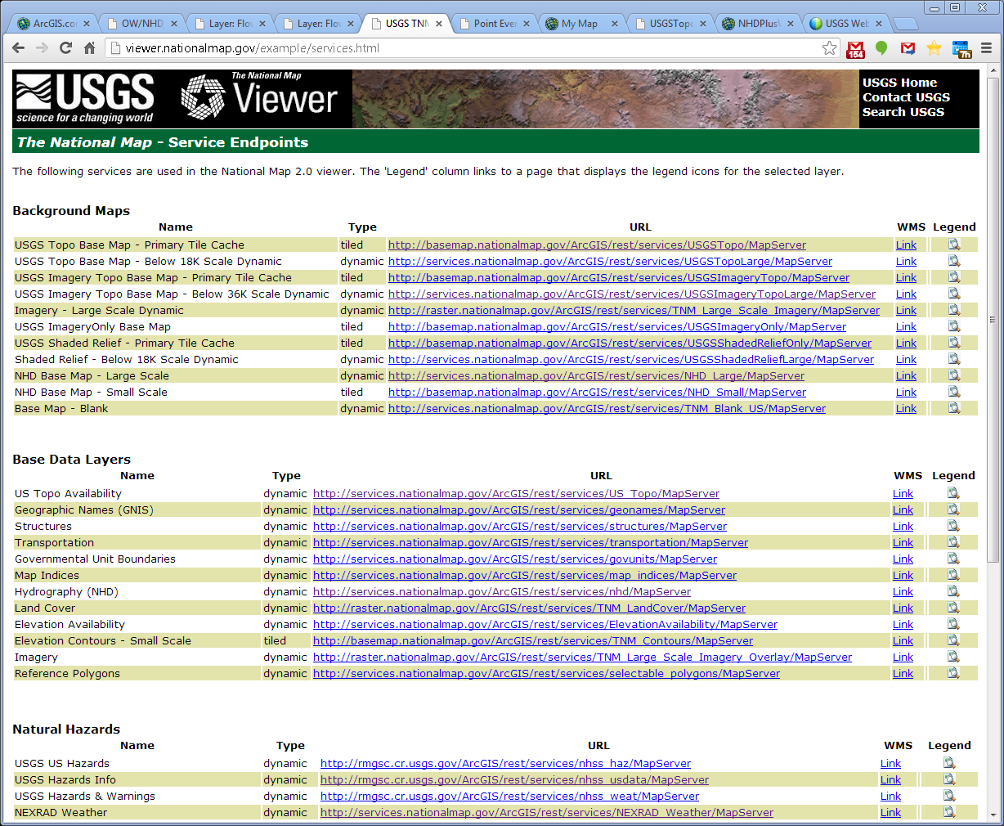

Slide 6
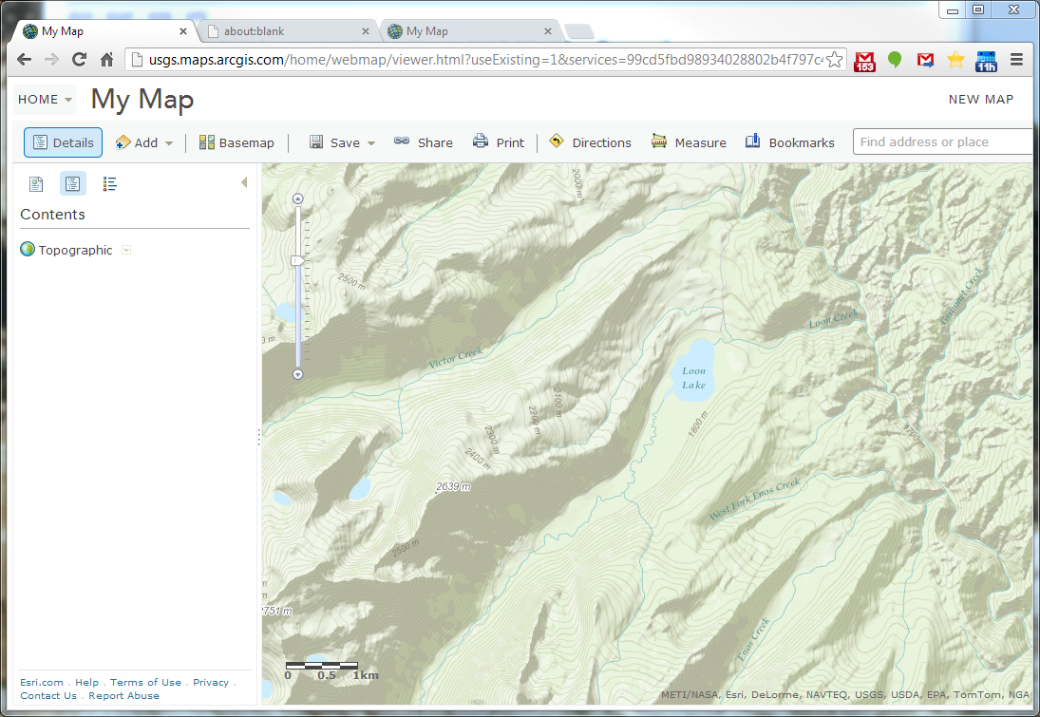

Slide 7
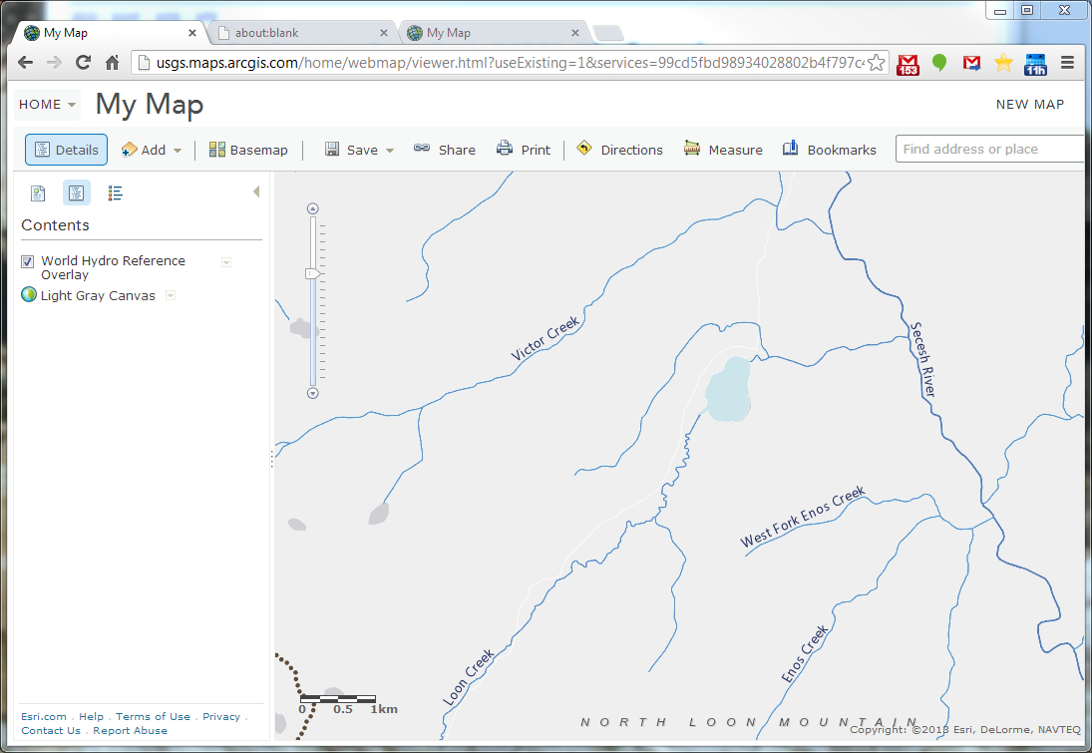

Slide 8
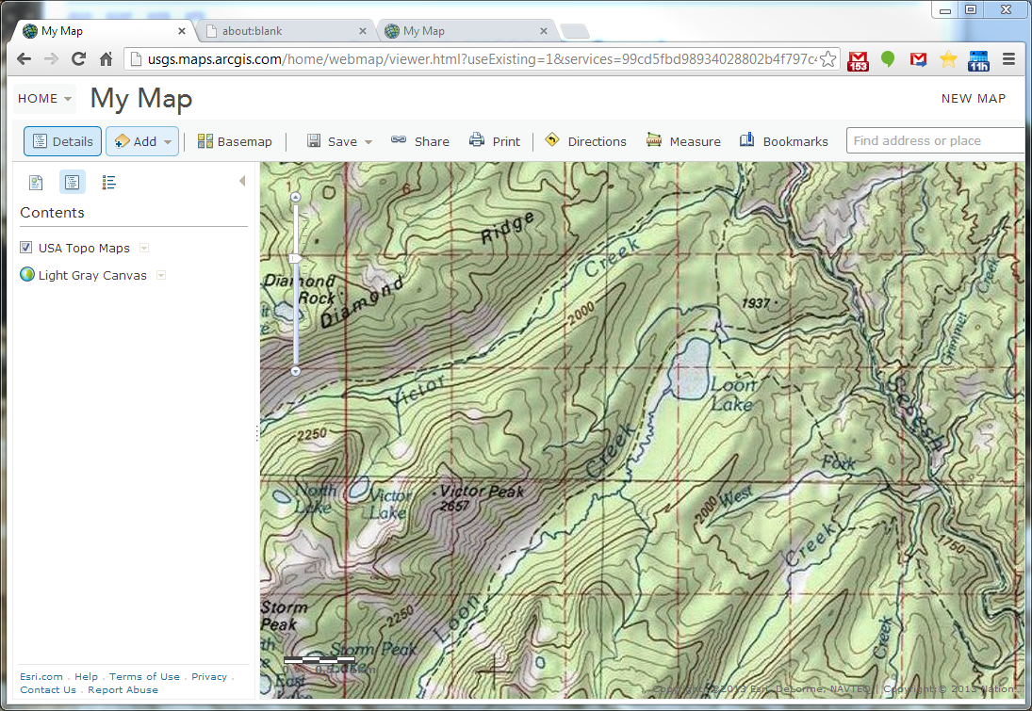

Slide 9
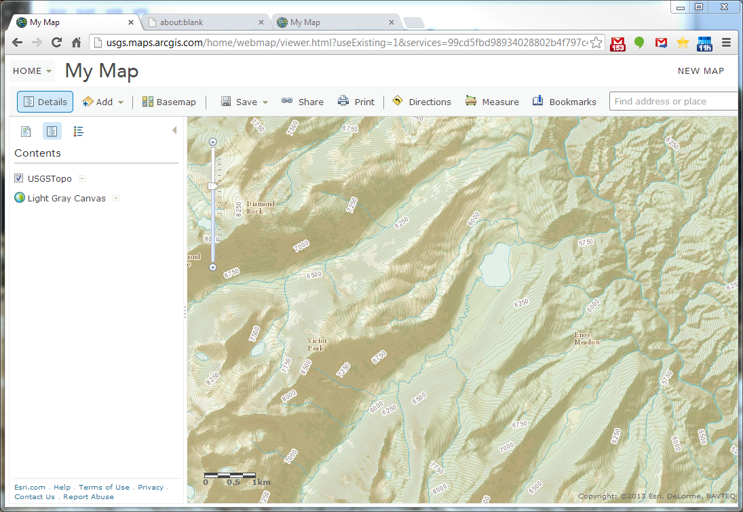

Slide 10
EPA WATERS Map and Web Services
These currently run using NHDPlus V1
Are being switched over to Version 2 soon
Several map services, an MXD, KMZ
Many web services including upstream/ downstream, watershed delineation, etc.
Currently on a small (slow) server, will be moving to pilot GeoCloud soon
Find these from http://epa.gov/waters

Slide 11
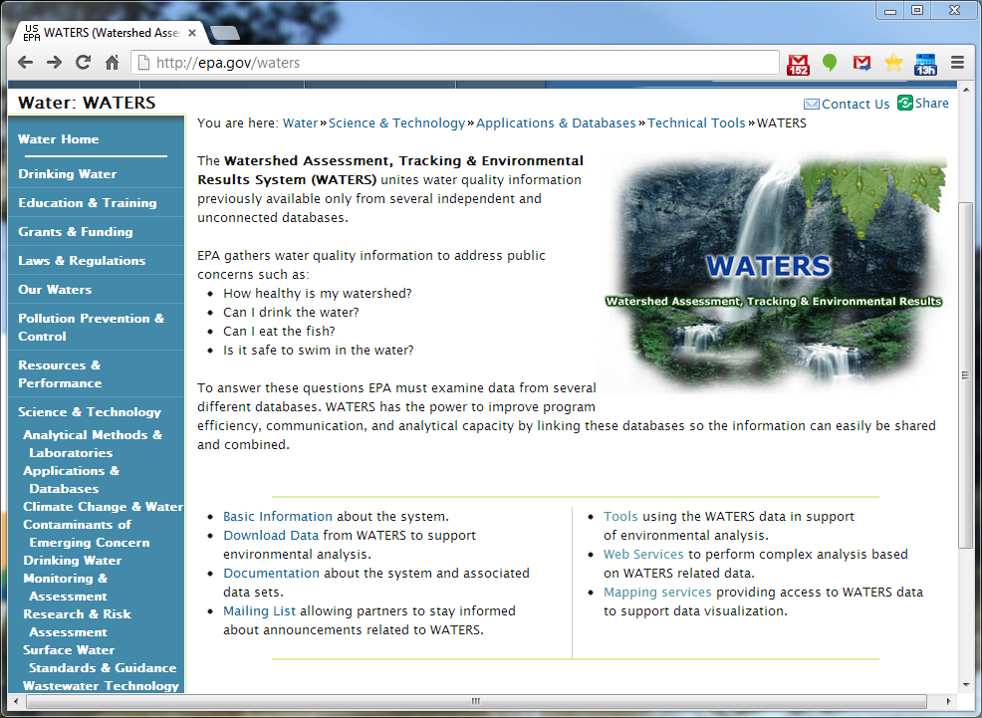

Slide 12
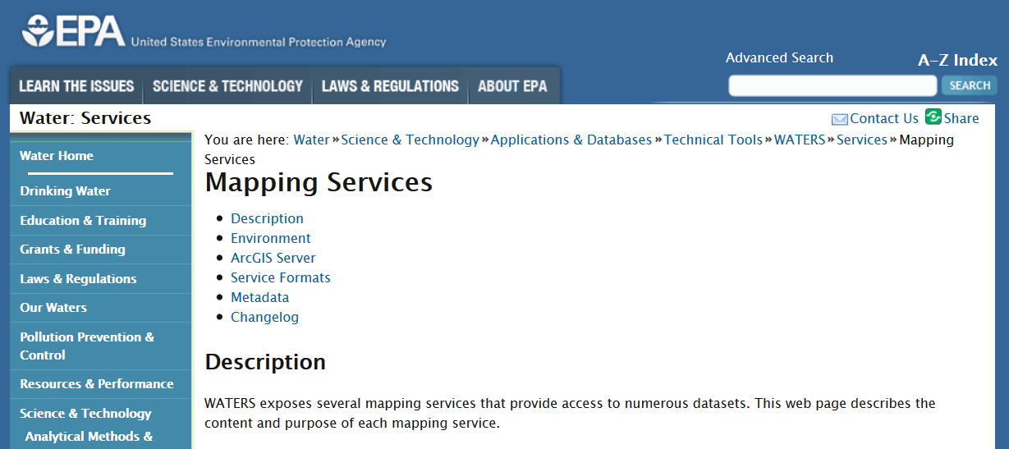

Slide 13
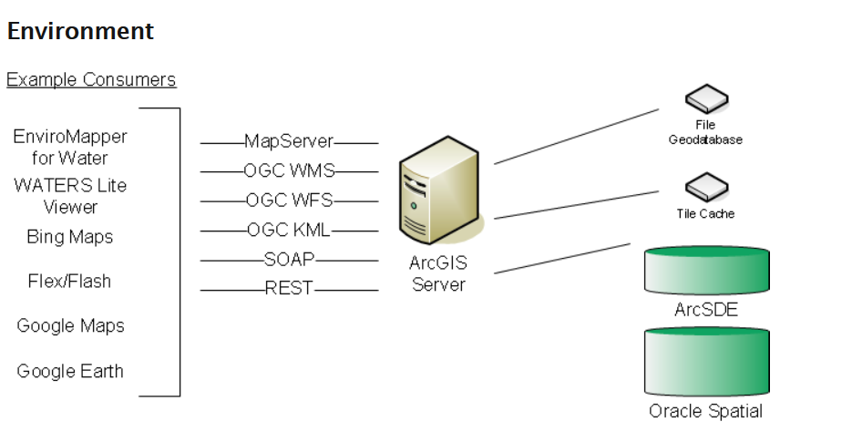

Slide 14
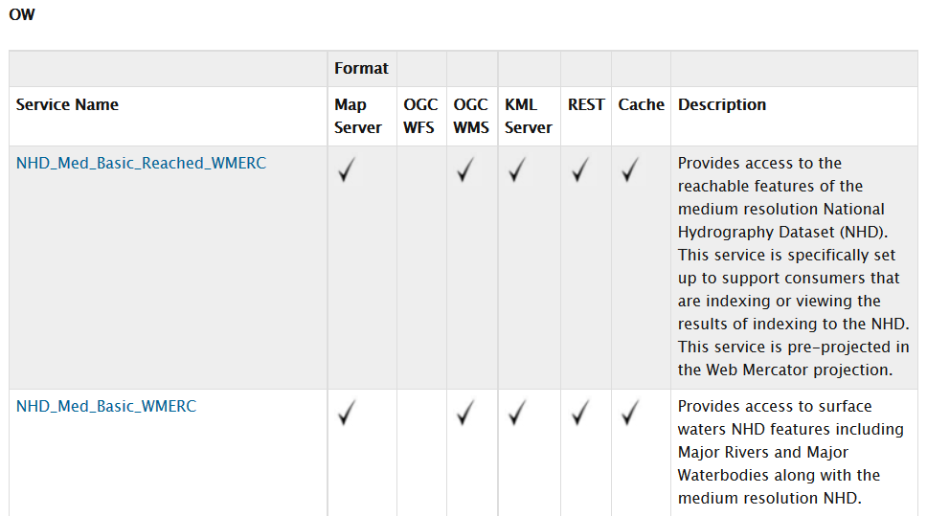

Slide 15
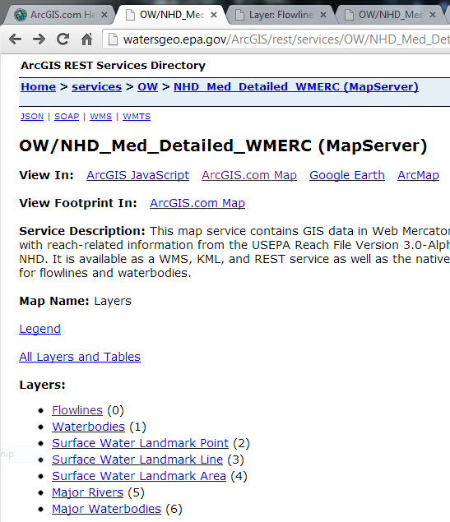
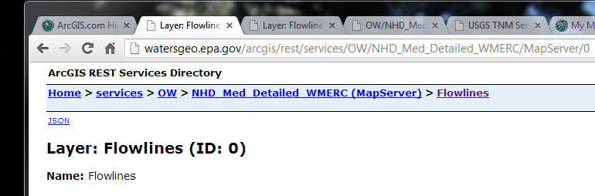
Notes:
This is one of the pages linked from the EPA WATERS Map Services page.
If you add the individual layers to AGOL, you get more control over functionality than you get if you add the whole map service. Simply paste the URL shown above into the Add Layer from Web dialog box.

Slide 16
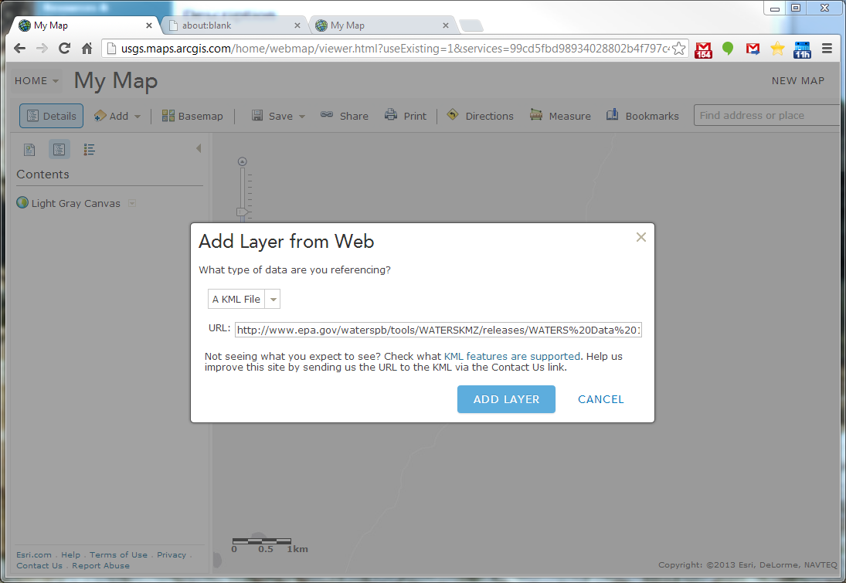

Slide 17
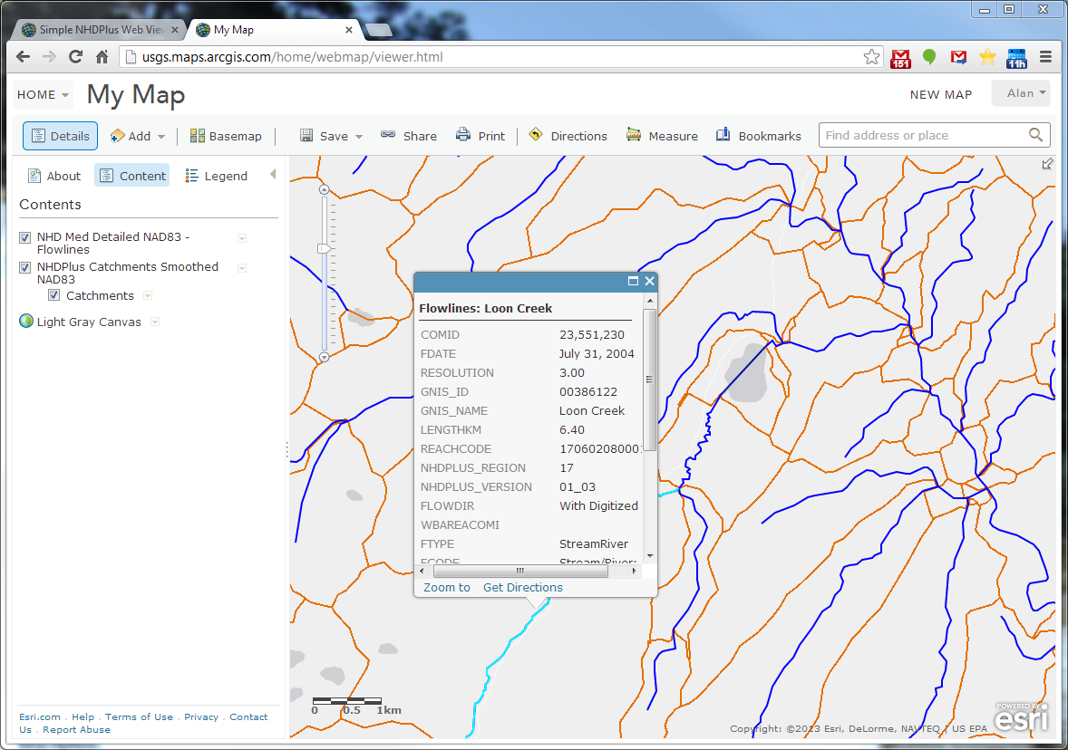

Slide 18
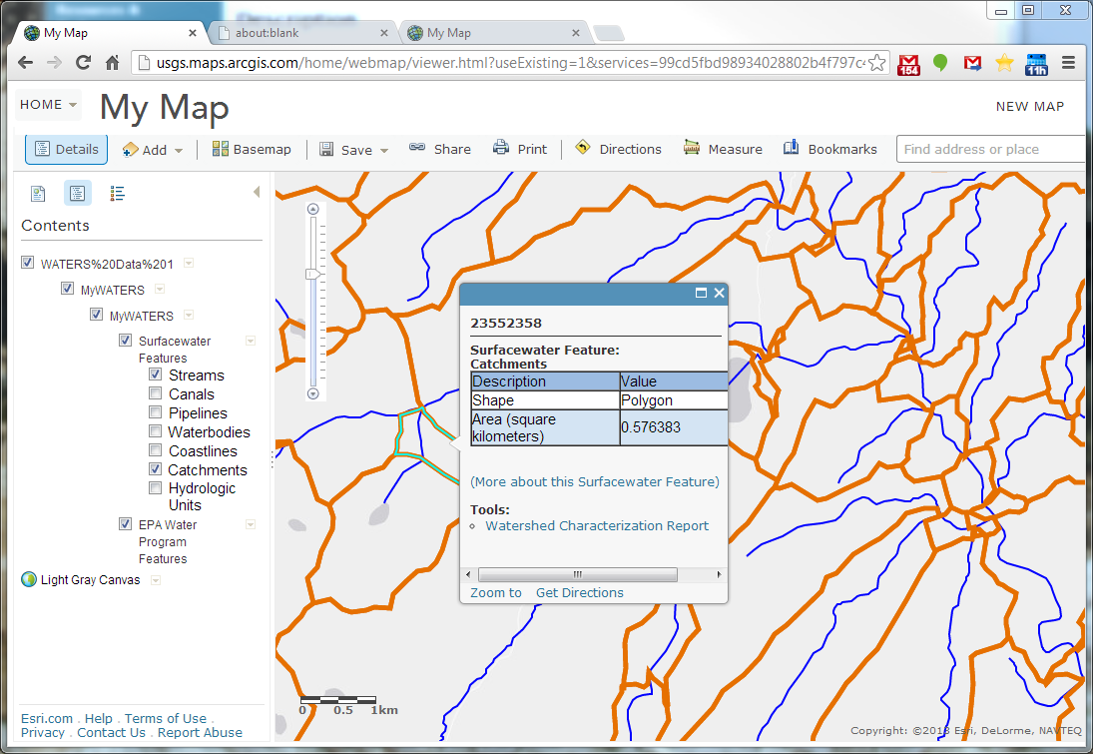

Slide 19
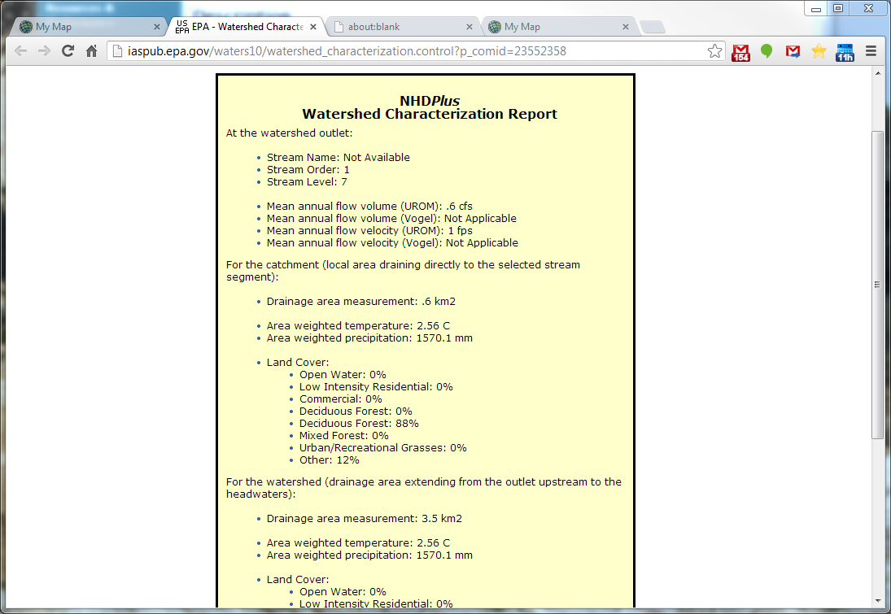
Incremental
Cumulative

Slide 20
ArcGIS Online Tips and tricks…
Looking for a particular feature? Use a filter.
Custom searches: search options in Help:
nhdplus owner:Federal_User_Community
When you find what you’re looking for, give it stars so it will rise to the top of searches
You can add web sources to your content, making it a little easier to find the next time
Go to ideas.arcgis.com, search for “My Favorite Layers”, and vote it up

Slide 21
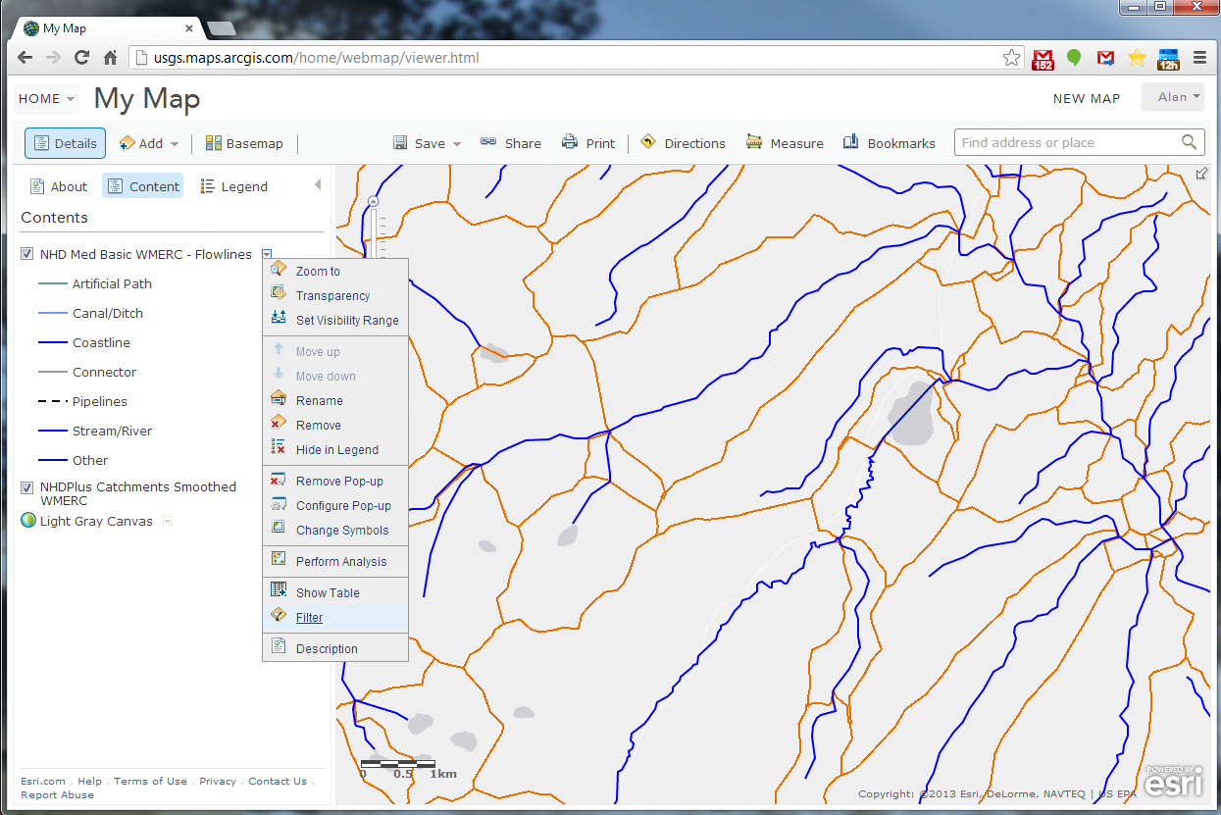

Slide 22
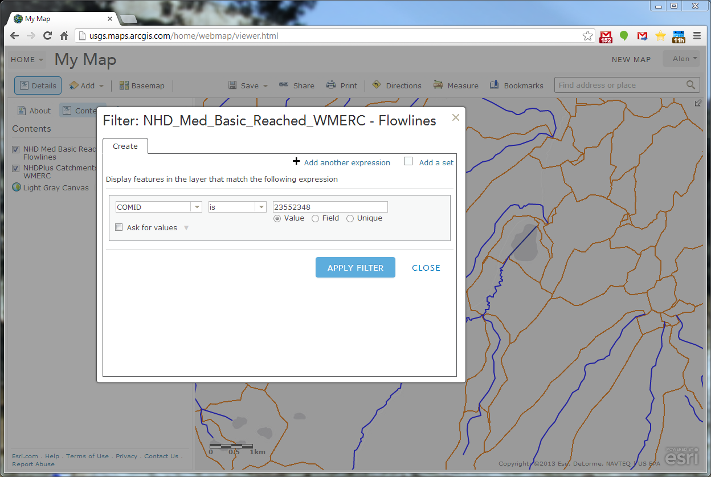

Slide 23
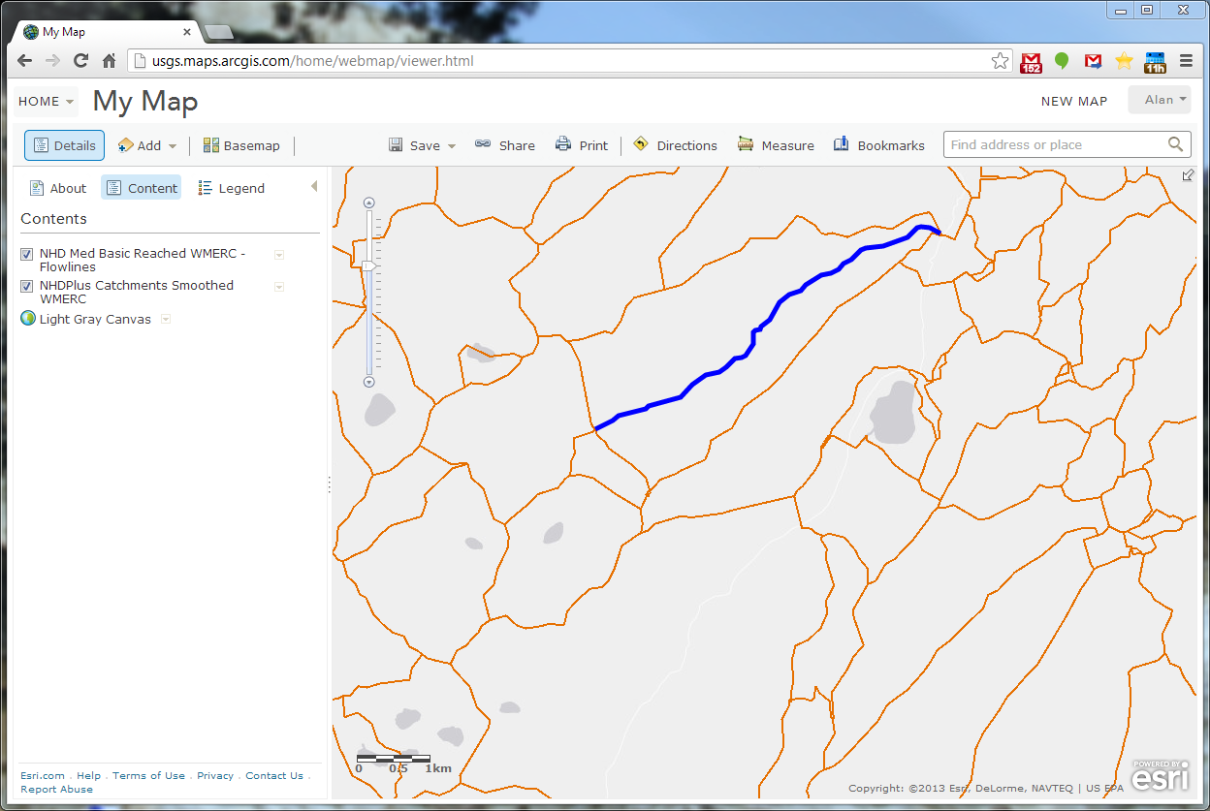

Slide 24
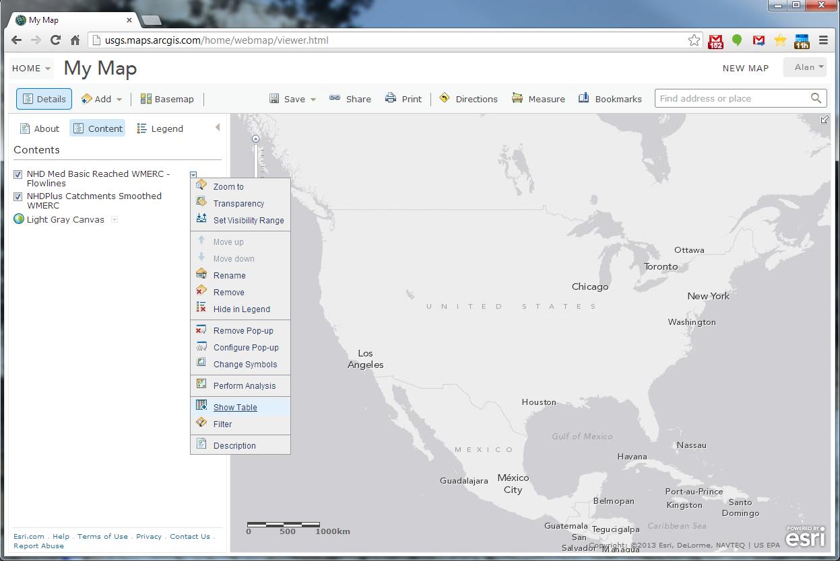

Slide 25
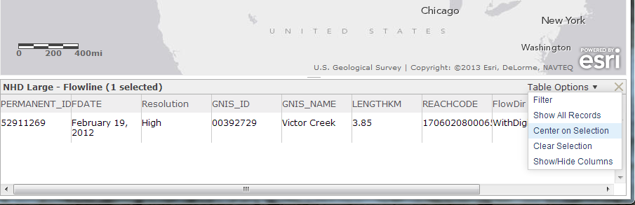

Slide 26
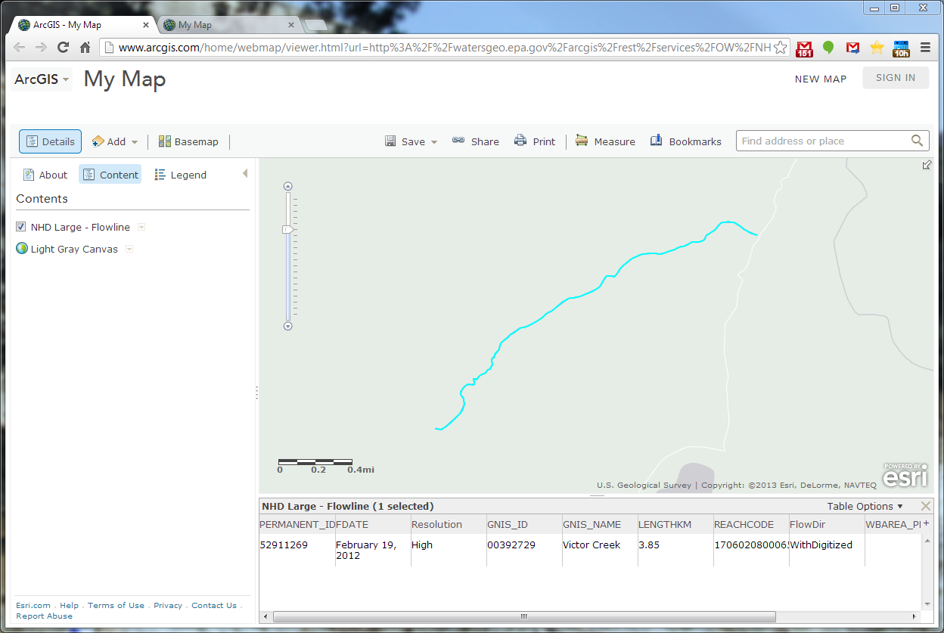

Slide 27
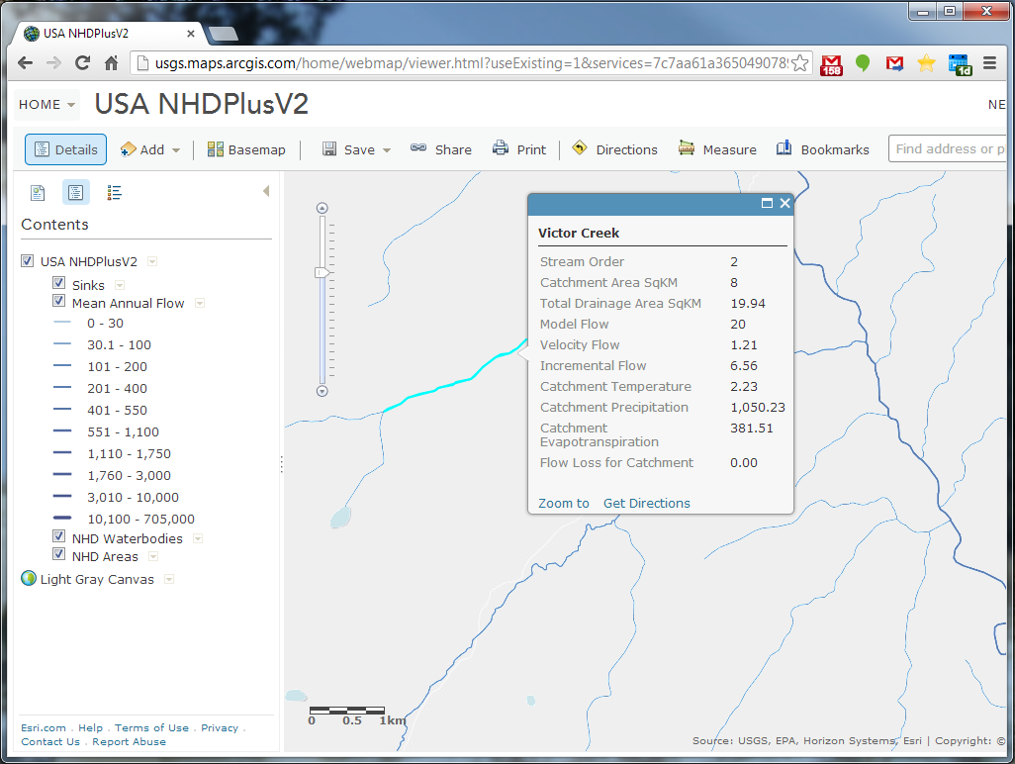
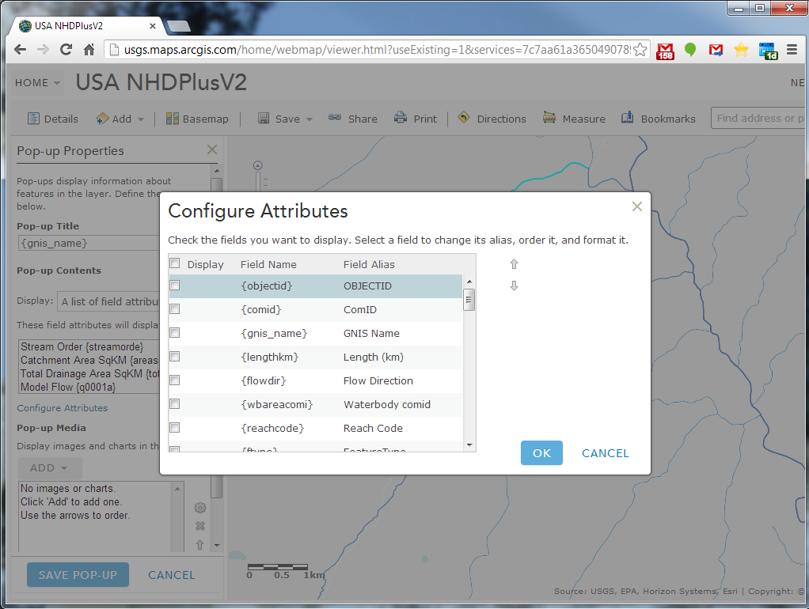
Notes:
This is one of the new map services put up by ESRI in the last week. It includes the NHDPlus V2 VAA’s, plus mean annual flow estimates, temperature and precip. Note not all the attributes are shown by default in the popup, but you can customize the popup to include the attributes you want. It isn’t everything in the NHDPlus, but it includes quite a few of the attributes available in NHDPlus V2. Also note, the above service can be found simply by searching AGOL for NHDPlus and sorting the search results by date. It does not require any particular login, although it says in the description that to use it you need an ArcGIS Organizational account subscription.

Slide 28
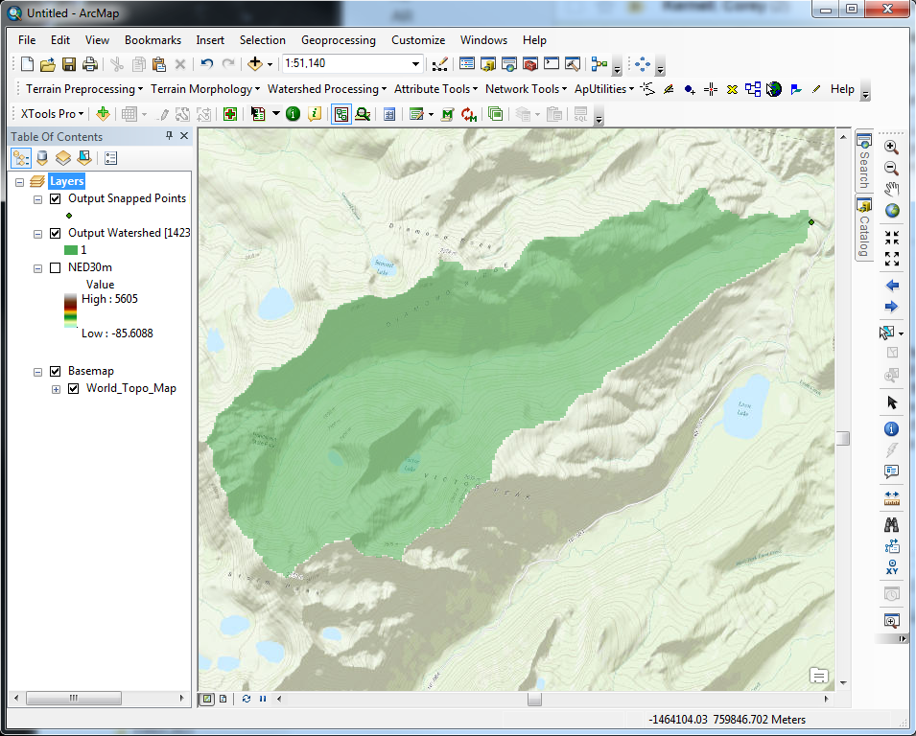
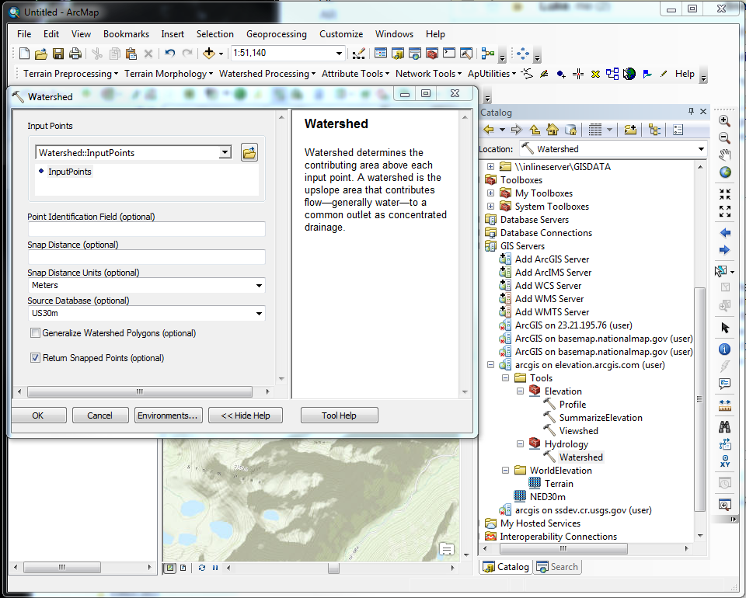
Notes:
This slide illustrates the new Watershed geoprocessing capability from ESRI. Note this is inside ArcMap, and it requires an ArcGIS Online subscription to sign in and use the service. This service is in Beta right now, with public release planned for November. Notice also there are some Elevation tools as well, to do things like compute Viewsheds, profiles, and to summarize elevation data. These services are derived from NHDPlus V2, with quite a lot of additional processing by ESRI.

Slide 29
Conclusions
More Web Map Services based on NHDPlus Version 2:
COMING SOON
  Contact info:
  ahrea@usgs.gov
  dewald.tommy@epa.gov
  ldm@horizon-systems.com

