Slide 1
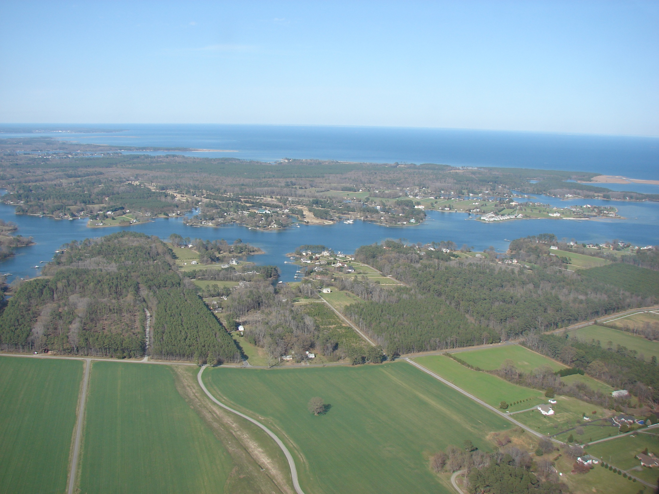
NHDPlus
Network Value Added Attributes
2/26/2014
Presented by: Cindy McKay
Sponsored by: USGS

Slide 2

NHDPlus Is Value Added
NHD + NED + WBD
=
NHDPLUS
Value Added Attributes
Value Added Spatial Layers

Slide 3
NHDPlusV2 Build/Refresh Process
Snapshots
NHD + WBD + NED
Phase 3
Catchment & Drainage Area Attribution
Phase 1 - Vector Processing
Phase 2 - Raster Processing
Network VAAs
&
Burn Components
Catchments
&
Raster Components
Extended
Attributes
Including
Stream Flow Estimates

Slide 4
National Hydrography Dataset
The “National Framework” Dataset for Hydrography
Origins in the Cartography of the USGS Quad Maps
Stream Network (“blue lines”) & Waterbodies
Stable (nearly permanent) Reachcode Identifiers on Stream Network and Waterbody Features
Flow Relationships & Ordered Geometry

Slide 5
Addressing Linear Reaches
National Hydrography Dataset
Each linear reach is one
addressable unit - a ‘street’
Each reach is assigned a
  unique Reachcode –
  the ‘street name’
Addresses are proportional
‘street’ numbers 0-100
from bottom to top
Notes:
The stream network is divided into ‘linear reaches’.
Generally, a reach is the stretch of stream between two confluences or
a headwater segment or the segment at the bottom of the network.

Slide 6
National Hydrography Dataset
Reaches are designed to be permanent/stable.

Slide 7
National Hydrography Dataset
Comes in Two Sizes
NHDPlusV2 - NHD
Medium Resolution
1:100K and better
NHDPlusV1 and V2
High Resolution
1:63K (AK), 1:24K or better
Notes:
Medium resolution NHD is referred to as 1:100K scale. However, if you look at a map of the entire dataset, you’ll see areas where the data is very dense. These areas are frequently comparable to 1:24K.
NHDPlusV1 and V2 were built from medium resolution NHD
In addition, during the development of NHDPlusV1 and NHDPlusV2, many features were added to the stream network in medium resolution.

Slide 8
NHDPlusV2 - NHD
NHDPlus & NHD
NHDPlusV1 – Medium Resolution NHD
NHDPlusV2 – Medium Resolution NHD
Areas of NHDPlus built from High Res NHD
    Texas (Vector processing only)
    Vermont (Vector processing only)
    1015 – headwaters of Niobrara R. (Vector processing only)
    070101 – headwaters of Mississippi River (full NHDPlus)
    7 subbasins (HUC8s) in New York State (full NHDPlus)
    Maine plus drainage from Canada/NH (full NHDPlus)
NHDPlus Network VAAs – coming for High Res NHD

Slide 9
NHDPlus Concepts: Integration of NHD, WBD, and NED
WBD Boundaries
“walled”
Into Elevation
NHD Streams
and
Waterbodies
“burned”
Into Elevation

Slide 10
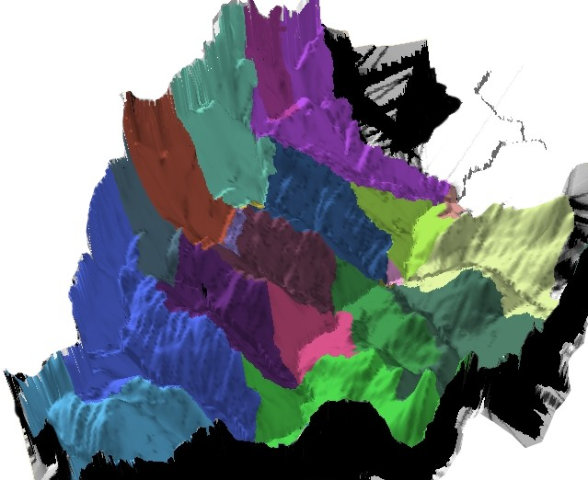
NHDPlus Concepts: Link between the Landscape & the Mapped Stream Network
Catchment: Land Surface that Drains to Each Stream Segment

Slide 11
NHDPlusV2 Value Added Attributes
PlusFlowlineVAA
Commonly called “The Network VAAs”
Elevation & Slope
ElevSlope
HeadWaterNodeArea
Area Draining to Headwater Node
Attributes Allocated to Catchments
Catchment Attributes
Drainage Attributes
Total Upstream Attributes
Mean Annual Flow/Velocity
EROM_MA
EROM_MM
Mean Monthly Flows/Velocities

Slide 12
NHDPlusV2 Network VAAs
  Network VAAs are an integrated set.
  Network VAAs are computed in a specific order.
  Each network VAA computation depends on the network VAAs computed before it.
  The NHD network must pass the mandatory NHDPlus QAQC checks BEFORE Network VAAs can be computed.

Slide 13
NHDPlusV2 Network VAAs
NHDPlus Analysis VAAs
  StreamOrder
  StreamCalculator
  ArbolateSum
  ReturnDivergence
  PathLength

Slide 14
NHDPlusV2 Network VAAs
NHDPlus Navigation VAAs
  FromNode/ToNode
  Hydroseq
  LevelPathID
  TerminalPathID
  StreamLevel
  Divergence
  StartFlag
  TerminalFlag
  VPUIn/VPUOut
  UpLevelPathID
  UpHydroSeq
  DnStreamLevel
  DnLevelPathID
  DnMinorHydroseq
  DnDrainCount

Slide 15
NHDPlusV2 Network VAAs
From node/To node
10
9
Set of nationally unique identifiers for the node endpoints of the flowlines.
Nodes are conceptual.
There is no node feature class in NHDPlus.
Compact Numbers
8
7
5
6
3
4
2

Slide 16
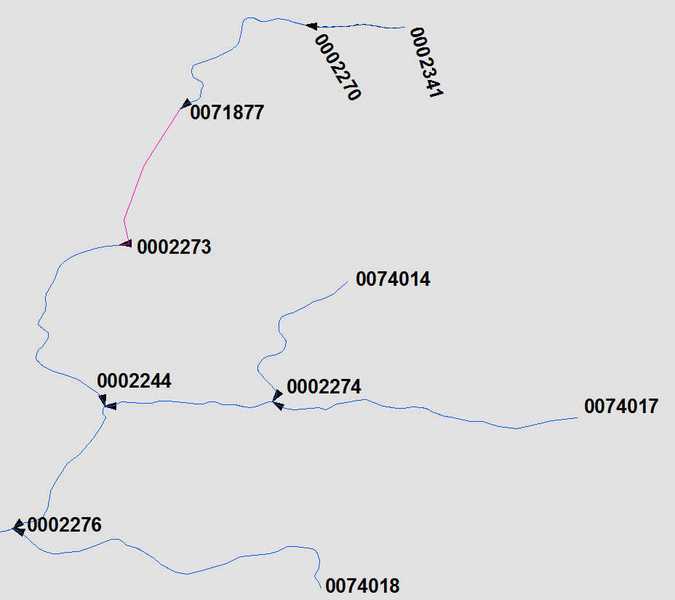
NHDPlusV2 Network VAAs

Slide 17
NHDPlusV2 Network VAAs
Strahler Stream Order
1
1
The smallest permanent streams are called "first order". Two first order streams join to form a larger, second order stream; two second order streams join to form a third order, and so on. Smaller streams entering a higher-ordered stream do not change the order number.
Strahler 1964
2
1
1
2
1
2
3

Slide 18
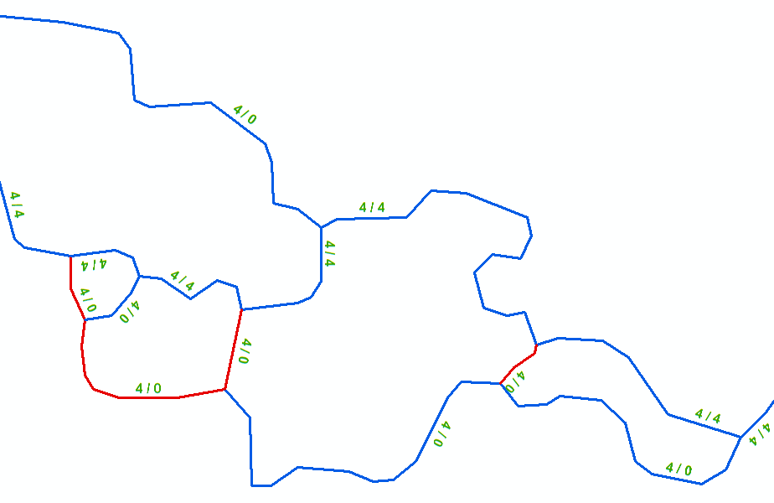
NHDPlusV2 Network VAAs
StreamOrder
&
StreamCalculator
Flow Direction

Slide 19
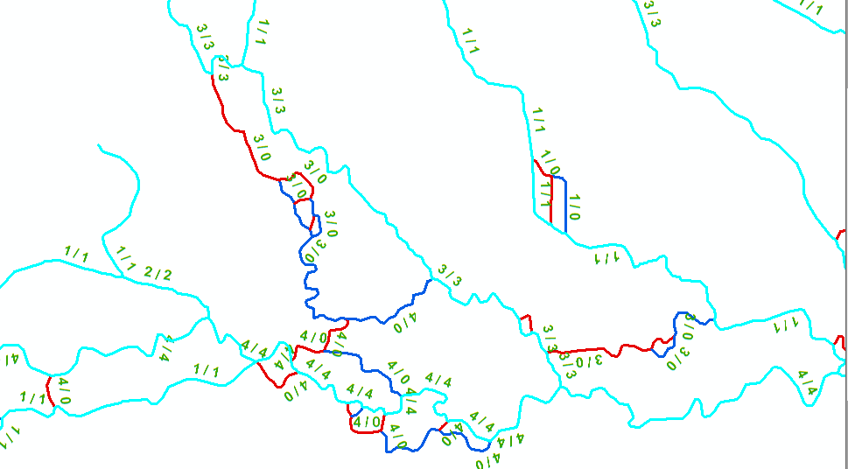
NHDPlusV2 Network VAAs
An Interesting Side Benefit of Stream Calculator - Selecting SC > 0 from NHDFlowline yields a dendritic network.

Slide 20
NHDPlusV2 Network VAAs
StreamLevel
Provides the information necessary to determine the main path upstream at each confluence.
  Flow Volume
  Stream Name
  Arbolate Sum
2
1
1
2
2
1
3
2
1

Slide 21
NHDPlusV2 Network VAAs
Divergence
0
0
A flag which defines the major and minor branches of a flow split (divergence).
1
0
2
1
2
0

Slide 22
NHDPlusV2 Network VAAs
PathLength
4/10.5
The distance from the downstream end of a flowline to the network terminus
5/10.5
3.5/7.0
4.5/7.0
2.5/3.9
5.1/1.9
2.2/3.9
2/1.9
1.9/0.0

Slide 23
NHDPlusV2 Network VAAs
Hydrologic Sequence Number
(HydroSeq)
8
A nationally unique sequence number that places each stream flowline in hydrologic order
Compact numbering system
At any flowline, all upstream flowlines have higher hydrologic sequence numbers and all downstream flowlines have lower hydrologic sequence numbers.
Ascending = downstream to up
Descending = upstream to down
9
7
6
3
5
4
2
1

Slide 24
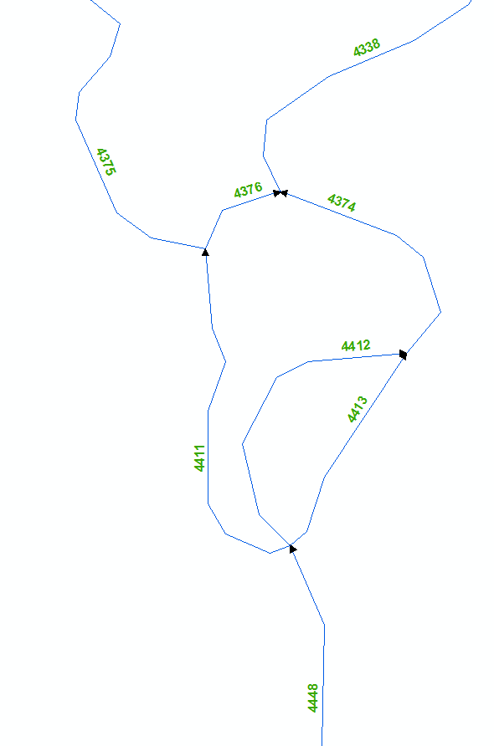
NHDPlusV2 Network VAAs
Hydrologic Sequence Number
(HydroSeq)
6
.
.
.
4448
4413
4412
4411
4376
4375
4374
4338
.
.
.
4
3
5
1
7
2
8

Slide 25
NHDPlusV2 Network VAAs
Level Path Identifier
Level Path ID = 55
2
The hydrologic sequence number of the most downstream flowline on the same level path.
1
1
2
2
3
1
2
1
Hydrologic Sequence Number = 55

Slide 26
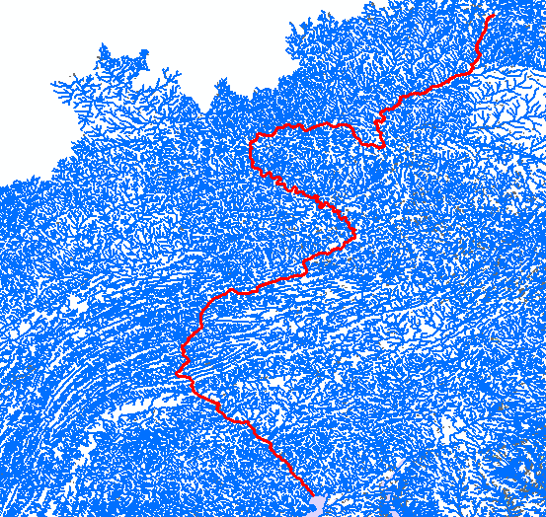
NHDPlusV2 Network VAAs
Susquehanna River
Main Stem

Slide 27
NHDPlusV2 Network VAAs
Terminal Identifier
Terminal ID = 55
The hydrologic sequence identifier for the terminal flowline to which a flowline ultimately flows.
Hydrologic Sequence Number = 55

Slide 28
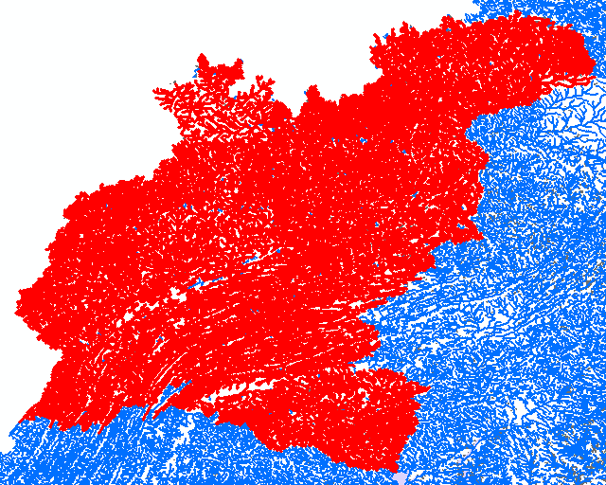
NHDPlusV2 Network VAAs
Susquehanna River
Drainage Basin

Slide 29
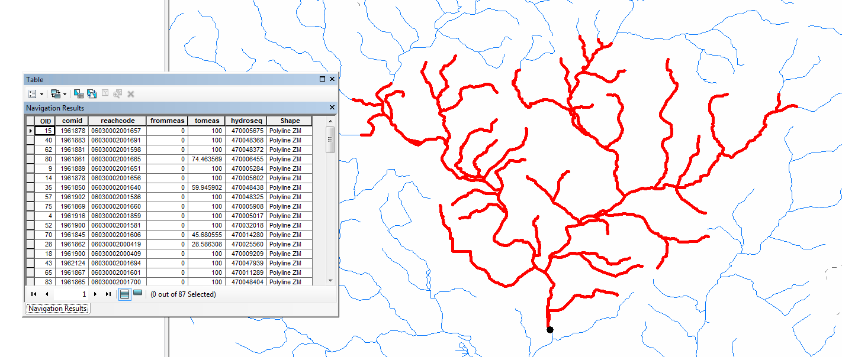
NHDPlusV2 Network VAAs
Navigate Upstream along all paths for 20 km.

Slide 30
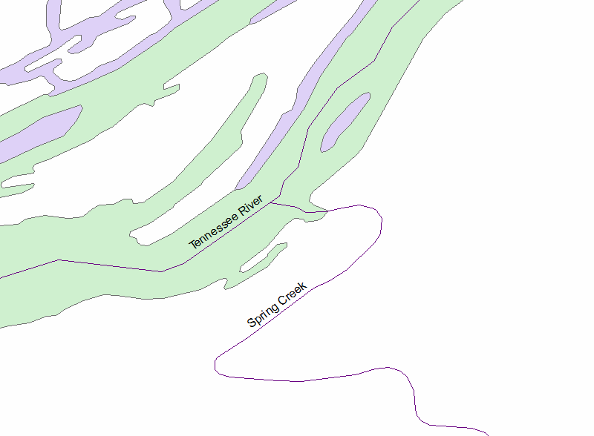
NHDPlusV2 Network VAAs
Find all the tributaries to
the Tennessee River
within 100 km upstream
of the confluence with
Spring Creek.

Slide 31
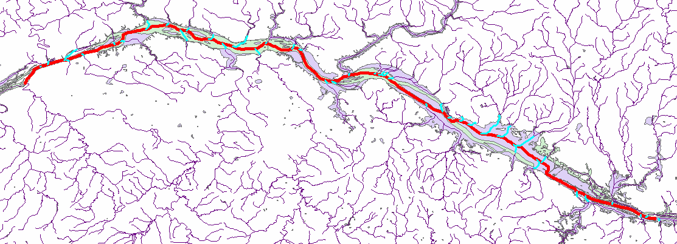
NHDPlusV2 Network VAAs
There are 42 tributaries to the Tennessee River within 100 km upstream of the confluence with Spring Creek.

Slide 32
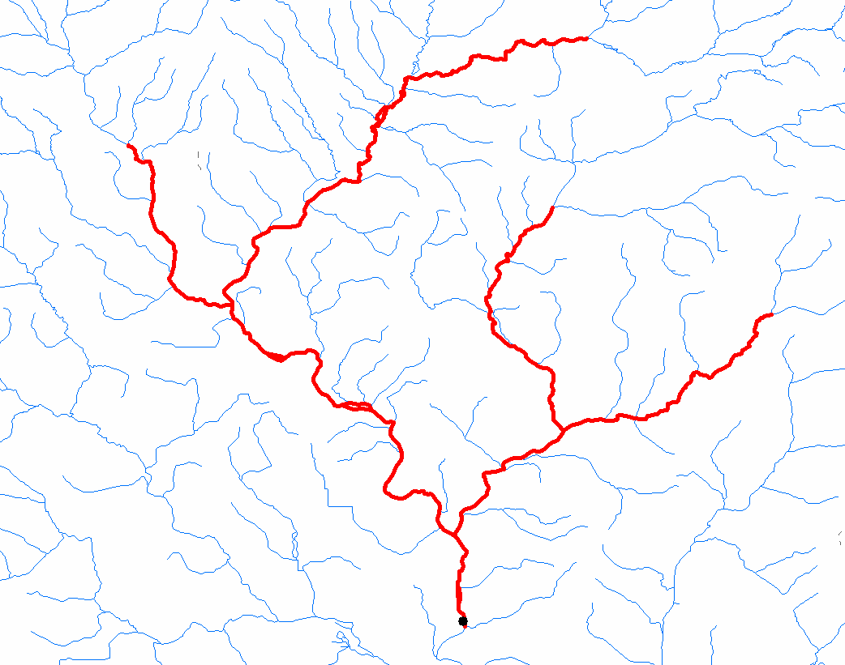
NHDPlusV2 Network VAAs
Navigate Upstream until Total Drainage Area < 50 sqkm

Slide 33
NHDPlusV2 Value Added Attributes
PlusFlowlineVAA
Commonly called “The Network VAAs”
Elevation & Slope
ElevSlope
HeadWaterNodeArea
Area Draining to Headwater Node
Attributes Allocated to Catchments
Catchment Attributes
Drainage Attributes
Total Upstream Attributes
Mean Annual Flow/Velocity
EROM_MA
EROM_MM
Mean Monthly Flow/Velocity

Slide 34
NHDPlus Value Added Attributes
Questions?

