Slide 1


The National Hydrography Dataset Plus a tool for SPARROW Watershed Modeling
Richard Moore
(presented by Alan Rea)

Slide 2
SPARROW (Spatially Referenced
Regressions On Watershed Attributes)
Described in Smith and others, Water Resources Research, 33(12): 2781-2798
An empirical (regression) approach relating observed water-quality data (nutrient loads) to upstream watershed characteristics in a GIS framework
Incorporates variables to simulate in-stream processes
Incorporates only statistically significant parameters.

Slide 3
NHDPlus
A digital stream network that is useful as a framework for both water-quality and stream-flow modeling.
Has been used to develop the Northeastern and MidAtlantic Region nutrient SPARROW models.

Slide 4
NHDPlus
Network
The success of the New England SPARROW originally encouraged the development of NHDPlus.

Slide 5
NHDPlus
Network
NHDPlus
Improved
SPARROW Models

Slide 6
NHDPlus V1 used for SPARROW watershed modeling of nutrient in the Northeastern and Mid-Atlantic Region of the United States

Slide 7
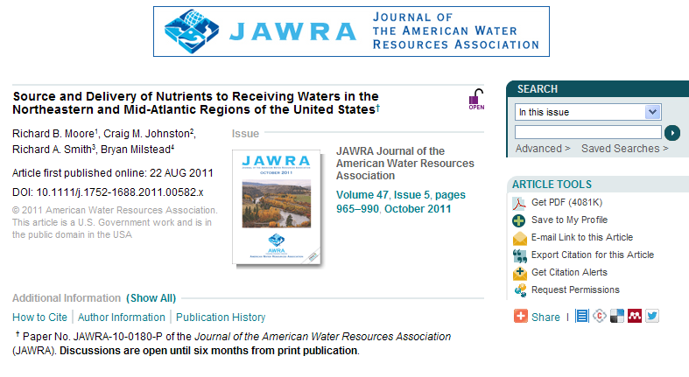
Sparrow Modeling to Understand Water-Quality Conditions
in Major Regions of the United States: A Featured Collection

Slide 8
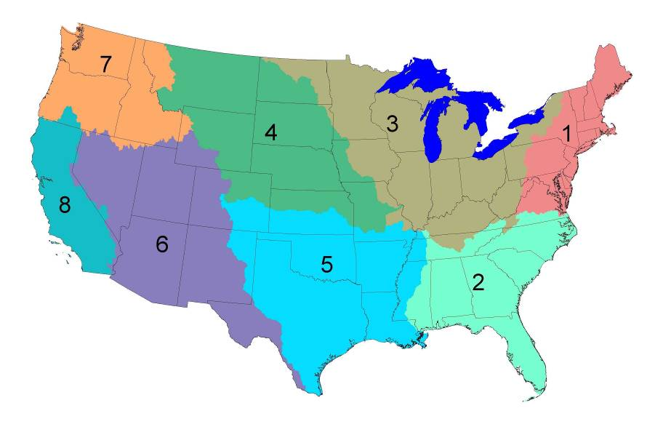

Regional Nutrient SPARROW models
developed for 2002 conditions
Major River Basin study areas
1 through 5, and 7 published

Slide 9
Regional Nutrient SPARROW models
developed for 2002 conditions -- with stream network
Major River Basin study areas
1 through 5, and 7 published
RF1 (NHDPlus V2
underway)
NHDPlus V1
RF1 (NHDPlus V2
underway)
RF1 (NHDPlus V2
underway)
NHDPlus V2
underway
RF1 (NHDPlus V2
underway)
RF1 (NHDPlus V1
underway)
RF1 = 1:500,000 scale
NHDPlus = 1:100,000 scale

Slide 10
Advantages in using NHDPlus
NE SPARROW model applications

Slide 11
Advantages in using NHDPlus to build models
  Provides greater detail
  A National Seamless Database of topographically derived catchments
  Mean annual stream flows and velocities
  “Value Added Attributes” (VAAs)
    Hydrologic sequence number
    Identified primary path
    From and to node navigation
    Terminal identifier

Slide 12
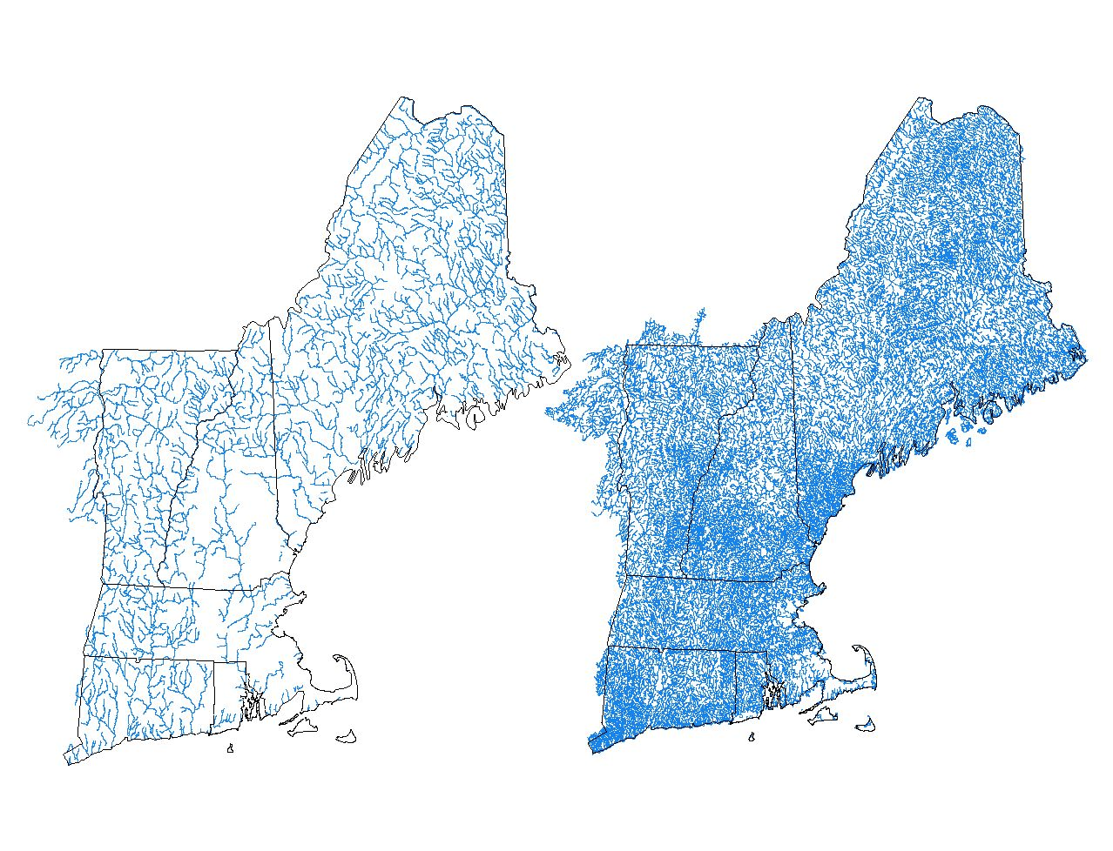
NHDPlus provides greater detail
RF1
2,462 Reaches
NHDPlus
72,085 Flowlines
(29 x RF1)

Slide 13
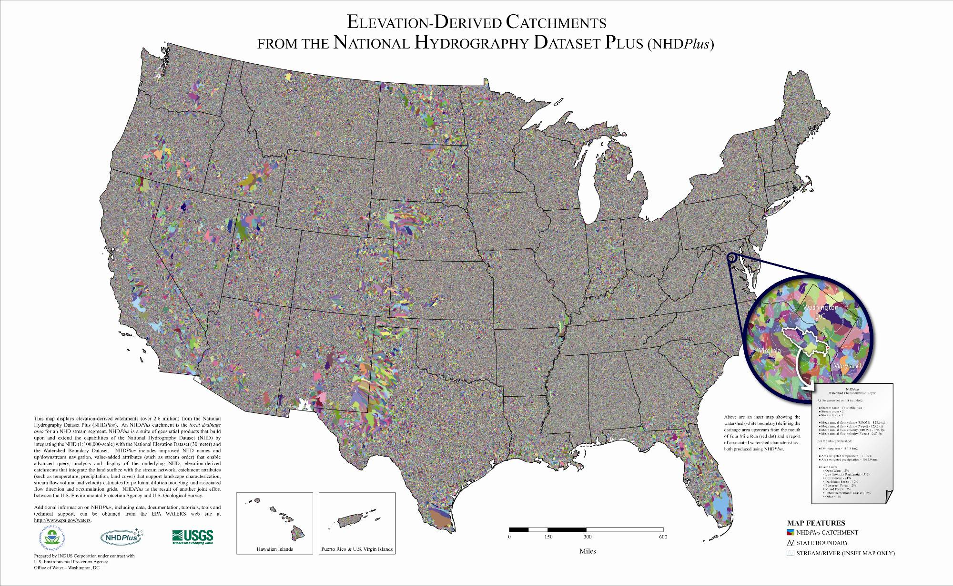
A National Seamless Database
2,613,709 catchments nationally

Slide 14
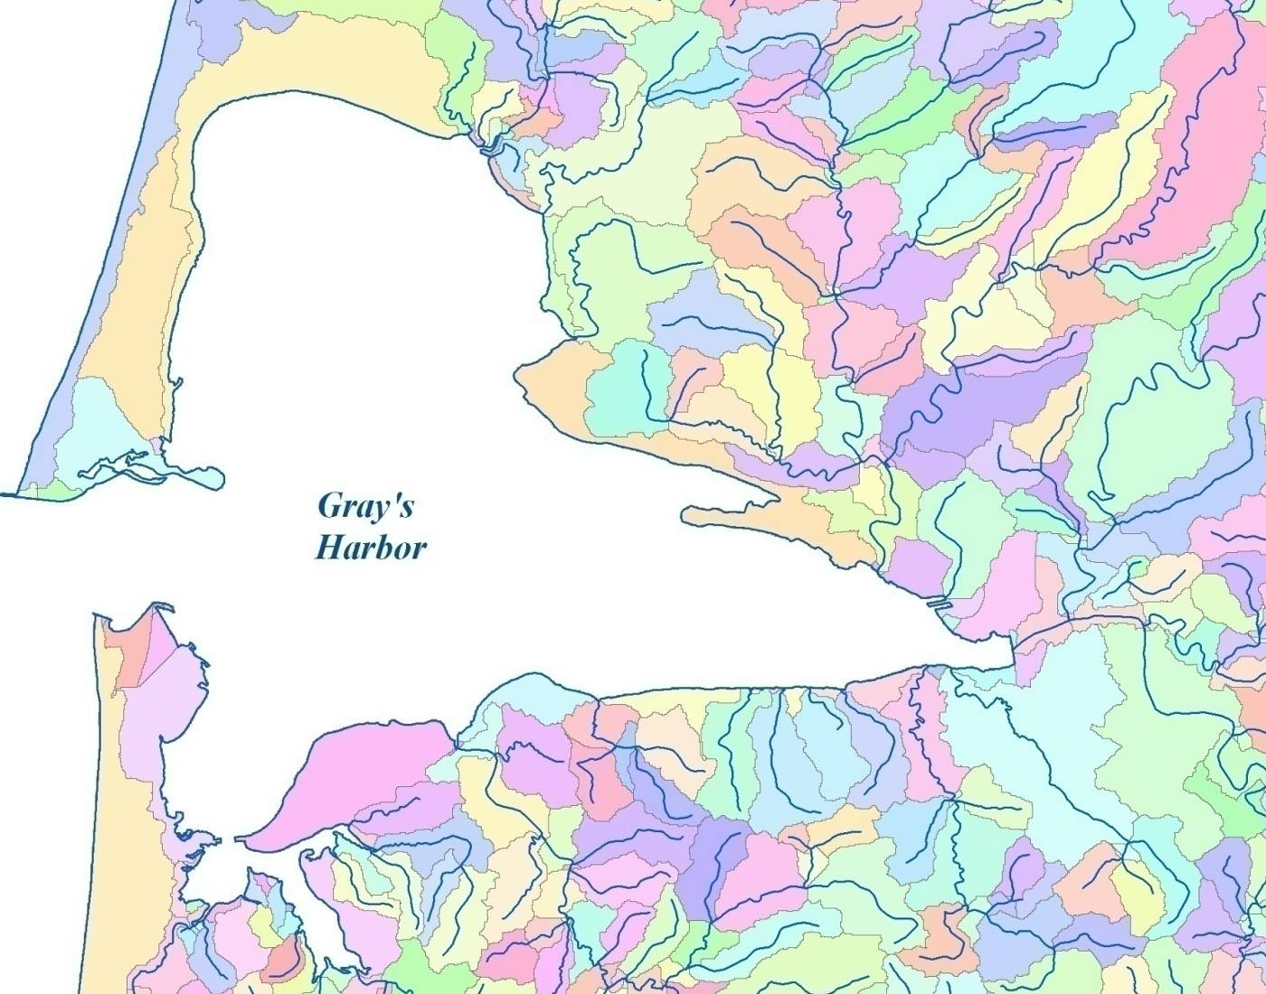
Catchments for Each Coastline Segment
13
Notes:
Day of Week, time am/pm
Day of Week, time am/pm

Slide 15
Catchments are used to compile the predictor variables:
  Nutrient source variables
  Land to water delivery variables
  Regionalization variables

Slide 16
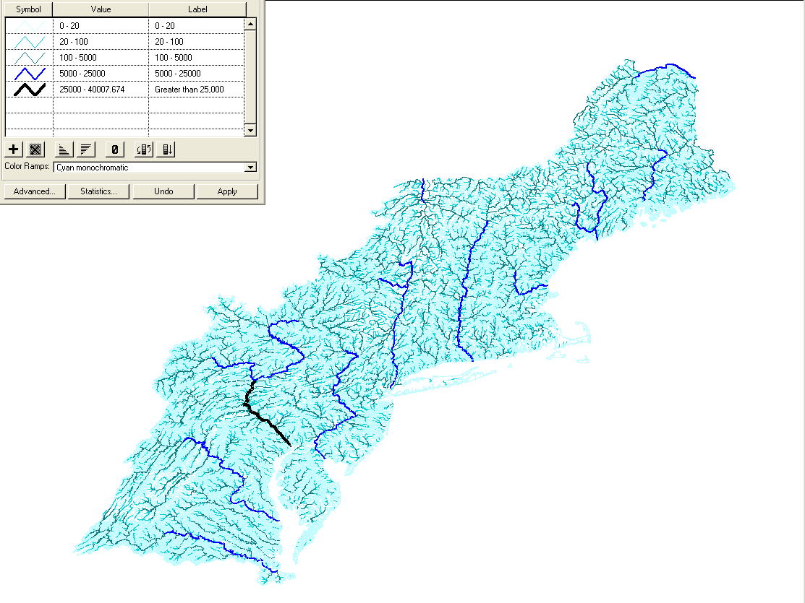
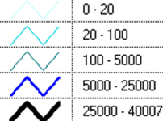
NHDPlus Flow Estimates
in cubic feet per
second (cfs)
Legend
SPARROW requires mean annual stream flow and velocity

Slide 17
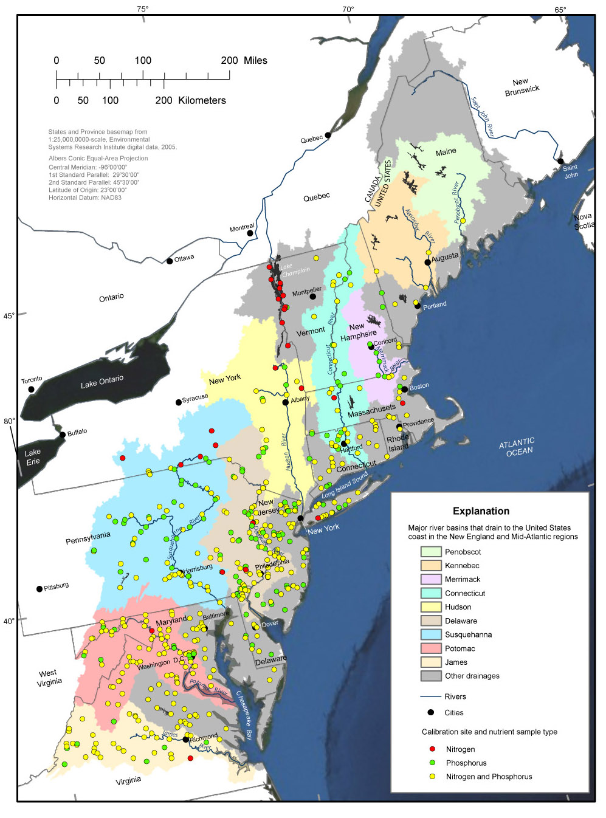
SPARROW model calibrated based on points, and predictions made for 187,171 stream segments
(plus 6156 coastal segments)

Slide 18
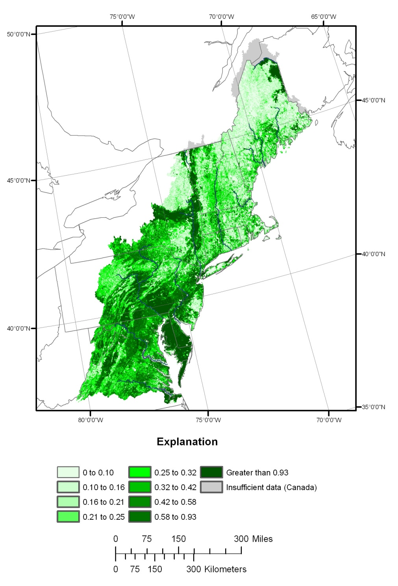
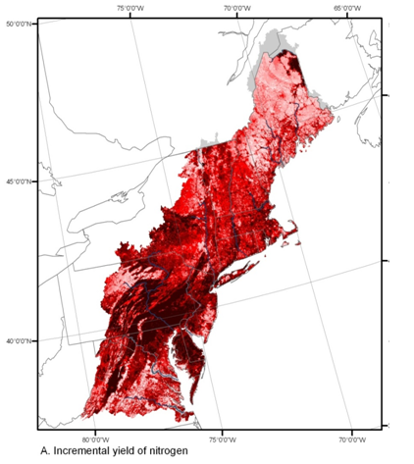

4A
4B
Phosphorus Nitrogen
Kg / ha / year
Phosphorus and Nitrogen yields predicted by the Northeastern and Mid-Atlantic regions SPARROW model.

Slide 19
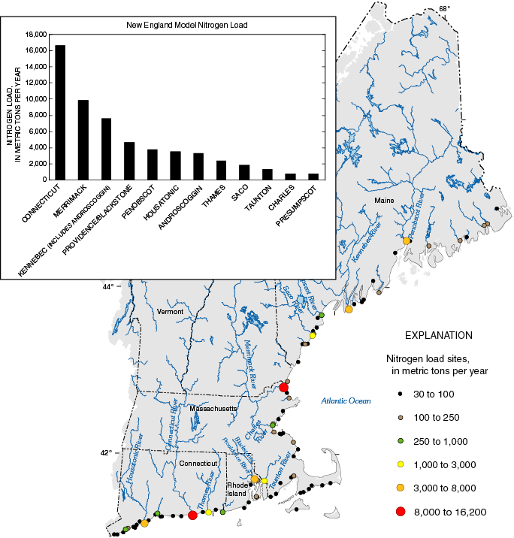
15,600 metric tons/year
SPARROW results are useful in evaluating load assessments to receiving waters
Long Island Sound

Slide 20
Predicted Sources of Nitrogen Loading from the Connecticut River Watershed to Long Island Sound

Slide 21
Predicted Nitrogen Load (kg/year)
Delivered to Long Island Sound from States within the Connecticut River Watershed

Slide 22
An Example
From Narragansett Bay
Integration:
1) National Coastal Assessment (probabilistic) sampling data,
2) moored instrumentation
3) Freshwater Nutrient (NHDPlus –based Sparrow) Modeling
4) Estuary Nutrient Mass Balance Calculations
EMAP 4/07

Slide 23
New England SPARROW Model
Narragansett Bay

Slide 24
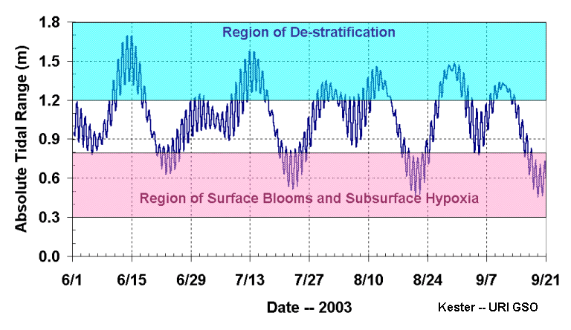
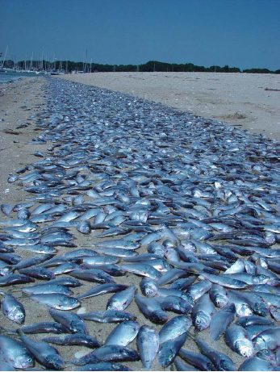
Dissolved Oxygen in Narragansett Bay, RI
Summer of 2003
Aug 20th

Slide 25
Point Sources
About 70 % of the TN loadings to the bay were estimated to be from point sources
  28 % directly into the bay
  42 % from upstream point sources (SPARROW model data)
  Supports recent management decisions to require tertiary treatment to reduce nitrogen loading to Narragansett Bay

Slide 26
Conclusion
  NHDPlus data structure is very compatible with freshwater nutrient (Sparrow) modeling, which has many useful applications
  NHDPlus represents a true partnership effort
  NHDPlus data website
  http://www.horizon-systems.com/nhdplus/

