Slide 1
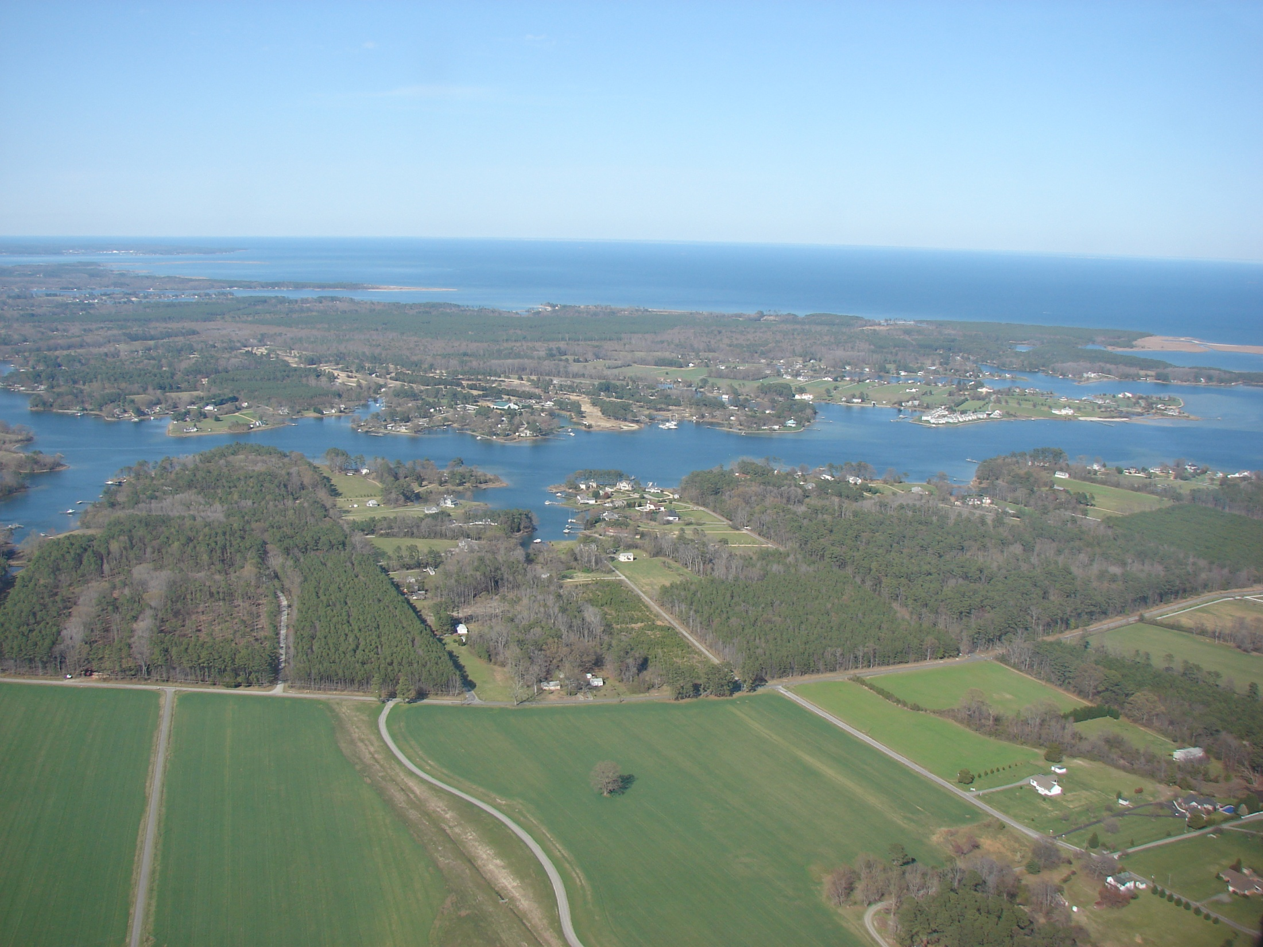
National Hydrography Dataset Plus
Version 2
(NHDPlusV2)
2012 ESRI User Conference
Presented by:
Cindy McKay, Horizon Systems Corporation
Sponsored by:
U.S. EPA, Office of Water

Slide 2

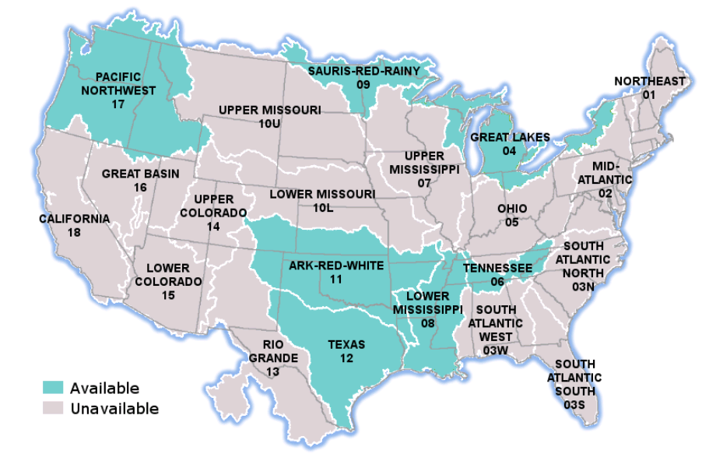
NHDPlus Availability
  NHDPlus Version 1 – 2006
    Available from Archive 6/1/2012
  NHDPlus Version 2 – 2012
    Full Continental U.S. ETA – 8/31/2012

Slide 3
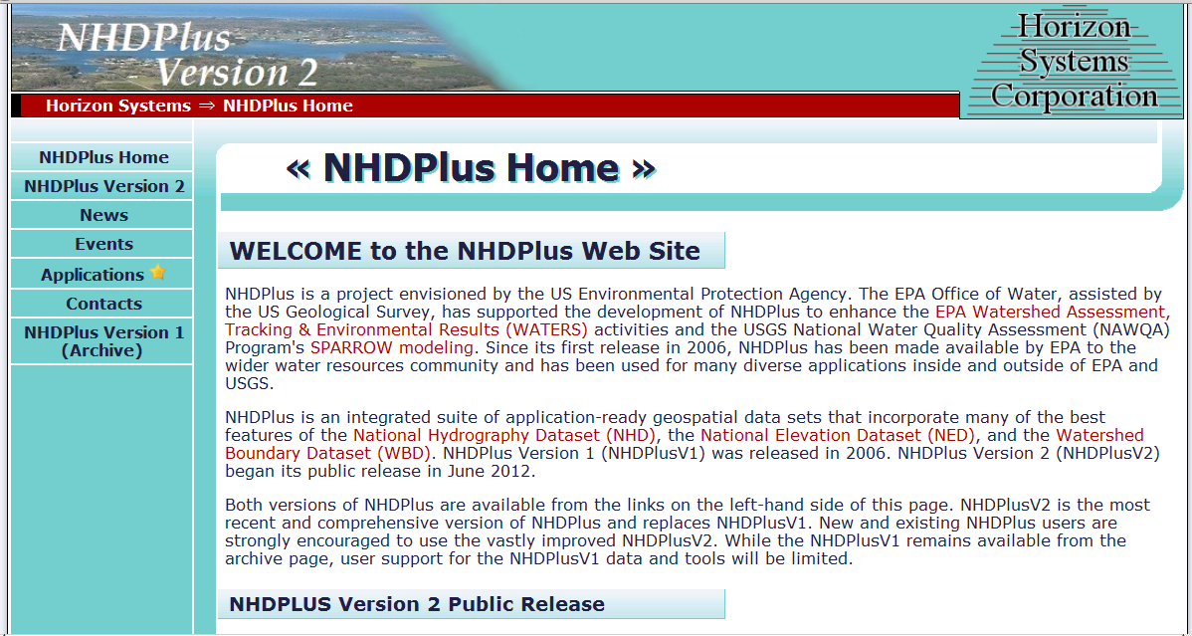
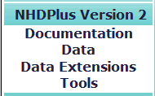
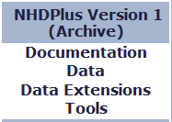
NHDPlus Access
ftp://ftp.horizon-systems.com/NHDPlus/NHDPlusV21

Slide 4
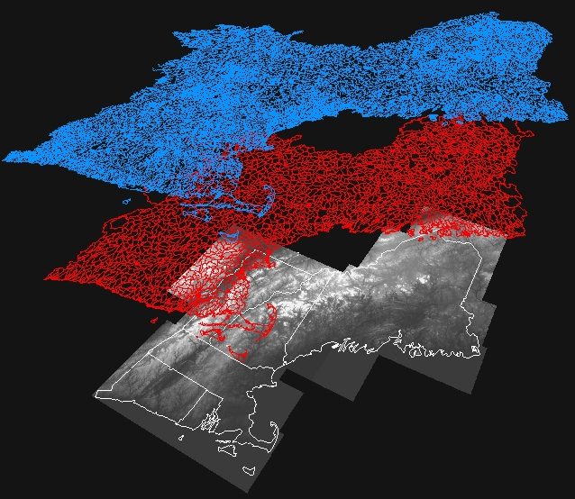
NHDPlus Concepts: Integration of NHD, WBD, and NED
National
Hydrography
Dataset (NHD)
Watershed
Boundary
Dataset (WBD)
National
Elevation
Dataset (NED)

Slide 5
NHDPlus Concepts: Integration of NHD, WBD, and NED
WBD Boundaries
“walled”
Into Elevation
NHD Streams
and
Waterbodies
“burned”
Into Elevation

Slide 6
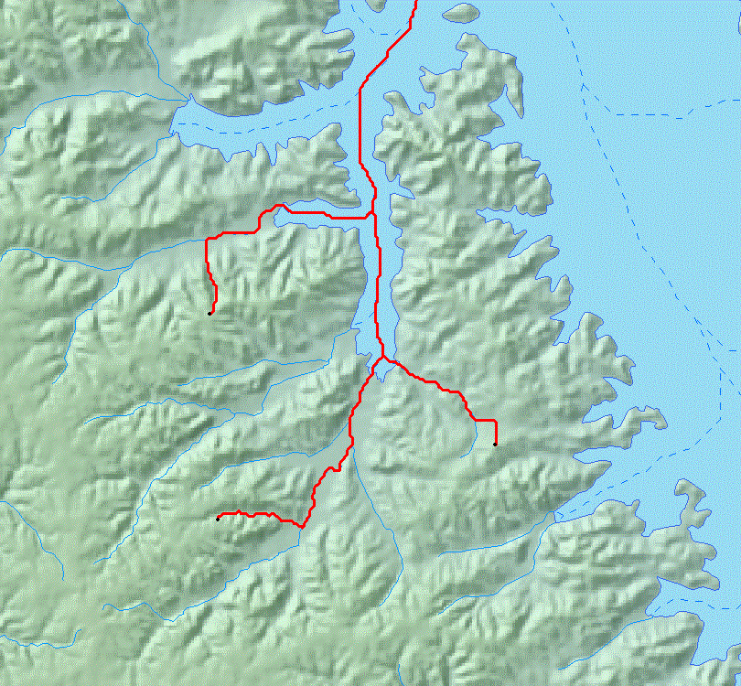

NHDPlus Concepts: Link between the Landscape the Mapped Stream Network

Slide 7
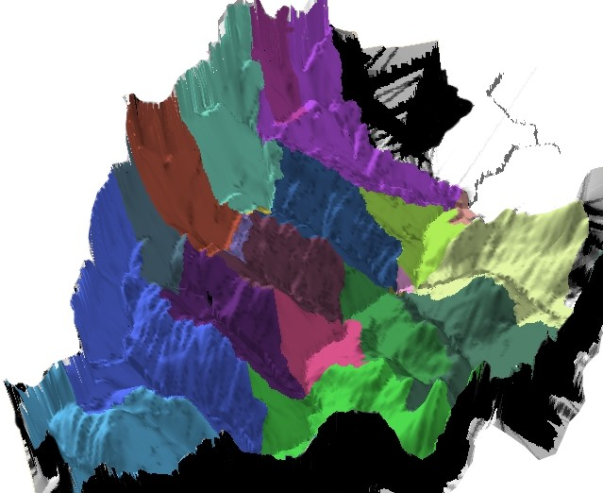
NHDPlus Concepts: Link the Landscape to the Mapped Stream Network
Catchment: Land Surface that Drains to Each Stream Segment

Slide 8
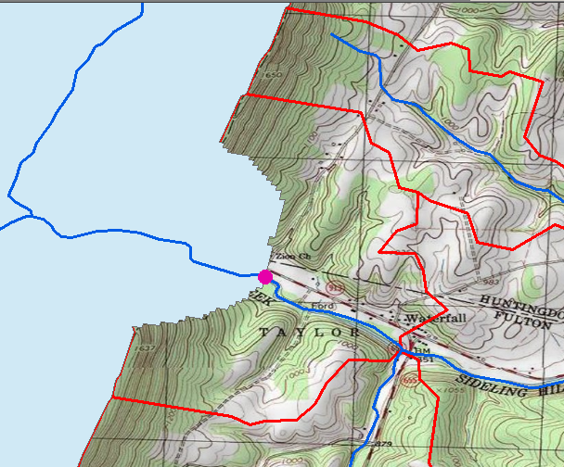
NHDPlus Concepts: Watershed Delineation From any Network Point

Slide 9
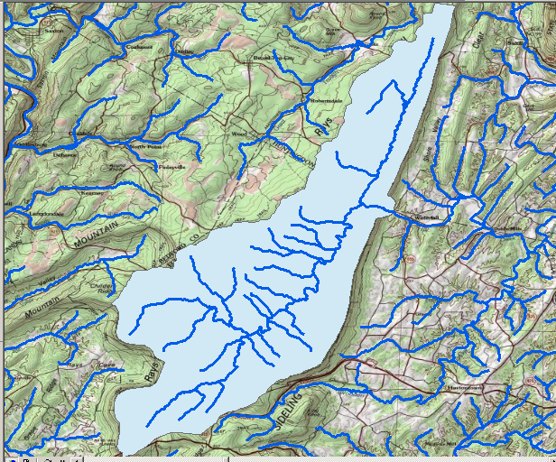
NHDPlus Concepts: Watershed Delineation From any Network Point

Slide 10
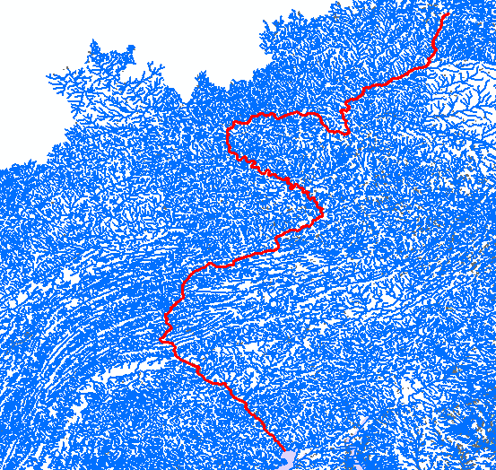
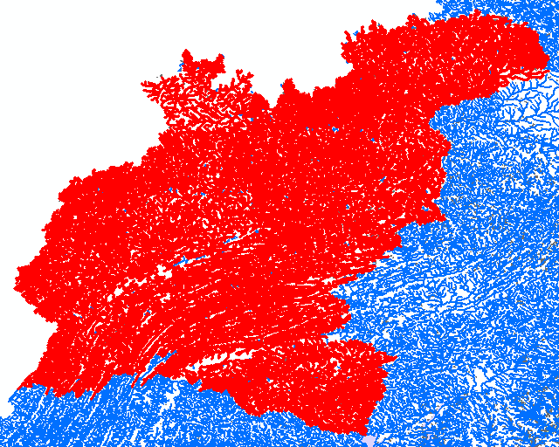
NHDPlus Concepts: Rapid Navigation of the Linear Surface Water Network
Susquehanna River
Drainage Basin
Susquehanna River
Main Stem

Slide 11
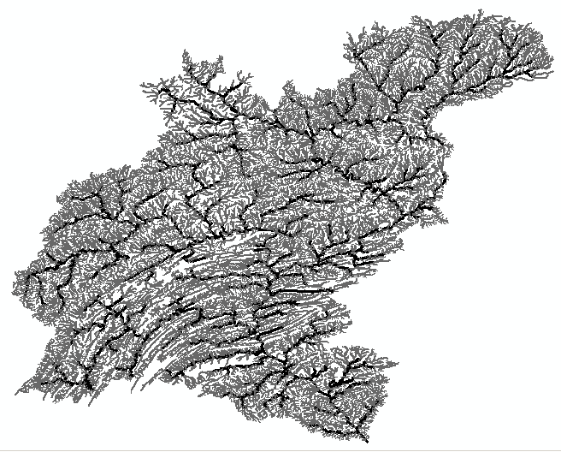
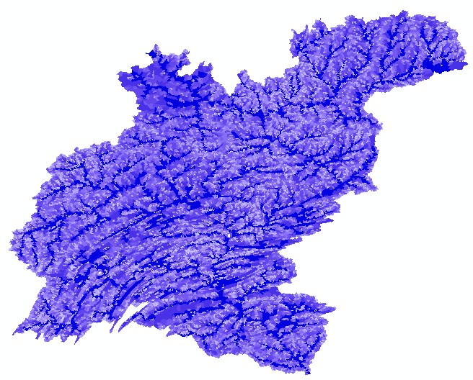
NHDPlus Concepts: Accumulated Characteristics using the Stream Network
Cumulative
Drainage Area
Stream Flow

Slide 12
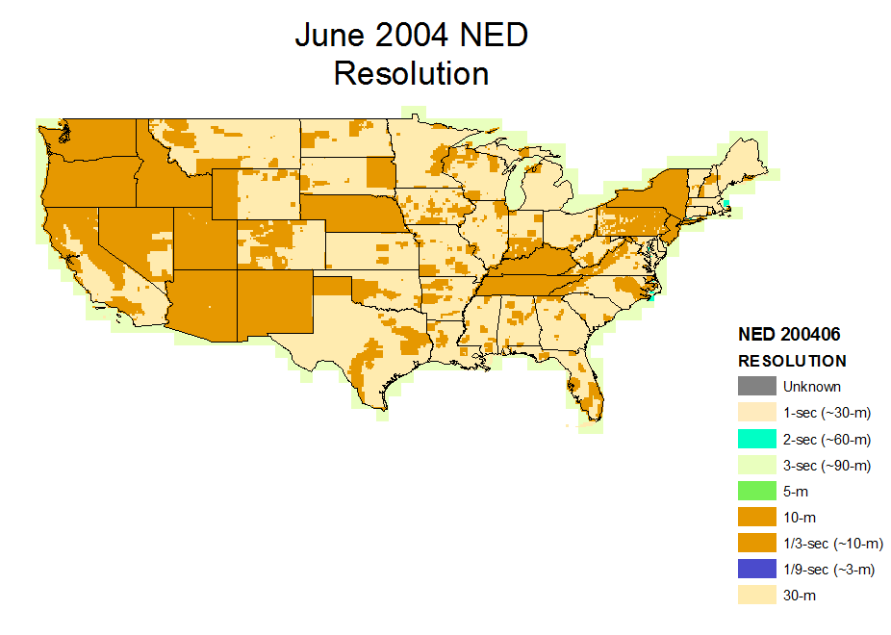
NHDPlusV1 - NED June 2004

Slide 13
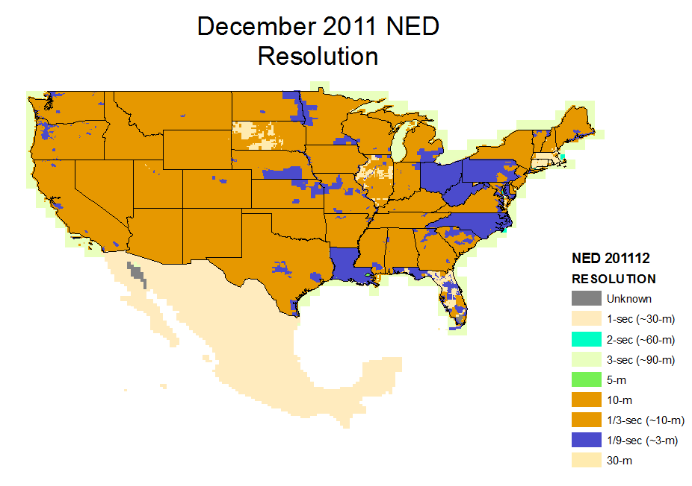
NHDPlusV2 – NED 2011-12
(ned.usgs.gov)
30m
re-sampled from
10m

Slide 14
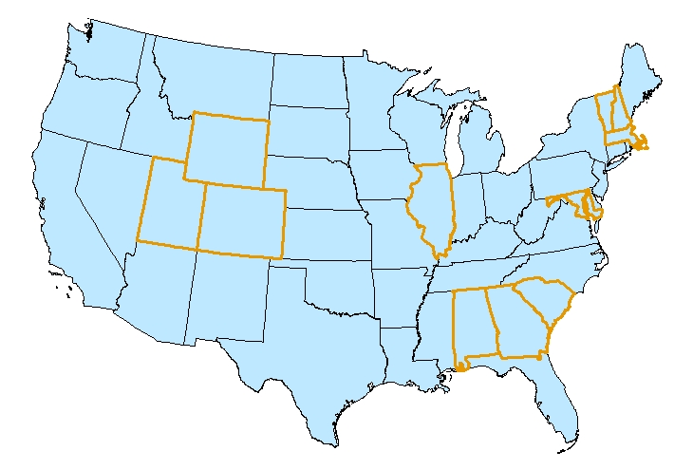
NHDPlusV1 – WBD 2005
Only Eleven States

Slide 15
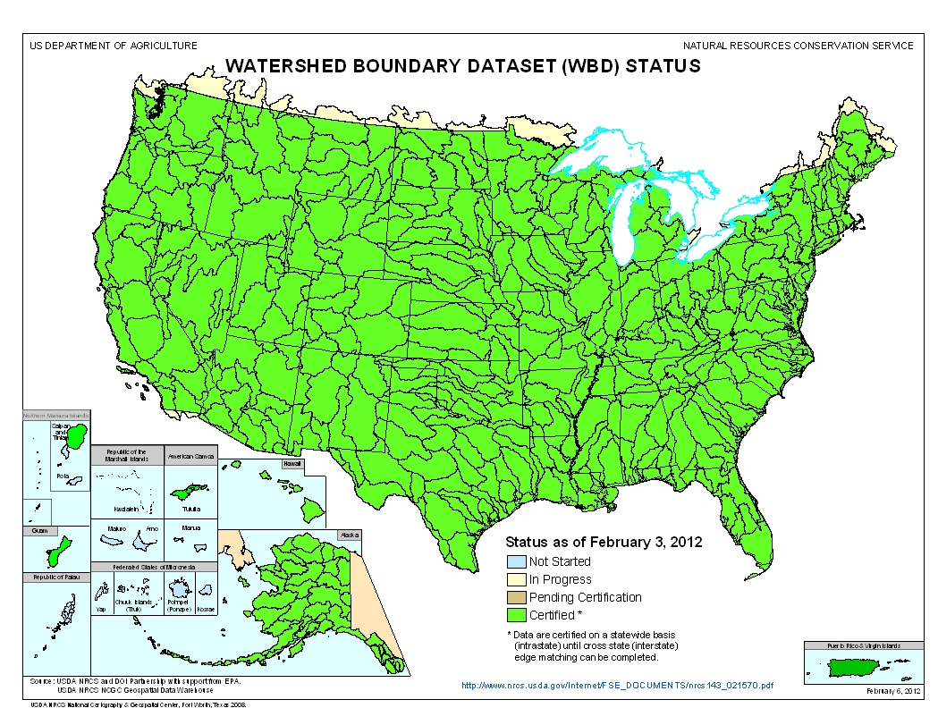
NHDPlusV2 – WBD 2011-12
(nrcs.usda.gov)

Slide 16
NHD: Data Improvements for NHDPlus V2
NHDPlusV2
  More names, corrected placement
  More lakes
  Lakes split by quad lines merged
  Disconnected networks connected
  Real sinks (non-contributing areas and networks that drain into the ground) identified
  Duplicate geometry removed
  Micro and small network gaps closed
  Great Lakes drainage connected
  Reachcodes migrated to the February 2012 WBD

Slide 17
Improved Process
NHDPlusV2
  Build/Refresh Tools
    Built-in QAQC
    More Consistent Processing Across the U.S.
    More Frequent Refreshes
    Scalable to Higher Resolution NHDPlus
  Inclusion of International Stream and Elevation Data
  Improved Hydro-Enforcement
  Enhanced Unit Run-off Flow Estimation

Slide 18

NHDPlusV2 Core Structure
Elev_cm
Fdr & Fac
FdrNull
PlusFlowlineVAA
CatSeed
FilledAreas
Hydrodem
CumulativeArea
Cat
FeatureIDGridCode
DivFracMP
Catchment
NHDFlowline
MegaDiv
NHDWaterbody
ElevSlope
Sink
PlusFlow
Burn Components
PlusARPointEvent
WBD_Subwatershed
PlusFlowAR

Slide 19
NHDPlusV2 Extended Structure
EROMExtension
Catchment & Cumulative Temp
NHDFlowline
Catchment & Cumulative Precip
Catchment Runoff
VOGELExtension

Slide 20
NHDPlusV2 Tools
Interactive Desktop Network Navigators
Batch Desktop Basin Delineator
Interactive Desktop Basin Delineator
Web Service Basin Delineator
Catchment Attribute Allocation and Accumulation
Network/Catchment/Attribute Generalization

Slide 21
NHDPlusV2 Access
http://www.epa.gov/waters/
NHDPlus.com
Google “NHDPlus”
User Support: NHDPlus@hscnet.com
Put yourself on the user email list.
Questions?
LDM@Horizon-Systems.com

