Slide 1
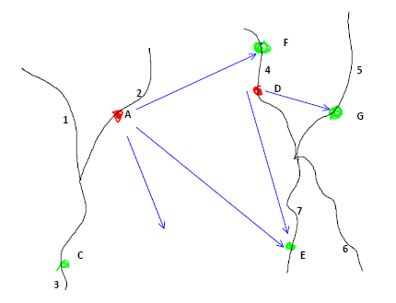


Improved Flow Estimates in NHDPlus Version 02
Tim Bondelid- NHDPlus Team
Consulting Engineer
2012 ESRI International User Conference
July 23-27, 2012
San Diego, CA

Slide 2
NHDPlus V02 Enhanced Runoff Method (EROM)
Contributors:
  The NHDPlus Team
  EROM:
    Dave Wolock, USGS
    Kernell Ries, USGS
    Greg Schwarz, USGS

Slide 3
Importance of
Stream Flow Estimates
Support the water element goals expressed in the EPA Strategic Plan
Support the water mission of the USGS
  Water-quality modeling (SPARROW)
  Regional and national stream flow assessments goal of National Stream Flow Information Program
  National Water Census
Watershed planning and management

Slide 4
NHDPlus Version 02
Flow Estimation
  Enhanced Runoff Method (EROM)
    Mean annual and mean monthly flow estimates
      Current V02 release is mean annual flow
    Significantly improved ingredient data
    Five-step process
      Each step incrementally improves the flow estimates
    Flow QA module; statistics on performance

Slide 5
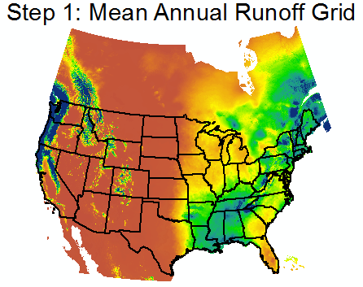
U.S.: Wolock and McCabe; CN and MX: Canadian Forest Service

Slide 6
Step 1: Runoff (SR)
QA Statistics
Gage Runoff EET Ref Reg. PlusFlow Gage Seq.
Mean Mean SEE Mean SEE Mean SEE Mean SEE SEE
2.36 2.17 58.8 2.17 58.8 2.37 32.6 2.37 32.6 23.0

Slide 7
Step 2: Excess Evapotranspiration
(EET)
Method developed by Dave Wolock of USGS.
(graphic courtesy of Dave Wolock)
7
Notes:
A couple of other points: the dashed line would be the equivalent of the Step 1 runoff flows, which is a conservative flow accumulation. The solid line is the effect of Excess ET. Note how it does a much better job of matching gage flows.
Also, it’s possible that the area circled in red could be used a “diagnostic” for places where PlusFlowAR records are needed.

Slide 8
Step 2: EET (10L)
QA Statistics
Gage Runoff EET Ref Reg. PlusFlow Gage Seq.
Mean Mean SEE Mean SEE Mean SEE Mean SEE SEE
2.35 2.46 118.7 2.30 90.6 2.37 32.6 2.37 32.6 23.0

Slide 9
Step 1: Runoff (SR)
QA Statistics
Gage Runoff EET Ref Reg. PlusFlow Gage Seq.
Mean Mean SEE Mean SEE Mean SEE Mean SEE SEE
2.36 2.17 58.8 2.17 58.8 2.37 32.6 2.37 32.6 23.0

Slide 10
Step 3: Reference Gage
Regression (SR)
QA Statistics
Gage Runoff EET Ref Reg. PlusFlow Gage Seq.
Mean Mean SEE Mean SEE Mean SEE Mean SEE SEE
2.36 2.17 58.8 2.17 58.8 2.37 32.6 2.37 32.6 23.0

Slide 11
Step 4: Transfer, Withdraw, Augment Flows (“PlusFlowAR”)
2
.3
.3
2
1
6
4
Transfer 2 cfs
7
.5
9
2.5
10
.5
8
12

Slide 12
Step 4: “PlusFlowAR” (NE)
QA Statistics
Gage Runoff EET Ref Reg. PlusFlow Gage Seq.
Mean Mean SEE Mean SEE Mean SEE Mean SEE SEE
2.42 2.40 14.9 2.40 14.9 2.43 14.7 2.43 11.7 10.9

Slide 13
Step 5: Gage Adjustment
2
.3
.3
2
Flowline adjustments closest
to the gage will get higher weights than Flowlines farther from the gage
1
6
.5
9
10
.5
Gage DA = 12
Gage Q = 13
EROM Flow = 12
QAdj = 13 – 12 = 1
12
Notes:
This graph shows cumulative DA’s for each flowline

Slide 14
Gage Adjustment: Re-Accumulated Flows
2
.3
.3
2
1
6.16
.5
9.40
.5
10.67
Gage DA = 12
Gage Q = 13
Flowline Flow = 12
QAdj = 13 – 12 = 1
13
Notes:
Flow adjustments are proportional to the cumulative drainage areas of the adjusted flowlines.

Slide 15
Gage Adjustment QA:
Randomly remove 20% of the gages from the gage adjustment
  Called “Gage Sequestration”
Provides a ballpark estimate of how well the final, gage-adjusted flows match gage flows
QA Statistics
Gage Runoff EET Ref Reg. PlusFlow Gage Seq.
Mean Mean SEE Mean SEE Mean SEE Mean SEE SEE
2.36 2.17 58.8 2.17 58.8 2.37 32.6 2.37 32.6 23.0

Slide 16
EROM – Next Steps
We are always looking for ways to improve EROM
  Reference Gage Regression; issue with cases where it “over-adjusts” at higher flows
  Increase the number of gages; the more valid gages the better!
  Update to a more recent version of Reference Gages; “GAGESII”?
  Adjust flows further upstream?
  Monthly flows

Slide 17
Down the Road
PlusFlowAR:
  Incorporate more detailed information from NHD Stewards, WBD, others!
  Seasonal values?
EET Step: Model Coefficients, issues in some areas
Other flows: 7Q10
Use a 1981-2010 time frame
  PRISM has released “normals” for this period
  The major issue: international drainage

Slide 18
Questions?
Tim Bondelid - Independent Consultant to EPA
timothy@trbondelid.com
NHDPlus V02:
http://www.horizon-systems.com/NHDPlus
Notes:
18

