Slide 1
Improved DEM Derivatives in the NHDPlus Version 2
Alan Rea
Craig Johnston
Richard Moore

Slide 2
DEM Derivatives included in NHDPlus Version 2
Flow direction grid
Flow accumulation grid
Catchment grid and shapefile
Catchment seed grid (rasterized NHD, sinks)
HydroDEM (burned and walled)
Filled areas grid (diagnostic)
fdrnull grid (for computing flowlength)

Slide 3
Burn Components used to create HydroDEM
BurnLineEvent (lines)
BurnWaterbody (polygons)
Sink (points—not directly in NHD)
Wall (lines)
LandSea (polygons)
BurnAddLine (lines not in NHD)
BurnAddWaterbody (polys not in NHD)

Slide 4
HydroDEM development
Process uses an AML called AGREE developed by University of Texas to “burn” NHD streams into the NED (NHDPlus V2 uses python and geoprocessing tools)
Needed since NHD streams do not always match the NED flowpaths – “DEM Flowpath Displacement”

Slide 5
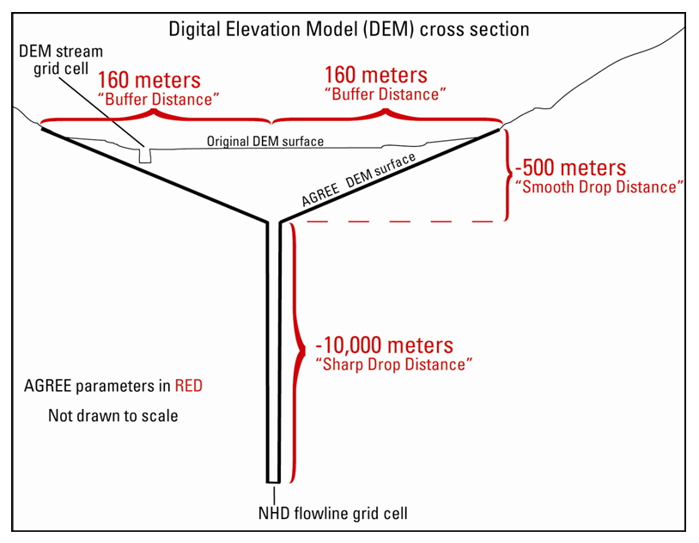
Hydro Enforcement for streams: “stream burning”

Slide 6
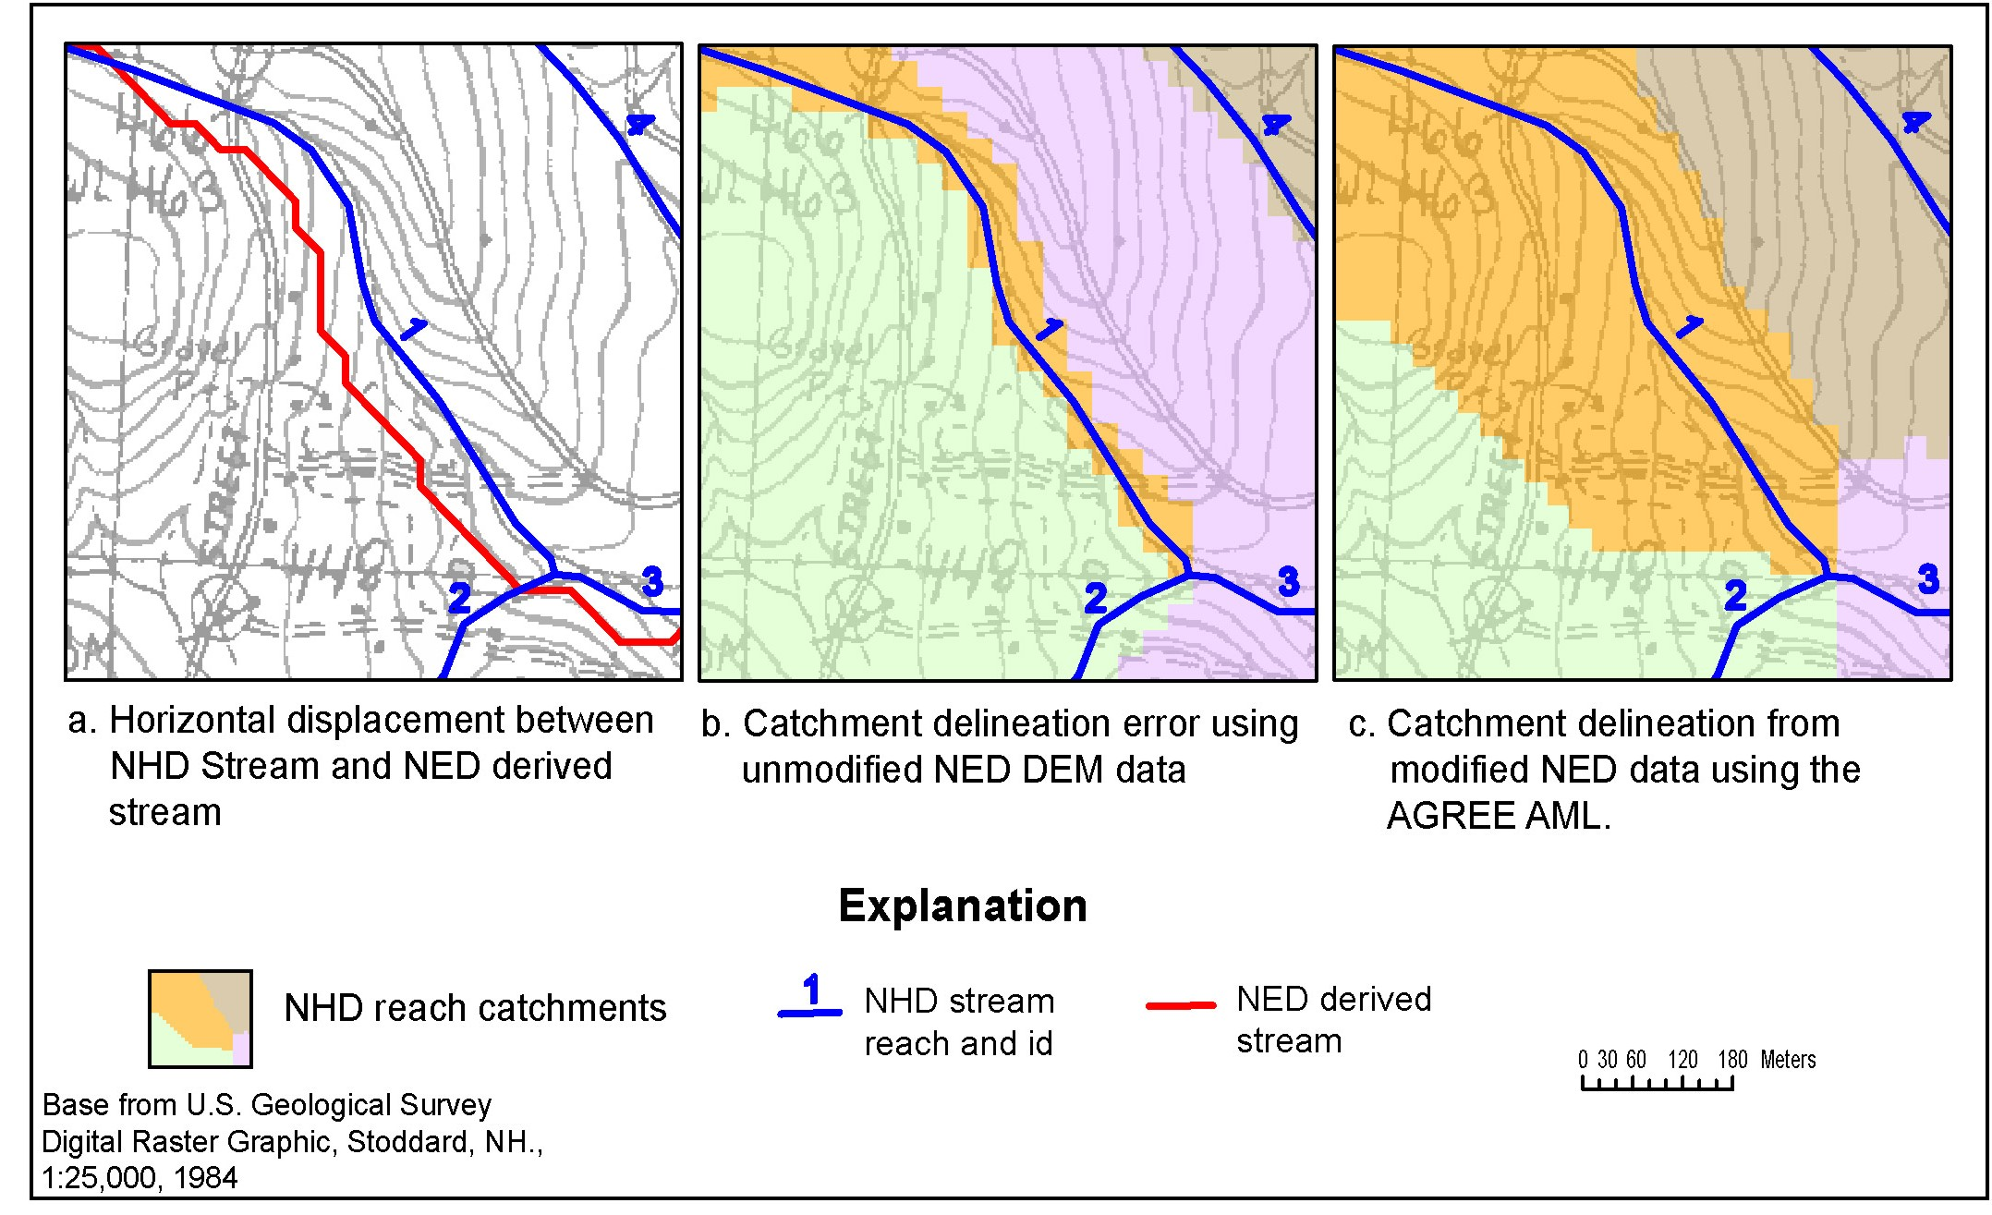
NED versus HydroDEM

Slide 7
NHDPlus Refinements
Further modified the DEM surface within waterbodies to create a “Bathymetric Gradient”
Version 2 also burned in all water bodies, even isolated ones
Catchments were generated for the NHD coastal reaches
Catchments also were generated for sinks in Version 2
Used VAA to enforce hydro stepping

Slide 8
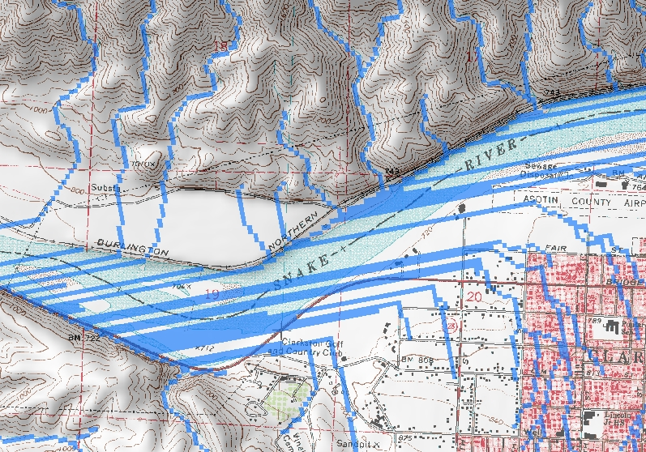
Standard DEM flow paths

Slide 9
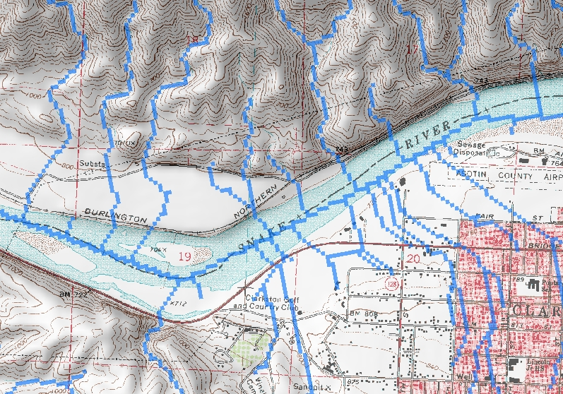
Flow paths with Bathymetric Gradient

Slide 12
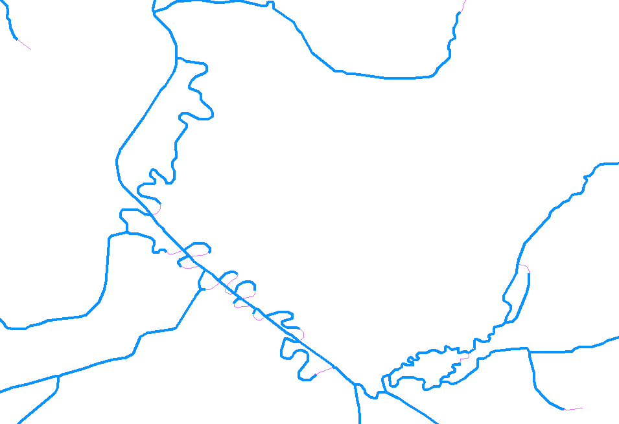

Slide 13
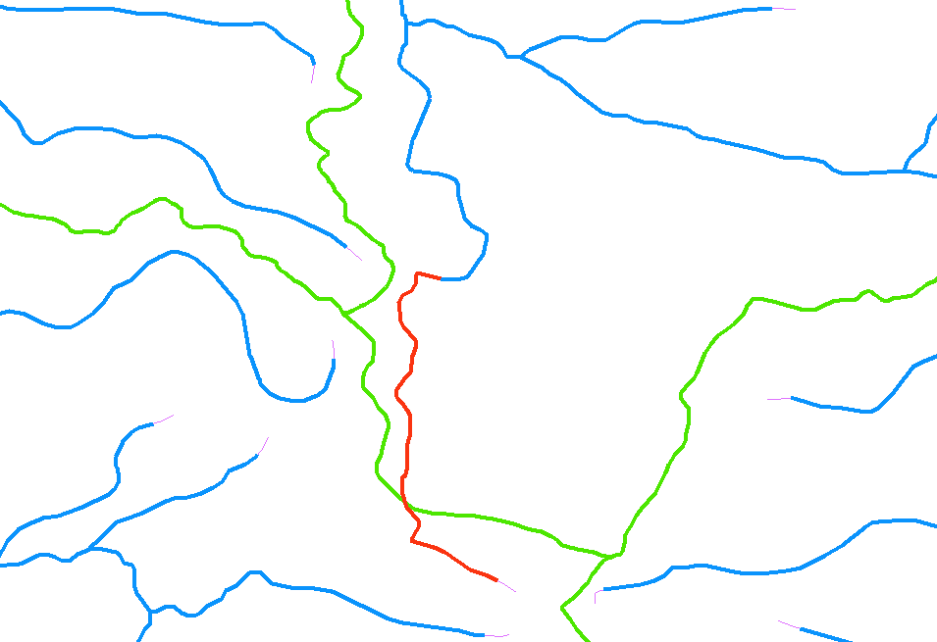

Slide 14
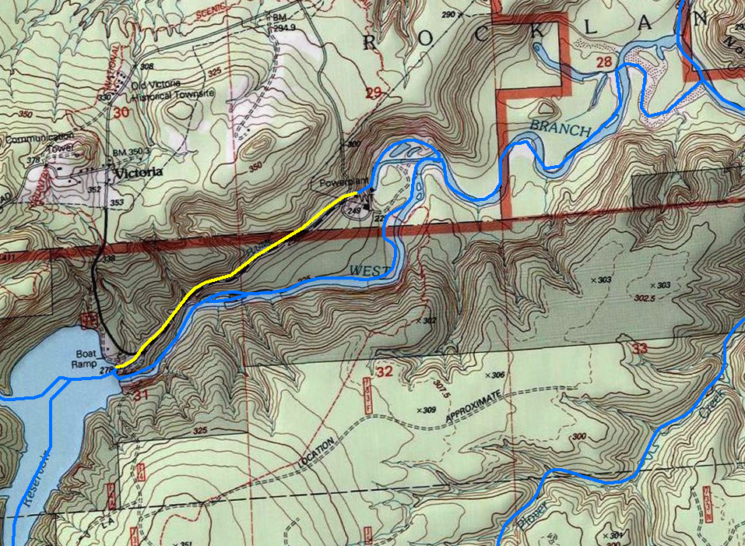
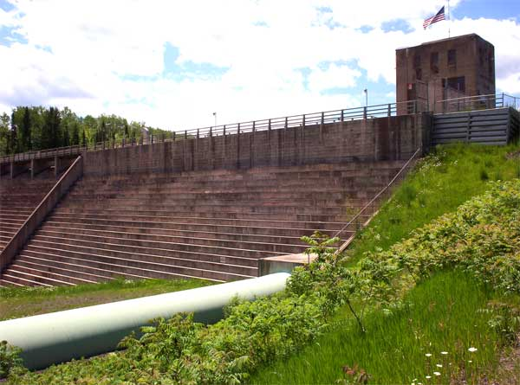
Victoria Reservoir Michigan
NHD Flowline FTYPE = Pipeline
Catch Burn Attributes
Catchment = N
Burn = N

Slide 15
Sinks in NHDPlus V2
A sink causes the raster representation of flow to stop
Actually created by inserting a NODATA cell in the HydroDEM grid
There are many more sinks in NHDPlus V2 than there were in V1
Sinks inserted wherever streams stop

Slide 16
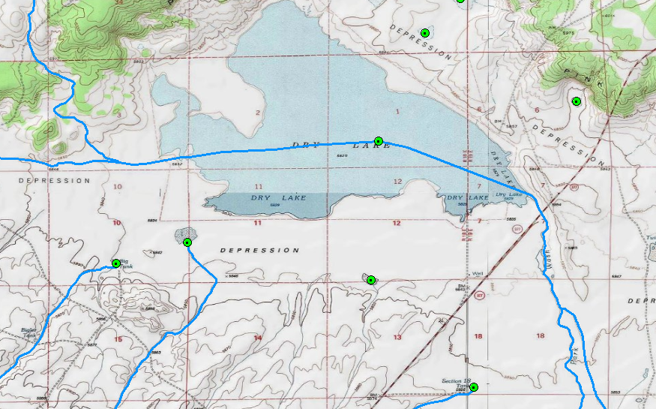
Sink Examples

Slide 17
Summary
Burned and walled HydroDEM and derivatives
Improvements to the flow direction grids
Improved input data (especially WBD)
Many more sinks than V1
Catchments generated for sinks
HydroDEM and Burn Components included in distribution

Slide 18
Questions?
ahrea@usgs.gov
http://www.horizon-systems.com/nhdplus/

