Slide 1


NHDPlus
A National Surface Water Geospatial Framework
USGS P&S Technical Teleconference
September 10, 2012
Notes:
NHDPlus provides a national surface water geospatial framework for integrating, visualizing and analyzing water information.

Slide 2
NHDPlus Presentation
USGS P&S Technical Teleconference
September 10, 2012
    Draft Agenda –
      Concepts
      Geographic Extent
      Applications Sampler
      Under the Hood
      What’s Next
    Presenting –
      Tommy Dewald (USEPA, Office of Water)
      Cindy McKay (Horizon Systems Corporation)
      Al Rea (USGS, Water)

Slide 3
What is NHDPlus?
An integrated suite of application-ready geospatial data sets developed to enable estimates of flow volume and velocity to support pollutant fate-and-transport (dilution) modeling
Incorporates many of the best features of the
  National Hydrography Dataset (NHD)
  National Elevation Dataset (NED)
  Watershed Boundary Dataset (WBD)
Includes -
  improved NHD names and networking
  elevation-derived catchments for each stream segment
  stream and catchment attributes
  flow direction and accumulation grids
Notes:
improved NHD names and networking
value-added attributes (such as stream order) that enable advanced query, analysis and display
elevation-derived catchments that integrate the land surface with the network
catchment attributes (such as temperature, precipitation, land cover)
stream flow volume and velocity estimates for pollutant dilution modeling
associated flow direction and accumulation grids

Slide 4
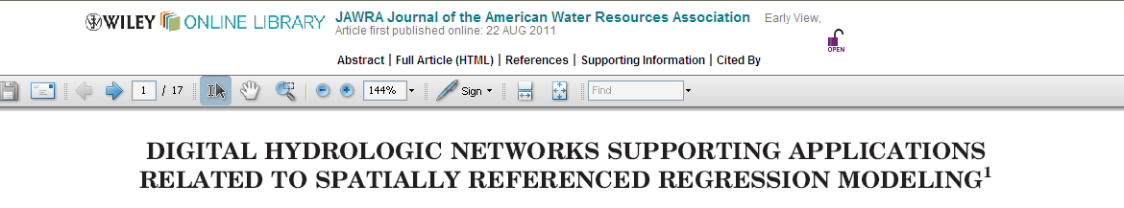
ABSTRACT (excerpt): Digital hydrologic networks depicting surface-water pathways and their associated drainage catchments provide a key component to hydrologic analysis and modeling. Collectively, they form common spatial units that can be used to frame the descriptions of aquatic and watershed processes. In addition, they provide the ability to simulate and route the movement of water and associated constituents throughout the landscape. Digital hydrologic networks have evolved from derivatives of mapping products to detailed, interconnected, spatially referenced networks of water pathways, drainage areas, and stream and watershed characteristics. These properties are important because they enhance the ability to spatially evaluate factors that affect the sources and transport of water-quality constituents at various scales. ….

Slide 5
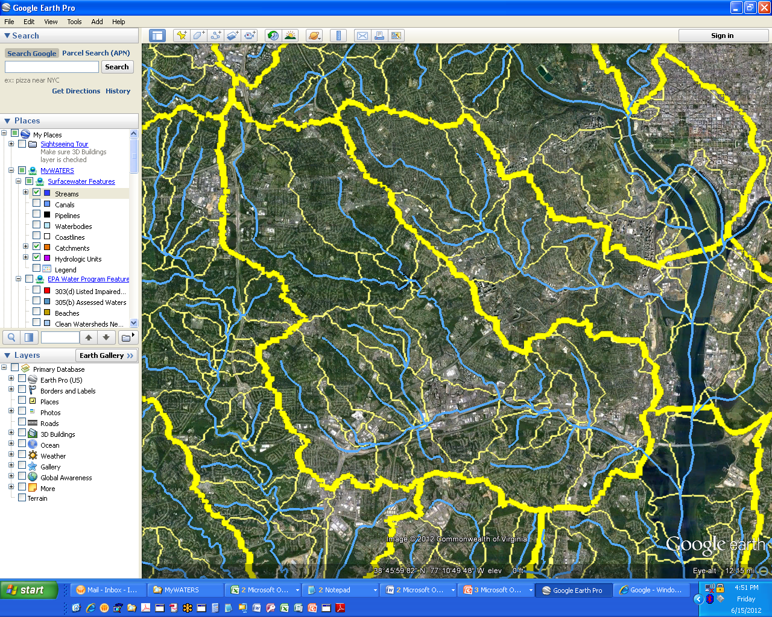
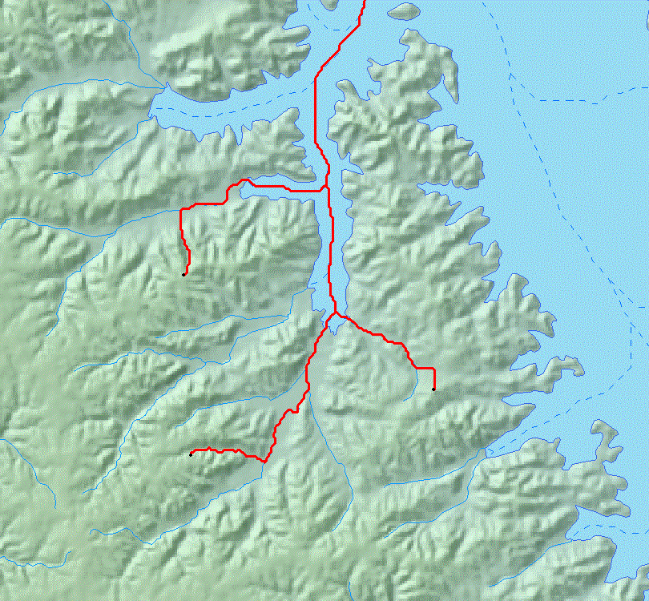
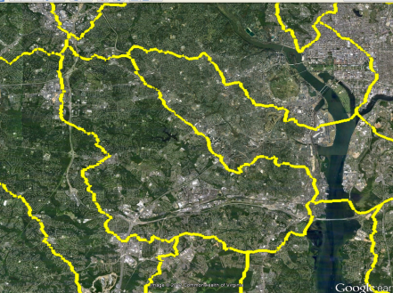
NHDPlus provides a Surface Water Geospatial Framework
Elevation
NHDPlus catchments link the landscape to the stream network forming a surface water geofabric
Hydrologic Units
(HUC12)
Stream Network
Stream Network | Map Scale | Map Accuracy | Total Stream Miles (mi) | # of Stream Segments | Stream Segment Average Length (mi) | # of Lakes | Catchment Average Area (sq mi)
Reach File Version 1 (RF1) | 1:500K | +/- 254m | 600,000 | 60,000 | 10 | 4,100 | 50
Medium Resolution NHD | 1:100k | +/- 50m | 3,200,000 | 2,600,000 | 1.2 | 38,000 | 1.1
High Resolution NHD | 1:24K or better | +/- 12m | 7,500,000 | 20,000,000 | 0.37 | 537,000 | do not exist

Slide 6
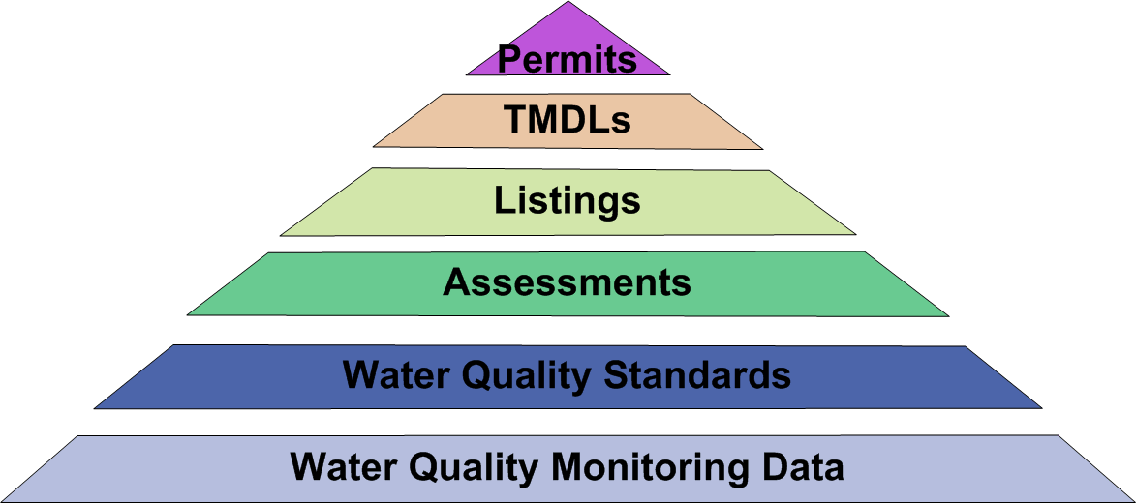
Providing Clean and Safe Water
Surface Waters (National Hydrography Dataset Plus)
Notes:
NHDPlus support EPA/OW primary business need - To know where surface waters and things affecting them are located (anywhere on the landscape) in order to support measures of progress towards providing clean and safe water.
EPA Relies Upon NHD/NHDPlus
Fundamental infrastructure for pursuing its goal of clean and safe water
Enables watershed protection through geospatial data and tools
Geospatial framework that promotes consistency and effectiveness in water quality analysis and reporting
Supports an ever increasing number of critical programmatic applications

Slide 7

WATERS Data Architecture
(Watershed Assessment, Tracking & Environmental ResultS)
(www.epa.gov/waters)
GRTS
WQSDB
Nonpoint Source Grants
Reach Address Database
(RAD)
Water Quality Standards
National
Hydrography
Dataset Plus
ATTAINS
STORET
Water Quality Assessments,
Impaired Waters &
Total Maximum Daily Loads
Water Quality Monitoring

Slide 8
Data Accessible Through WATERS
Public Access
Listed Impaired Waters
Assessed Waters
Beaches
Clean Watershed Needs
Combined Sewer Overflows
CWSRF Benefits Reporting
Permitted Dischargers
Fish Consumption Advisories
Fish Tissue Data
Impaired Waters with TMDLs
Sewage No Discharge Zones
Nonpoint Source Projects
Water Quality Standards
Water Quality Stations
Internal Access Only
Drinking Water Intakes
Source Water Areas
Special Appropriations Projects

Slide 9
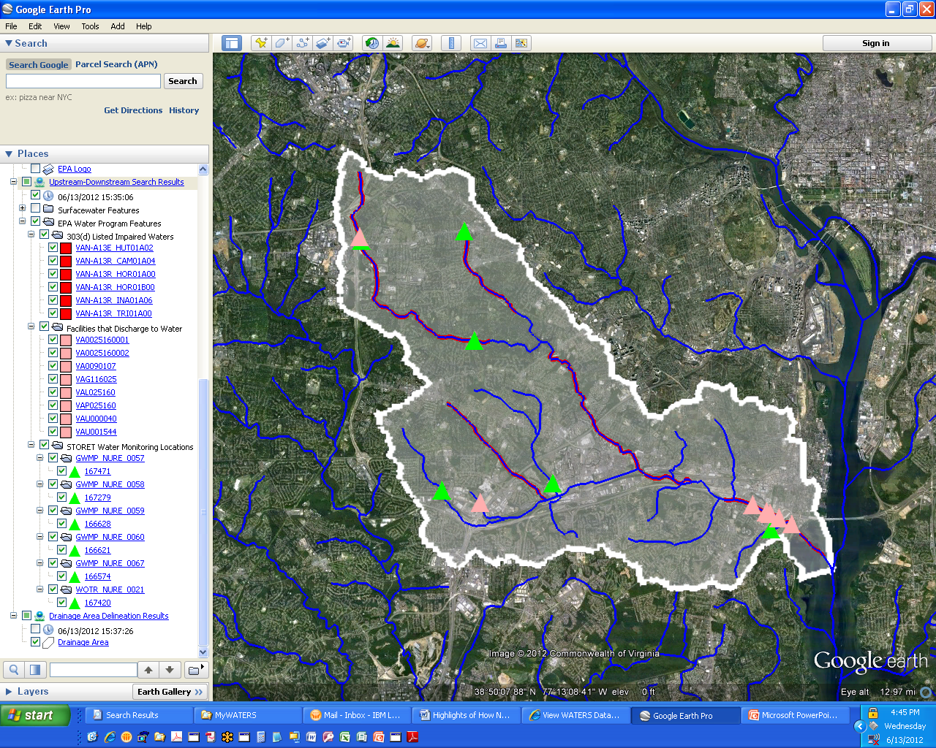
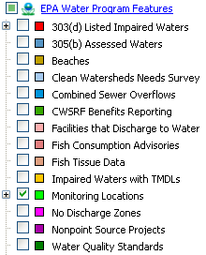
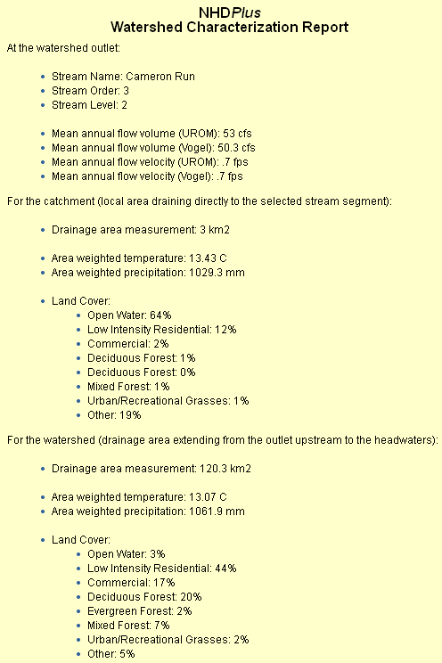
This data architecture enables ... …
EPA has developed a robust set of tools and services that use this framework to support integrated, cross-programmatic display and analysis
Core Tools and Services
Reach IndexingTools for linking data to the network
Forms-based Tools – AskWATERS, Expert Query
Map-based Tools – MyWATERS Mapper, Google Earth KMZ
Sharable web services used by these and other applications
  Map layers
  Analytical – waterbody name search, up/downstream search, watershed delineation, watershed report, total waters summaries, …

Slide 10
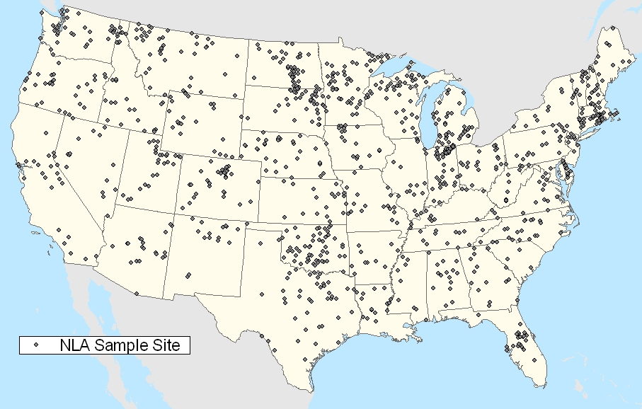
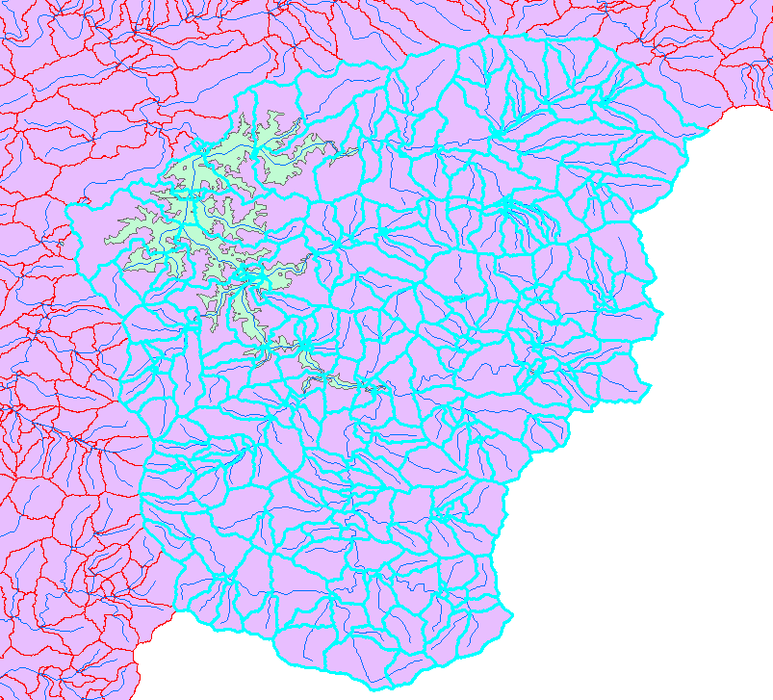
EPA National Aquatic Resource Surveys
NHDPlus serves as the basis for
establishing the NRSA and NLA survey sample frames – from which a representative set of sample sites are randomly selected.
NHDPlus is also used to calculate drainage areas for sampled sites to support data analysis.
(www.epa.gov/owow/lakes/lakessurvey)

Slide 11
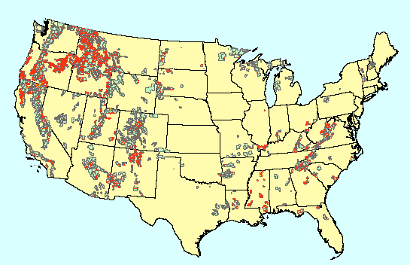
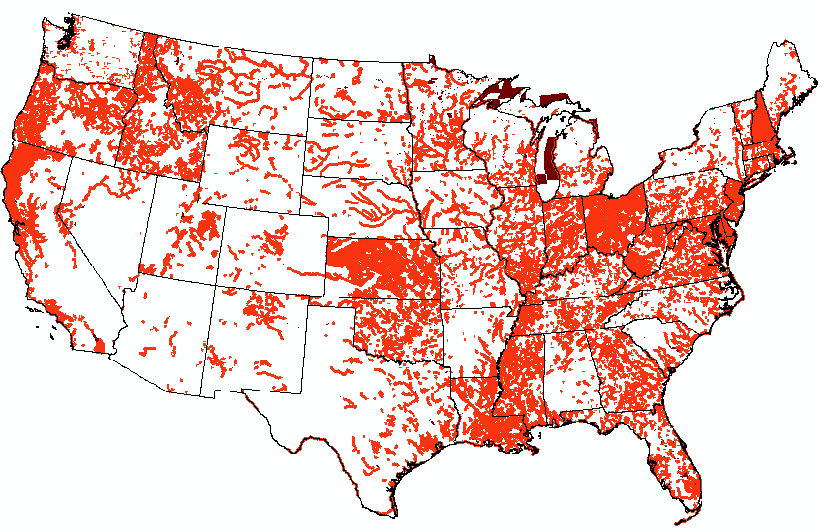
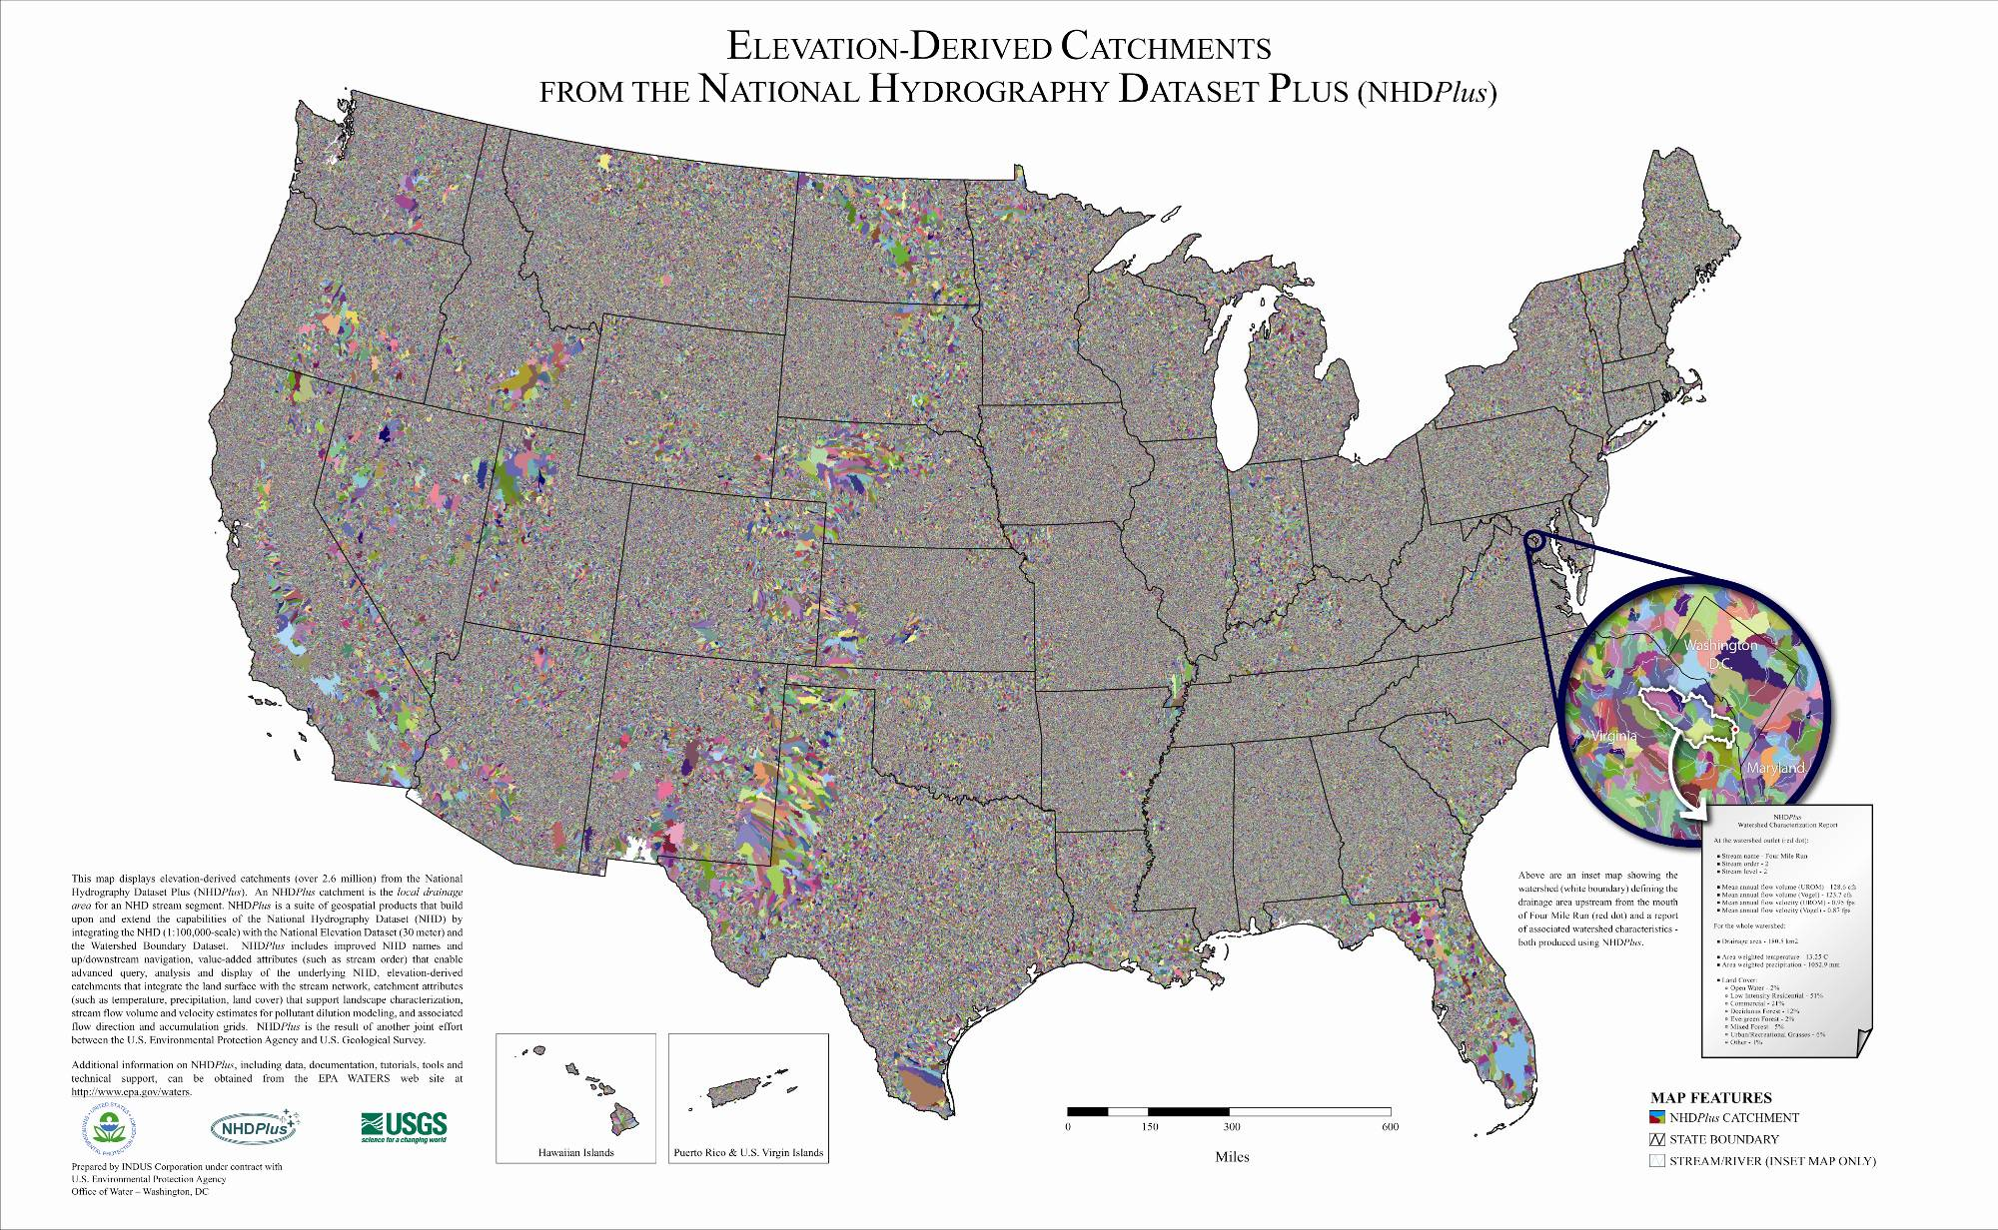
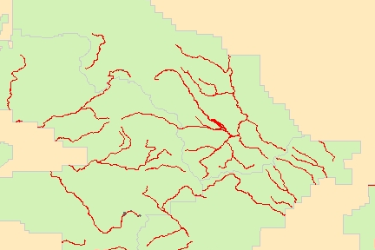
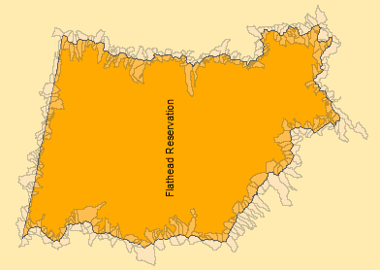
Assessing Impaired Waters Occurrence Within and Near Federal Lands
Federal Lands
Impaired Waters
NHDPlus Catchments
Identified impaired waters ‘wholly or partly within’ federal lands
Identified impaired waters ‘hydrologically near’ but not within
NHDPlus Catchments “Near Zone” around a property boundary
(norton.douglas@epa.gov)
Notes:
Assessing Impaired Waters Occurrence Within or Near Federal Lands – usfs, fws wildlife refuges and fish hatcheries

Slide 12
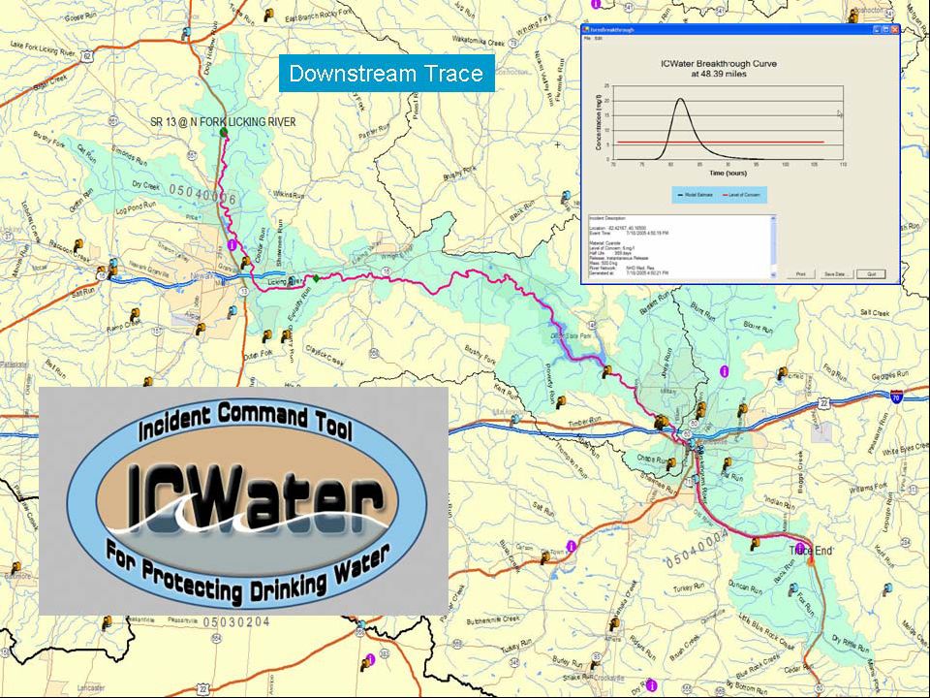
(Doug Ryan/ USFS, Bill Samuels/SAIC)

Slide 13
Pesticide Risk Assessments
The EPA Office of Pesticide Programs is using NHDPlus in a variety of applications related to pesticide risk assessments.
Figure 1
In this example, NHD navigation tools are combined with the NLCD and NHDPlus catchments to estimate the direct and indirect effects of agricultural pesticide use on endangered aquatic species.
Figure 2
(thawley.michelle@epa.gov)
Notes:
First ever spatially-based national pesticide risk assessment

Slide 14
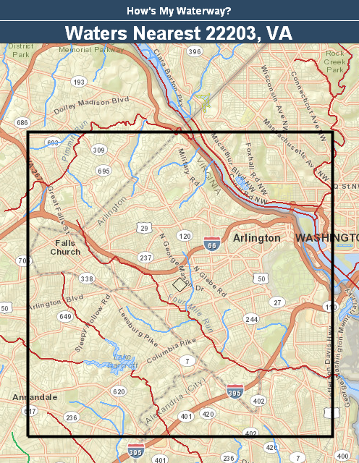

Mobile Phone Applications?
It’s Happening!
Soon-to-be-released
How’s My Waterway App
Includes NHDPlus-based WATERS web services

Slide 15
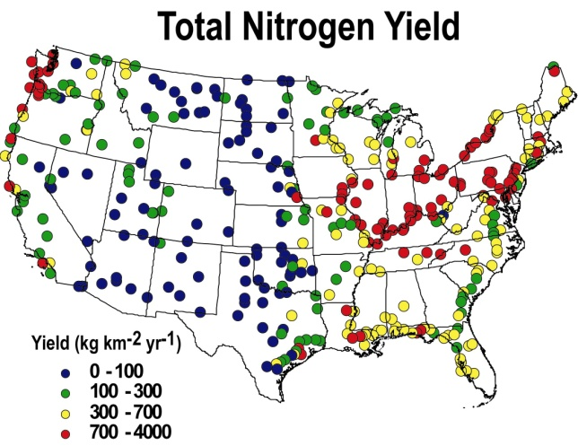
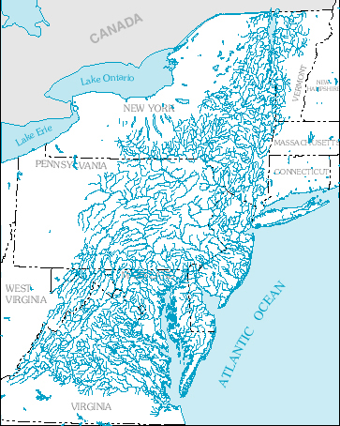

Smith et al., Water Resour. Res., 1997
SPARROW
(SPAtially Referenced Regression Qn Watershed Attributes)
Monitoring Data
Aquatic Landscape (network & catchments)
Terrestrial Landscape
Predicted Flux, Concentration and Yield: Origin and Fate

Slide 16
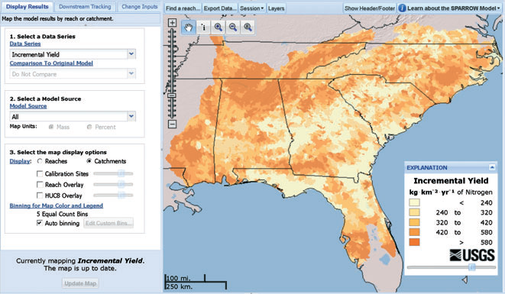
New SPARROW Decision Support System
A web-based decision support infrastructure has been developed to provide access to SPARROW simulation results on stream water-quality conditions and to offer sophisticated scenario testing capabilities for research and water-quality planning via a graphical user interface with familiar controls.
Map sources of nutrients
together / individually,
zoom functions,
overlays (e.g. – land use);
Relate upstream sources to
nutrient loads delivered to
downstream waterbodies;
Evaluate benefits nutrient reduction scenarios.

Slide 17
Other Noteworthy NHDPlus Applications
Clean Water Act jurisdictional analyses
Nitrogen and Phosphorus Pollution Data Access Tool
USGS StreamStats, WaterSmart …
National Fish Habitat Action Plan
USFS Post fire debris flow hazards
Native American historical migration paths
DOE Hydro Power Potential Analyses
FEMA flood-related analyses
Critical Loads of Atmospheric Sulfur & Nitrogen in Streams
(Share your NHDPlus applications with others
at www.epa.gov/waters > NHDPlus Quicklink)

Slide 18
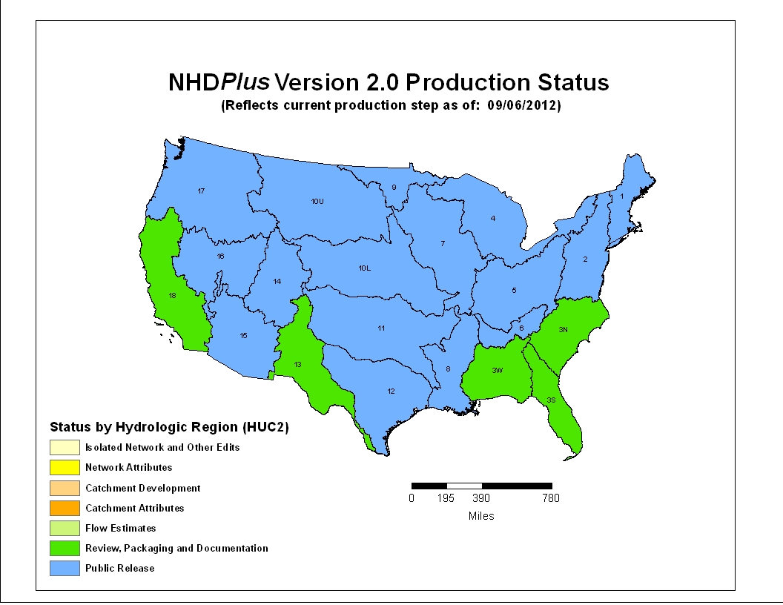
“Fortitudine Vincimus” (By Endurance We Conquer)
(Arctic explorer Ernest Shackleton’s family motto)

Slide 19
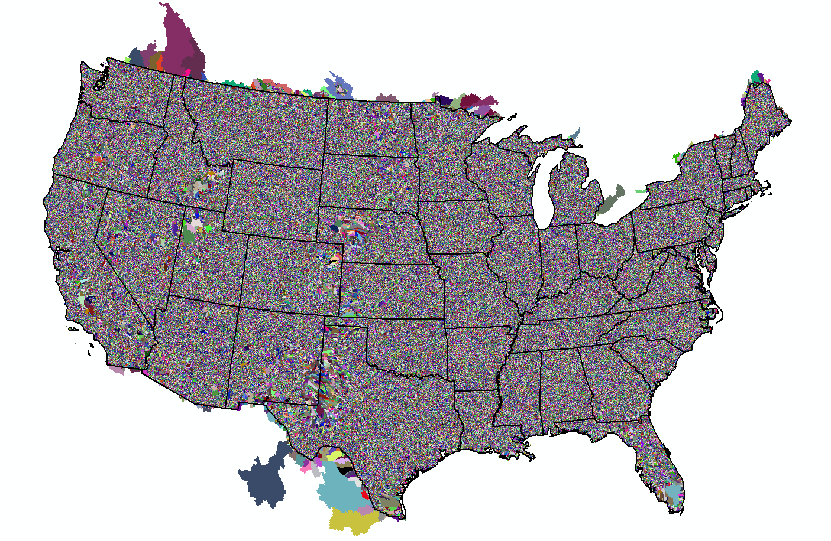
NHDPlusV2 Elevation-Derived Catchments
Notes:
Geographic extent for now … hi, pr/usvi, ak?

Slide 20
and applying lessons that we’ve learned along the way …
(just for fun)

Slide 21
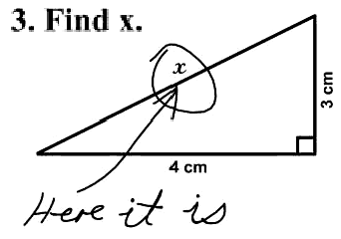
Use simple solutions when they exist

Slide 22
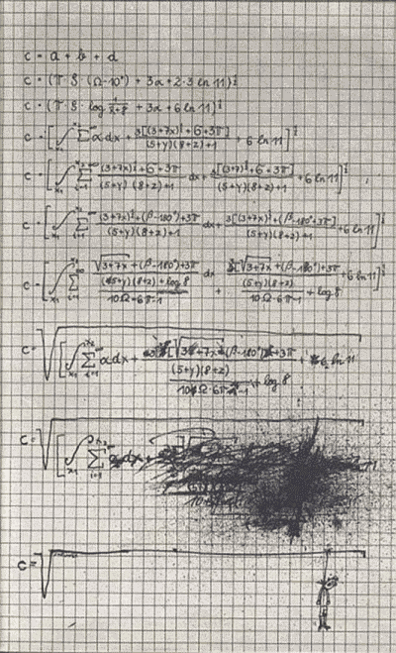
Letting things get too complicated can be risky

Slide 23
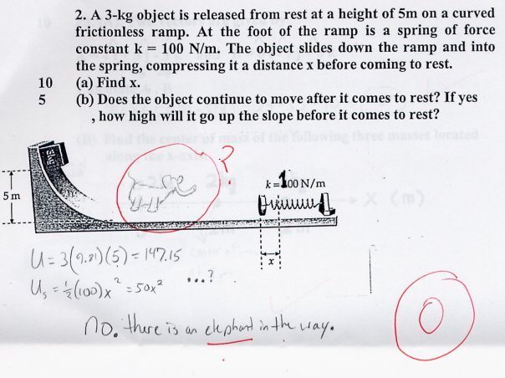
Complex problems require creative solutions

Slide 24
What About the Future?
Enhanced hydro geo-fabric produced from higher resolution source data that enables:
  more diverse flow estimates
  improved access to, and display of, water related information through the Web
Data stewardship to maintain and enhance this geo-fabric will be crucial
(The National Map Conference, 2011)

Slide 25
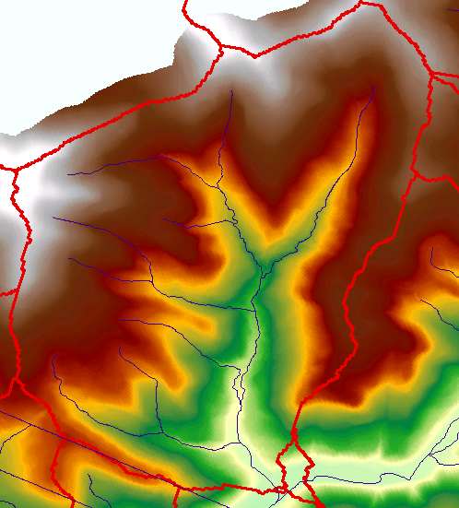
LiDAR-based streams and NHDPlus in NYC Watershed
(Horizon Systems Corporation, 2012)

Slide 26
What’s Next?
1980s EPA Reach File 1 (500K)
2000 NHD (100K)
2006 NHDPlus V1 (100K)
2007 NHD (24K or better)
2009 WBD (24k or better)
2010 NHD/WBD integration (24k or better)
2012 NHDPlus V2 (100K)
xxxx ?
xxxx LiDAR-derived NHDPlus?
xxxx ?
“It always seems impossible until it’s done.” (Nelson Mandela)

