Slide 1
NHDPlus Applications—What is this good for?
Two examples for today:
  West Virginia Chemical Spill
  NorWest Stream Temperature/Habitat Modeling
More application examples:
http://www.horizon-systems.com/NHDPlus/applications.php

Slide 2
West Virginia Chemical Spill
Spill one mile upstream from water treatment plant
Incident Command Tool for Drinking Water Protection (ICWater) used to warn downstream water suppliers
  Uses NHDPlus flows and velocities
  Adjusts with real-time gage data
  Provided accurate travel-time estimates
  Protected Cincinnati water supply and others

Slide 3
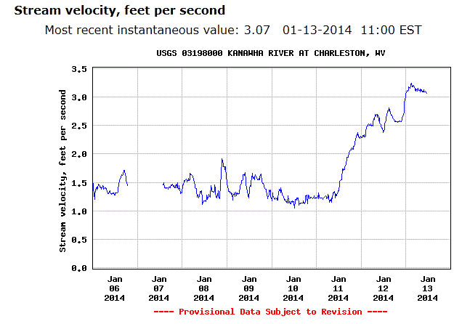
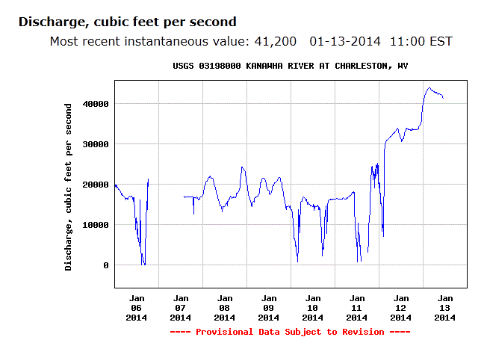
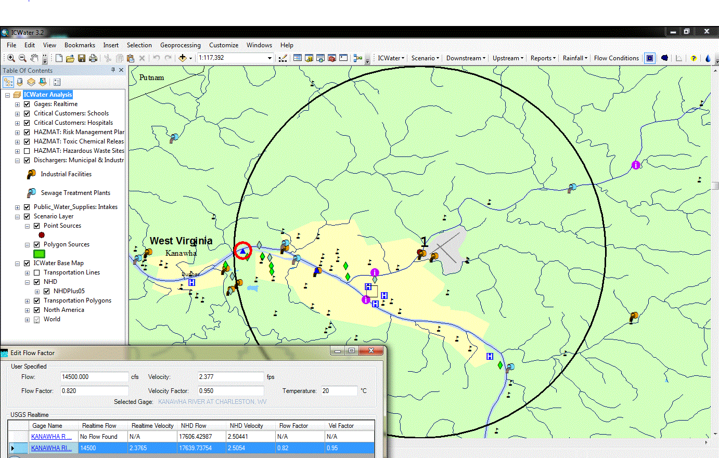
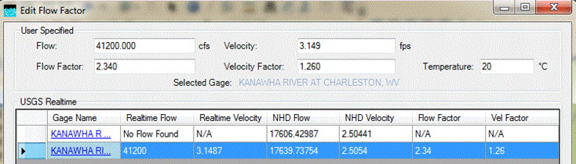
Measured
velocity
Intake
Spill site
Model velocity

Slide 4
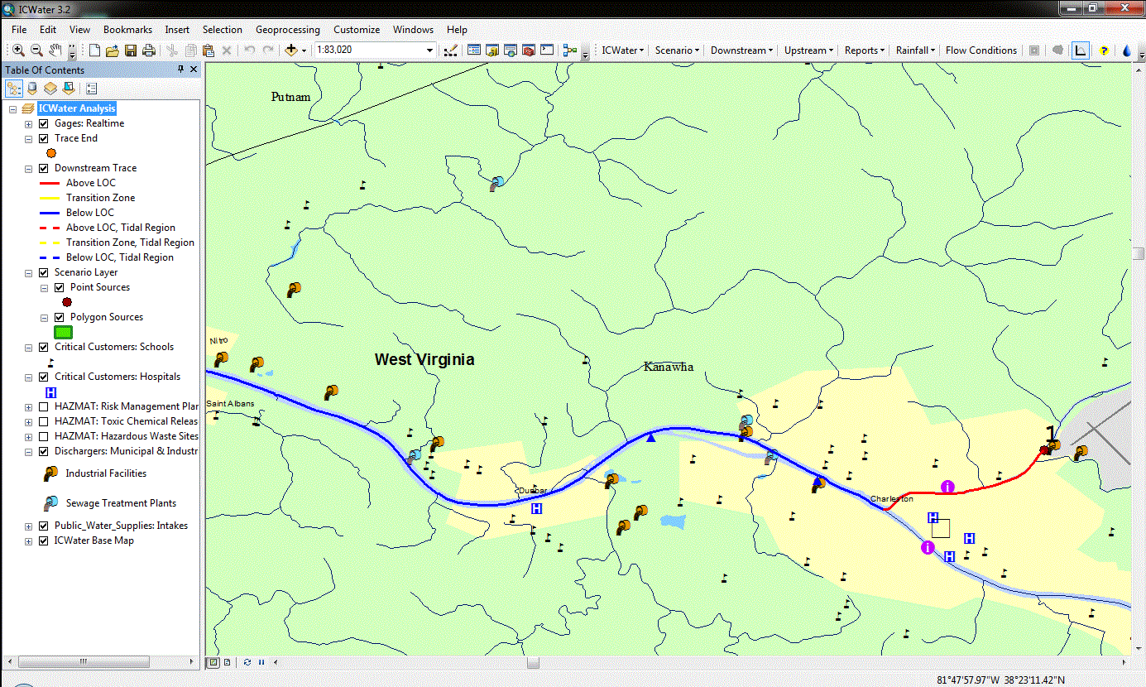
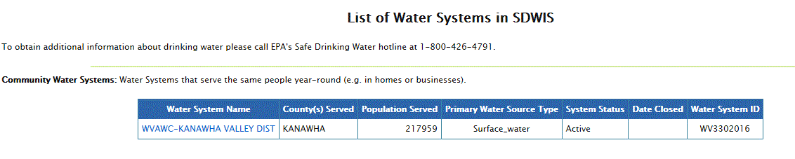
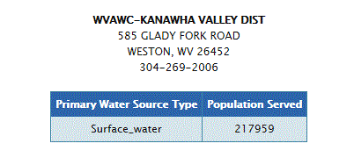
Downstream trace
Spill site

Slide 5
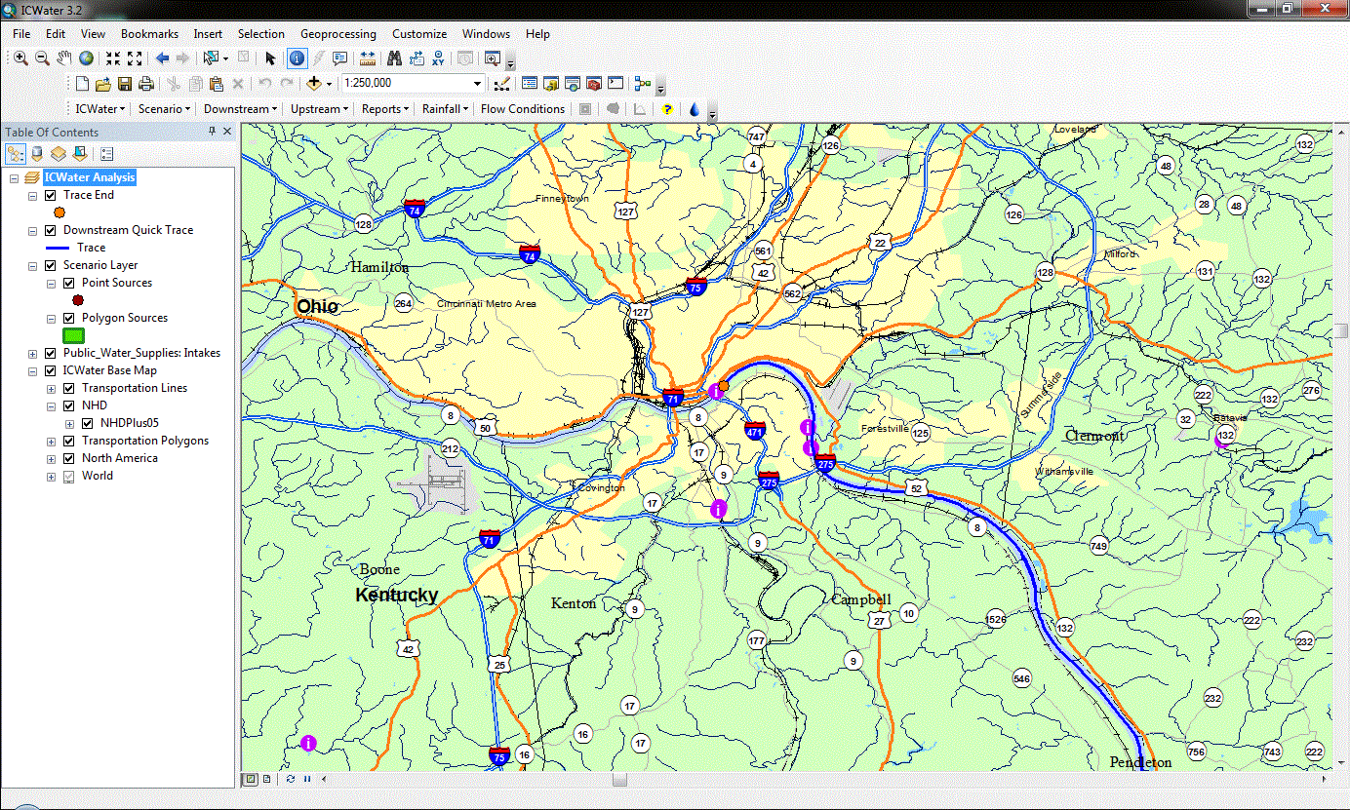
Intakes near Cincinnati
120 hours

Slide 6



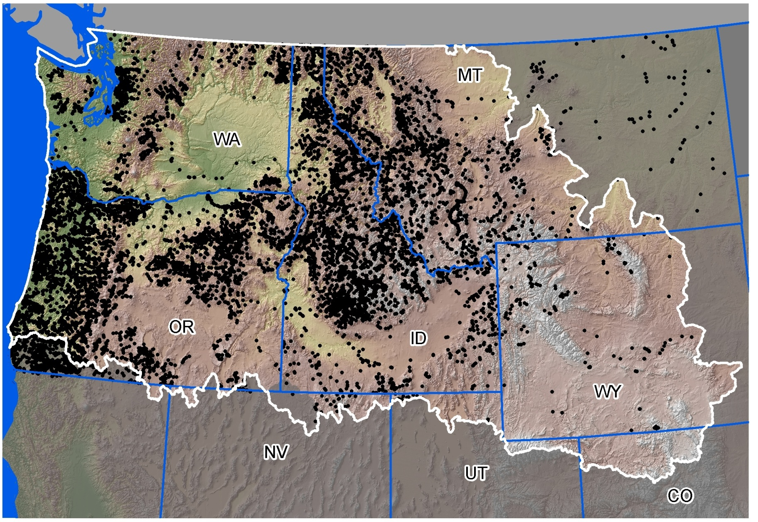

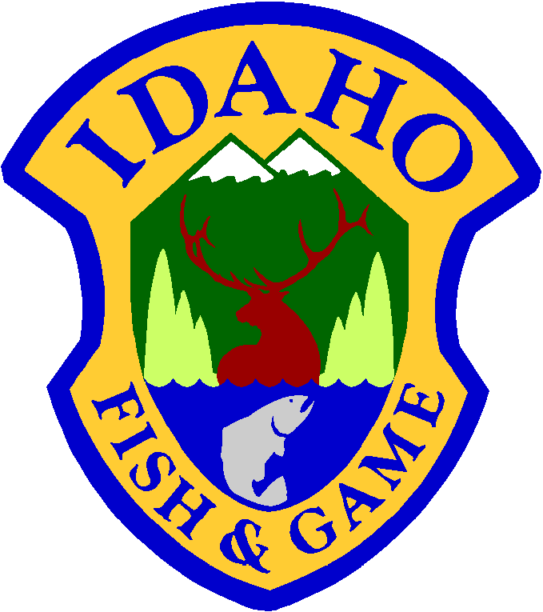





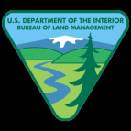




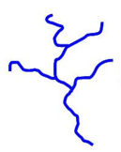
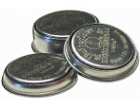
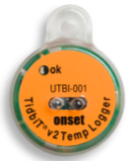
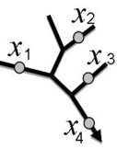
>45,000,000 hourly records
>15,000 unique stream sites
>60 agencies
$10,000,000

Slide 7
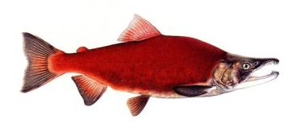

Statistically Valid, Unbiased
Information from Stream Databases
Non-spatial Stream Temp =
– 0.0064*Elevation (m)
+ 0.0104*Radiation
+ 0.39*AirTemp (°C)
– 0.17*Flow (m³/s)
Spatial Stream Temp =
– 0.0045*Elevation (m)
+ 0.0085*Radiation
+ 0.48*AirTemp (°C)
– 0.11*Flow (m³/s)
Mean Summer Stream Temp
r² = 0.68; RMSE = 1.54°C
1:1 line
Parameter estimates are different because of autocorrelation in database
Non-spatial Model
Predicted (°C)
r² = 0.93; RMSE = 0.74°C
1:1 line
Spatial Model
Isaak et al. 2010. Ecol. Apps. 20:1350-1371
Observed (°C)
Notes:
And stream temperature predictions could be made at 1 kilometer intervals throughout the river network.

Slide 8
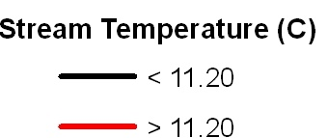
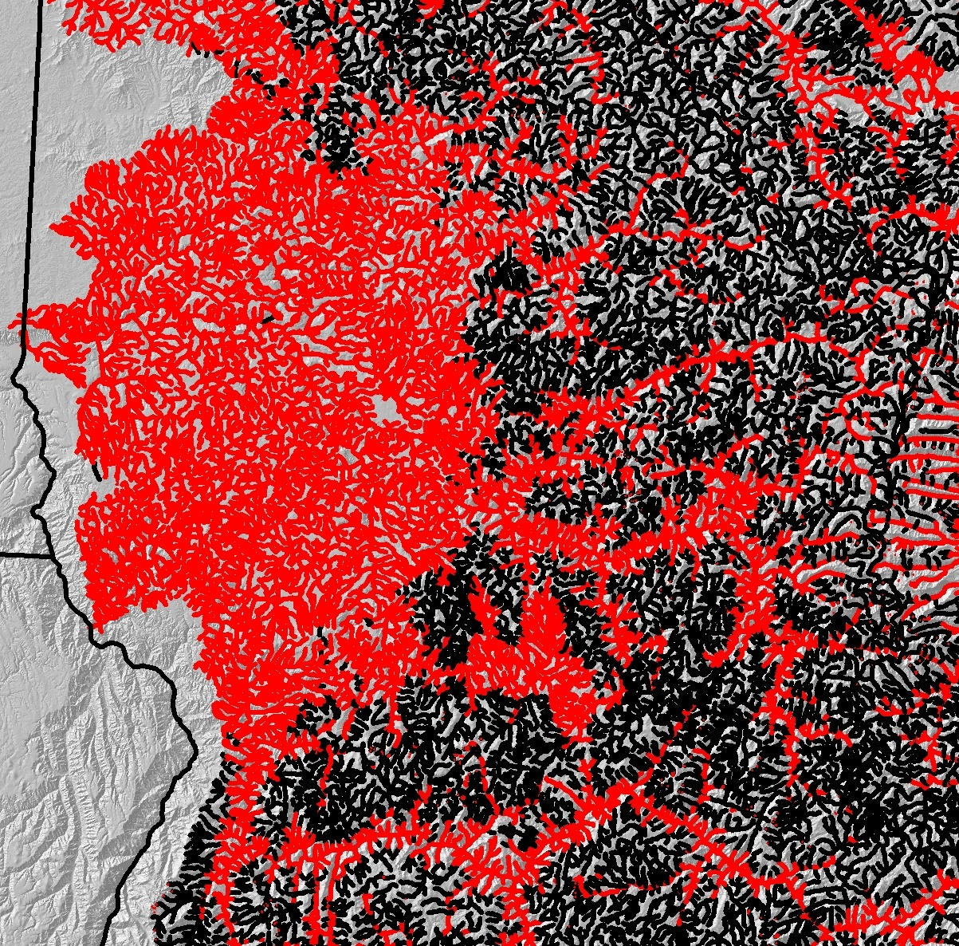
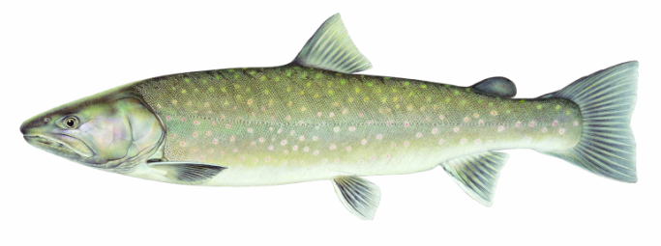
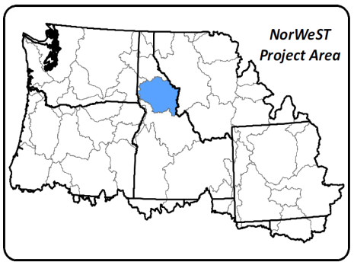
Climate Effects on Bull Trout Thermal Habitat
Historic (1993-2011 Average August)
Lochsa R.
Suitable
Clearwater R.
Unsuitable
< 11.0˚C
Selway R.
Salmon R.

Slide 9
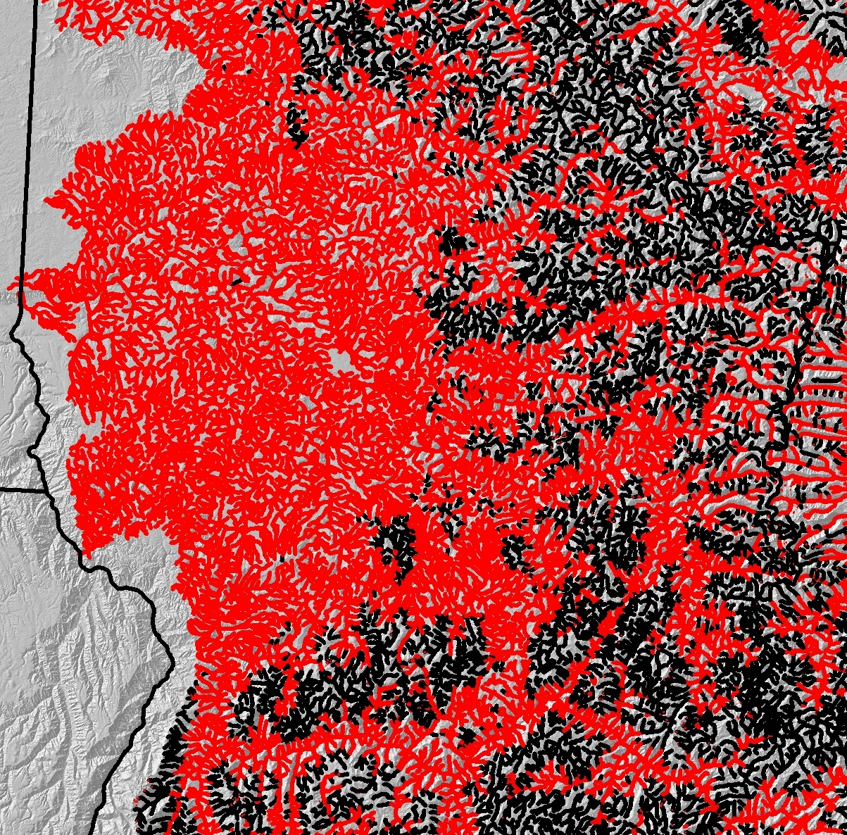
Climate Effects on Bull Trout Thermal Habitat
+1.50˚C Stream Temp (~2040s)
Lochsa R.
Suitable
Clearwater R.
Unsuitable
< 11.0˚C
Selway R.
Salmon R.

Slide 10
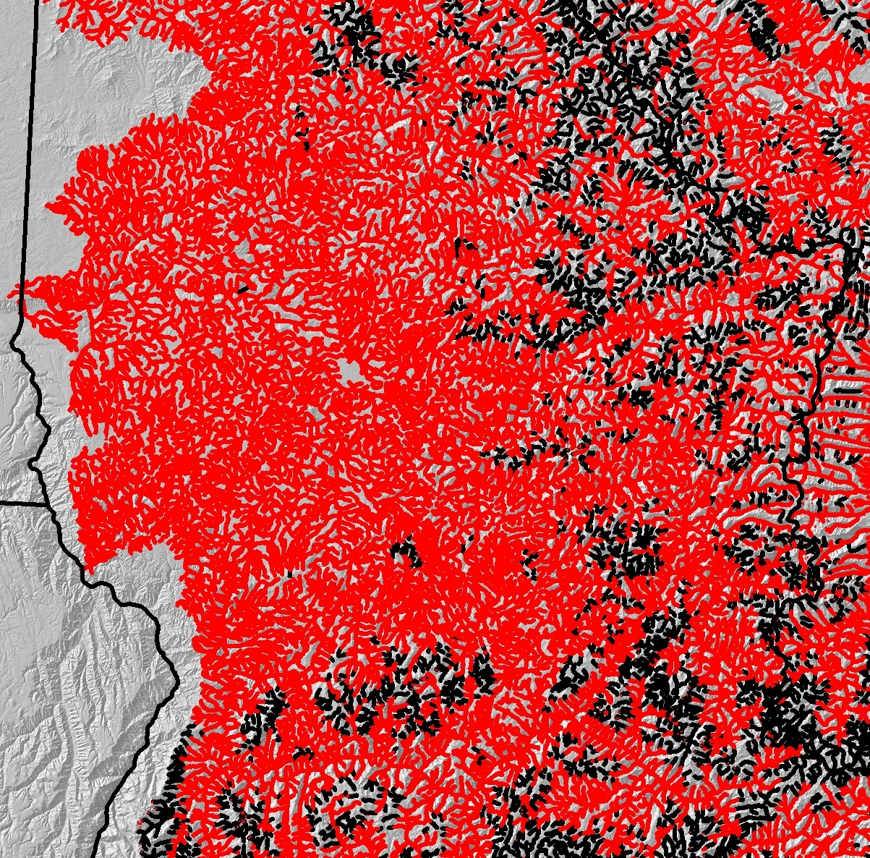
Climate Effects on Bull Trout Thermal Habitat
+3.00˚C Stream Temp (~2080s)
Lochsa R.
Suitable
Clearwater R.
Unsuitable
< 11.0˚C
Selway R.
Salmon R.

Slide 11
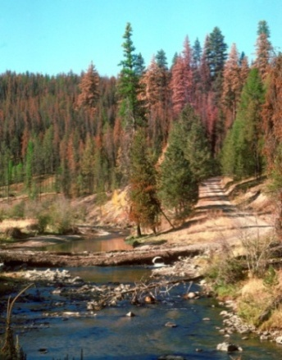
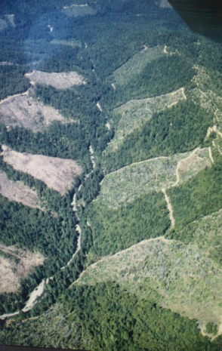
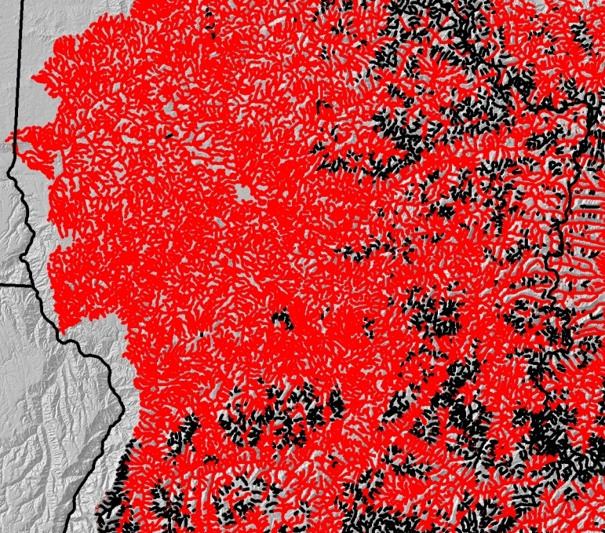
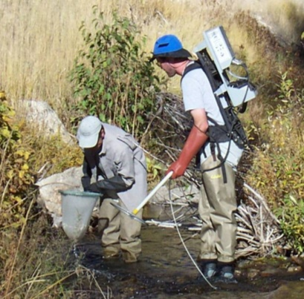
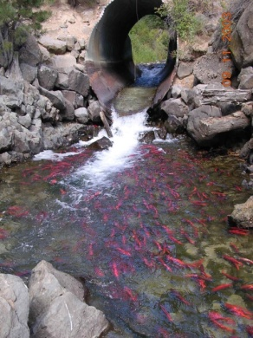
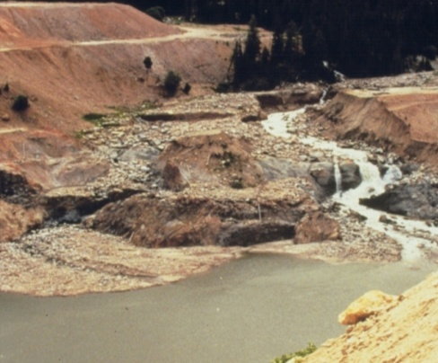
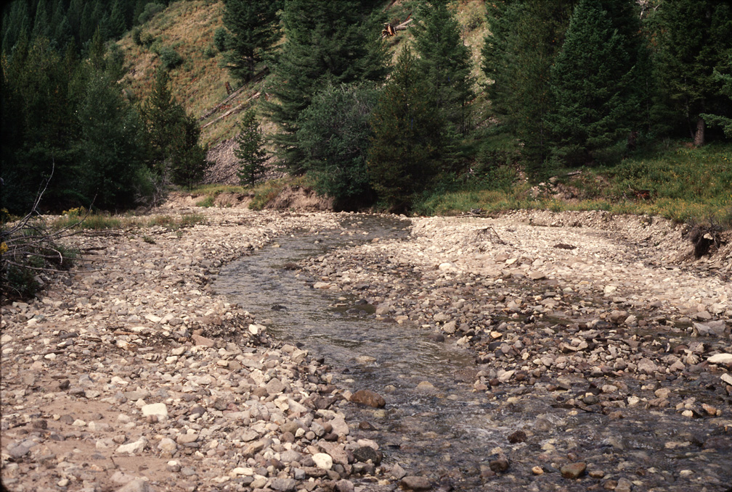
Strategic Prioritization of Habitat Restoration
Lots of things we can do…
Maintaining/restoring flow…
Maintaining/restoring riparian…
Restoring channel form/function…
Prescribed burns limit wildfire risks…
Non-native species control…
Improve/impede fish passage…
But where to do it?
Low Priority
High Priority

