Slide 1


Mean Monthly and Low Flow Estimates in NHDPlus Version 2
Tim Bondelid- NHDPlus Team
Consulting Engineer
2014 AWRA Spring Conference on GIS and Water Resources VIII
May 12 to May 14, 2014
Snowbird, Utah

Slide 2
This Presentation
NHDPlus V1 and NHDPlus V2 include mean annual (MA) flow and velocity estimates
  All 2.7 M networked stream segments
We have now released mean monthly (MM) flow and velocity estimates
We have a first-round test of 7Q10 flows
I will talk about how we did these MM and 7Q10 flow estimates

Slide 3
NHDPlus V02 Enhanced Runoff Method (EROM)
Contributors:
  The NHDPlus Team
  EROM:
    Dave Wolock, USGS
    Kernell Ries, USGS
    Greg Schwarz, USGS

Slide 4
Importance of
Stream Flow Estimates
Support the water element goals expressed in the EPA Strategic Plan
Support the water mission of the USGS
  Water-quality modeling (SPARROW)
  Regional and national stream flow assessments goal of National Stream Flow Information Program
  National Water Census
Watershed planning and management
Response to emergencies (ICWATER)

Slide 5
NHDPlus V02
EROM Flow Estimation Steps
Runoff based on water balance model (RO)
“Excess ET” component that takes into account excess evapo-transpiration in the stream channel area (EET)
A regression of Step 2 flows on Gage flows using Reference gages (RGR)
A capability for users to add, remove and transfer flows (PlusFlowAR)
Adjustments to observed gage flows
A flow QA module to evaluate accuracy of the flow estimates
Notes:
Reference gages are those gages minimally influenced by man; we are using the Reference gages developed by Falcone, et. al.
Step 6 is done because all gages are used in Step 5, so any QA statistics on Step 5 flows versus gage flows would always be “perfect “.

Slide 6
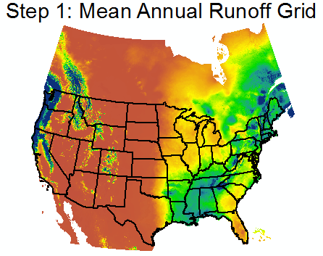
U.S.: Wolock and McCabe; CN and MX: Canadian Forest Service
1971 - 2000

Slide 7
Step 3: Reference Gage
Regression (SR)
QA Statistics
Gage Runoff EET Ref Reg. PlusFlow Gage Seq.
Mean Mean SEE Mean SEE Mean SEE Mean SEE SEE
2.36 2.17 58.8 2.17 58.8 2.37 32.6 2.37 32.6 23.0

Slide 8
EROM MM Flows
EROM built for MA and MM flows
QA issues with MM flows:
  RO results in winter months in some areas produced very poor results
  Sometimes EET helped, sometimes it hurt
  RGR helped most of the time, but sometimes made the QA worse
These QA issues led to the decision to not release MM flows

Slide 9
Poor RO Results
Occurs in winter months in the Great Plains
The runoff model is not able to model the VERY low baseflows in the persistently cold months.
This issue occurs in 17 VPU/months.
Approach: Replace the runoff grids with a regression equation.
  Need to model unit runoff (cfs/km²)
  EROM uses a flow accumulation approach

Slide 10
The Water Balance Model
Temperature
Potential Evapotranspiration
Snow
Snow Melt
Rain
Actual
Evapotranspiration
Snow
Storage
Direct Runoff
Surplus Runoff
Soil-Moisture Storage Capacity
Soil-Moisture Storage
(Slide courtesy of Dave Wolock, USGS)

Slide 11
Unit Runoff Regression
Tested several statistical model forms
Used Reference Gages
What works well:
  Log-log regression using Precip, Temp, and Baseflow Index (BFI):
    URO (cfs/Km²) = 10ª * Pcm^{c} * TDegC^{d} * BFIe * BCF
      a, c, d, e = regression coefficients
      BCF = Bias Correction Factor
Required CA3T allocations for Temp and Precip for each of the 17 VPUs/months

Slide 12
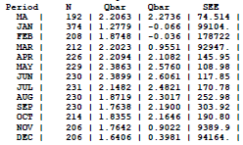
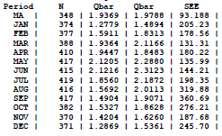
Runoff QA With RO Reg

Slide 13
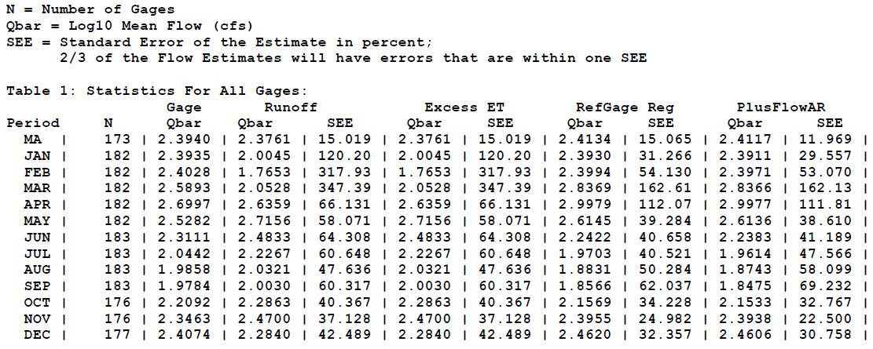
Setting “Switches” for EET and RGR

Slide 14
Implementing Mean Monthly Flows
Made a new production version of EROM (Version 10)
Limits the RGR to the regression bounds
Minimum of 10 years of gage record
A new input file named “EROMOPTS.DBF” is used:
  One record for each VPU/Timeperiod
    21 VPUs * 13 flows = 273 records
  “Switches” for running/not running EET and RGR and RO Regression coefficients

Slide 15
What Is Available
EROMExtension:
  MA and MM flow and velocity estimates
  MA and MM QA files
  A QA spreadsheet; please use it
VPUAttributeExtension:
  Catchment-level MA and MM Runoff, Temperature and Precipitation
  Cumulative MA Temperature and Precipitation

Slide 16
7Q10 Flow Estimates
Estimate 7Q10 flows on ungaged flowlines (stream segments) in NHDPlusV2
  Use networked flowlines
    Removes many canals and ditches
  Note: less than 1% of the flowlines have gages
Leverage the advanced capabilities in NHDPlusV2 and the Enhanced Runoff Method (EROM) to test a cost-effective method for estimating interpretive flow statistics

Slide 17
Approach
Calculate 7Q10 at gages
  Use the DFLOW program in BASINS
USE NHDPlusV2 watershed characteristics:
  drainage area (DA), mean precipitation (MP) and temperature (MT), mean watershed elevation (MWE), watershed slope (WS), Base Flow Index (BFI)
  EROM MA and MM Flows
Develop regionalized regression equations by “Vector Processing Units” (VPUs)
  7Q10 = Fn(EROM Flow, DA, MP, MT, MWE, WS, BFI)
  Use a log-log regression

Slide 18
Approach (Cont.)
Develop regionalized regression equations by “Vector Processing Units” (VPUs)
  7Q10 = Fn(EROM Flow, DA, MP, MT, MWE, WS, BFI)
Additional Steps
  Intermittent flowlines: 7Q10 = 0
  “Large River” Adjustments

Slide 19
Challenges
Low flows are affected by factors that can be difficult to quantify on a broad scale:
  Groundwater/baseflow
  Geology
  Physiography
  Reservoirs, other flow alterations
The scope for this project is MUCH larger than other such studies
  2.7 Million Stream Segments across CONUS
The VPUs are MUCH larger than the geographic areas normally used.

Slide 20
Regression Accuracy Measures
Regression Measures: R², Model Error Variance [log₁₀] (MEV), Standard Error of the Regression (SER) in %.
  Q_E: EROM Flow
  Q_E * BFI works best overall
  VPU 02 Statistics:
Vars | n | R² | MEV | SER (%) | BCF
Q_E*BFI, DA | 563 | 0.92 | 0.16 | 115% | 1.4

Slide 21
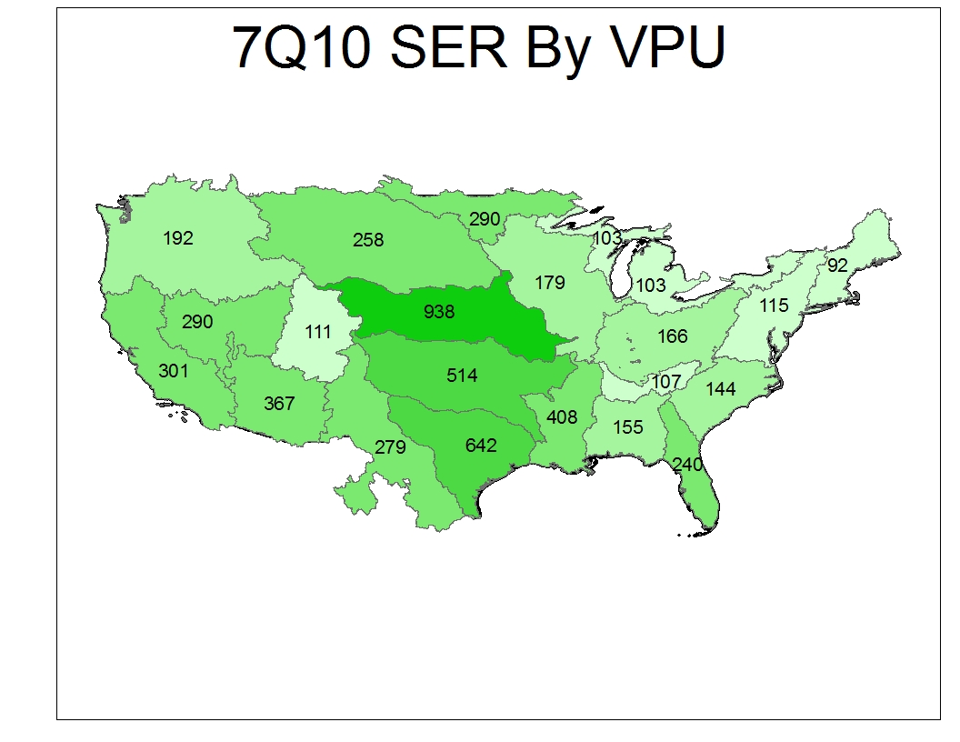

Slide 22
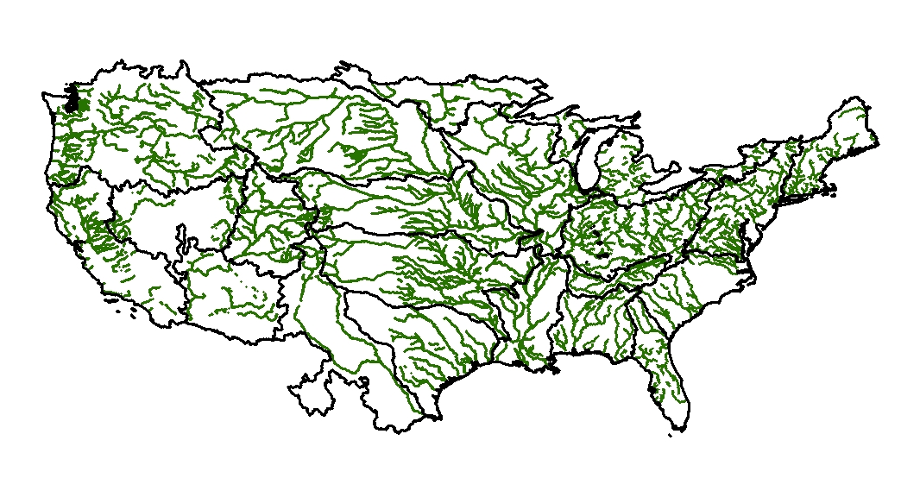
Large River Adjustments

Slide 23
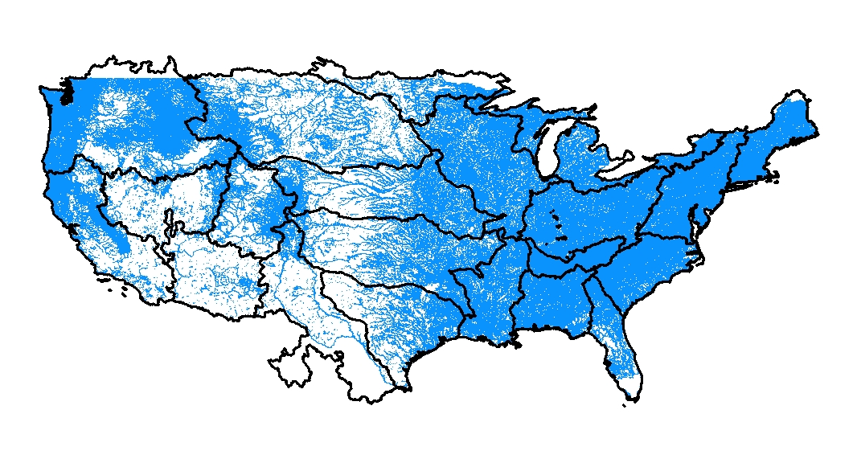
Perennial Streams

Slide 24
Major Issues and Caveats
DFLOW:
  7Q10 flows are “unsupervised”
  Need to modify DFLOW for production
Poor results in the Great Plains:
  Subdivide large VPUs
  Winter low flows?
Poor Results in Southwest
  Very few perennial streams
Some “minor” adjustments
Streamline the process

Slide 25
A Low Flow Production System
Period of Record,Flow Statistic(s)
DFLOW
NHDPlus, EROM, Other Data
DBMS
Regression Areas, Other Options
Statistics
Evaluation
Regression Coefficient Db
Low Flow Computations
NHDPlus Low Flow Extension

Slide 26
Down the Road
PlusFlowAR:
  Incorporate more detailed information from NHD Stewards, WBD, others!
  Seasonal values?
EET Step: Model Coefficients, issues in some areas
Continue 7Q10, other low flows
Use a 1981-2010 time frame
  PRISM has released “normals” for this period
  An issue: international drainage

Slide 27
Read All About It!
Go to NHDPlus.com
  This redirects you to the ftp.horizon-systems.com page
  Click on a hot-link in the text to get the User Guide
In the User Guide:
  Pages 61-69: EROM and Attribute Extension Table Layouts
  Pages 125-147: How EROM works
    Note caveats for using velocities!!!!

Slide 28
Questions?
Tim Bondelid - Independent Consultant to EPA
timothy@trbondelid.com
NHDPlus V02:
http://www.horizon-systems.com/NHDPlus
Notes:
28

