Slide 1
Building Analytical Applications Using NHDPlusV2
Presented by:
Cindy McKay
Horizon Systems Corporation
Sponsored by:
US EPA, Office of Water

Slide 2
Agenda
NHDPlus Basics
Elements of an NHDPlusV2 Application
Resources

Slide 3
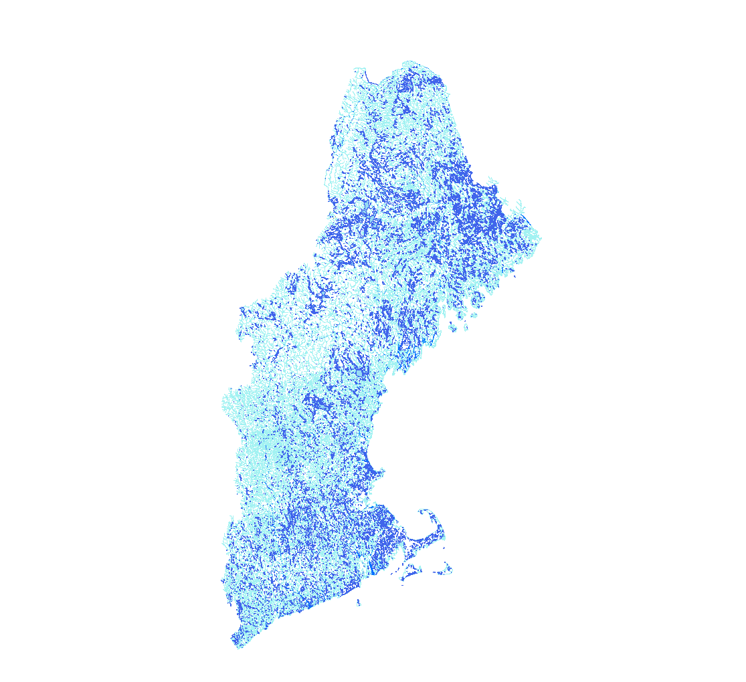
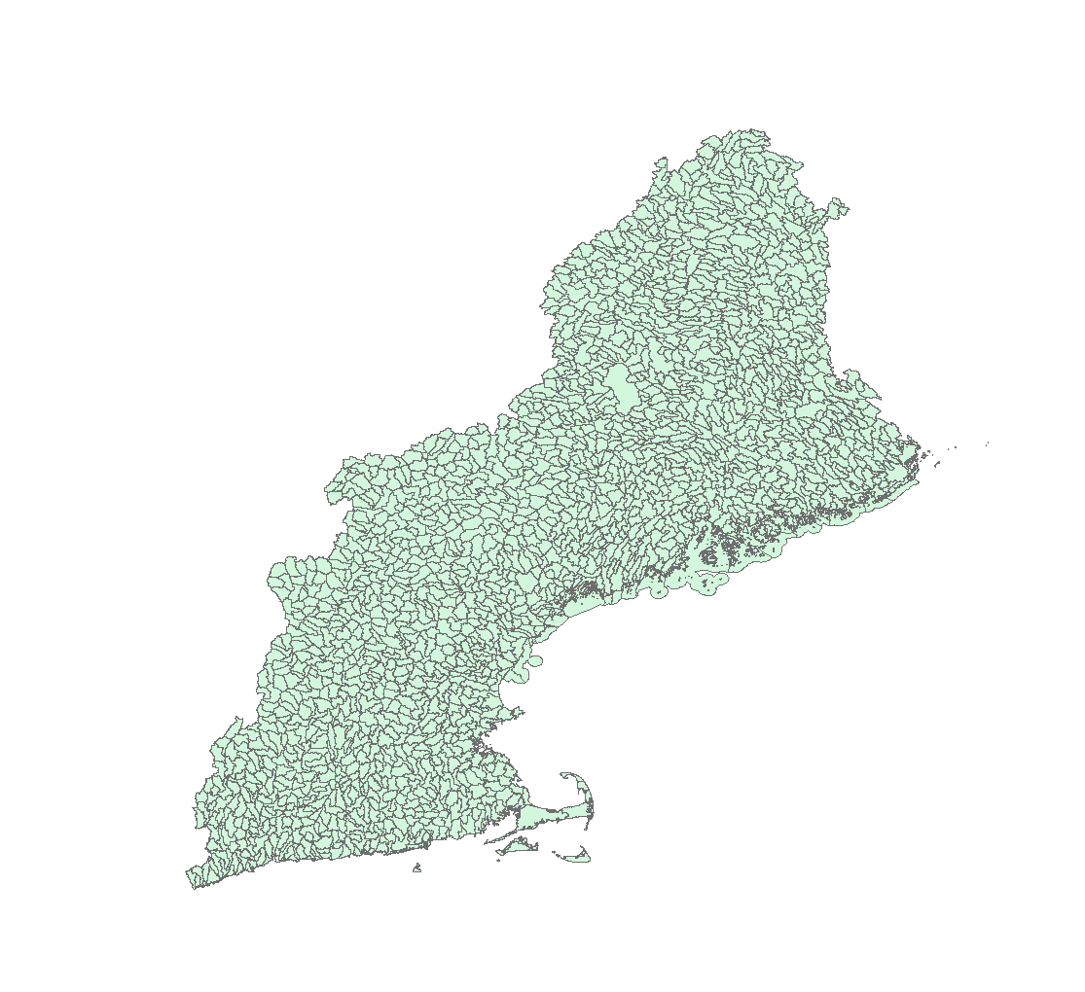
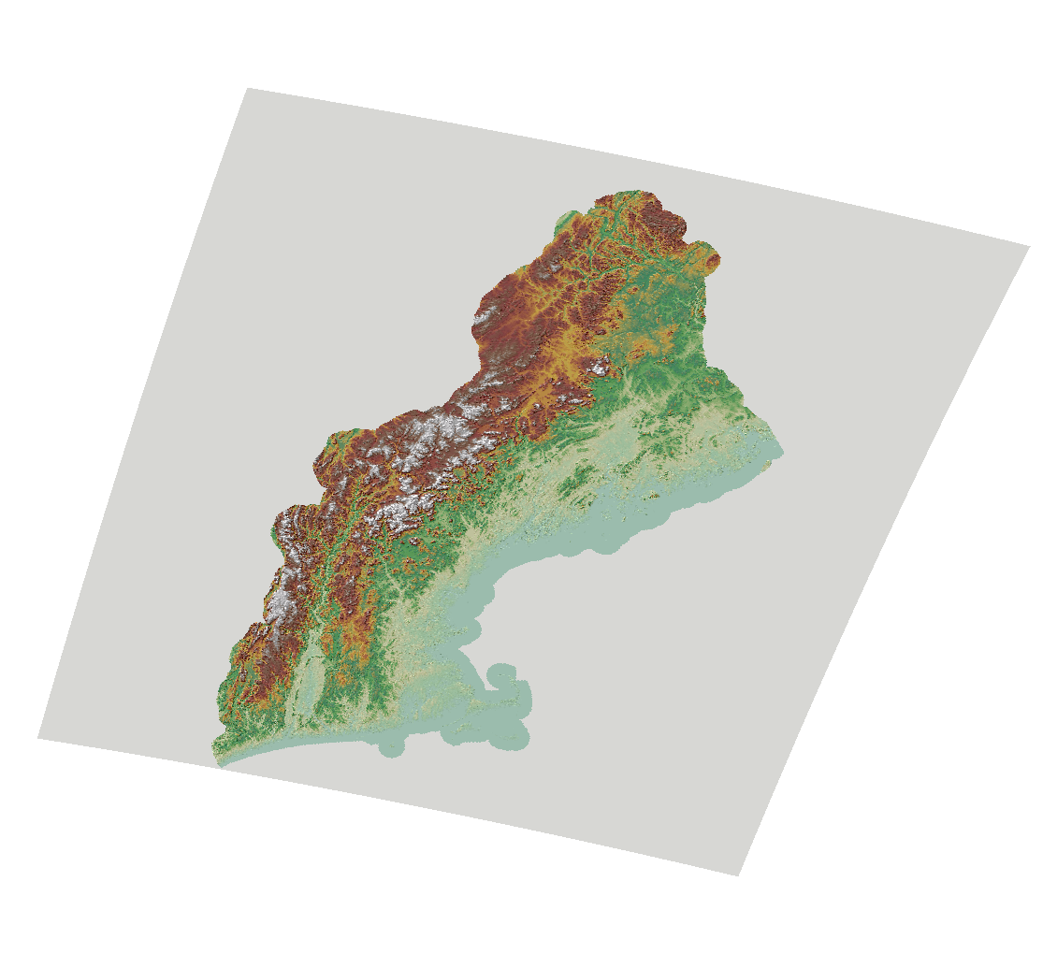
NHDPlusV2 Basics
National
Hydrography
Dataset (NHD)
Watershed
Boundary
Dataset (WBD)
National
Elevation
Dataset (NED)

Slide 4
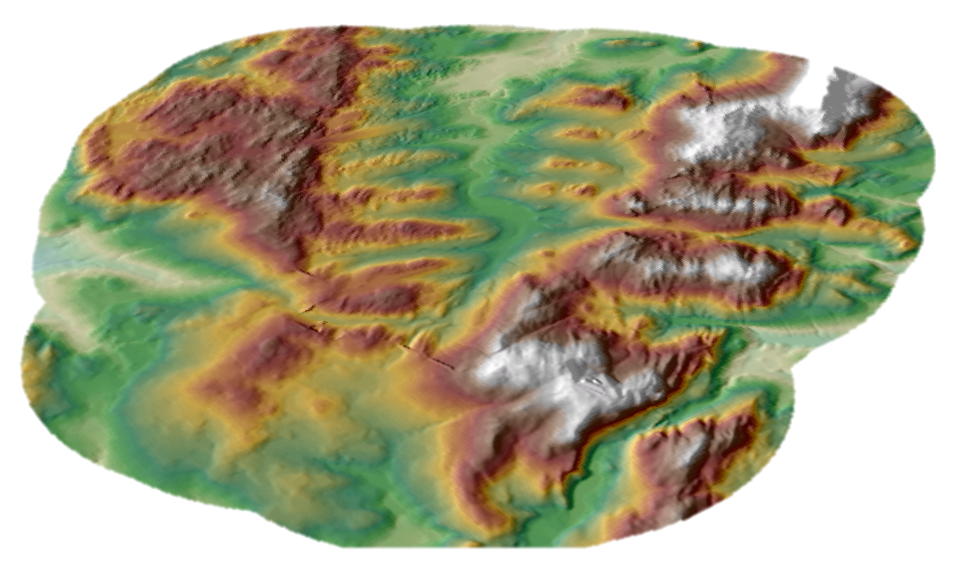
NHDPlusV2 Basics
NED
Elevation

Slide 5

NHDPlusV2 Basics
WBD
HUC 12 Boundaries
___________
Used To Build
Walls
In the Elevation

Slide 6

NHDPlusV2 Basics
NHD Streams and Waterbodies
___________
Used to Trench
And Scoop
Into the Elevation

Slide 7

NHDPlusV2 Basics
Link the mapped surface water to the landscape.
Catchment
for each Network Segment

Slide 8
NHDPlusV2 Components
Vectors
Rasters
NHD Snapshot
WBD Snapshot
Hydro-Enforcement Features
Catchment Polys
NED Snapshot
FDR/FAC
Hydro DEM
Catchments
More…
Many Attributes

Slide 9
Elements of an NHDPlus Application
NHDPlus Surface Water Network and Catchments
NHDPlus Network Attributes
Points of Interest Linked the Network
Catchment & Watershed Attributes
Network Navigation and Information Discovery
Analysis

Slide 10
NHDPlus Surface Water Network Features and Catchments
NHDFlowlines
  Streams and other flow paths
NHDWaterbody
  Lakes, ponds, swamps and other discrete waterbodies
NHDArea
  Polygonal versions of features in NHDFlowline
Catchments
  Elevation based area that drains to an individual NHDFlowline feature

Slide 11
NHDPlus Network Attributes
Stream Order
Distance to Network Terminus
Cumulative Network Length Upstream
Catchment Area & Cumulative Drainage Area
Elevation & Slope
Level Path ID
Terminal Path ID

Slide 12
Points of Interest along the Network (NHDPlus, Yours & Others)
Stream Flow Gages (NHDPlus)
Dams (NHDPlus)
Water Quality Monitoring Stations, Discharge Permits, WQ Standards, Assessments, Impairments, and TMDLs (EPA)
Road Crossings
Habitats
…

Slide 13
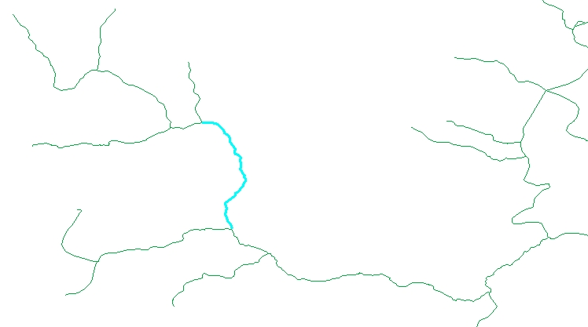
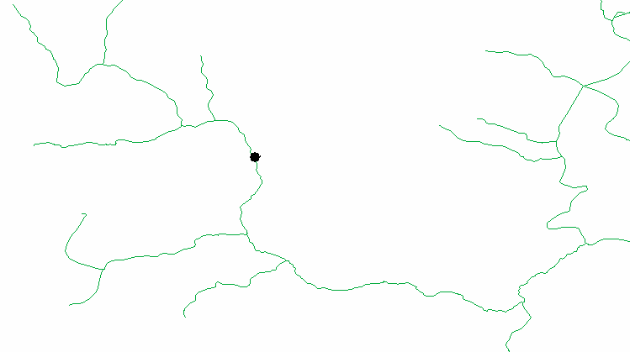
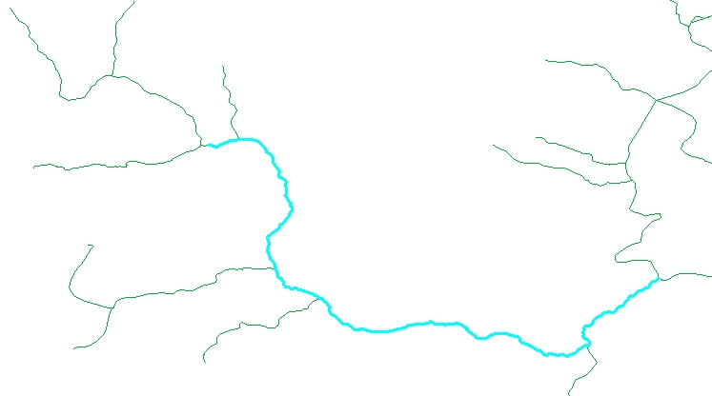
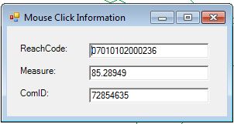
Linking Information to the NHDPlus Network
100
ComID 72854635
Measure 85.28949
Reach 07010102000236
Measure 85.28949
0

Slide 14
Catchment & Drainage Area Attributes (NHDPlus)
Mean Annual & Monthly Temperature
Mean Annual & Monthly Precipitation
Mean Annual & Monthly Runoff
NLCD 2011 – Land Use, Impervious Surface, 2001/2006/2011 Change

Slide 15
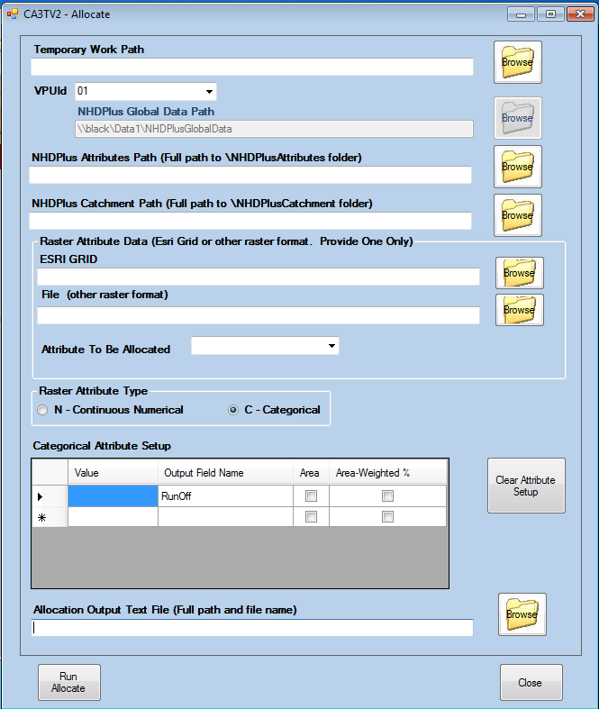
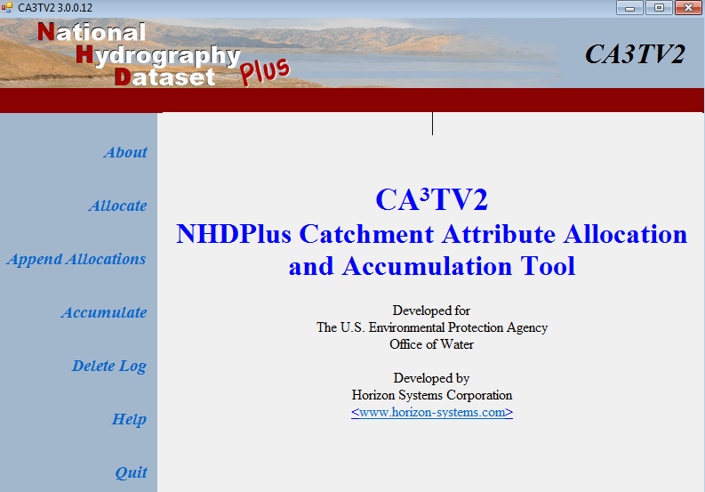
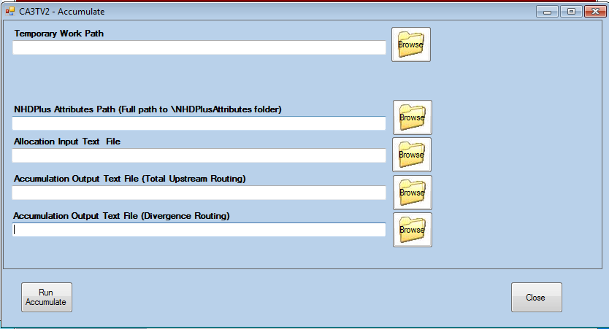
Catchment & Drainage Area Characteristics (Yours)
Raster Formats:
Grid, .img, .tif, .bmp, .png, .jpg, or .gif
Raster Value Type:
Continuous Numerical or Categorical

Slide 16
Navigating the Network
NHDPlus Data:
  NHDPlus Network Value Added Attributes
  NHDPlus Flow Table
  Geometric Network & ArcGIS
Tools:
  Flow Table Navigator
  Network VAA Navigator

Slide 17
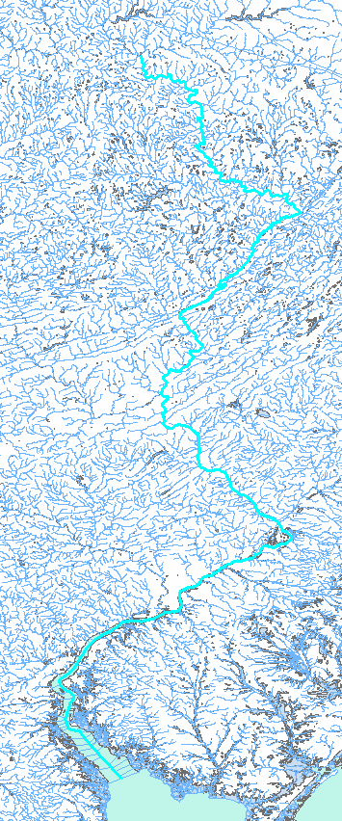
Navigating the Network
NHDPlus Network Value Added Attributes
Level Path Identifier

Slide 18
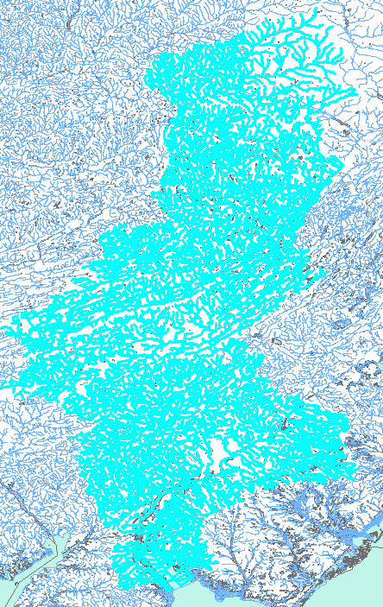
Navigating the Network
NHDPlus Network Value Added Attributes
Terminal Path Identifier

Slide 19

Navigating the Network
NHDPlus PlusFlow Table
4
FromID | ToID
1 | 5
3 | 2
4 | 2
2 | 5
3
1
2
5

Slide 20
Navigating the Network
NHDPlus Network Value Added Attributes
N1
N2
N3
From and To Node Numbers
N4
N5

Slide 21
Navigating the Network
NHDPlus Network Value Added Attributes
5
4
3
Hydrologic Sequence Numbers
2
1

Slide 22
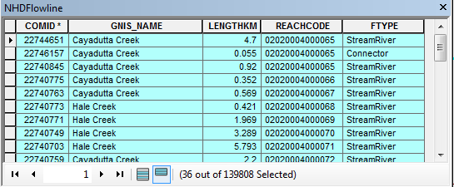

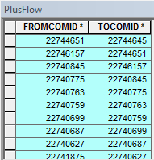
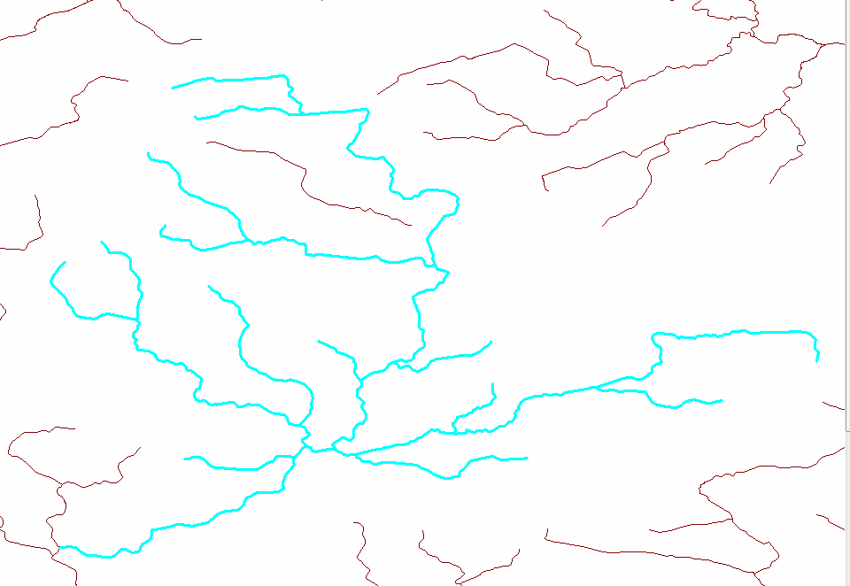
Navigating the Network with NHDPlus Flow Table Navigator
NHDPlusV2 Flow Navigator

Slide 23

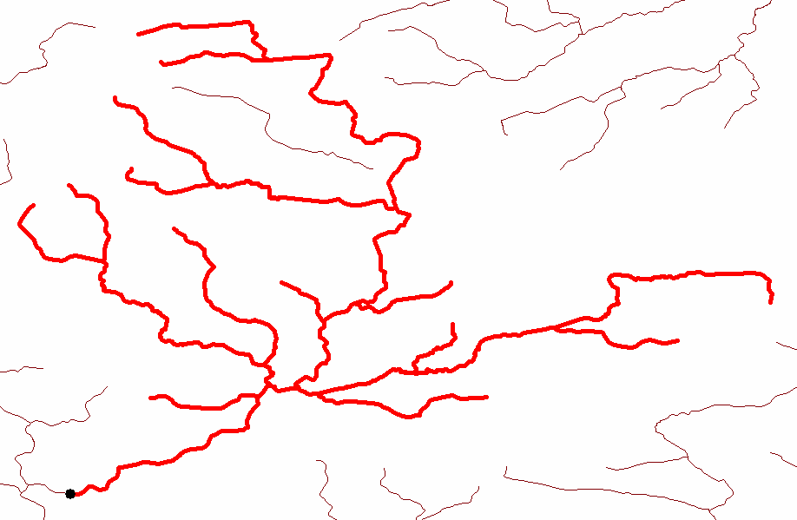
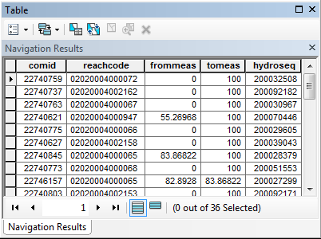
Navigating the Network with NHDPlusV2 Network VAA Navigator
Navigation Results Layer
NHDPlusV2 VAA Navigator

Slide 24
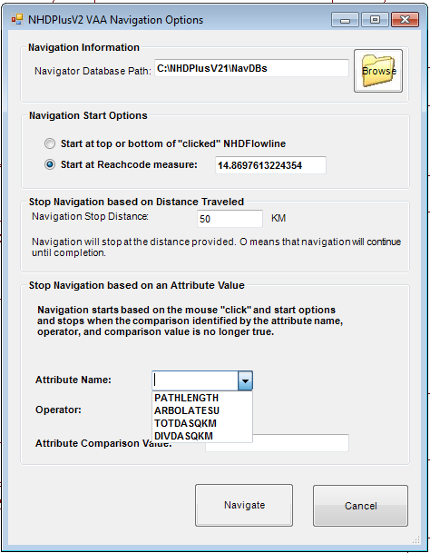
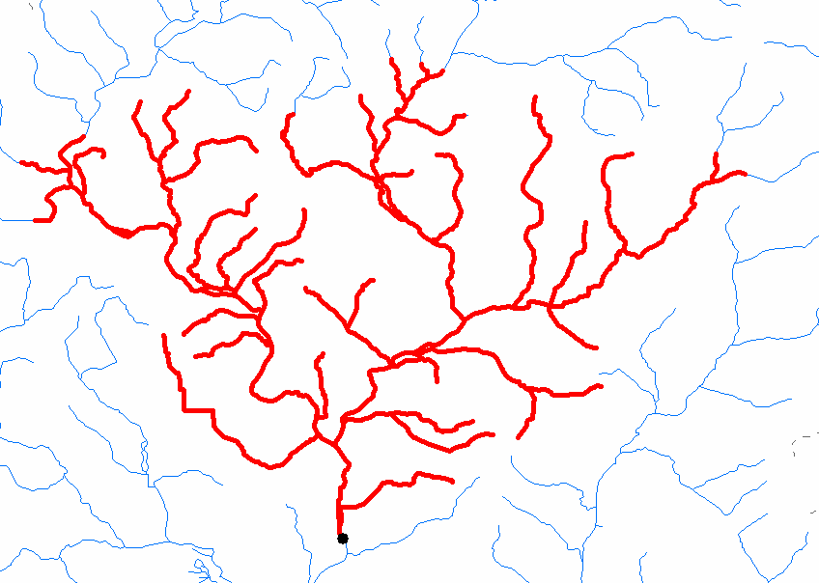
Navigating the Network with NHDPlusV2 Network VAA Navigator

Slide 25
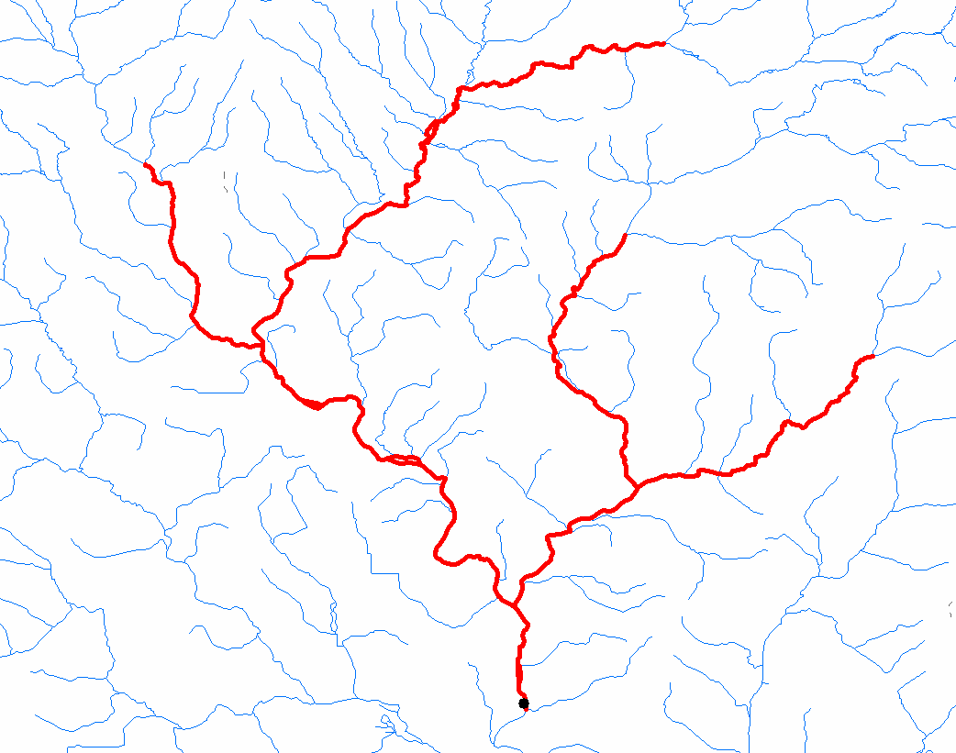
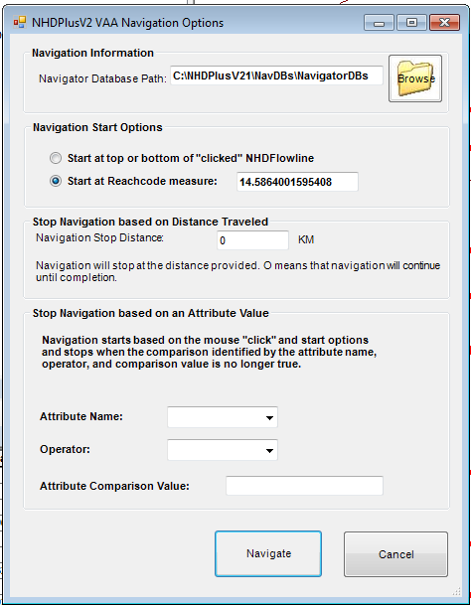
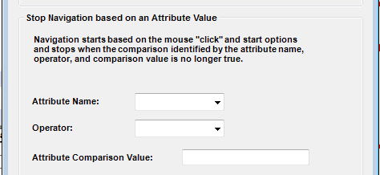
Navigating the Network with NHDPlusV2 Network VAA Navigator
Upstream until
drainage area < 50 sqkm

Slide 26
Discovering data linked to the network

Slide 27
Discovering Data Linked to the Network
WQ Monitoring Station
Paper Mill Discharge Permit
Drinking Water Intake
S
Stream Flow Gage
Timber Production
Rug Rat Habitat
Impaired Waters

Slide 28
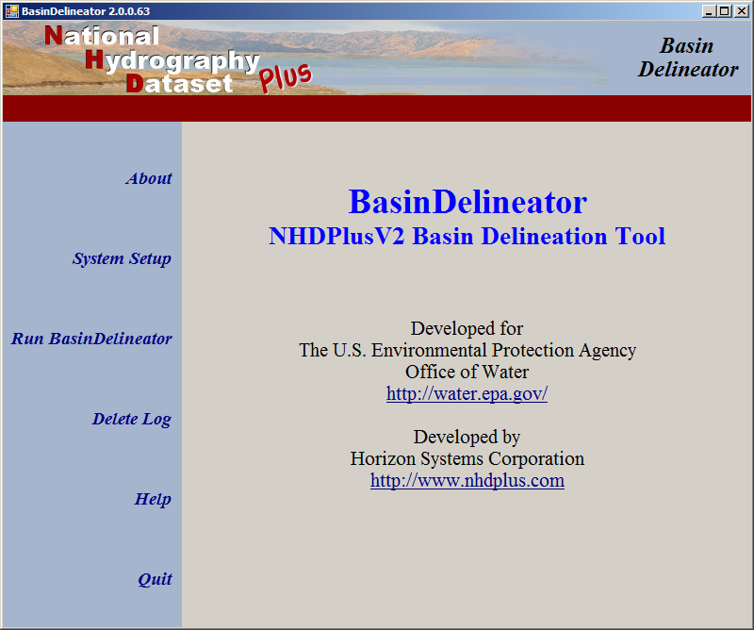
Basin Delineation

Slide 29
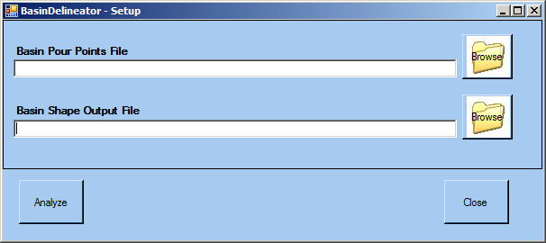
Basin Delineation

Slide 30

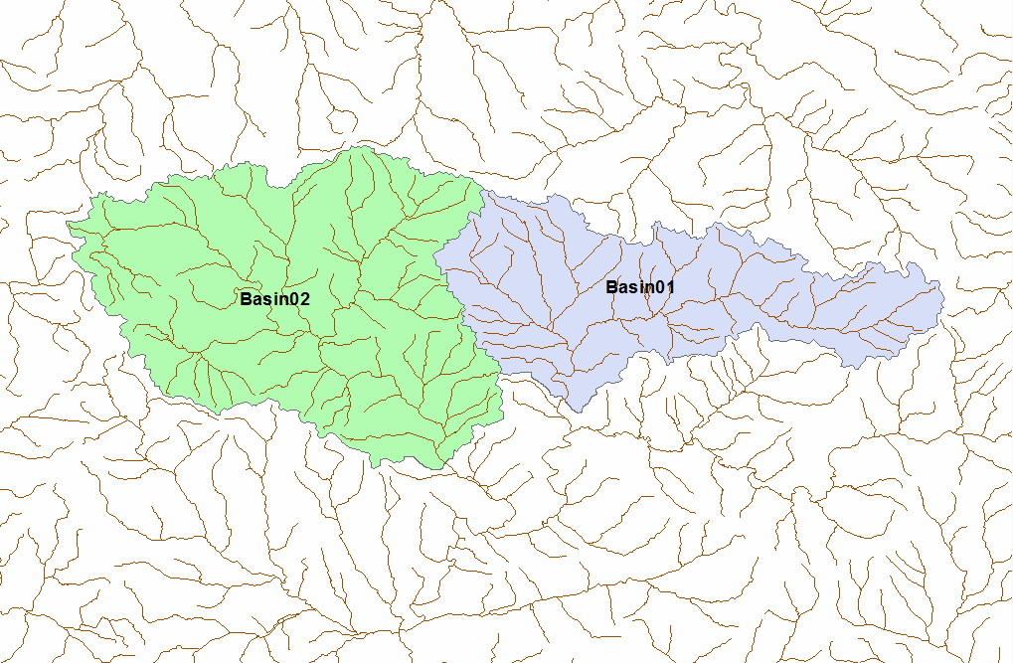
Basin Delineation

Slide 31
Analysis
Fate/Transport Modeling
Dilution Modeling
Impact Analysis
Watershed Characterization
Proximity Studies
…

Slide 32

Resources
DEAR NHDPLUS@HSCNET.COM,
NHDPlus.com
  Data
  Tools
  Documentation
  Exercises/Tutorials
  Presentations
  Links to NHDPlus Applications and Authors

