Slide 1
An Update on NHDPlus
1987
2010
July 9, 2013
Tommy Dewald Cindy McKay
EPA Office of Water Horizon Systems Corporation

Slide 2
Overview
NHDPlus Concepts
Flow Estimation Projects
Higher Resolution NHDPlus
Integrating Z-value
WBD HUC12 network relationships with NHDPlus

Slide 3
Business Need
To know where surface waters and things affecting them are located (anywhere on the landscape) in order to support measures of progress towards providing clean and safe water.
‘All the water that will ever be is, right now.’
- National Geographic, October 1993
‘We forget that the water cycle and the life cycle are one.’
- Jacques Cousteau

Slide 4
NHD & NHDPlus Concepts
National Hydrography Dataset (NHD)
National digital map of Nation’s waterbodies
Stream addresses (like street addresses) for linking features to the stream network
Stream network that enables hydrological analysis of features
National Hydrography Dataset Plus (NHDPlus)
Extends the capabilities of the NHD by integrating the network with the land surface
Associates each the NHD stream segment with its local drainage area (catchment)
Stream and catchment characteristics

Slide 5
National Hydrography Dataset Plus (NHDPlus)
Developed by EPA and USGS-Water (2006) to provide flow volume and velocity estimates for pollution dilution modeling
Builds upon NHD stream network – integrated with elevation and HUC12s
Additional stream attributes (stream order, flow, etc)
Catchments and attributes (precipitation, temperature, land cover)
Success of initial version led to Version 2 production by EPA and USGS-Water
NHDPlus team
EPA - Tommy Dewald, Cindy McKay (c), Tim Bondelid (c)
USGS-Water - Rich Moore, Craig Johnston, Al Rea, [Greg Schwarz, Kernell Ries, Dave Wolock]

Slide 6
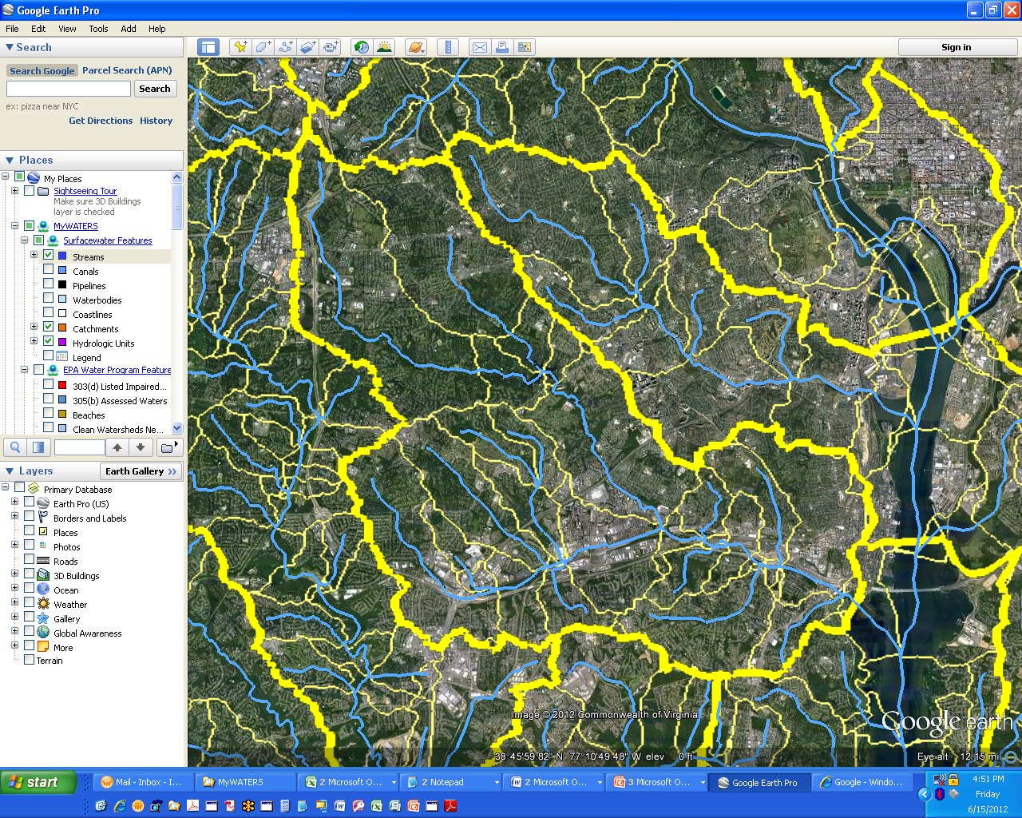
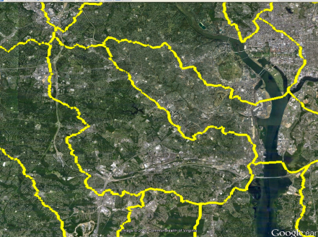
NHDPlus provides the Surface Water Geospatial Framework
Elevation
(30m)
NHDPlus catchments tie the landscape to the stream network forming a ‘surface water geofabric’
Hydrologic Units
(HUC12)
Stream Network
Stream Network | Map Scale | Map Accuracy | Total Stream Miles (mi) | # of Stream Segments | Stream Segment Average Length (mi) | # of Lakes | Catchment Average Area (sq mi)
Reach File Version 1 (RF1) | 1:500K | +/- 254m | 600,000 | 60,000 | 10 | 4,100 | 50
Medium Resolution NHD | 1:100k | +/- 50m | 3,200,000 | 2,600,000 | 1.2 | 38,000 | 1.1
High Resolution NHD | 1:24K or better | +/- 12m | 7,500,000 | 20,000,000 | 0.37 | 537,000 | do not exist
(These figures are approximations (+/- 10%) provided for purposes of comparison.)

Slide 7
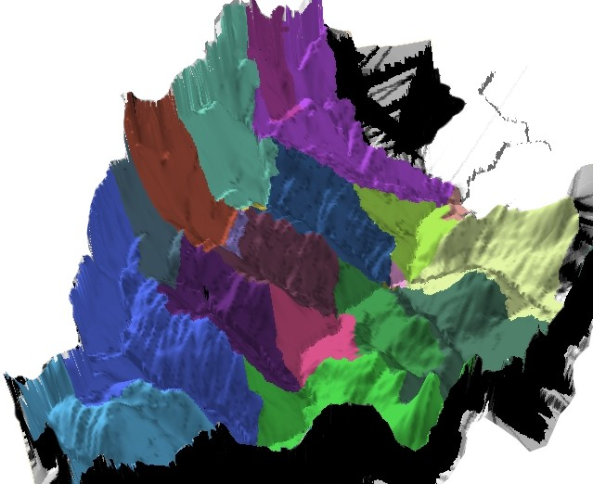
NHDPlus Concepts: Integrating the Landscape with the Stream Network
NHDPlus Catchments in 3D

Slide 8
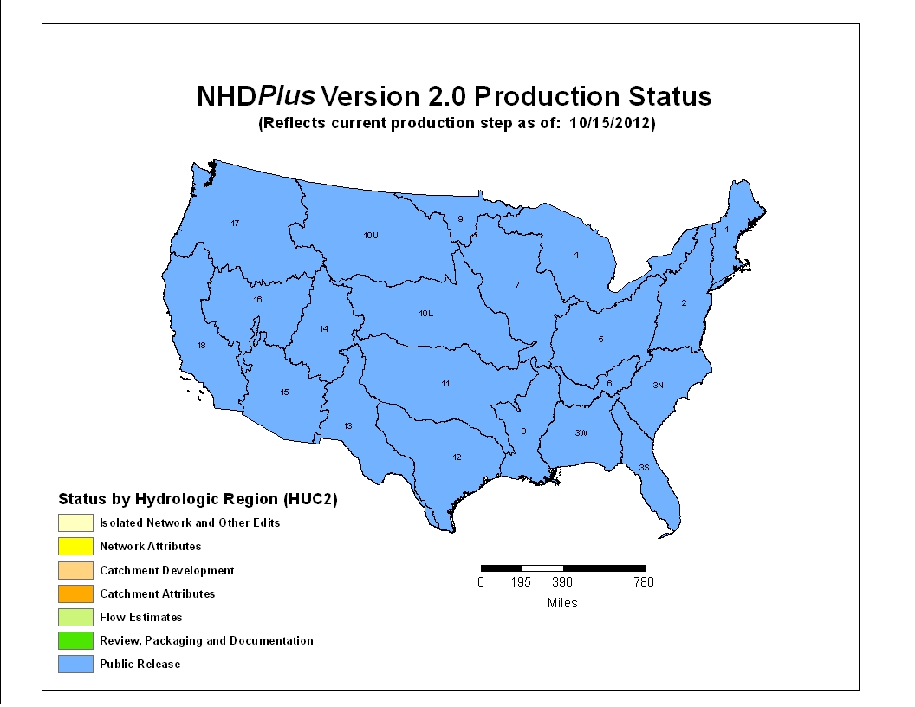
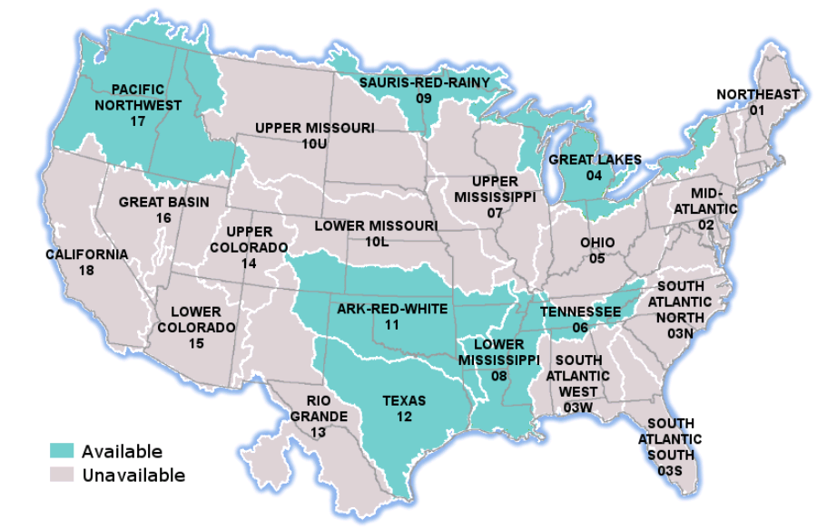
Introducing
NHDPlus Version 2
October 15, 2012
“By Endurance We Conquer”
(Sir Ernest Shackleton)
2012 ESRI UC
Significant Version 2 improvements:
Over 5,000 isolated networks connected
Over 60% enhanced elevations nationally
Now-completed national HUC12s
More robust flow estimation method
Runoff (USGS water balance model)
Excess evapotranspiration
Reference Gage Regression
Flow additions and removals
Adjustment using gaged flows

Slide 9
Estimating Streamflow Using NHDPlus
“What I think this project (NHDPlus) offers that is unique is in the full characterization of the flow network, identification of unregulated and regulated gages and reaches, and network-based interpolation and adjustment of flows.” (A.Rea, USGS)
Mean annual flow and velocity (completed as part of NHDPlus)
Mean monthly flow (completion during FY2013 as part of NHDPlus)
7Q10 flows (completion during FY2013 by EPA OPP and OW)
On-Going: Mean daily flows (planned by USGS Water Census)
Vision: Forecasting future flows (substituting forecasted model inputs)
How can we improve our stream periodicity characteristics?

Slide 10
Higher Resolution NHDPlus
Efforts to date
Value-Added Attributes only – Texas, Vermont, Nebraska
NHDPlus – Minnesota, New York City watershed (LiDAR-based), outstanding proposal for an area in Alaska (IfSAR-based)
USGS high resolution NHD network improvement project (and plans for network value-added attributes (FY14), catchments and flow estimates)
Interest in LiDAR-based hydrography
LiDAR-NHD Best Practices Workgroup report (pending)
Hope to more fully address extraction of hydrologic features in USGS LiDAR collection specification and ASPRS LiDAR Manual
Also, potential for hybrid solutions using high resolution NHD with medium resolution NHDPlus
How can we improve our stream periodicity characteristics?

Slide 11
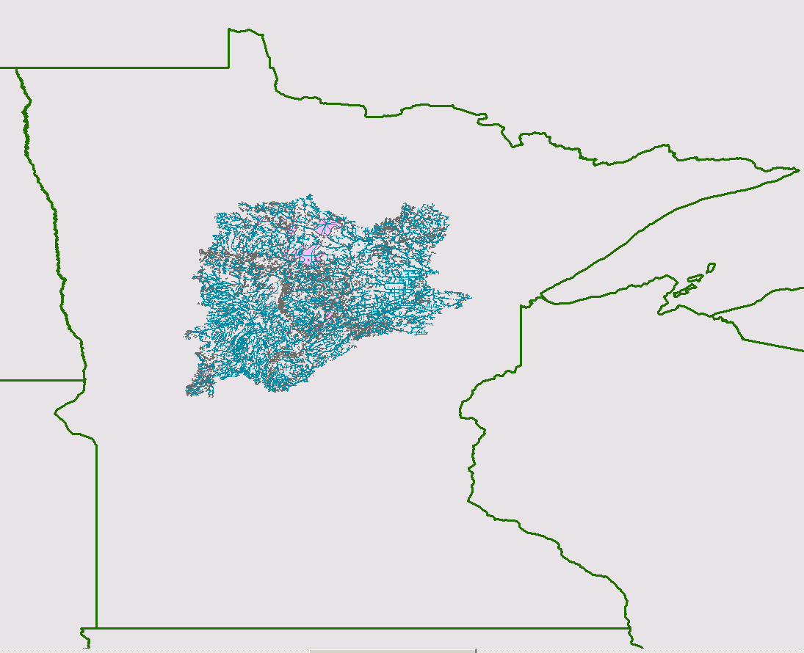
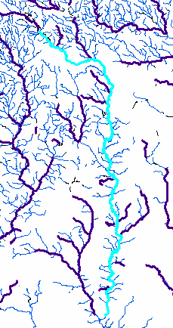
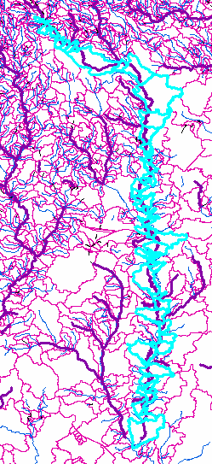
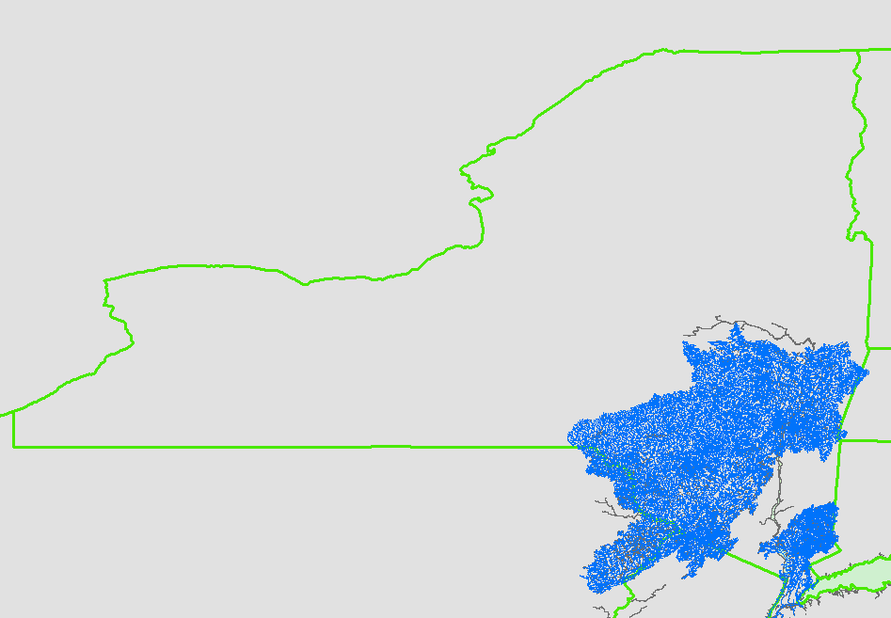
Higher Resolution NHDPlus
Minnesota: Mississippi Headwaters
Hybrid: High Res NHD
With NHDPlusV2 Catchments
NHD 1:100K -> 1:24K
NED 30M -> 10M
NHD 1:100K -> 1:8K
DEM 30M -> 3M
NYC: Drinking Water Source Area

Slide 12
Linking WBD HUC12 to the NHDPlusV2 Network
WBD HUC12 boundaries define the ridge lines of NHDPlusV2 catchments.
WBD: 87,259 HUC12s – avg. size of 72.2 sq. mi.
NHDPlusV2: 2,647,454 Catchments – avg. size of 1.2 sq. mi.
Can we roll catchments up to HUC12s?

Slide 13
NHDPlusV2 Catchments-HUC12 Comparison
Using GRID processing, overlay the catchments on the HUC12s and assign each catchment to the HUC12 that contains most of the catchment
Identify the parts of catchments that extend outside of the HUC12 that the catchment has been assigned to. These cells are colored red on the comparison map.
For the country, 97% of the cells are assigned to the correct HUC12.

Slide 14
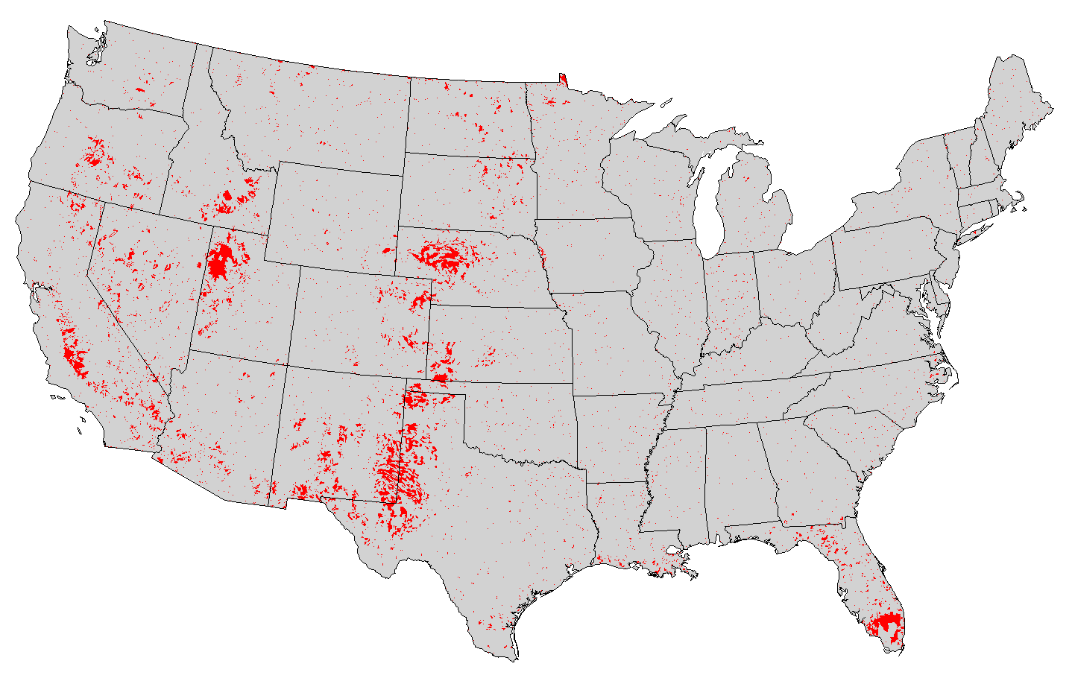
97.0 % agreement between aggregated NHDPlus catchments and WBD HUC 12s
(Red = areas of disagreement)

Slide 15
NHDPlusV2 Catchments-HUC12 Comparison
Of the 3%, The Most Common Areas of Disagreement

Slide 16
NHDPlusV2 Catchments-HUC12 Comparison
Large Areas of Disagreement

Slide 17
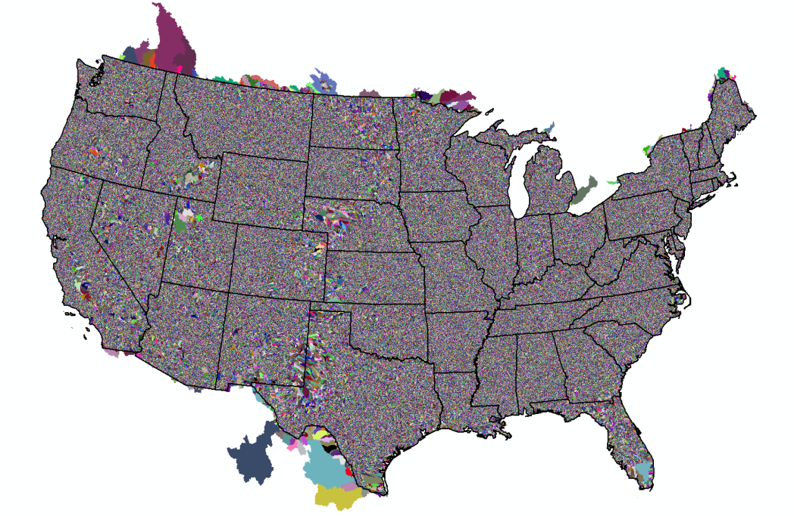
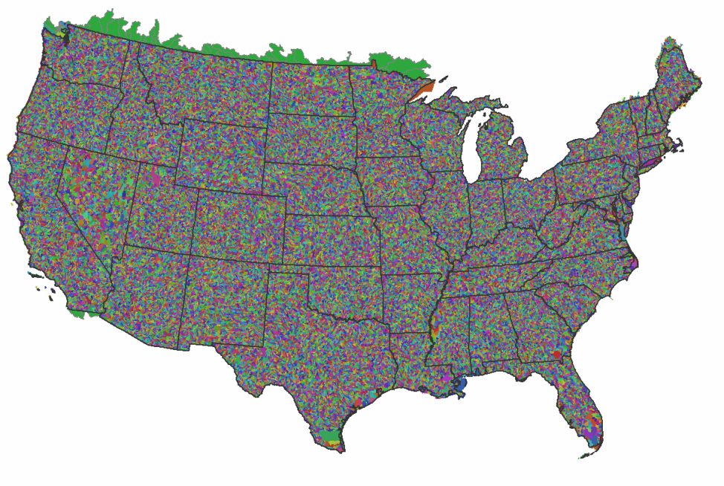
NHDPlusV2 Catchments & HUC12 2 Linked Analysis Scales
NHDPlusV2
2,647,454 Catchments
Avg. size - 1.2 sq. mi.
WBD
87,259 HUC12s
Avg. size - 72.2 sq. mi.

Slide 18
NHDPlusV2 - Other News
NHDPlus V1 -> V2 Crosswalk published
WBD HUC12 – NHDPlusV2 Catchment Crosswalk soon to be published
47,000 dams linked to the NHDPlus network
USGS Proposal for z-values still seeking funding

Slide 19
Summary
NHDPlus provides the common geospatial surfacewater framework (the plumbing)
NHDPlus is the closest we’ve come to a hydro Geo-fabric
NHDPlus continues to grow in data content and analysis capabilities
Enabling informed decision-making

Slide 20
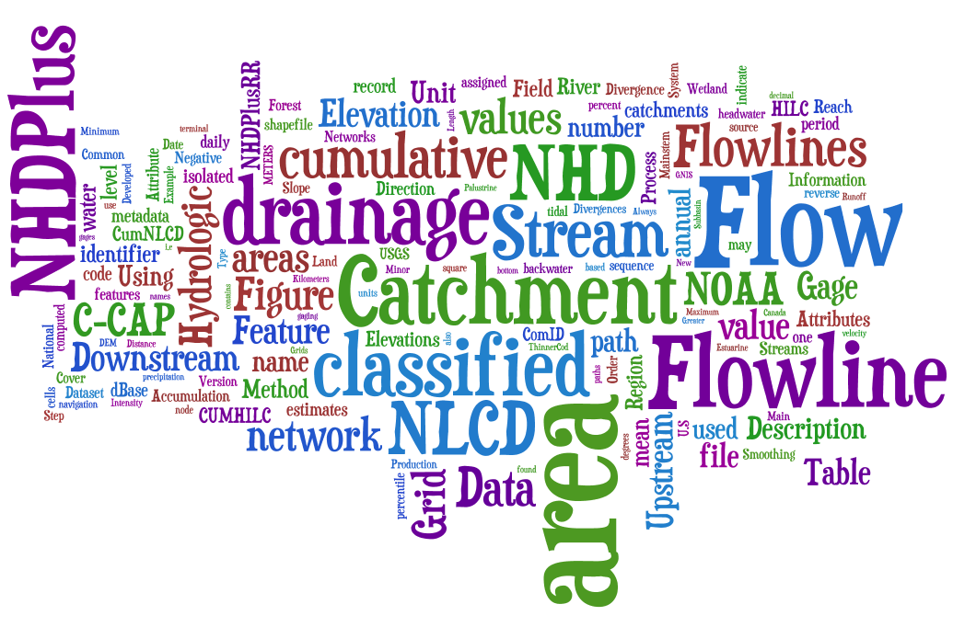
Thanks!
EPA GIS Workgroup Meeting
Arlington, VA - May 7, 2009
http://www.wordle.net

