Slide 1
Georeferencing Water Quality Assessments to NHDPlus Catchments A New Approach to Evaluating and Measuring Progress in Surface Water Quality
Dwane Young, U.S. EPA, Office of Water

Slide 2
Outline
Georeferencing Pilot (GeoPilot)
Background and Goals
Methods in Brief
Results
Using Catchment-Based Indexing to Measure Progress
Benefits
Examples

Slide 3
Clean Water Act
Section 303(d)
A List of Impaired Waters for which a TMDL still needs to be completed
Section 305(b)
An Assessment of the Water Quality of all navigable waters in each State
Integrated Report (IR)
Integrates data from Sections 303(d) and 305(b)

Slide 4
Background
States submit IR/303(d)/305(b) decision data and the corresponding location information to EPA
Geospatial data are different formats
Resolutions
Medium Resolution: 1:100,000 scale
High Resolution: mixture of scales, typically 1:24,000 or better
Reference layers
NHD/NHDPlus
Other than NHD
Current processing is mostly manual
Time consuming
Expensive to EPA
GeoPilot initiated to investigate and test potential improvements

Slide 5
Goals of Georeferencing Pilot
Reduce cost through automated processing
Process and publish geospatial data faster
Maintain high data quality
Create more complete dataset

Slide 6
Catchment-Based Indexing
Used NHDPlus Version 2 Catchments
Approximately 2.6 million catchments in contiguous US
Average size: 1.1 square miles
Significant range in size, but 99% smaller than 15 square miles
Needed to accommodate many types of inputs
Linear events, Area events, HUC-like events
Medium resolution (1:100K)
High resolution (1:24K or better)
NHD or Non NHD
Separating Display and Analysis

Slide 7
GeoPilot Prototypes
Three prototypes – based on input type
Linear to Catchment
Area Waterbody to Catchment
HUC-like to Catchment
Prototypes use attributes from NHDPlus
Stream level
Hydrologic sequence number
Level path
Artificial path
Divergence

Slide 8
Linear to Catchment Prototype

Slide 9
Results
 | Old Method | Catchment-Based Method
Manual Processing Time | 20-100 hours per state | 7-15 hours (pre-processing and QA) per state
Automated Processing Time | Varies with significant QA/QC time | Varies: 5 minutes to 3 hours per state
Estimated Cost | ~$2,000 - $10,000 per state | ~$700-$1,500 per state
Outputs
Resolution for Analysis | 1:100K NHDPlus | 1:100K NHDPlus Catchments
Resolution for Display | 1:100K NHDPlus | State’s original resolution
*Catchment-based indexing should have a minimal impact to how states submit data

Slide 10
Strategic Measures and Tracking Progress
CWA Section 303(d) Measures first to test this approach
Extent of priority areas identified by each state that are addressed by EPA-approved TMDLs or alternative restoration approaches for impaired waters that will achieve water quality standards. These areas may also include protection approaches for unimpaired waters to maintain water quality standards.
State-wide extent of activities leading to completed TMDLs or alternative restoration approaches for impaired waters, or protection approaches for unimpaired waters.

Slide 11
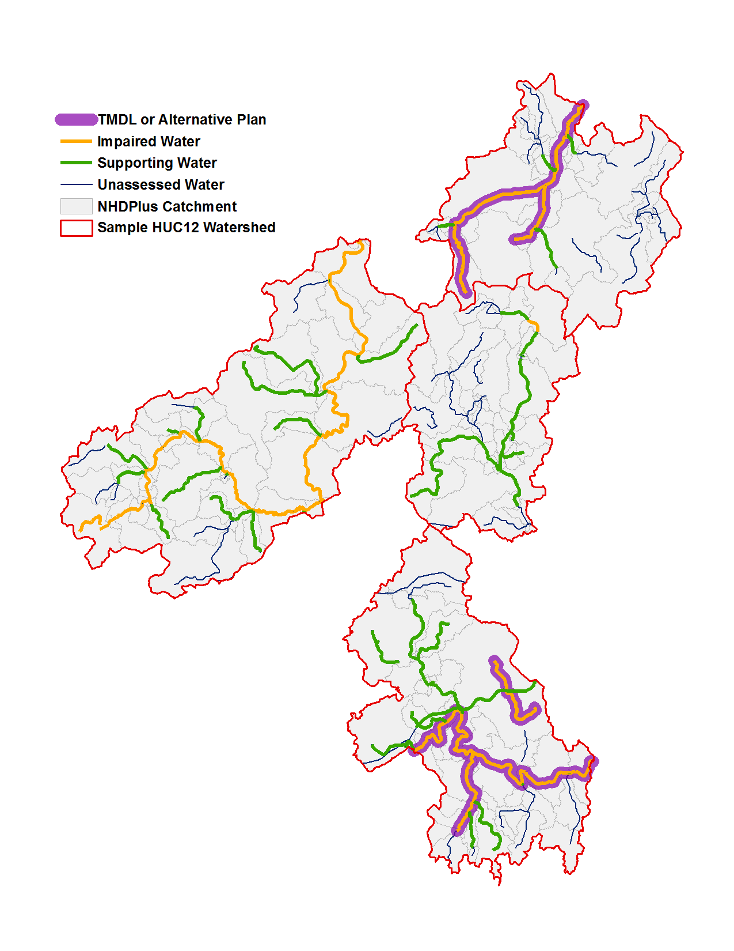
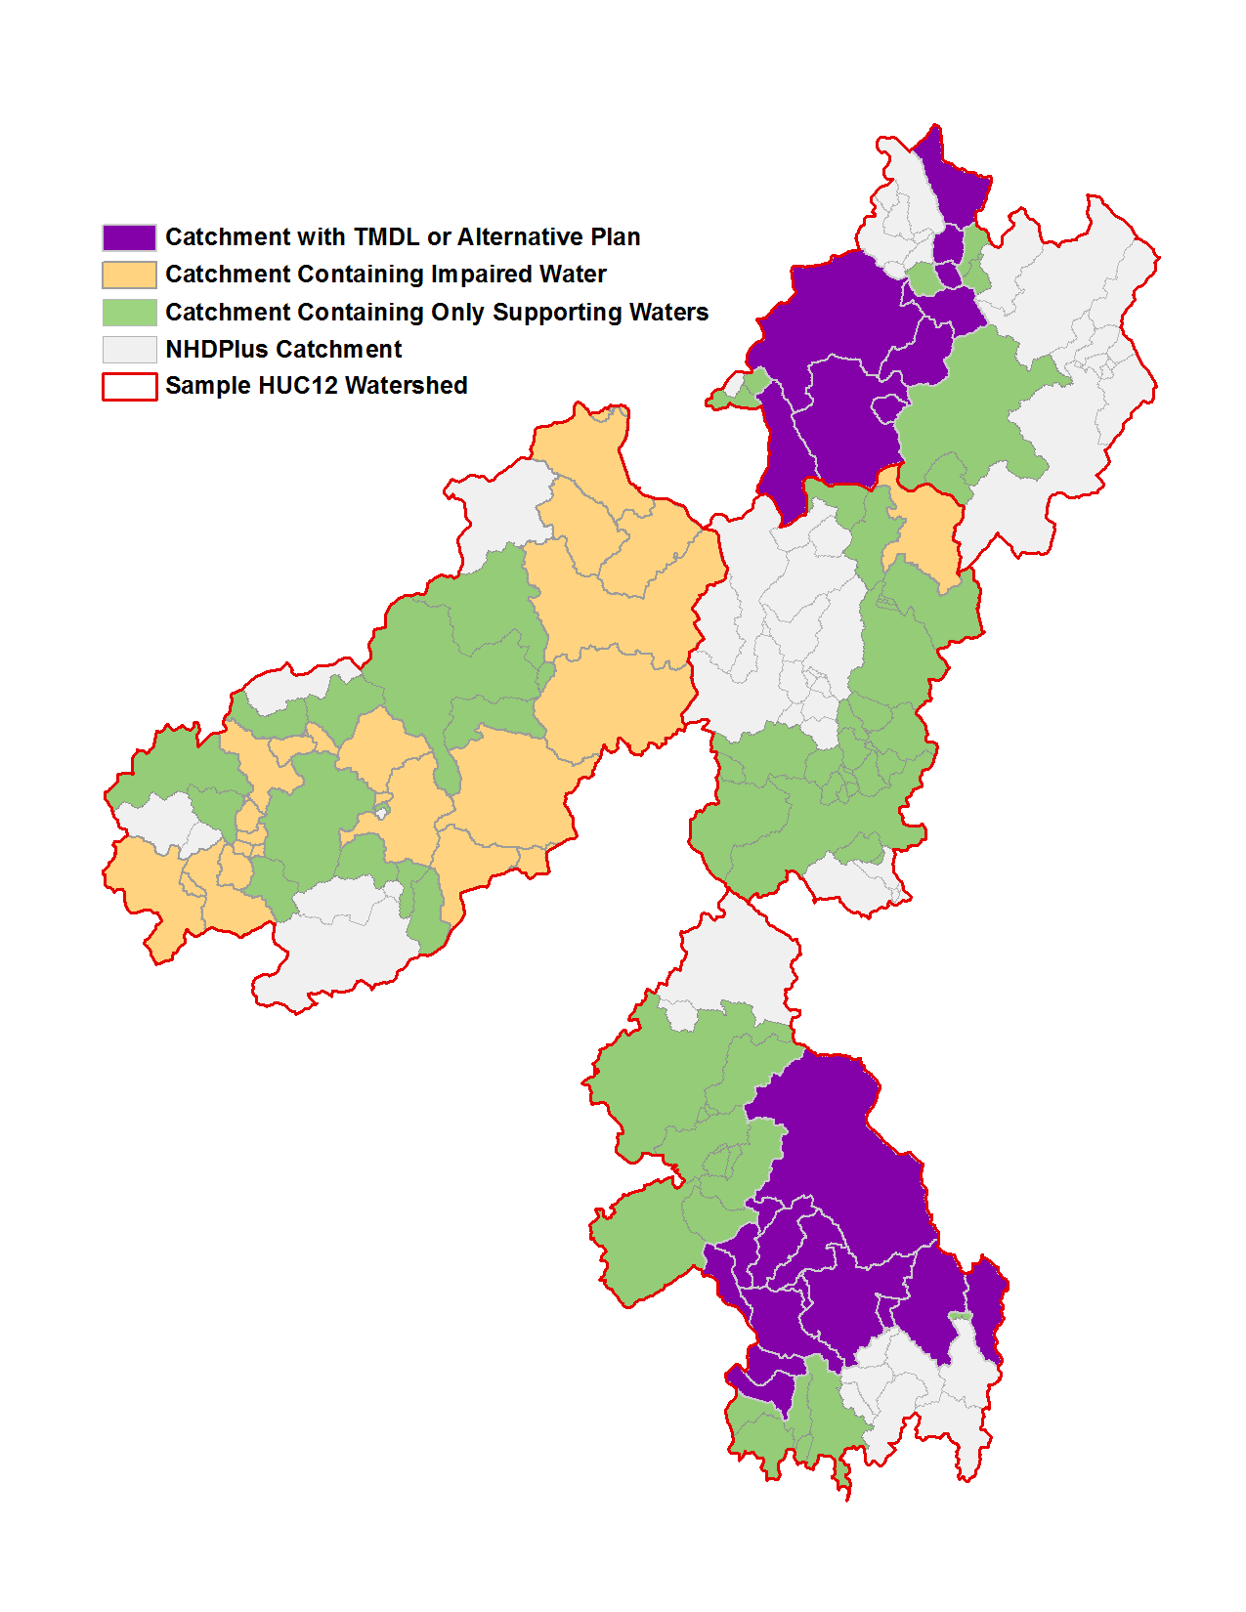
Mapping State GIS Data to the Catchments
Receive GIS data from States
Translate to Catchments

Slide 12
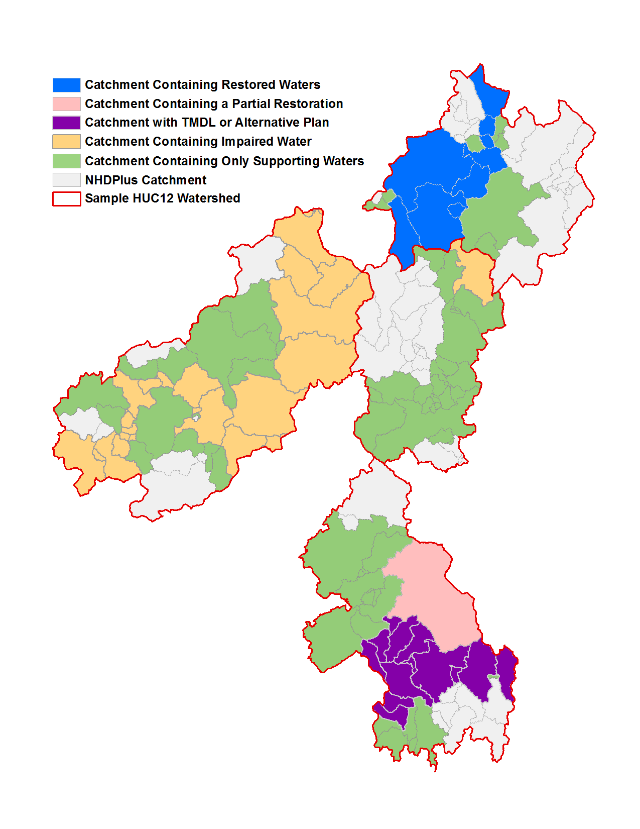
Using the Catchments to Track Progress
2010 303(d)/305(b) Integrated Report
2012 303(d)/305(b) Integrated Report
Category | Watershed Area
Supporting | 149 sq. km
Restored | 27 sq. km
Partially Restored | 15 sq. km
Impaired | 67 sq. km
With TMDL or Alt. Plan | 37 sq. km
Not Assessed | 343 sq. km
Total Size | 596 sq. km
Category | Watershed Area
Supporting | 122 sq. km
Impaired | 131 sq. km
With TMDL or Alt. Plan | 64 sq. km
Not Assessed | 343 sq. km
Total Size | 596 sq. km

Slide 13
Next Steps
Finalize the evaluation of this approach using the 303(d) measure as a test case
Convert from Prototype to Production Process
Process IR GIS data using Catchment-based indexing method as data are received

Slide 14
For More Information
For process details, see the IR Georeferencing Pilot Report (coming soon)
Water Quality Assessment and Total Maximum Daily Loads Information
http://www.epa.gov/waters/ir/
Contact Info
Dwane Young, EPA Office of Water
Young.Dwane@epa.gov
Wendy Reid, EPA Office of Water
Reid.Wendy@epa.gov
Tommy Dewald, EPA Office of Water
Dewald.Tommy@epa.gov

Slide 15
Questions?

Slide 16
Appendix

Slide 17
Area Waterbody to Catchment Prototype
Area Waterbody Input
Results*
A
B
*Area circled in yellow shows a portion of the waterbody where catchments were not associated with the waterbody because it did not meet the requirements: the pieces were smaller than the threshold used, and they were not part of an NHD artificial path.
Notes:
Takes an Intersection of waterbody and catchments, and then uses thresholds or artificial path
Thresholds:
% of waterbody in the catchment was less than 1%, OR
% of catchment covered by the waterbody was less than 50%
This prototype is less accurate than the linear prototype

Slide 18
HUC-like to Catchment Prototype
HUC-like input
results
A
B
Notes:
Takes an Intersection of the HUC Assessment Unit and the catchments, and then uses thresholds to determine whether the catchment is including in the output results for the HUC-like Assessment Unit
Thresholds:
% of waterbody in the catchment was less than 1%, OR
% of catchment covered by the waterbody was less than 50%
This is the least accurate of the three prototypes

