Slide 1
Catching Up on NHDPlus Version 2 (National Hydrography Dataset Plus)
EPA Office of Water
May 12, 2014
AWRA Specialty Conference on GIS and Water Resources VIII

Slide 2
Acknowledgements
NHDPlus Team
Tommy Dewald / EPA Office of Water
Cindy McKay / Horizon Systems Corporation
Tim Bondelid / Consultant
Craig Johnston, Rich Moore, Al Rea / USGS Water
(Greg Schwarz, Kernell Ries, Dave Wolock / USGS Water)
(Karen Hanson / USGS WBD Technical Lead)

Slide 3
Overview
NHDPlus Concepts
Introducing NHDPlus Version 2
Applications Sampler

Slide 4
Why NHDPlus?
“What I think NHDPlus offers that is unique is in the full characterization of the flow network, identification of unregulated and regulated gages and reaches, and network-based interpolation and adjustment of flows.”
- Al Rea, USGS

Slide 5
National Hydrography Dataset Plus (NHDPlus)
Developed by EPA and USGS-Water (2006) to provide flow volume and velocity estimates for pollution dilution modeling
Builds upon NHD stream network – integrated with elevation and HUC12s
Additional stream attributes (stream order, flow, etc)
Catchments and attributes (precipitation, temperature, land cover)
Success of initial version led to Version 2 production by EPA and USGS-Water (2012)

Slide 6
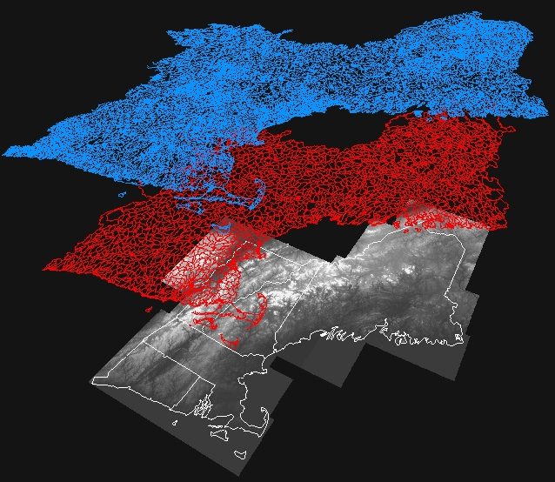
NHDPlus Concepts: Integration of NHD, WBD, and NED
National
Hydrography
Dataset (NHD)
Watershed
Boundary
Dataset (WBD)
National
Elevation
Dataset (NED)

Slide 7
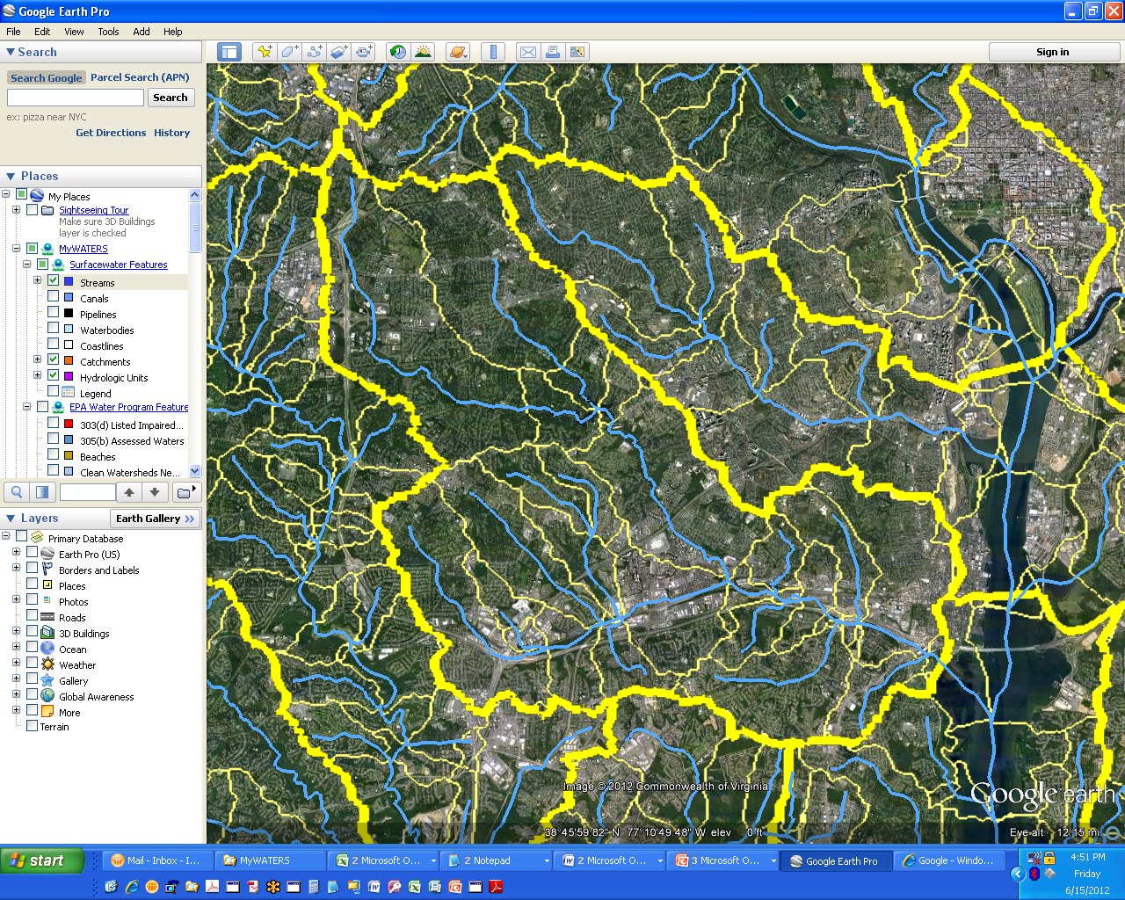
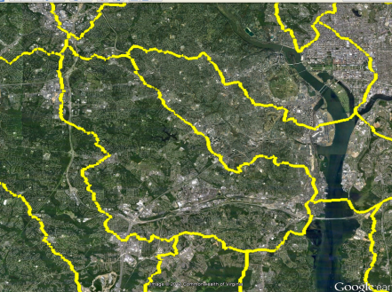
NHDPlus provides the Surface Water Geospatial Framework
Elevation
(30m)
NHDPlus catchments tie the landscape to the stream network forming a ‘surface water geofabric’
Hydrologic Units
(HUC12)
Stream Network
Stream Network | Map Scale | Map Accuracy | Total Stream Miles (mi) | # of Stream Segments | Stream Segment Average Length (mi) | # of Lakes | Catchment Average Area (sq mi)
Reach File Version 1 (RF1) | 1:500K | +/- 254m | 600,000 | 60,000 | 10 | 4,100 | 50
Medium Resolution NHD | 1:100k | +/- 50m | 3,200,000 | 2,600,000 | 1.2 | 38,000 | 1.1
High Resolution NHD | 1:24K or better | +/- 12m | 7,500,000 | 20,000,000 | 0.37 | 537,000 | do not exist
(These figures are approximations (+/- 10%) provided for purposes of comparison.)

Slide 8
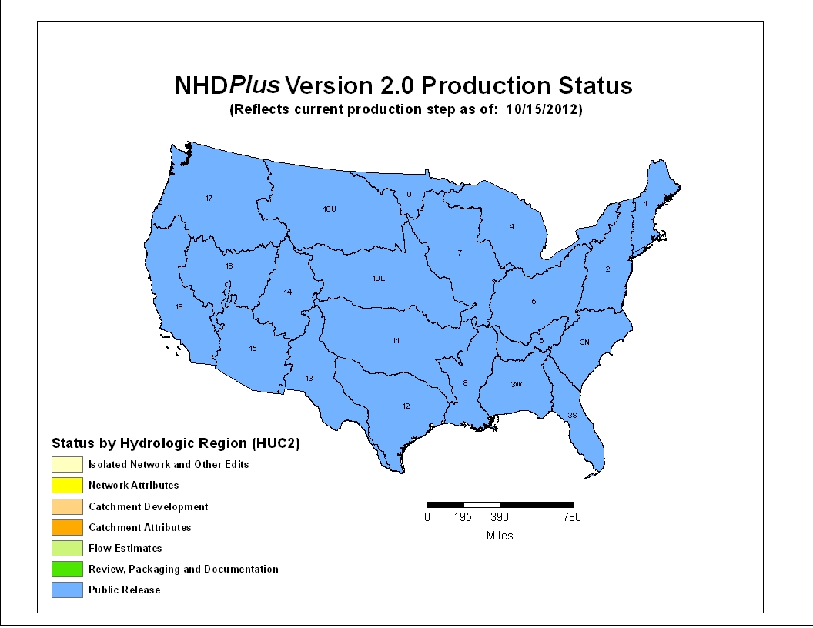
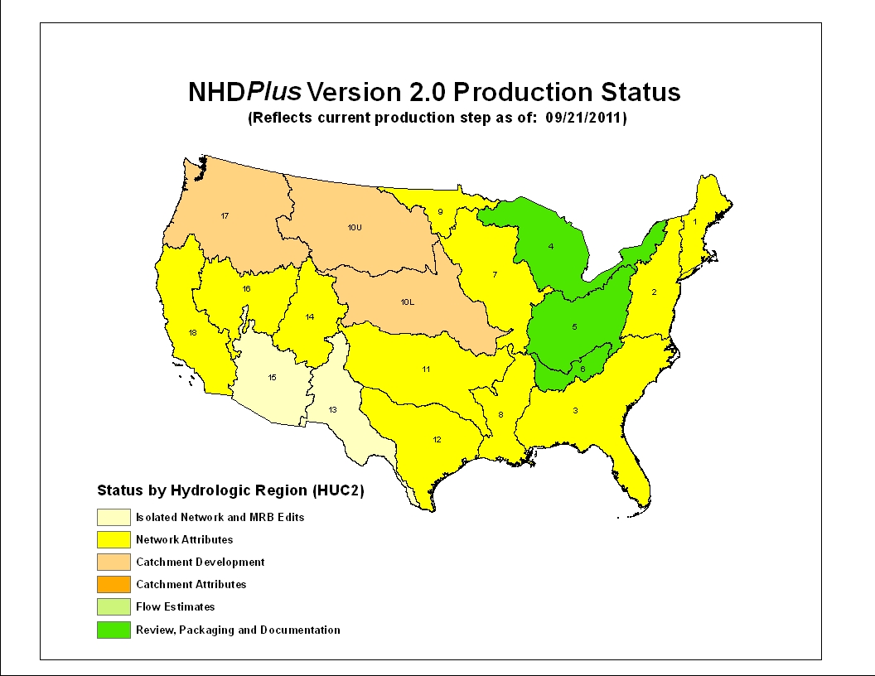
NHDPlus Version 2
“By Endurance We Conquer”
(Sir Ernest Shackleton)
Significant Version 2 improvements:
Over 5,000 isolated networks connected
Over 60% enhanced elevations nationally
Now-completed national HUC12s
More robust flow estimation method
Runoff (USGS water balance model)
Excess evapotranspiration
Reference gage regression
Flow additions and removals
Adjustment using gaged flows

Slide 9
Notable Quotes - NHDPlus Production
85. “We can’t afford to be perfect.”
(P.Wiese, 6/8/00)
93. “Trust me, I’m an experienced burner.”
(D.Maidment, 12/13/00)
131. “... everything that you can imagine happening, does happen.”
(T.Bondelid, 7/5/05)
191. “No worries since we have unlimited minutes on nights and weekends!”
(C.Johnston, 7/1/10)
198. “Are we allowed to sleep or what?”
(A.Rea, 10/7/10)

Slide 10
NHDPlus Release Announcement
(March, 2014)
Documentation - new NHDPlusV2 User Guide, metadata, training exercises, technical papers, more presentations
Data - component updates, monthly mean flow estimates
Tools - NHDPlusV2.1 Flow Table Navigator, NHDPlusV2.1 Toolbox (includes a tool that will compare your local data holdings with the versions available on the web site)

Slide 11
USGS NAWQA Cycle 2 SPARROW Nutrient Models
(released August, 2011)
Regional SPARROW Models
Online Decision Support System
Water managers, researchers and the general public can access SPARROW models and map predictions of long-term average water-quality conditions, track transport to downstream receiving waters, and evaluate management source reduction scenarios.
(cida.usgs.gov/sparrow)
RF1
NHDPlusV1
RF1
RF1
RF1
Next generation of NAWQA regional SPARROW models is using NHDPlus Version 2 stream network and catchments
RF1
NHDPlusV1

Slide 12
EPA Office of Water Geospatial Architecture Watershed Assessment Tracking and Environmental ResultS (WATERS) (www.epa.gov/waters)
Applications
Source Water Areas
NARS Watersheds
ATTAINS
NPS GRTS
Ask Waters
How’s My Waterway?
MyWATERS Mapper
MyWATERS Google KMZ
Watershed Plan Builder
NPDAT
DARTER (with COE)
Drinking Water Mapping Application
Construction General Permit
DMR Pollutant Tool
OECA ECHO
KCWaters.org
Many others
Programmatic Data/Databases
Reach Address Database
(RAD)
Discharge
Permits
Web Services
Mapping Layers
Name Search
Up/Downstream Search
Watershed Delineation
Watershed Report
Many others
Stream
Addresses
Water Quality Monitoring
NHDPlus
Water Impairments
Drinking Water Intakes
Many others

Slide 13
NHDPlus
The inset map shows the watershed (white boundary) defining the drainage area upstream from the mouth of Four Mile Run (red dot) and a report of associated watershed characteristics – both produced using NHDPlus.

Slide 14
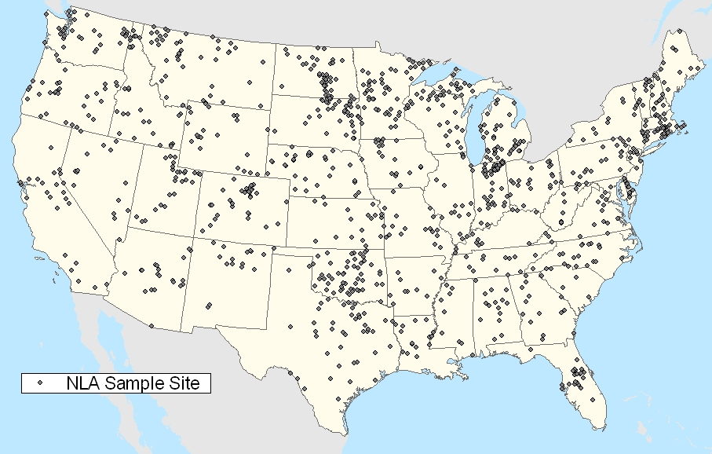
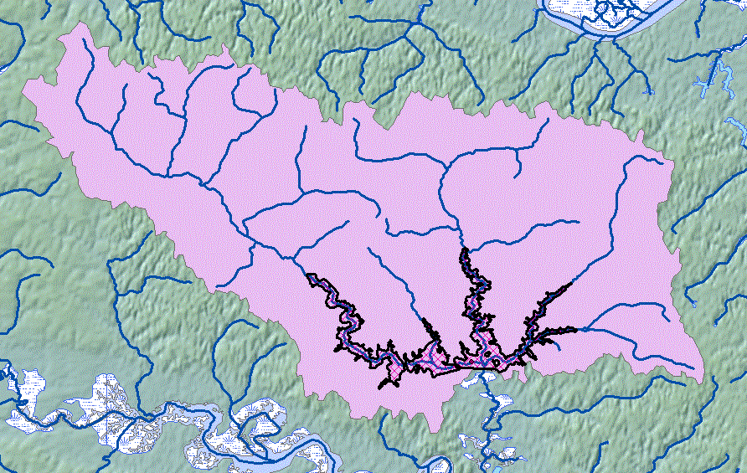
EPA National Aquatic Resource Surveys
NHDPlus serves as the basis for
establishing the NRSA and NLA survey sample frames – from which a representative set of sample sites are randomly selected.
NHDPlus is also used to support data analysis, such as delineating drainage areas and associated attributes for sampled sites.
Drainage Area = 114.24 km²
NLCD 2001 Land Cover :
- Residential = 7.86 km²
- Forest = 86.42 km²
- Agriculture = 12.64 km²
- Wetlands = 7.32 km²
(www.epa.gov/owow/lakes/lakessurvey)

Slide 15
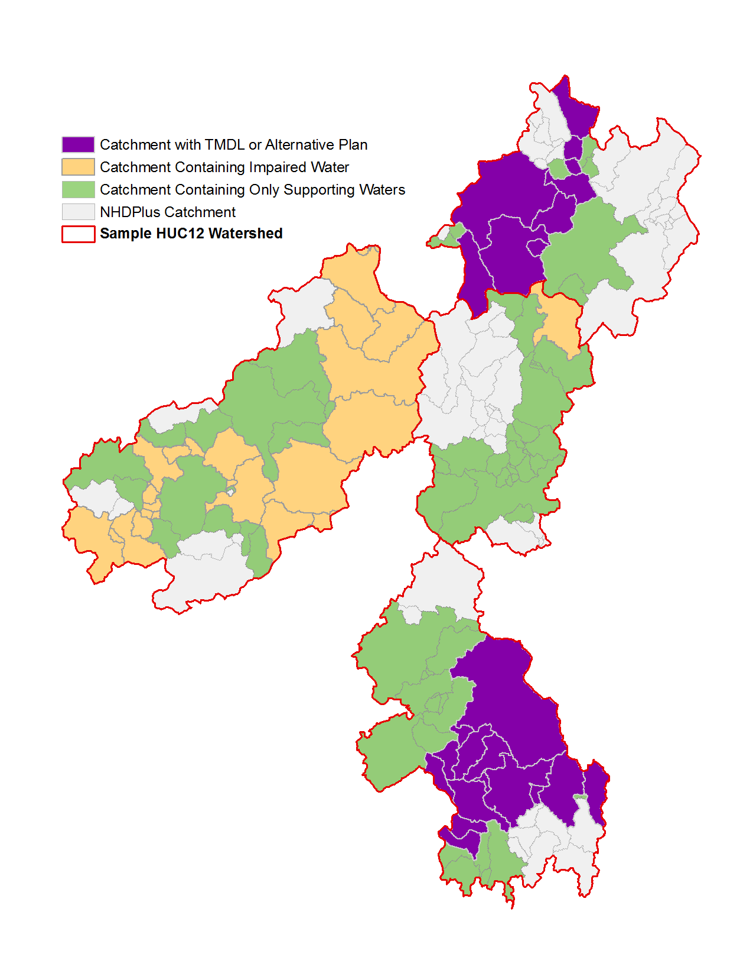
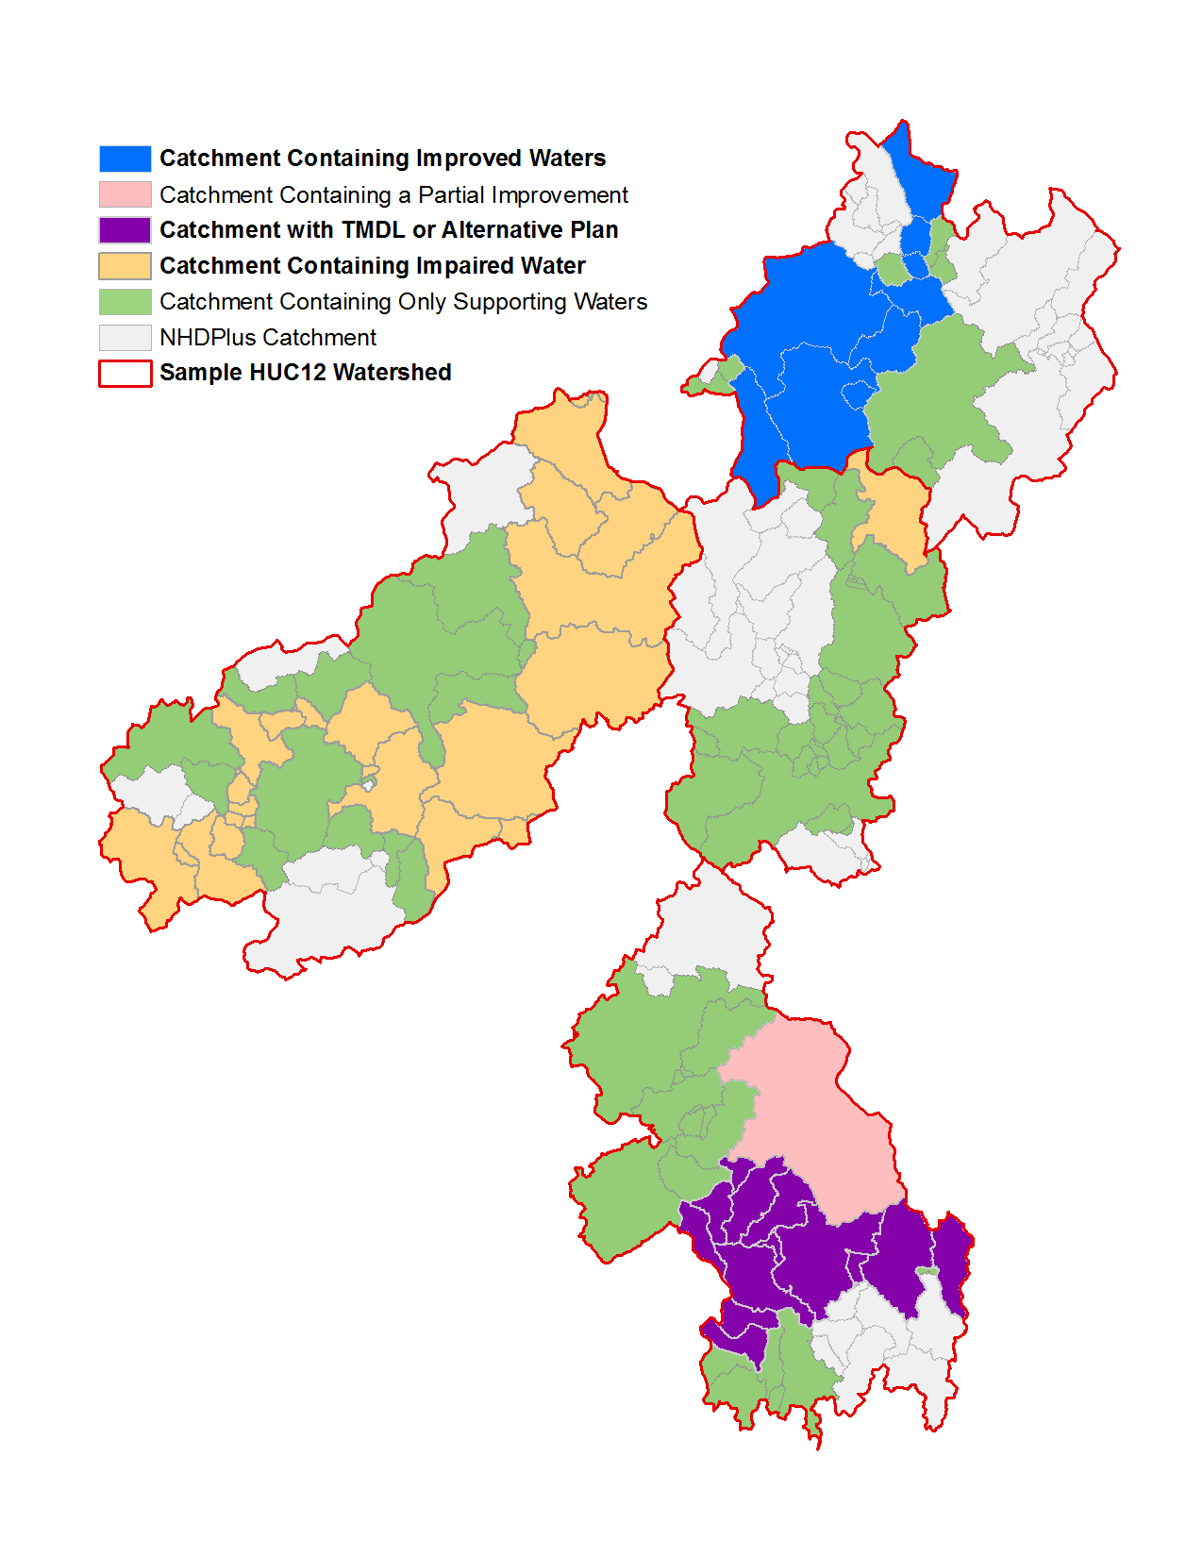
(Draft) Using the Catchments to Track Progress
2010 303(d)/305(b) Integrated Report
2012 303(d)/305(b) Integrated Report
Category | Watershed Area
Supporting | 149 sq. km
Improved | 27 sq. km
Partially Improved | 15 sq. km
Impaired | 67 sq. km
With TMDL or Alt. Plan | 37 sq. km
Not Assessed | 343 sq. km
Total Size | 596 sq. km
Category | Watershed Area
Supporting | 122 sq. km
Impaired | 131 sq. km
With TMDL or Alt. Plan | 64 sq. km
Not Assessed | 343 sq. km
Total Size | 596 sq. km
(young.dwane@epa.gov, reid.wendy@epa.gov)

Slide 16
West Virginia Chemical Spill
Spill of thousands of gallons of coal-washing chemical MCHM—4-methylcyclohexane methanol into the Elk River, WV
Spill one mile upstream from water treatment plant
Incident Command Tool for Drinking Water Protection (ICWater) used to warn downstream water suppliers
Uses NHDPlus flows and velocities
Adjusts with real-time gage data
Provided accurate travel-time estimates
Protected Cincinnati water supply and others
(william.b.samuels@leidos.com)

Slide 17
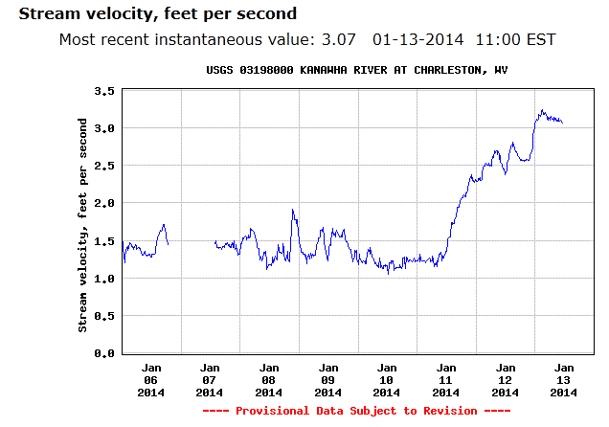
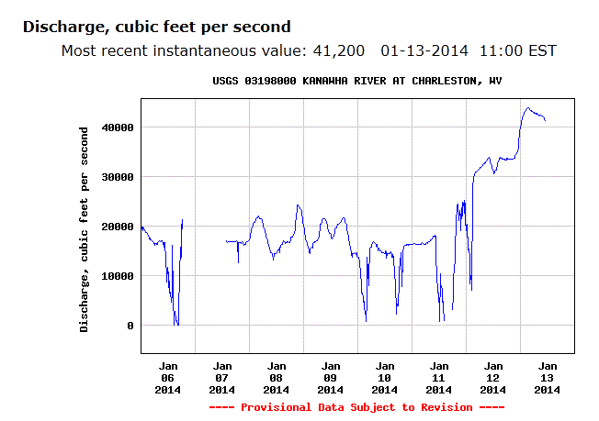
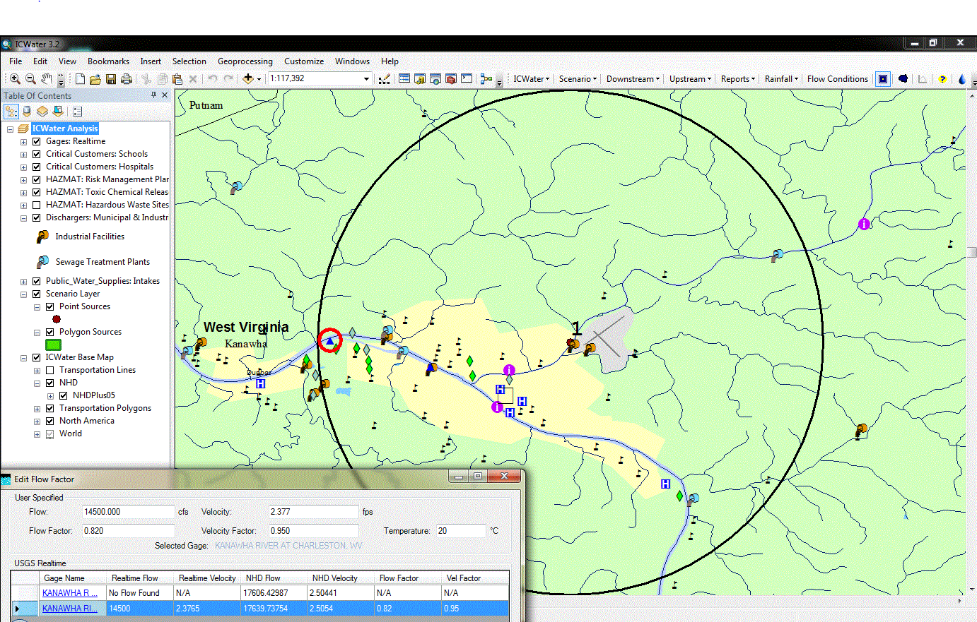
Measured
velocity
Intake
Spill site
Model velocity

Slide 18
Building State Capacity to Identify Healthy Watersheds
Owen McDonough, EPA ORISE Fellow
30 April 2014

Slide 19
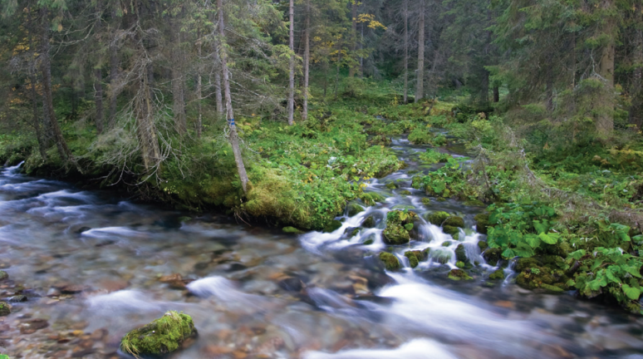
Healthy Watersheds
Habitat Condition
Hydrologic Condition
Geomorphic Condition
Water Quality
Biological Condition
Landscape Condition
(water.epa.gov/polwaste/nps/watershed)
(gabanski.laura@epa.gov)

Slide 20
DRAFT - For many shallow groundwater systems, groundwater flowpaths closely follow the downward directions expressed by the land-surface topography
(moore.richard@usgs.gov)

Slide 21
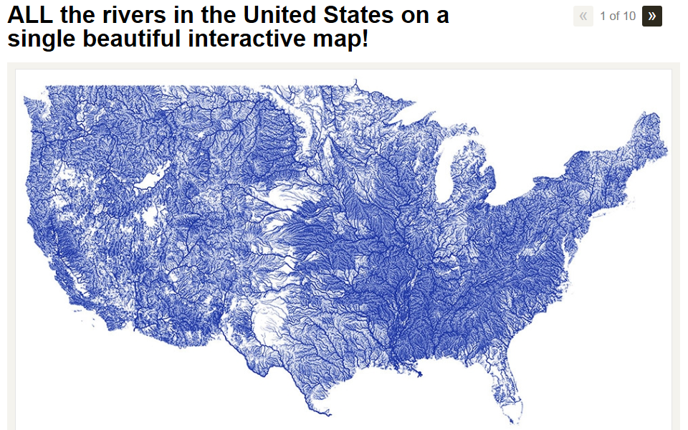
WIRED and Popular Science Magazines (June, 2013)
Treehugger.com (January, 2014) –
A recent report by the U.S. Environmental Protection Agency concluded that 55 percent of U.S. rivers and streams are in poor condition¹. Most of us don't go to that many different rivers in our lives, so when we see a number like that we might not realize just how many rivers and streams there are in the United States. Well, the map above gives you an idea of how many there are. All river data comes from the NHDPlus dataset, a geo-spatial, hydrologic framework dataset envisioned by the USEPA.
¹Draft National Rivers and Streams Assessment 2008-2009 (March, 2013)
Courtesy: Nelson Minar

Slide 22
NHDPlus-related Sessions
Monday
Session 1C – Water and Energy Decisions-1
Monday and Tuesday –
Poster presentation - “NHDPlus Attributes for Stream-Water-Quality Modeling”
Tuesday
Session 4A - Panel: The Integration of Elevation and Hydrography Data
Wednesday
Session 8B and 9B – NHD (and NHDPlus) Workshop: Parts 1 and 2
Conference Luncheon - Panel: 3DNHD – The Plan For The Future
Session 10C - Integrated Watershed Management-2

Slide 23
‘All the water that will ever be is, right now.’
National Geographic Magazine, October 1993
‘We forget that the water cycle and the life cycle are one.’
- Jacques Cousteau
Questions?
Tommy Dewald
EPA Office of Water
dewald.tommy@epa.gov
(On the Web - Google ‘nhdplus’)

